Slide 1
Internet Safety
Advice for Parents & Carers
September 2025

Slide 2


IT COULD HAPPEN HERE!

Slide 3
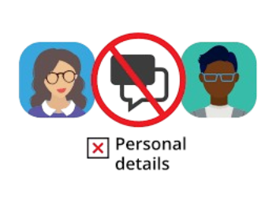


10 Key Internet Safety Tips for Children
Be careful who you talk to – strangers can pretend to be children. Never share personal details (name, school, address, photos). If asked for pictures, say no and tell a trusted adult.
Social media age limits – most apps require you to be 13+. Keep accounts private, think before posting, and remember images can be shared anywhere once uploaded.
AI tools – not everything they generate is true. Never give them personal info or photos, as these could be misused.

Slide 4



10 Key Internet Safety Tips for Children
4. Your digital footprint matters – what you post now could affect things like job opportunities later.
5. If something upsets you online – tell a trusted adult straight away and report it using the app’s tools (usually via the 3 dots).
6. Check your sources – news and stories online may be fake or misleading.

Slide 5




10 Key Internet Safety Tips for Children
7. Beware of scams – don’t forward chain messages or give out passwords or payment details.
8. Avoid money transfer schemes – offers of “easy cash” are usually linked to crime.
9. Think before spending in games – loot boxes and in-game purchases can add up quickly.
10. Don’t believe everything you see – people edit photos, exaggerate lifestyles, or use AI. Gang life online, for example, is rarely what it seems.

Slide 6
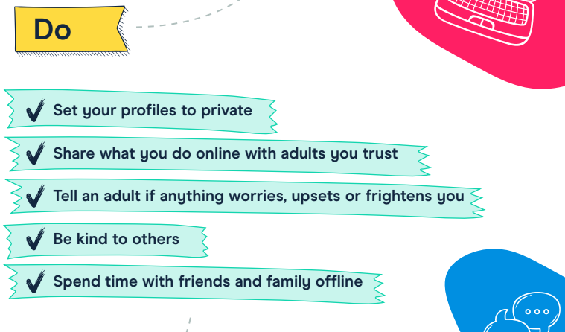

Slide 7
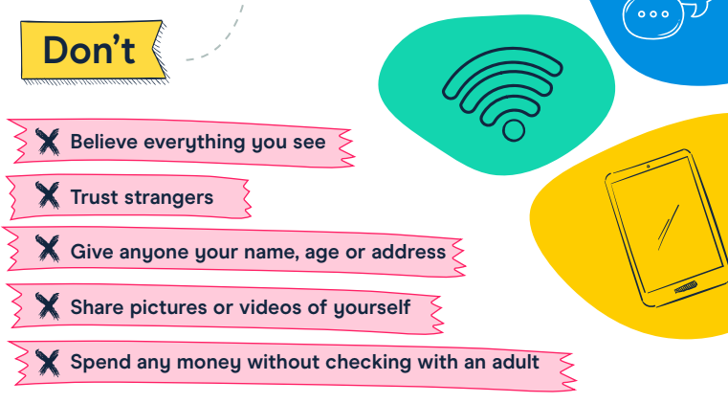

Slide 8
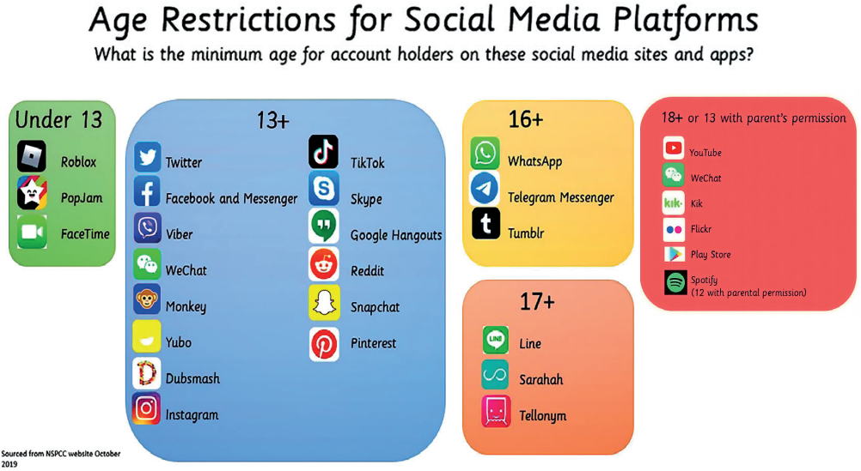

Slide 9
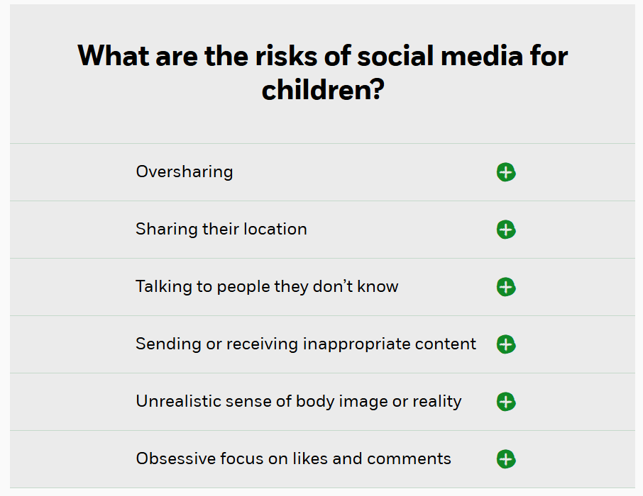







Slide 10
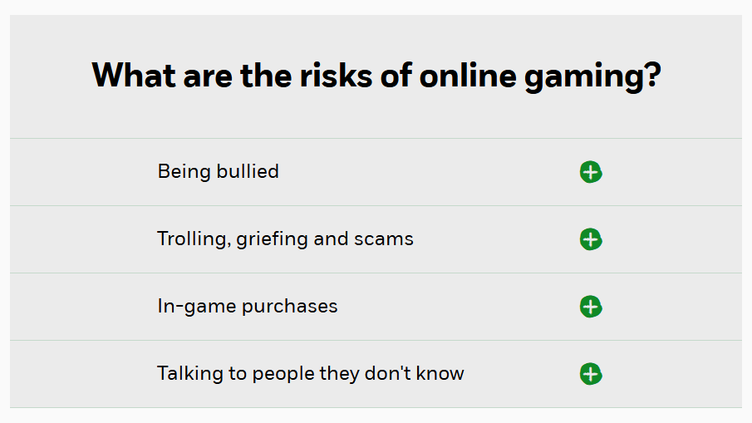




Slide 11


Children and Parents: Media Use and Attitudes Report (May, 2025)
https://www.ofcom.org.uk/siteassets/resources/documents/research-and-data/media-literacy-research/children/childrens-media-use-and-attitudes-report-2025/childrens-media-literacy-report-2025.pdf?v=396621

Slide 12
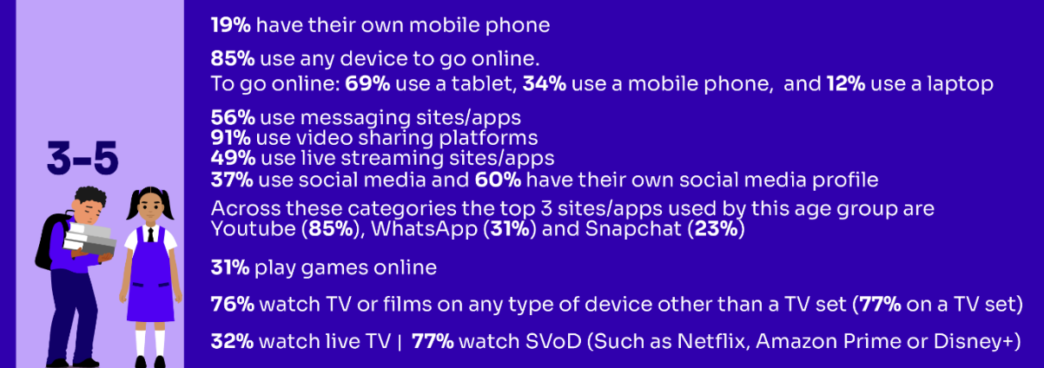
Media use, by age:

Slide 13
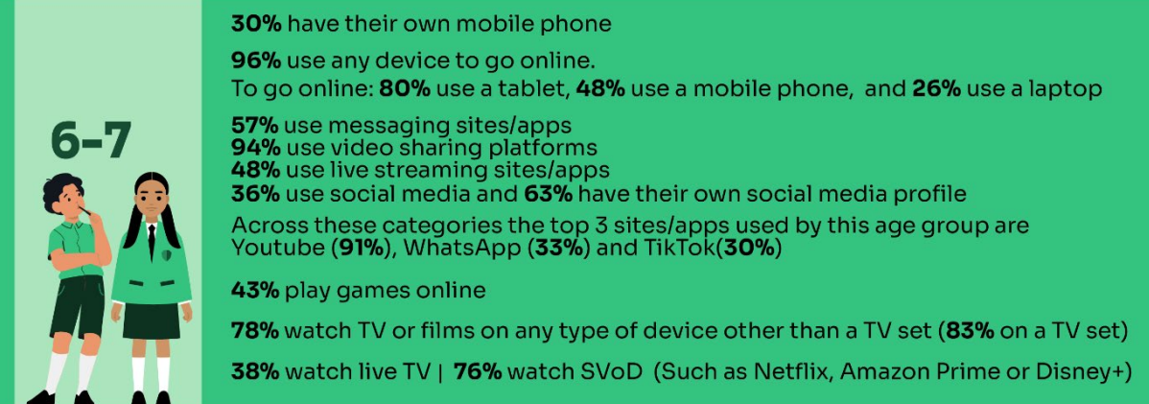
Media use, by age:

Slide 14
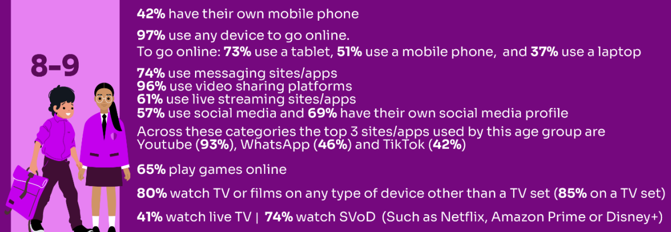
Media use, by age:

Slide 15
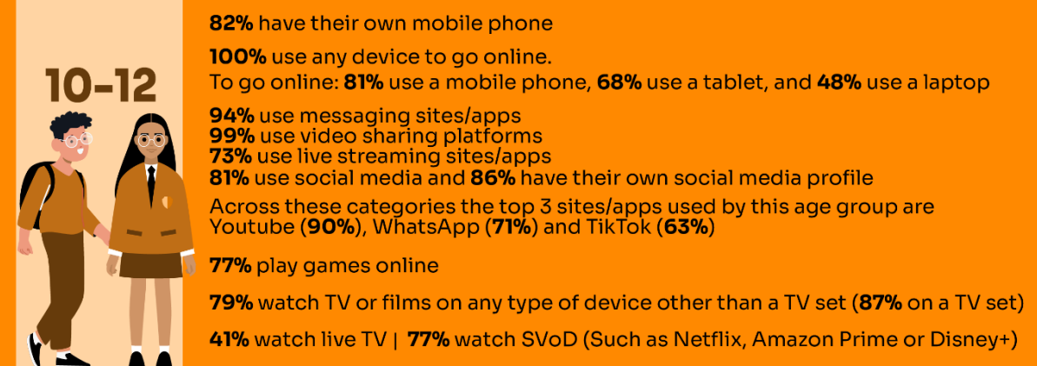
Media use, by age:

Slide 16
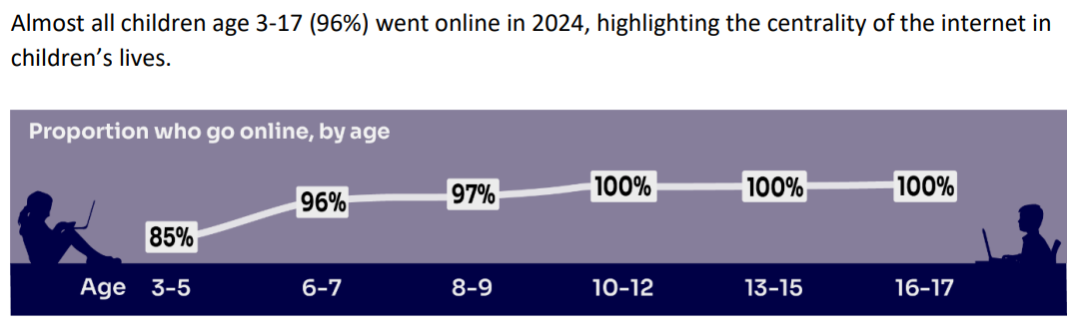

Slide 17
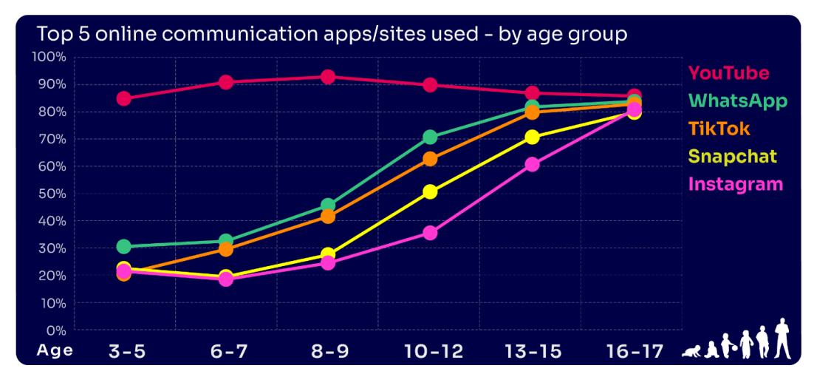

Slide 18
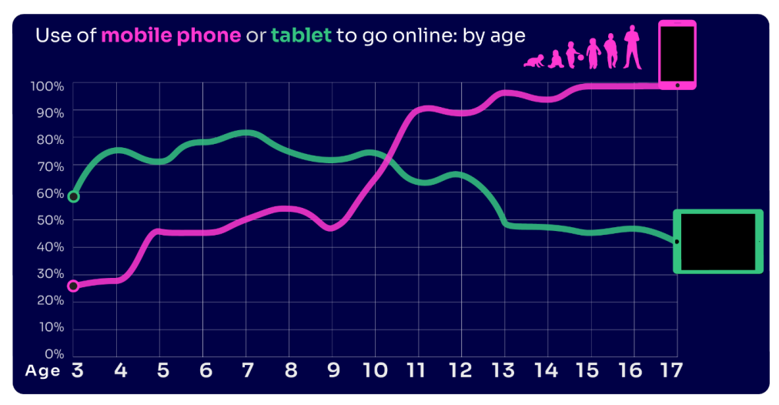

Slide 19
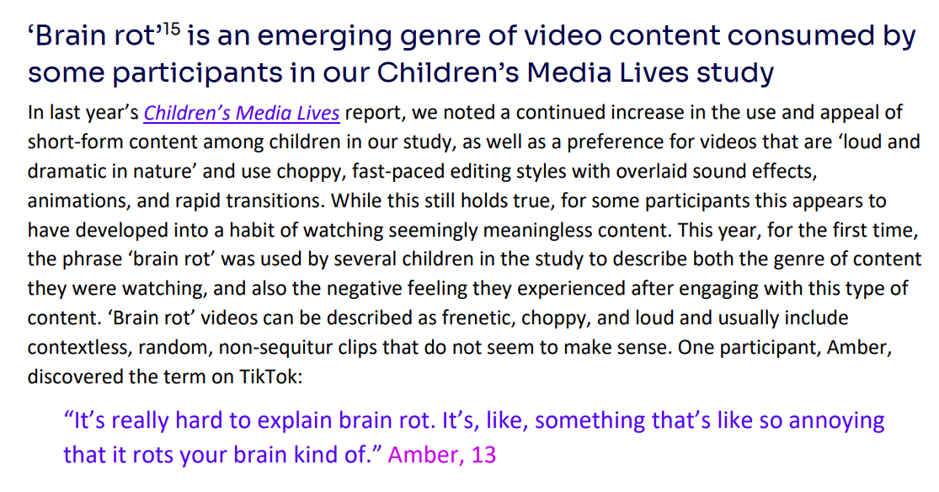

Slide 20
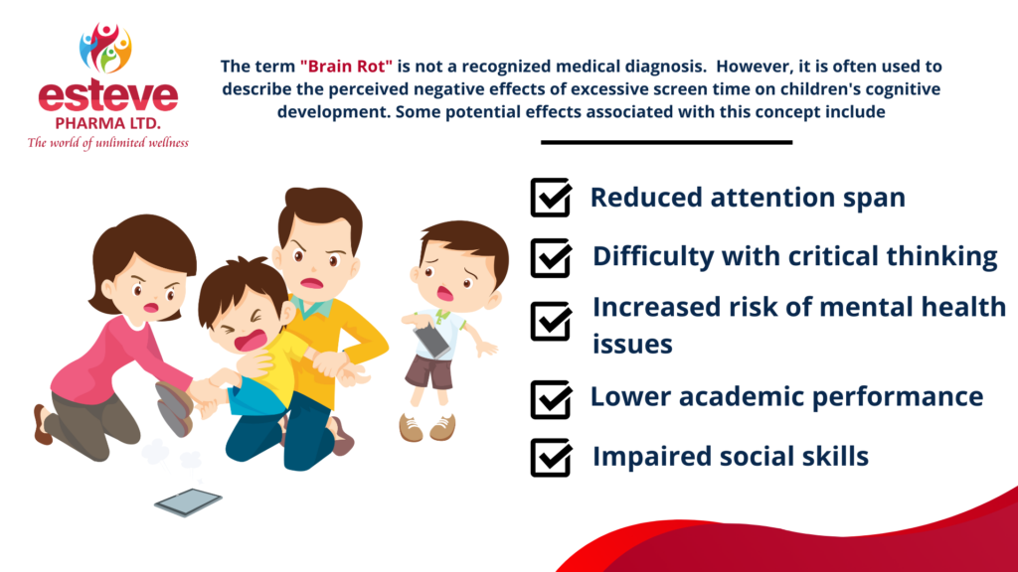

Slide 21
Key Findings:
Nearly four in ten 8-17s believe that people are mean or unkind to each other online all or most of the time
Girls continue to be more likely than boys to experience nasty or hurtful interactions online
Certain demographics (8-13) are more likely to see worrying or nasty content online
Nearly four in ten parents would let their child create a profile before reaching the minimum age
Parents continue to set rules for their children about being online, although there have been some decreases among parents of 10-12s
A high proportion of parents are aware of online protection tools or controls, but many do not use them
Many parents who are aware of content filters prefer to rely on their child’s ability to navigate online content

Slide 22

https://www.securus-software.com/dangerous-apps-for-children/

Slide 23
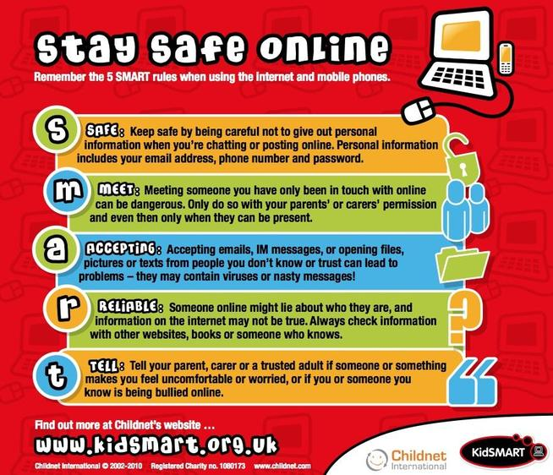

How can we help to protect children?

Slide 24
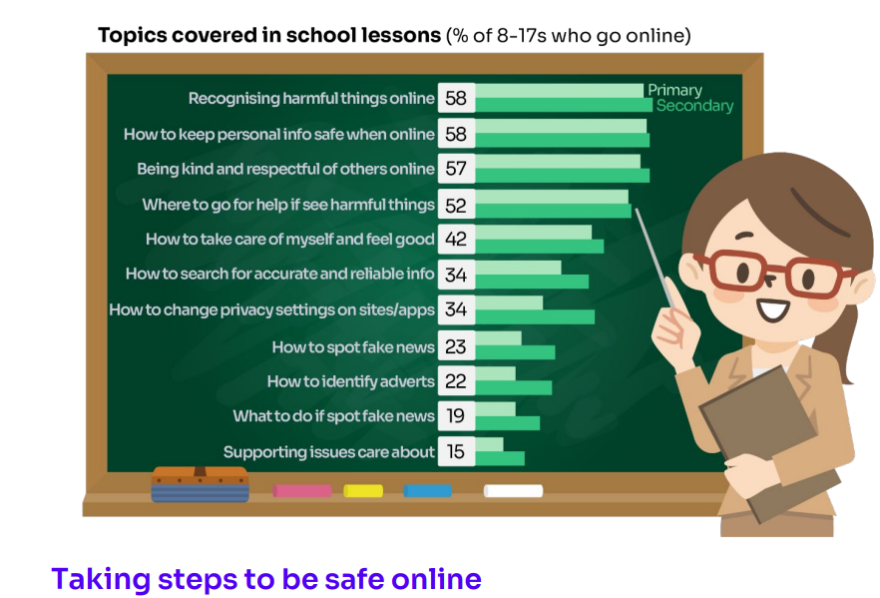

Slide 25
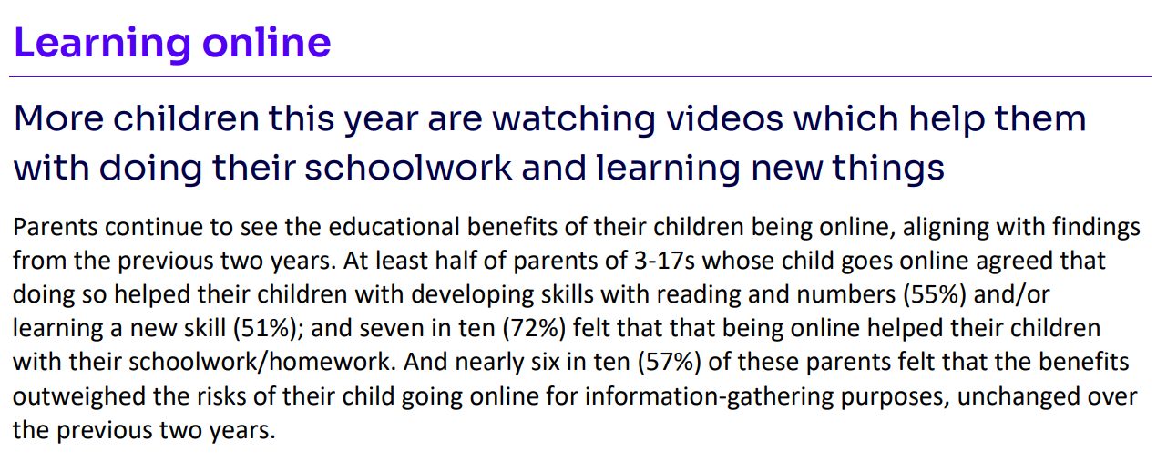

Slide 26
✅ Actionable Advice for Online Safety
Set Clear Screen Time Limits
Agree on daily/weekly screen time and stick to it.
Use tools like “downtime” or “bedtime” features on devices to automatically limit usage.
Encourage balance: outdoor play, reading, and family time alongside screen time.

Slide 27
✅ Actionable Advice for Online Safety
2. Stay Informed and Educated
Keep up to date with the apps, games, and websites your child is using.
Explore resources like NSPCC Net Aware, UK Safer Internet Centre, or Childnet.
Talk to your child regularly about their online interests so you understand what they enjoy and where risks might lie.

Slide 28
✅ Actionable Advice for Online Safety
3. Remember: It Could Happen Here
Don’t assume “my child would never…”—online risks (cyberbullying, strangers, inappropriate content) can affect any child.
Keep conversations open so children feel safe telling you if something goes wrong.

Slide 29
✅ Actionable Advice for Online Safety
4. Use Filtering and Parental Controls
Activate filters on your home Wi-Fi and on individual devices.
Set up child accounts with age-appropriate restrictions.
Regularly review privacy and security settings on apps and websites.

Slide 30
✅ Actionable Advice for Online Safety
5. Limit Internet Access Times
No devices in bedrooms overnight—charge them in a shared space.
Set “offline times” such as during meals, family activities, or before school.

Slide 31
✅ Actionable Advice for Online Safety
6. Monitor Devices Proactively
Keep devices in shared areas where you can see what’s happening.
Check browsing history, app use, and friend lists on social apps/games.
Consider agreeing a “digital contract” with your child, setting expectations about how devices are used.

Slide 32
✅ Actionable Advice for Online Safety
7. Talk Openly and Regularly
Encourage your child to tell you if they see something that worries or confuses them.
Role-play scenarios (“What would you do if someone you don’t know messages you?”).
Praise honesty—children are less likely to hide mistakes if they feel supported.

Slide 33
✅ Actionable Advice for Online Safety
8. Model Good Online Habits
Show your child that you also put your phone away at dinner or bedtime.
Be mindful of your own screen time, social media use, and sharing of photos/information.

Slide 34




Useful links and resources:
https://www.nspcc.org.uk/keeping-children-safe/online-safety/
https://saferinternet.org.uk/guide-and-resource/parents-and-carers
https://www.gov.uk/government/publications/coronavirus-covid-19-keeping-children-safe-online/coronavirus-covid-19-support-for-parents-and-carers-to-keep-children-safe-online
https://www.barnardos.org.uk/get-support/support-for-parents-and-carers/child-abuse-and-harm/keeping-children-safe-online

