Slide 1
RSE in Our School
Notes:
TOS

Slide 2
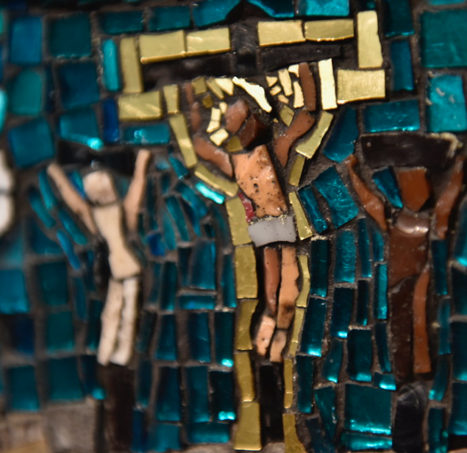
Prayer
Father,
Thank you for your great love for us. You sent your only Son to live with us and show us how to love.
As we explore teaching about relationships to the young people in our school, help us to keep them and Christ at the centre of our minds.
May The Holy Spirit bring us wisdom and peace in guiding our conversations.
We commend to you our words and actions.
Amen

Slide 3
Objectives:
To explore why RSE is important.
To share the statutory requirement of RSE coming into place in September 2020.
To explain what the statutory changes are to RSE provision.
To share the Curriculum and supporting documents from the Catholic Education Service.
To explain the timeline of implementation in our school.

Slide 4

What was your experience of RSE?

Slide 5
What do you want for your children?
What do your children need?

Slide 6
Why is RSE important?
Majority of parents support RSE.
Some parents say that RSE was the responsibility of parents, and that they welcome the right they have (enshrined in current law) to withdraw their child from Sex education lessons
Most of the young people present disagreed strongly, stressing that their parents have not in fact taught them!
Many parents/carers don’t discuss RSE as much as they wish to!
Notes:
Sex education forum survey 2011
Baroness Sheila Hollins Today’s teenagers, tomorrow’s parents: Connecting with young people in a complicated world – report to bishops is 2012
Research on young people in the church – one area explored was RSE.

Slide 7
Why is RSE important?
Research show that effective, honest, well-delivered sex and relationship education:
  Delays a young person’s first experience of sex
  Means they have fewer sexual partners
  Reduces the chance of teenage pregnancy.
  Abstinence only sex education programmes are not proved effective in these areas.
  (Unesco – international technical guidance on sexuality education)
Notes:
Myth buster – RSE does not encourage Sexual activity
Baroness Sheila Hollins Today’s teenagers, tomorrow’s parents: Connecting with young people in a complicated world – report to bishops is 2012
Unesco - Why comprehensive sexuality education is important

Slide 8
The world in which they live
Celebrity culture
Media influences, social media
Sexualised images –TV, advertising, online
Access to pornography
Online safety & behaviour, sexting, vulnerability to grooming
Impact above all on children and young people’s attitudes, behaviour and values
Notes:
THAs well s the wonderful aspects of our world and the internet……

Slide 9
What we can offer through RSE:
Understanding their value and the values of others.
Instilling confidence and self-esteem.
Reliable, correct information in a safe learning environment
Knowing how to keep safe.
Helping with peer pressure.
Learning how to make sensible and informed decisions in a changing cultural climate.
Understanding the positive impact of loving God, self, neighbour and our common home.
Notes:
THAs well s the wonderful aspects of our world and the internet……

Slide 10
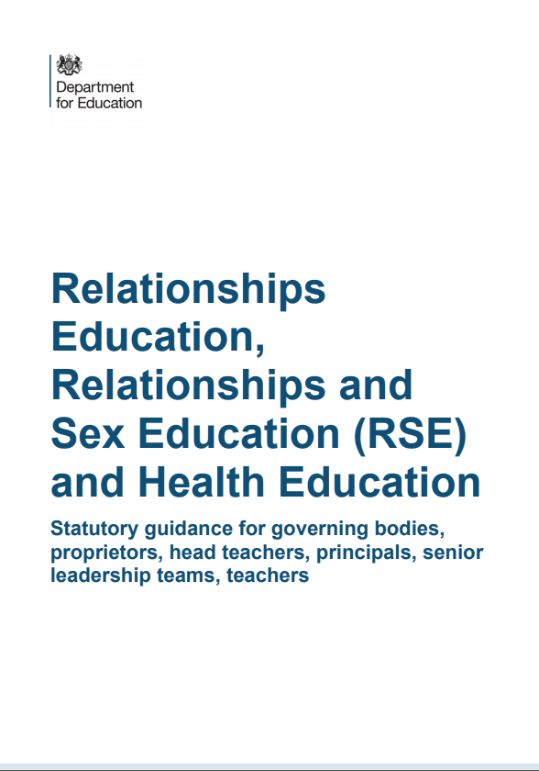
Statutory RSE
Notes:
THAs well s the wonderful aspects of our world and the internet……

Slide 11
Primary Relationships Education
Relationships Education will put in place the building blocks needed for positive and safe relationships, including with family, friends and online.
Your child will be taught what a relationship is, what friendship is, what family means and who can support them.
In an age-appropriate way, your child’s school will cover how to treat each other with kindness, consideration and respect.
By the end of primary school, pupils will have been taught content on:
• families and people who care for me
• caring friendships
• respectful relationships
• online relationships
• being safe
You can find further details by
searching ‘relationships, sex and health education’ on GOV.UK.
Notes:
tos

Slide 12
Primary Health Education
Health Education aims to give your child the information they need to make good decisions about their own health and wellbeing, to
recognise issues in themselves and others, and to seek support as early as possible when issues arise.
By the end of primary school, pupils will have been taught content on:
• mental wellbeing
• internet safety and harms
• physical health and fitness
• healthy eating
• facts and risks associated with drugs, alcohol and tobacco
• health and prevention
• basic first aid
• changing adolescent body
(The science curriculum in all primary schools also includes content on human development, including reproduction, which there is no right to withdraw from.)
You can find further details by
searching ‘relationships, sex and health education’ on GOV.UK.

Slide 13
Secondary Relationships and Sex Education
Relationships and Sex Education will build on the teaching at primary. It aims to give young people the information they need to help them develop healthy, nurturing relationships of all kinds.
Your child’s school will cover content on what healthy and unhealthy relationships look like and what makes a good friend, colleague and successful marriage or committed relationship. At the appropriate time, the focus will move to developing intimate relationships, to equip your child with knowledge they need to make safe, informed and healthy choices as they progress through adult life.
By the end of secondary school, pupils will have been taught content on:
• families
• respectful relationships, including
friendships
• online media
• being safe
• intimate and sexual relationships, including sexual health
You can find further details by
searching ‘relationships, sex and health education’ on GOV.UK.

Slide 14
Secondary Health Education
Health Education aims to give your child the information they need to make good decisions about their own health and wellbeing, to
recognise issues in themselves and others, and to seek support as early as possible when issues arise.
By the end of secondary school, pupils will have been taught content on:
• mental wellbeing
• internet safety and harms
• physical health and fitness
• healthy eating
• drugs, alcohol and tobacco
• health and prevention
• basic first aid
• changing adolescent body
You can find further details by
searching ‘relationships, sex and health education’ on GOV.UK.

Slide 15
Vision for Relationship and Sex Education in Westminster Catholic Schools
It is our vision for Relationship and Sex Education in Catholic Schools in the Diocese of Westminster that pupils would learn how to foster healthy relationships and friendships in light of the wisdom of the Church.
Pupils will flourish when they truly understand their innate human dignity, love and appreciation of themselves, including respect for their bodies, and the way they were made by God.
Pupils will learn to make sensible and informed decisions in a changing cultural climate, focussing on the virtues, such as patience and chastity, that ultimately lead to true happiness.
Sacred Scripture is key to this vision and the message Jesus gave us to love God, self, neighbour and our common home.
RSE in our schools must always remain faithful to the teaching of the Church, recognising the diversity of pupils’ situations. We aim to be sensitive to each individual, ensuring that their physical and emotional well-being and their safety are of paramount importance.

Slide 16
Catholic Education Service- RSE documents
Model Curricula
Who is responsible for delivering RSE?
“RSE is part of the mission of Catholic schools to educate the whole person. It should be carried out as part of the holistic education which seeks to form as well as inform young people in preparation for adult life.” (CES)

Slide 17
Pedagogical principles
‘it must, above else, qualify as good education’.
Model Curriculum page 1

Slide 18
Differentiated
Cross curricular
Integrated
Coordinated
Balanced
Progressive and developmental
Notes:
th

Slide 19
Pedagogical principles
‘….Led to a deeper and fuller understanding by degrees at a rate which corresponds to their maturing’
Progressive and developmental
Notes:
Must qualify as good education
Like any good curriculum – planned and developmental. Appropriate to age and develops a deeper understanding as pupils mature.
Differentiated and ADAPTED. TRAINING UNDERTAKEN IF PARTICULAR NEED. SEN not withdrawn because of lack of resources or training.
Cross-teach the content where it is most appropriate.
PSHE, RE, SCIENCE ICT- EACH

Slide 20
Pedagogical principles
RSE is sensitive to the different needs of individuals and taught in a way that allows access to pupils at different stages of cognitive and emotional development’
Differentiated
Notes:
th

Slide 21
Pedagogical principles
‘Each discipline should speak with consistency about the meaning of human love and the virtues that are enshrined in the Church’s teaching on human love.’
Cross curricular
Notes:
th

Slide 22
Pedagogical principles
‘This can only be achieved if the home, parish and school work to integrate the teaching of RSE’
Integrated
Notes:
th

Slide 23
Pedagogical principles
None of these educational goals are possible if RSE is not given the time and importance it deserves by those who plan and implement its delivery in school. RSE must be taken seriously by school leaders; led properly by someone who has the time and expertise to co-ordinate the subject with dedication and commitment at a senior level; taught by those committed to doing it well; taught as part of a whole-school approach by those who are able to celebrate – not merely tolerate – the teaching of the Church on love and human sexuality.
Coordinated

Slide 24
Pedagogical principles
Whilst promoting Catholic virtues, schools should ensure that children and young people are offered a broad and balanced RSE programme which provides them with clear factual, scientific information when relevant and meets the statutory requirements placed on schools.
Balanced

Slide 25
Model Curricular
A model RSE Curriculum for Primary
A model RSE Curriculum for Secondary
3 themes
Created and loved by God
Created to love others
Created to live in community
Model Curriculum page 2

Slide 26
Created and loved by God
The Christian imperative to love self, made in the image and likeness of God, shows an understanding of the importance of valuing and understanding oneself as the basis for personal relationships.
Education in virtue
Religious understanding of the human person: loving myself.
Me, my body and my health
Emotional wellbeing and attitudes
Life cycles and fertility

Slide 27
Created to love others
God is love. We are created out of love and for love. The command to love is the basis of all Christian morality
Education in virtue
Religious understanding of human relationships: Loving others
Personal Relationships
Keeping Safe and People Who Can Help Me

Slide 28
Created to live in community
Human beings are relational by nature and live in the wider community. Through our exchange with others, our mutual service and through dialogue, we attempt to proclaim and extend the Kingdom of God for the good of individuals and the good of society.
Education in virtue
Religious understanding of the importance human communities
Living in the wider world

Slide 29
Education in Virtue
Each theme begins with a statement of the virtues which are necessary to living well in relationship with others and these virtues should underpin the teach habits which are learned from experiencing but also should emerge as a consequence of it. Virtues are, and are gained through imitation the same virtues being modelled by those who teach. They express the qualities of character that schools should seek to develop in their pupils, through their exemplification by the whole community of which the pupils are a part. These virtues reflect our Christian tradition but they are also, of course, fundamental human virtues which are universally shared
Model Curriculum page 2
Notes:
th

Slide 30
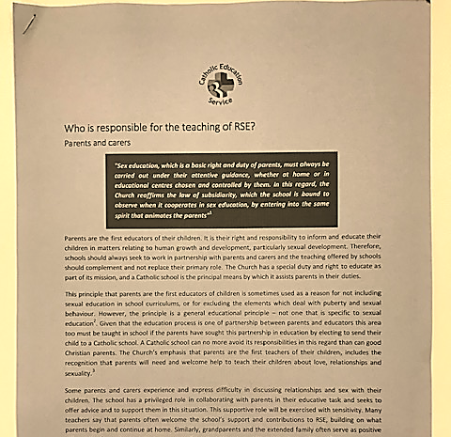
Who is responsible for teaching RSE?
Parents
Governors
Headteacher
Teachers and other staff
Visitors and external speakers
Parish and diocese
Notes:
‘school-based programmes are complemented with the involvement of parents and teachers, training institutes and youth-friendly services.’

Slide 31
Partnership with parents
Primary educators of children
Unique knowledge of your children
Ability to have regular conversations
Impart our shared values.
Teach alongside the school.
RSE most effective when reinforced at home and elsewhere.
Some parents find it difficult or lack confidence.
Some homes are unable to provide this.
Some children prefer these conversations outside the home
Notes:
‘school-based programmes are complemented with the involvement of parents and teachers, training institutes and youth-friendly services.’

Slide 32

DfE- Parents rights
The important lessons you teach your child about healthy relationships, looking after themselves and staying safe, are respected and valued under this new curriculum.
Teaching at school will complement and reinforce the lessons you teach your child as they grow up.
Your child’s school is required to consult with you when developing and renewing their policies on Relationships Education. These policies must be published online and be available to anybody free of charge.
You can express your opinion, and this will help your child’s school decide how and when to cover the content of the statutory guidance. It may also help them decide whether to teach additional non-statutory content.
Schools are required to ensure their teaching reflects the age and religious background of their pupils.
Notes:
Th
Link between parents as first teachers and parent rights.
Reassure they will be informed about what they will be learning.

Slide 33
DfE - Right to withdraw your child- Primary
You cannot withdraw your child from Relationships Education because it is important that all children receive this content, covering topics such as friendships and how to stay safe.
Your child’s primary school can choose to teach Sex Education. If you’d like to know more about this, we recommend speaking to the school to understand what will be taught and when. If you do not want your child to take part in some or all of the lessons on Sex Education, you can ask that they are withdrawn. At primary level, the head teacher must grant this request.
The science curriculum in all maintained schools also includes content on human development, including reproduction, which there is no right to withdraw from.

Slide 34
DfE- Right to withdraw your child – Secondary
You cannot withdraw your child from Health Education or the Relationships Education element of Relationships and Sex Education, because it is important that all children receive this content, covering topics such as friendships and how to stay safe.
If you do not want your child to take part in some or all of the Sex Education lessons delivered at secondary, you can ask that they are withdrawn. Your child’s head teacher will consider this request and discuss it with you, and will grant this in all but exceptional circumstances, up until three school terms before your child turns 16. At this age, your child can choose to receive Sex Education if they would like to, and the school should arrange for your child to receive this teaching in one of those three terms (unless there are exceptional circumstances).
The science curriculum in all maintained schools also includes content on human development, including reproduction, which there is no right to withdraw from.
Notes:
th

Slide 35
Changes- Primary
Primary schools | What’s new? | What’s not?
Sex Education | It is the consistent teaching of the church through the centuries that it is only in the context of marriage that sexual love can take on its true meaning. Marriage is a mutual commitment of total fidelity which is open to the gift of life. In the culture in which we live it is vital that our young people understand the importance of commitment for life. It is only through commitment that the deepest lessons of love can be learnt. | Some schools teach beyond statutory requirements. Parents can withdraw from sex education taught outside of science, beyond statutory obligations. Science national curriculum includes content on human development, including reproduction.
Relationship Education | Now a statutory obligation: • families and people who care for me • caring friendships • respectful relationships • online relationships • being safe | We cover this also through RE, PSHE and computing and in other ways e.g. SEAL Keeping children safe in education would have had an impact in this area.
Health Education | Now a statutory obligation • mental wellbeing • internet safety and harms • physical health and fitness • healthy eating • facts and risks associated with drugs, alcohol and tobacco • health and prevention • basic first aid • changing adolescent body | We cover some of these issues through science and PSHE please click on the link to see the Mind, Body, Spirit and Soul page on the school website. ://www.stmichaelandstmartin.co.uk/mind-body-spirit-soul/ e.g. Computing - cyber bullying Science – Hygiene, nutrition, exercise, alcohol.

Slide 36
Parent Consultation
We are consulting on our RSE policy.
The school welcomes and will take account of and listen to your views. Decisions will also be based on the needs of pupils, the views of staff and governors as well as compliance with legal requirements as set out in the DfE guidance and the Equalities Act 2010.
Ultimate decisions about the curriculum and policy will be up to the school.
Notes:
TOS
Use existing strategies if they are effective - multiple strategies
Group / one to one/ form/ online etc…..
Same questions – multiple formats

Slide 37
To take part in the consultation please
(include details of how you are inviting parents to contribute)

Slide 38
Timeline - What Next?
Parent Information Session 1
Statutory requirements
Distinctive Catholic approach
Parent consultation on policy from 2nd- 10th October
Please contribute to this consultation by/ via email to office@stmichaelrc.hounslow.sch.uk
Parents will be informed of the conclusions that have been reached and the curriculum and policy that has been adopted via the school newsletter and publishing the policy on the school website.
Parent information session 2
Curriculum and resources
Notes:
TOS

Slide 39
Closing Prayer
Heavenly Father,
As we come to the end of our time together we thank you for what has been accomplished here.
May the matters discussed serve as a catalyst to move us forward and cause us to advance and see growth in all areas of our lives.
May we leave here recognising that you are the God of all wisdom and you are willing to lead us forward.
This we pray in the name of Jesus the Lord,
Amen
Notes:
TOS

