Slide 1
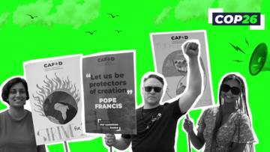
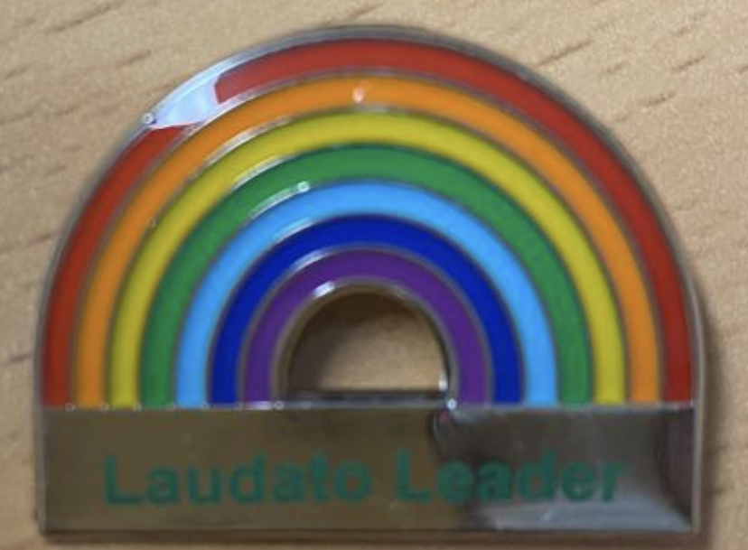

Slide 2
About this prayer we are going to read to you :)
Working in partnership with CAFOD, the Catholic Bishops’ Conference of England and Wales have written a prayer to encourage people to pray for the leaders meeting at COP26 this month.
The most important goal of the summit, known as COP26, is to put the world on a path to aggressively cut greenhouse gas emissions and slow Earth's warming. Negotiations will take place over two weeks.

Slide 3
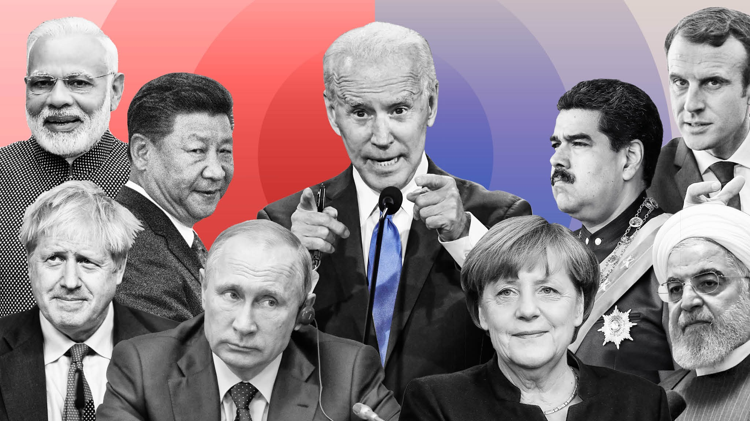
This prayer has been prepared in the hope that God will provide world leaders with the courage necessary to take action on behalf of the environment and the world’s poorest, this prayer is part of a wider effort by the Church to pursue ecological justice.

Slide 4
As a Laudato leader at St Michael and St Martin, It will be my/our responsibility to make sure we are doing our bit to keep our school “green” and make it even more “green”. We will also pray to God for guidance for our school community.

Slide 5
Loving God,
We praise your name with all you have created.
You are present in the whole universe,
and in the smallest of creatures.
We acknowledge the responsibilities you have placed upon us
as stewards of your creation.

Slide 6
May the Holy Spirit inspire all political leaders at COP26 as they
seek to embrace the changes needed to foster a more sustainable society.
Instil in them the courage and gentleness to implement fairer solutions
for the poorest and most vulnerable,
and commit their nations to the care of Our Common Home.
We ask this through Our Lord Jesus Christ your Son.
Amen

