Slide 1






Reception, Year 1 & 2 Maths Workshop
Miss Oakes
Maths Lead

Slide 2
Maths at St. Michael & St. Martin
Here at school, we value how developing a good grounding and strength in numeracy will help support your children as they progress throughout their education and into their adult lives.
Every year group undertakes a minimum of 4 hours of numeracy learning each week, which covers a wide range of topics including: basic number & understanding, shapes, space & measure and more developed, applied mathematics.
We challenge and encourage our children to partake in mental math tasks and teach them various methods to make calculations in their heads.
We aim to help each child by breaking down any fears they may have around numeracy through encouragement and support, and a firm belief that all our children can learn to love maths like we do!
Parent Information on our website: https://www.stmichaelandstmartin.co.uk/maths-1/

Slide 3
Maths National Curriculum
The national curriculum for mathematics aims to ensure that all pupils:
•become fluent in the fundamentals of mathematics, including through varied and frequent practice with increasingly complex problems over time, so that pupils develop conceptual understanding and the ability to recall and apply knowledge rapidly and accurately.
•reason mathematically by following a line of enquiry, conjecturing relationships and generalisations, and developing an argument, justification or proof using mathematical language
•can solve problems by applying their mathematics to a variety of routine and non-routine problems with increasing sophistication, including breaking down problems into a series of simpler steps and persevering in seeking solutions.

Slide 4
OfSted and Maths
Her Majesty’s Chief Inspector, Amanda Spielman, said:
•Our education inspection framework is clear that schools should ensure the maths curriculum is designed to help pupils to gain increasing mathematical proficiency and build confidence in their ability.
It said high-quality maths education would ensure new content draws on and links to content that pupils have previously acquired.

Slide 5
White Rose Maths
•Concrete-pictorial-abstract (CPA) approach to support children to understand the maths they are learning and to be able to use it elsewhere.
•“Small step” approach means nothing is left to chance – all curriculum objectives are broken down into accessible parts that build on each other so the learning journey is complete.
•Example questions are provided together with notes and guidance for teaching each step; teachers and children are both supported.
•Schemes start with blocks on Place Value, followed by the essential calculation skills children need to succeed in maths. This firm grounding in number gives children confidence and helps them to access the rest of the maths curriculum.
•They have continuously reviewed their schemes in the light of previous events and released an updated version for September 2023.

Slide 6
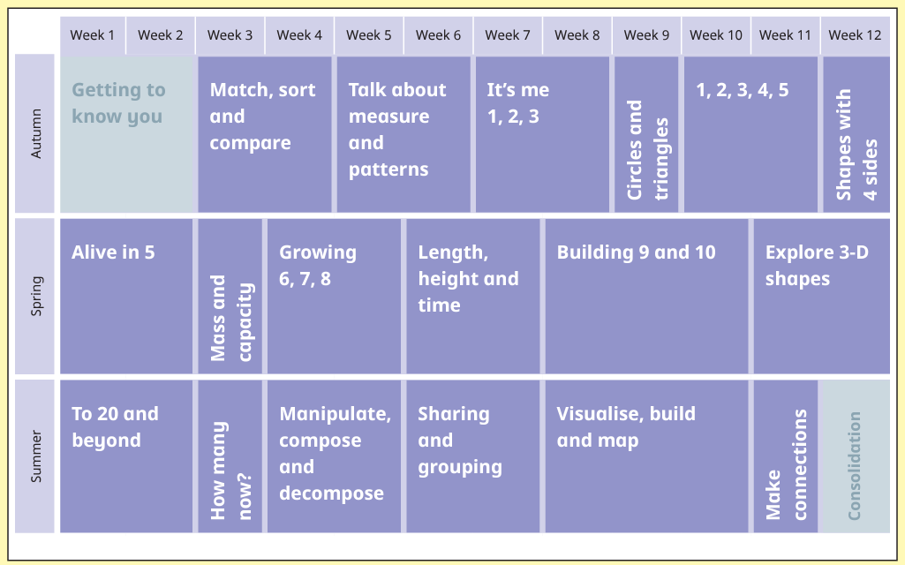
How does it show progression?
Reception

Slide 7
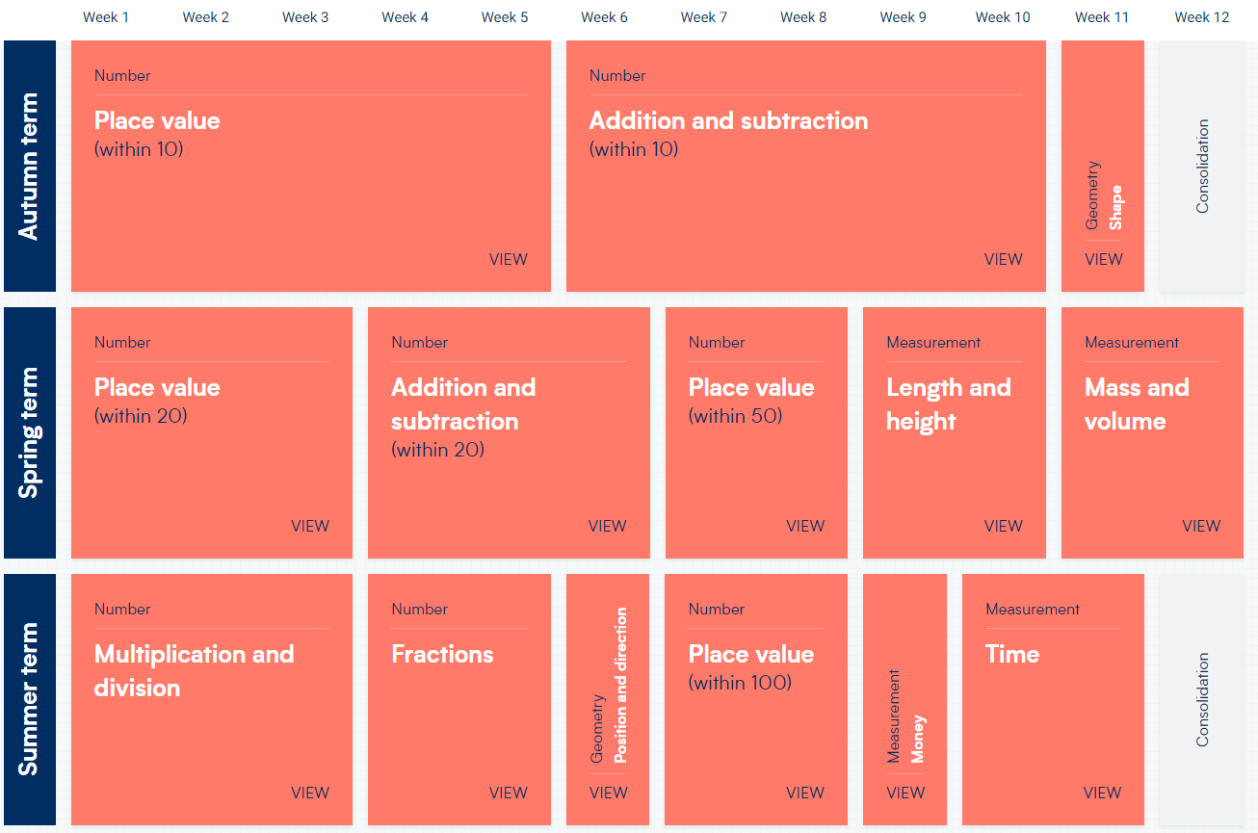
How does it show progression?
Year 1

Slide 8
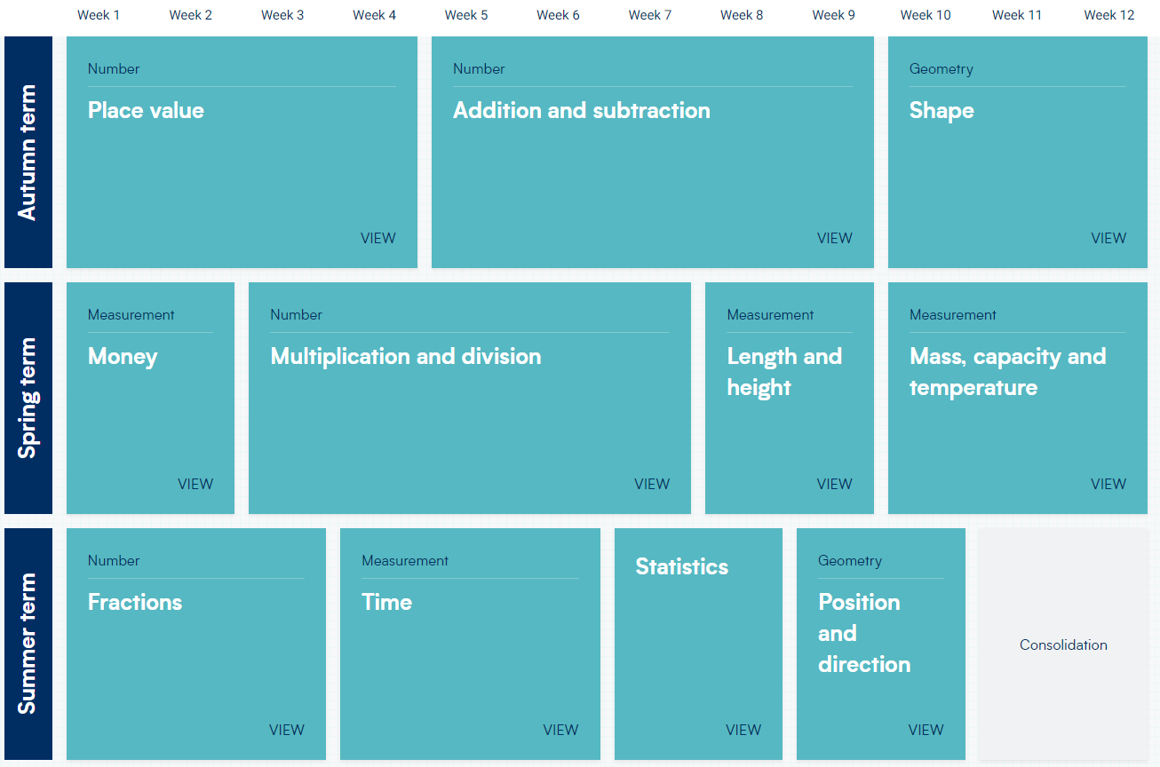
How does it show progression?
Year 2

Slide 9
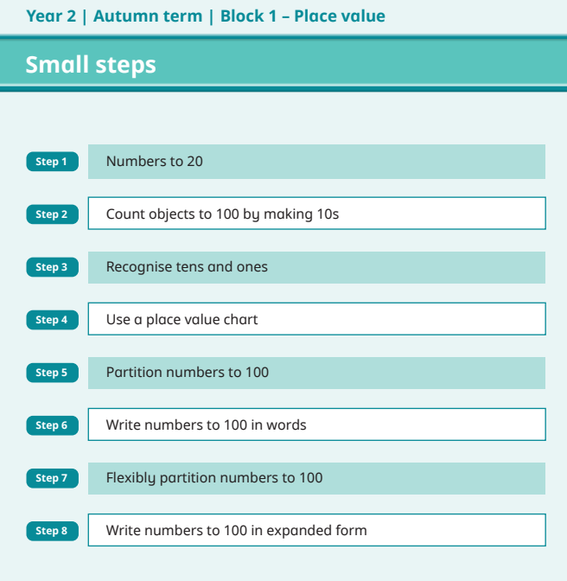
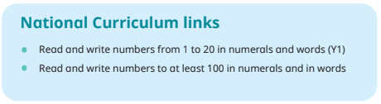
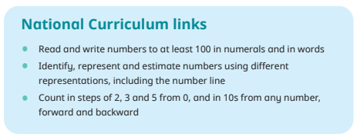
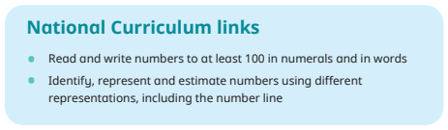
How does it show progression?
Small Steps

Slide 10


Why do we need a calculation policy?
To provide an understanding of when and how the four operations –addition, subtraction, multiplication and division, are taught.
To make teachers and parents aware of the continuity and progression in skill development across the year groups.
Equip our children with a bank of strategies to tackle different types of mathematical problems.
Calculation Policy: https://primarysite-prod-sorted.s3.amazonaws.com/st-michael-st-martin-catholic-primary-school/UploadedDocument/6332359c-396c-4f45-80b7-31abd155cea4/st-mm-calculation-policy.pdf

Slide 11

How does it show progression?
How does it show progression?
Children will progress through the stages and methods in each of the four areas.
All children will be given the opportunity to learn different methods for each operation.
Some children may need to recap or go back a stage to consolidate their understanding of concepts.

Slide 12
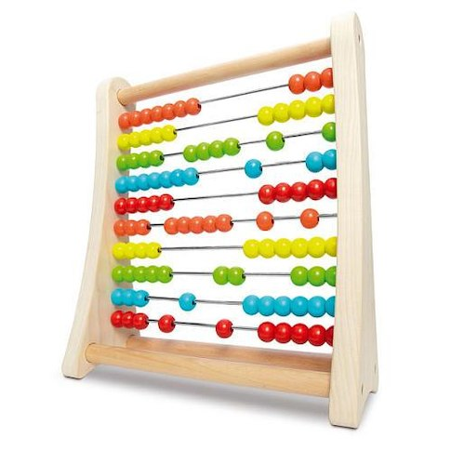
Addition [+]
Addition is the process of calculating the total of two or more numbers or amounts.
It is the inverse of subtraction.

Slide 13
Addition [+]
Nursery 1+1 = | Reception 6+ 4 = | Year 1 9 + 6 = | Year 2 23+ 35 =
Year 3 123 + 94 = | Year 4 1226 + 192 = | Year 5 2,999 + 497 = | Year 6 3,350 + 4,652 =

Slide 14




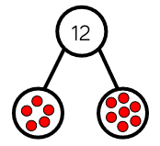
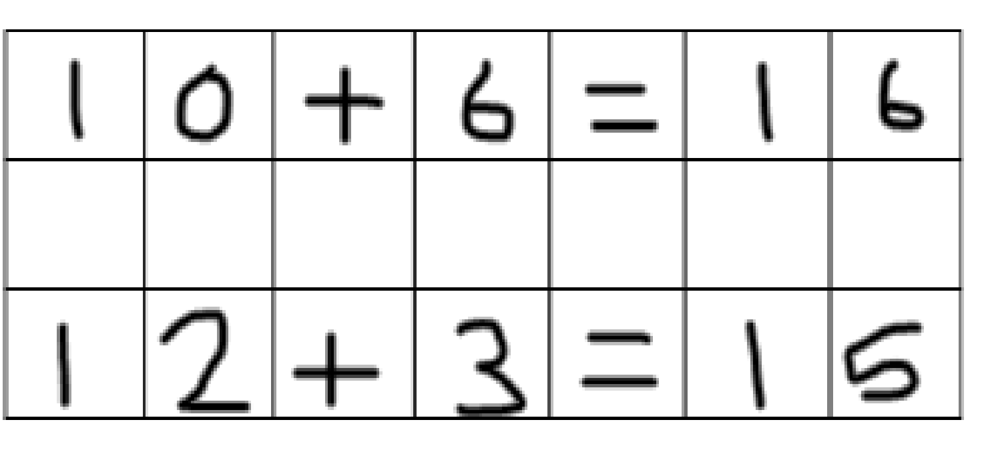
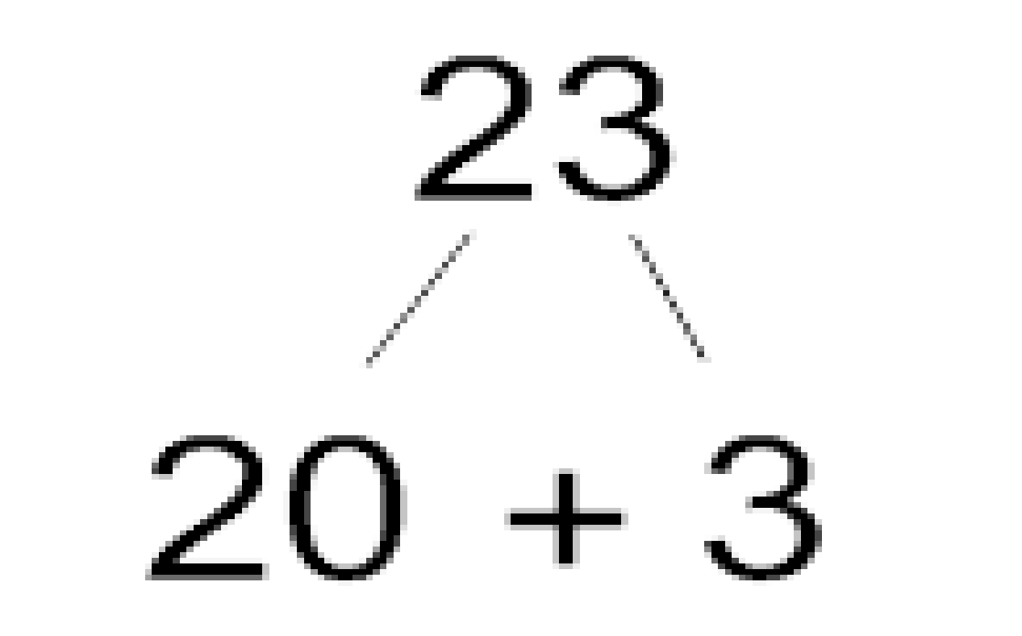
Methods for Addition [+]
Use of visual aids to confidence writing sentences
Number line and part whole model 5 + 7 = 12
Partitioning

Slide 15


Slide 16
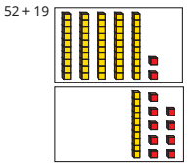
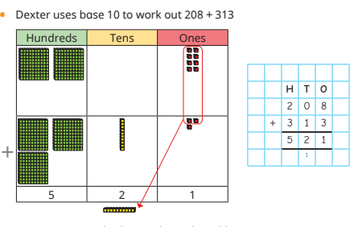

Slide 17
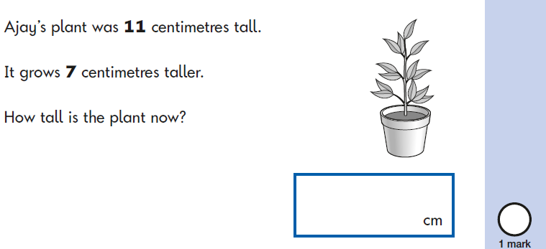
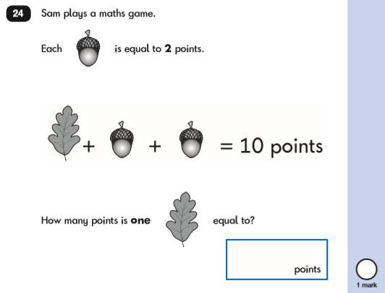
Reasoning & Problem Solving

Slide 18
Subtraction[-]
Subtraction is the process or skill of taking one number or amount away from another or finding the difference between two numbers.

Slide 19
Subtraction[-]
Nursery 2 - 1 = | Reception 6- 4 = | Year 1 11 - 6 = | Year 2 35 + 23 =
Year 3 123 - 94 = | Year 4 1226 - 192 = | Year 5 2,999 - 1497 = | Year 6 4,350 - 2,652 =

Slide 20

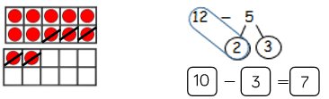
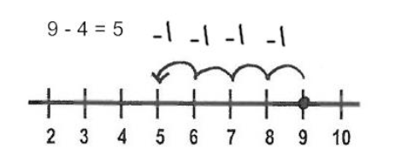
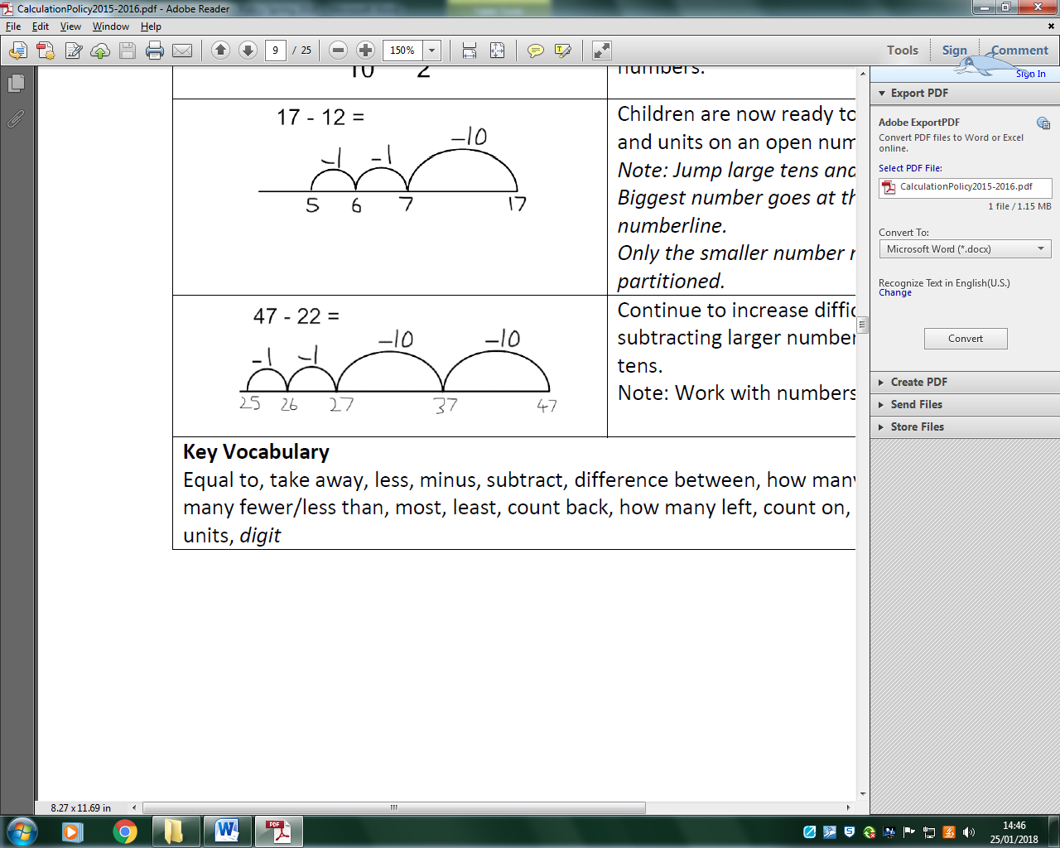
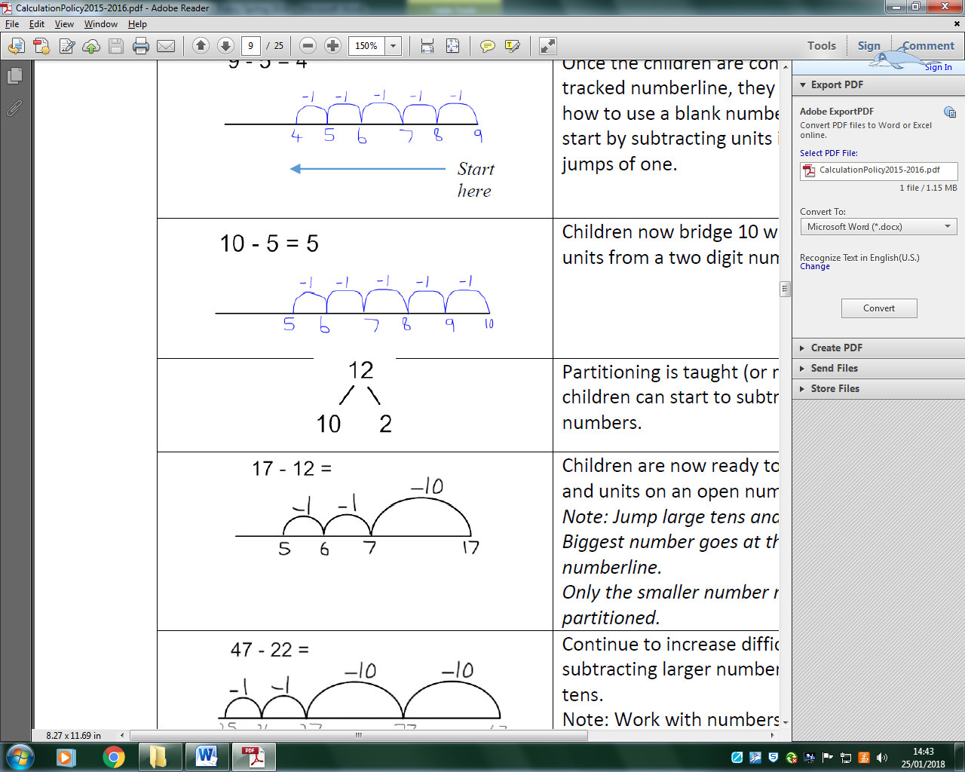

Methods for Subtraction [-]
Visual aids and making 10
Number line
Partitioning and part-whole model

Slide 21
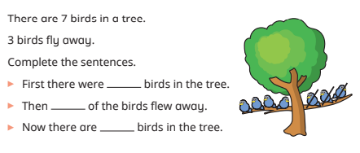
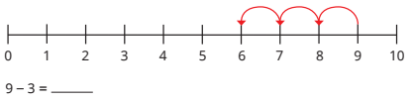

Slide 22
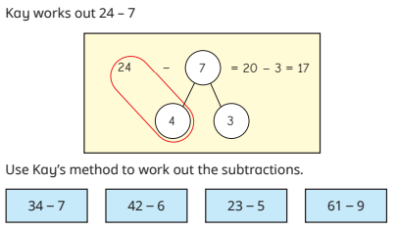
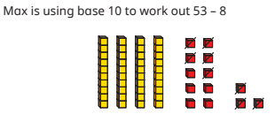
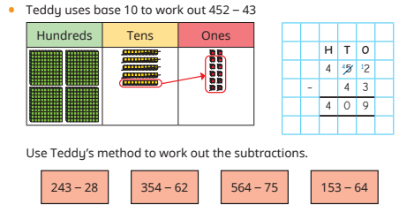

Slide 23
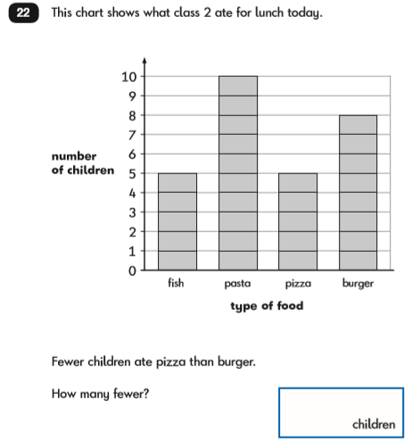
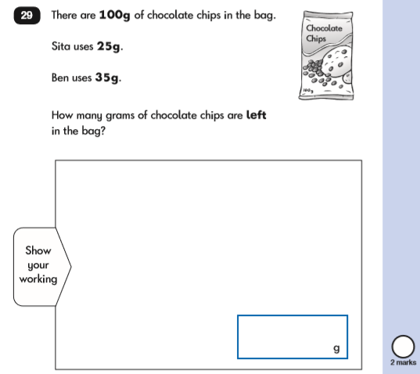
Problem Solving & Reasoning

Slide 24
Multiplication[x]
Multiplication is the product of two numbers or repeatedly adding the same set of number as many times as the other number.
It is an inverse operation of division.

Slide 25
Multiplication[x]
Nursery (doubling) 1 + 1 = | Reception (doubling) 5+5 = | Year 1 4 x 2 = | Year 2 12 x 3 =
Year 3 36 x 4 = | Year 4 126 x 6= | Year 5 1234 x 13 = | Year 6 2345 x 24=

Slide 26
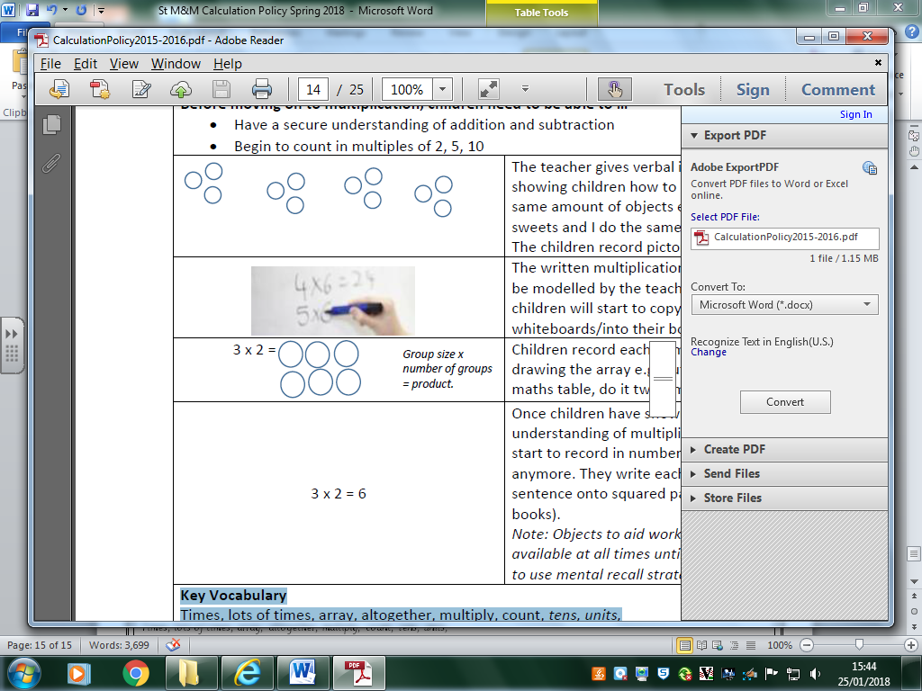
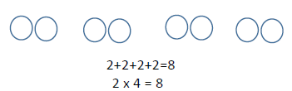

Methods for Multiplication[x]
Arrays
Repeated addition
Open numberline

Slide 27
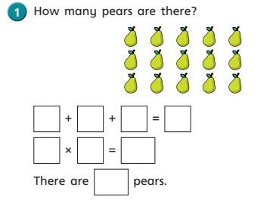
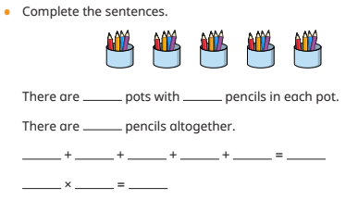

Slide 28
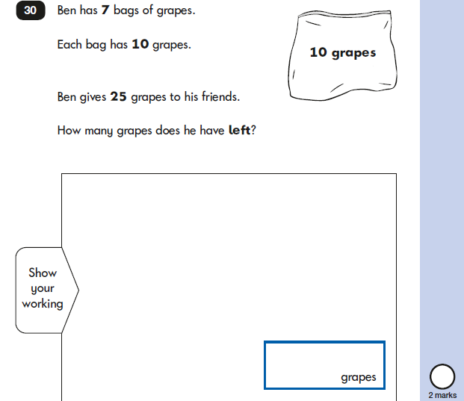
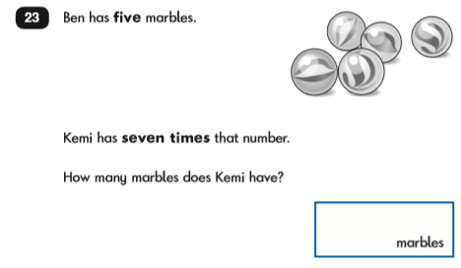
Problem Solving & Reasoning

Slide 29
Division
Dividing is a quick way of subtracting several lots of the same number or quantity, or splitting it up into equal groups.

Slide 30
Division
Nursery 2 ÷ 1 = | Reception 6 ÷ 3 = | Year 1 10 ÷ 2 = | Year 2 24 ÷ 4 =
Year 3 36 ÷ 9 = | Year 4 125 ÷ 5 = | Year 5 726 ÷ 7 = | Year 6 7548 ÷ 9 =

Slide 31
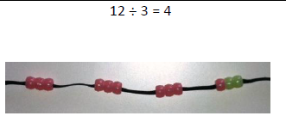
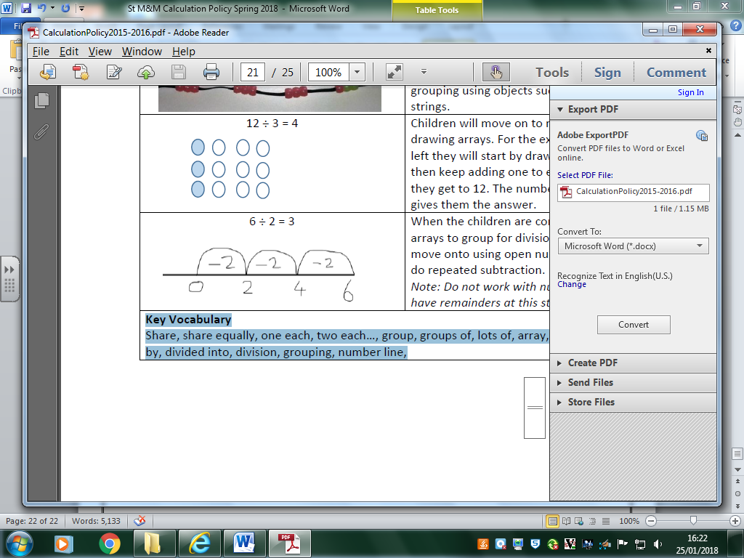
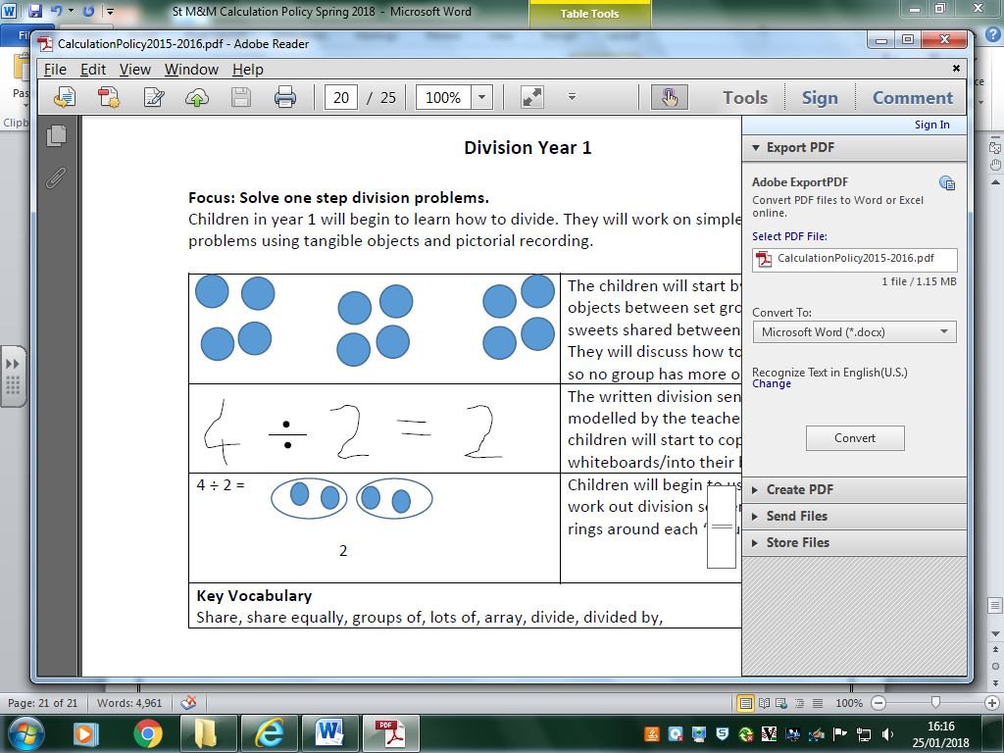
Methods for Division
Visuals
Open number line
Arrays & Grouping

Slide 32
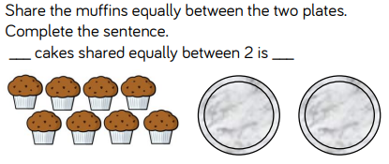
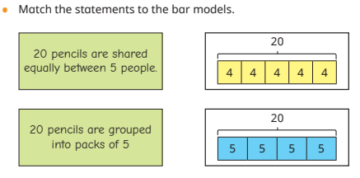

Slide 33
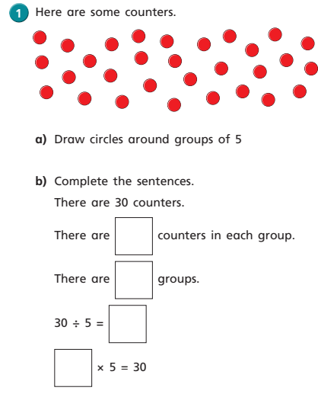

Slide 34
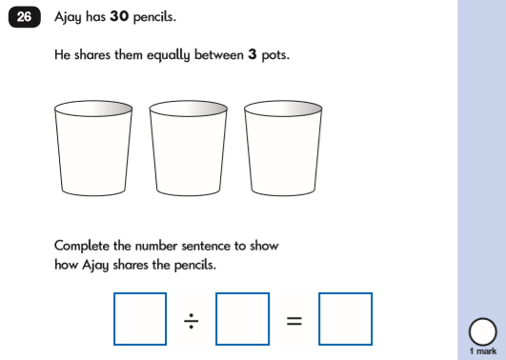
Problem Solving & Reasoning

Slide 35

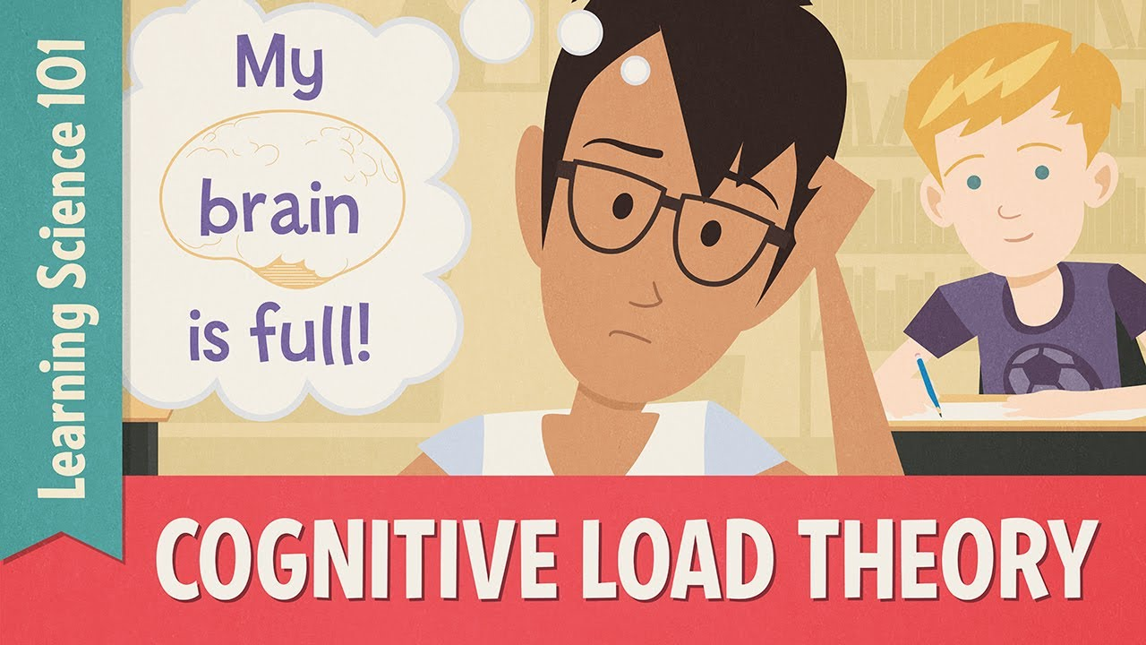
Cognitive Overload
Cognitive load is the term used in cognitive science to describe how much working memory capacity a topic takes up. Cognitive overload is what happens if too many demands are placed on working memory at once.

Slide 36
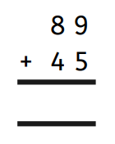
Cognitive Overload in Maths
Look at children learning to use the vertical addition algorithm with the following example:
A child who has their number bonds stored in their long-term memory and knows that 9 + 5 = 14 can import that fact into their working memory without conscious effort.
None of that precious, finite capacity of working memory has to be wasted working out 9+5.
Whereas, a child who does not know the answer automatically has to divert processing resources away from thinking about columns, value and regrouping, thinking instead about what 9+5 adds up to.
Their overloaded working memory can’t cope with this additional demand on top of everything else it is already thinking about, so it ‘forgets’ one of the important steps in the procedure. The child therefore gets the answer wrong.
Or even if the child doesn’t get the answer wrong, they do not learn how to use the vertical algorithm as a useful method they can generalise and transfer to other similar problems.
The value of children practising their number bonds and times tables every evening cannot be undermined - it is one of the main reasons children can end up struggling with mathematical concepts in UKS2.

Slide 37
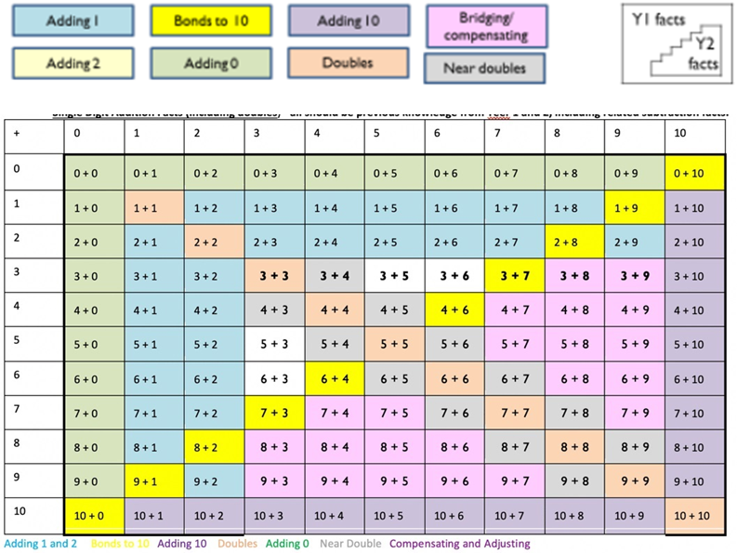
Year 1 Number Facts
Children learn how to add and subtract number facts up to 20, becoming familiar with all the different combinations, such as: 1+9=10, 14+3=17, 16+4=20, etc.

Slide 38
Year 2 Number Facts
Children will consolidate their knowledge on number facts up to 20 and be able to learn them off by heart.
As well as this, they will learn that number bonds to 20 are related to number facts up to 100, e.g. 4+6=10 is the same as 40+60=100.
Multiplication and division for the 2, 5 and 10 times tables are introduced in Year 2.

Slide 39
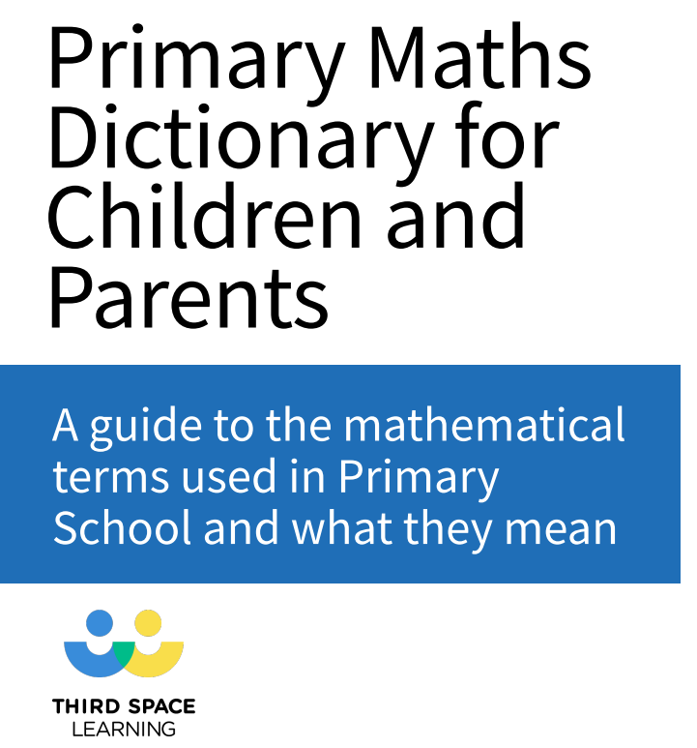
Vocabulary
https://drive.google.com/file/d/1Z7sYTK-UX7b0l2HzvCTn2_uBDrTJ5Acz/view?usp=sharing

Slide 40


Reasoning Workshop

