Slide 1


Parent Presentation for Nursery- May 2022
Led by Miss Ponter
Notes:
1
Make sure you have a pen and paper at the ready!

Slide 2
Phonics at St M&M
We are using the Read Write Inc (RWI) Scheme as our phonics program.
This is a more structured approach with writing aspects included.

Slide 3
Why synthetic phonics?
“Synthetic phonics offers the vast majority of young children the best and most direct route to becoming skilled readers and writers” Sir Jim Rose
Rose Review of Reading 2006
Synthetic phonics is the ability to convert a letter or letter group into sounds that are then blended together into a word.
Notes:
3

Slide 4
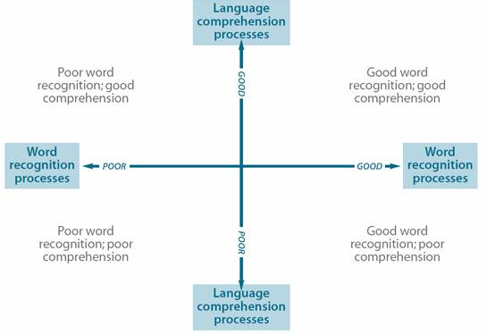
Simple view of reading
Notes:
4

Slide 5
Phonics at St M&M
We are using the Read Write Inc (RWI) scheme as our phonics program.
This is a more structured approach with writing aspects included.

Slide 6
Why Read Write Inc Phonics?
Tried and tested over many years
Systematic and structured
Early success in reading
Training and ongoing staff development
RWI Introduction
https://www.youtube.com/watch?v=lFyDwUKSw7Y
Notes:
6

Slide 7
What is Read Write Inc Phonics?
A rapid Learn to read programme
so children can…
Read to learn for the rest of their lives
Notes:
7

Slide 8
How does it work?
Children:
Learn 44 sounds and matching letters/letter groups
Learn to blend sounds to read words
Read lots of specially written books
This is decoding.
Notes:
8

Slide 9
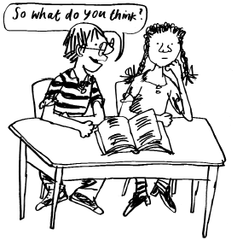
How does it work?
Children:
Talk a lot about what they have read to show they understand.
Listen to and discuss other ideas to deepen understanding.
This is comprehending.
We do lots of talking in partners.
Notes:
9

Slide 10
Sounds
All words are made up of sounds
In the English language there are 44 sounds (phonemes)
Sound Pronunciation Guide
https://www.youtube.com/watch?v=TkXcabDUg7Q
Notes:
10
Show flashcards to parents MTYT

Slide 11
Graphemes
A grapheme is a sound written down
English has more than 150 graphemes
There are more than 150 ways to represent the 44 sounds using our 26 alphabet letters.
A complex code!
You
Notes:
11

Slide 12
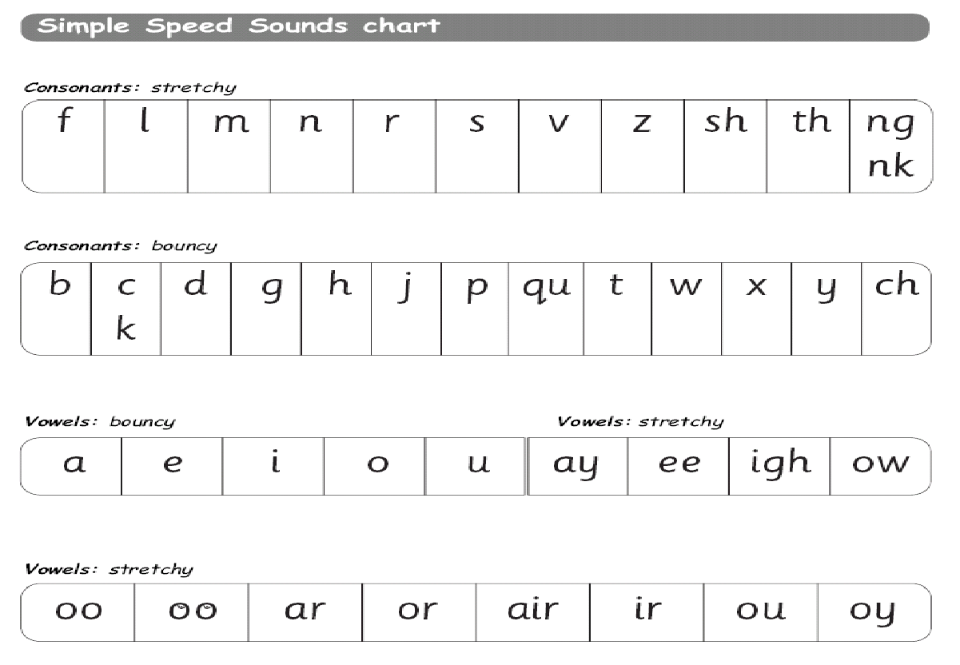
Learning the code
Children learn a simple code first
Notes:
12

Slide 13
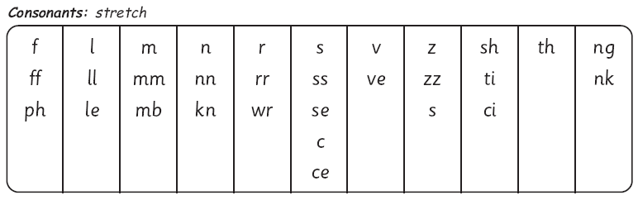
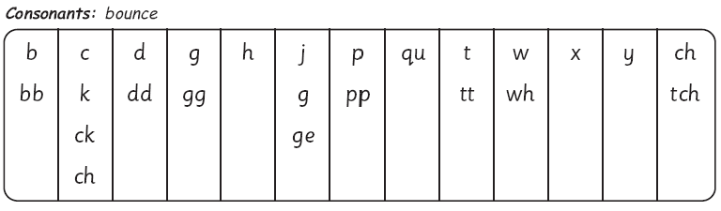
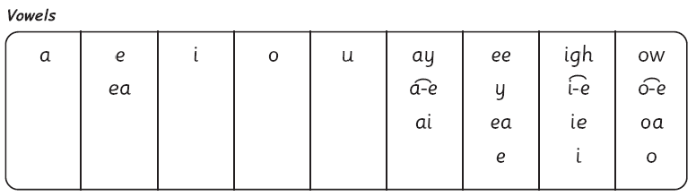
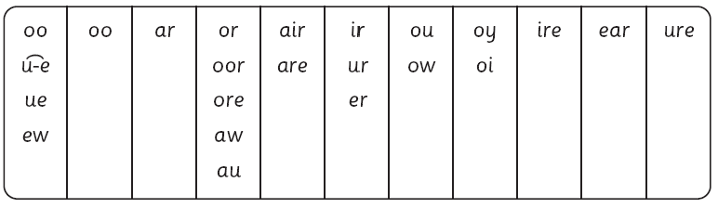
The complex English alphabetic code
Notes:
13

Slide 14
Consonants: stretchy
f | l | m | n | r | s | v | z | sh | th | ng
 |  |  |  |  |  |  |  |  |  | nk
Consonants: bouncy
b | c | d | g | h | j | p | qu | t | w | x | y | ch
 | k
Vowels: bouncy
Vowels: stretchy
a | e | i | o | u | ay | ee | igh | ow
oo | oo | ar | or | air | ir | ou | oy
Set 1 sounds
Set 2 sounds
Notes:
14

Slide 15
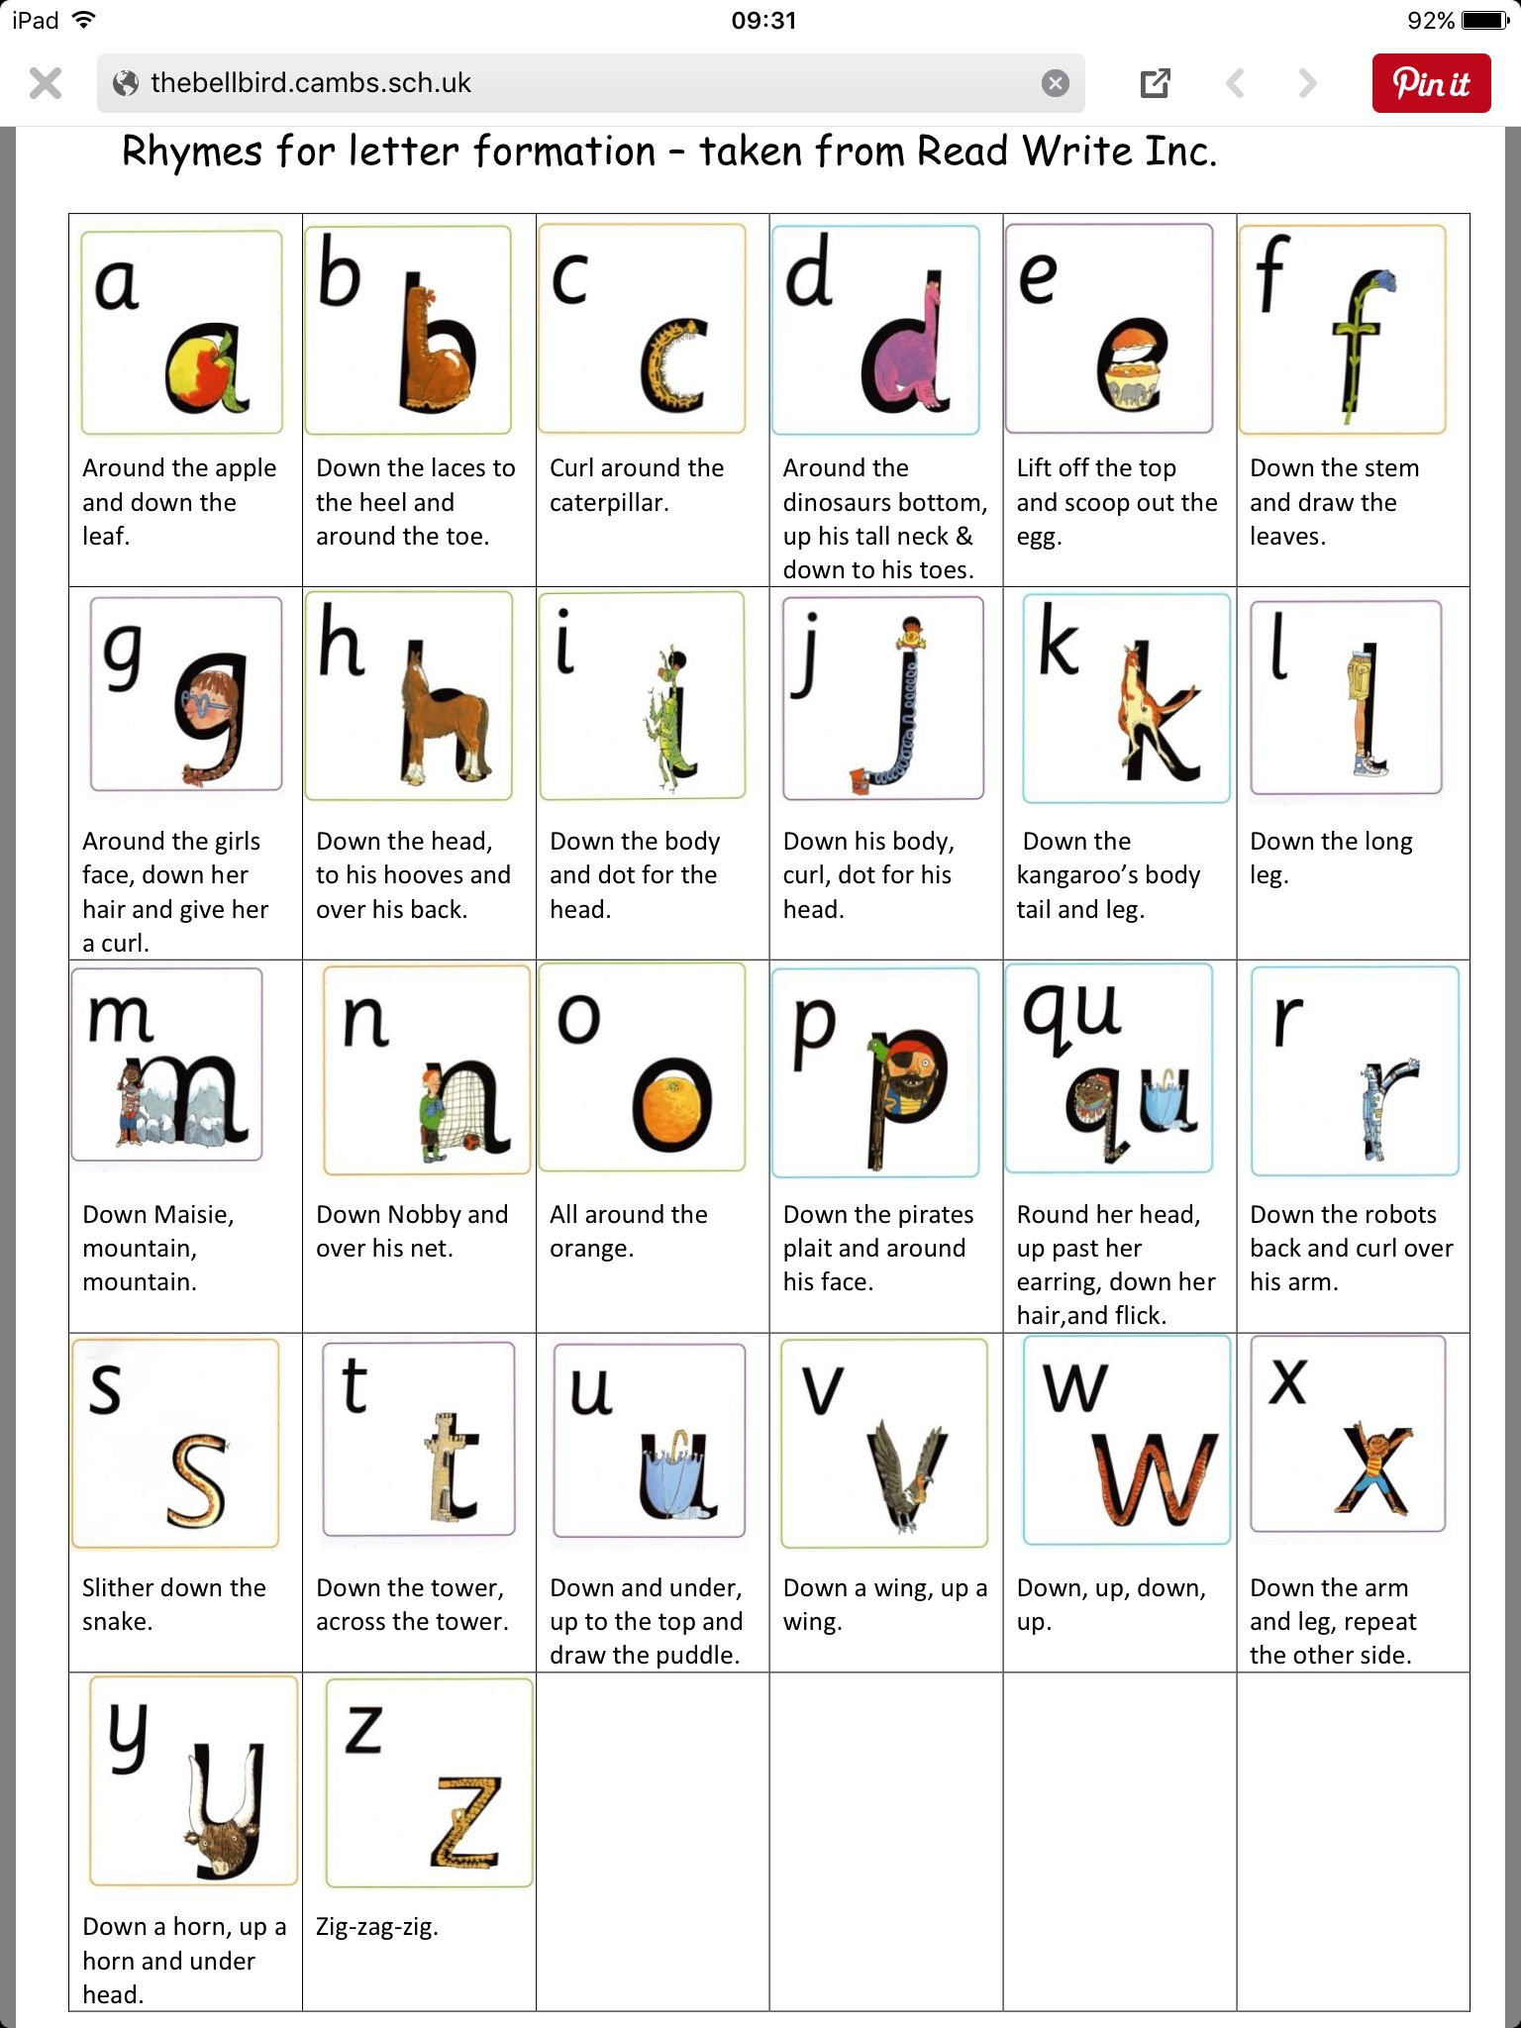

Slide 16
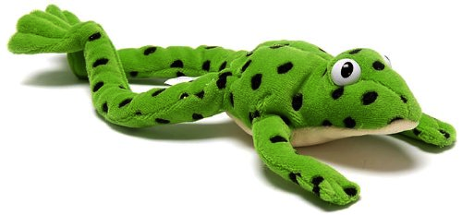
Fred...
Fred helps children learn to read
Fred can only talk in sounds...
(Fred can only say c_a_t, he can’t say cat)
We call this Fred Talk
Notes:
16

Slide 17
Fred…
If children understand Fred
they can blend orally.
Blending is needed for reading.
Notes:
Copyright Ruth Miskin Literacy
17
Use My Turn Your Turn with the parents to have a go at some Fred Talk – you Fred Talk a CVC word d_o_g, they Fred Talk it back & ask them to tell you what word Fred is trying to say.

Slide 18
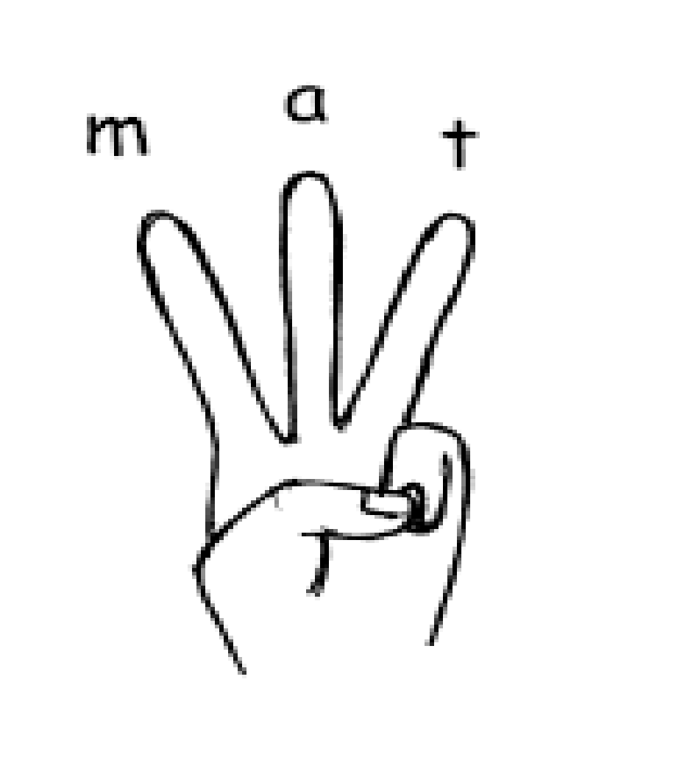
Fred...
Fred helps children learn to spell as well!
Children convert words into sounds.
They press the sounds they hear on to their fingers...
We call this Fred Fingers.
Notes:
Use My Turn Your Turn with the parents – say “show me three fingers – the word is dog.”
18

Slide 19
Green words
Green words are words we can Fred talk. (Phonetically decodable)
These are words we can segment and blend.
For example – play and coin.

Slide 20
Red Words
These were called tricky words.
Red words are words we can Fred talk.
For example ‘I’, ‘the’ and ‘said’.
You can’t Fred a red!

Slide 21
Terminology
MTYT – my turn your turn.
Turn to your partner – talk to their partner.
Fred talk – using the Fred the frog to sound out and segment the letters in the word.

Slide 22
Typical session in Nursery
Show the flashcards of the sounds learnt so far. Recognise and say the sound.
Remember the rhyme to help write. Children practise on a whiteboard.
Recognising the letters in their name.
Introduce Fred the Frog – Fred talk simple words.
Children will begin to write simple words.

Slide 23
Nursery
Nursery children will learn a new letter sound a week. They will focus on the sound at the beginning of words.
They will be able to recognise, say and write the letter sound using the flashcards.
There will be a rhyme to help your child to form the letter correctly.
When ready they will move on to Fred talk to read simple words.
Notes:
23

Slide 24
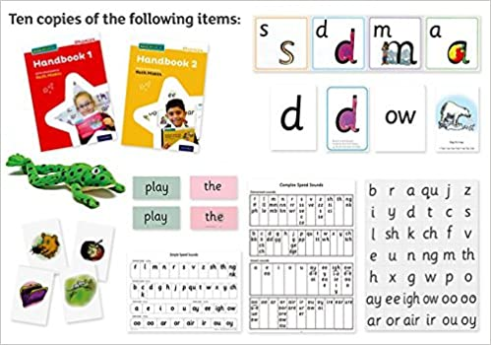

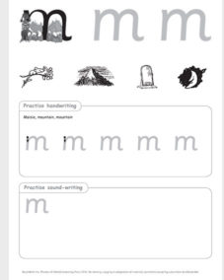
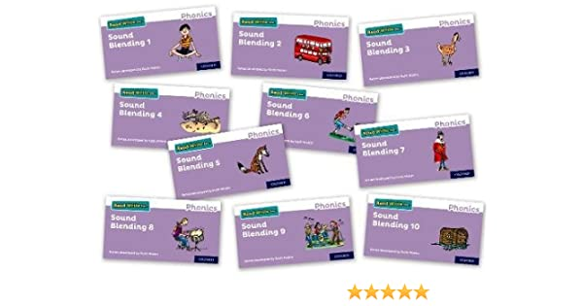
RWI Resources we use in school

Slide 25
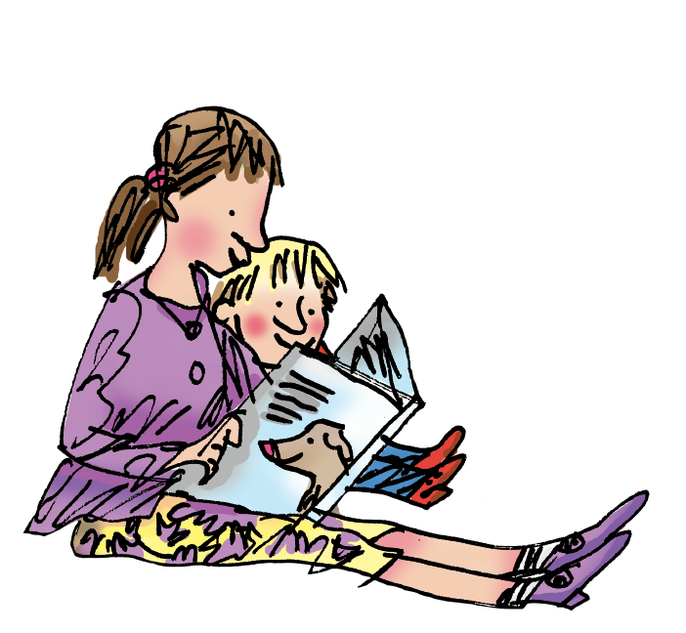
How to help your child at home…

Slide 26
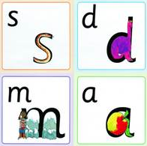
You can practice pronouncing sounds.
Remember no ‘fuh’ and ‘luh’!
Notes:
26

Slide 27

Reading books home
Books will be sent home to be shared with your child.
These are called ‘Book Bag Books’. They will match the sounds your child would be learning in the classroom.

Slide 28
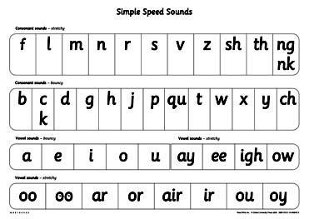
So how can you help your child?
By knowing the 44 sounds
By knowing how to blend using Fred Talk for reading m_a_t
By using sounds for the letters of your child’s name- no uppercase letters!
Notes:
28

Slide 29
And...
By having fun with Fred Talk at home!
“Where’s your c-oa-t?”
“Time for b-e-d!”
Notes:
29

Slide 30
And...
By reading to your child lots of lovely stories and asking lots of questions!
Use these prompts to help you:
What is that character thinking?
What is happening?
What do you think
happens next?
What is the character saying?
What do you
think that character is
feeling now?
Notes:
30

Slide 31
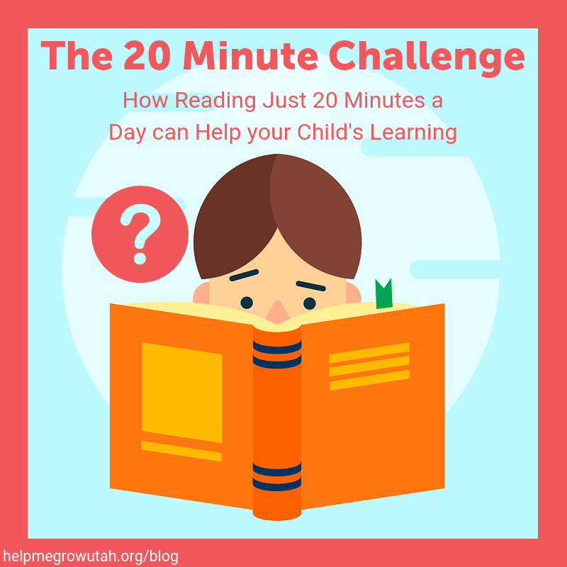

Reading with your child at home.
https://schools.ruthmiskin.com/training/view/0SvcYiIT/BBNcQKj6 (link will work until 5th July 2022)

Slide 32
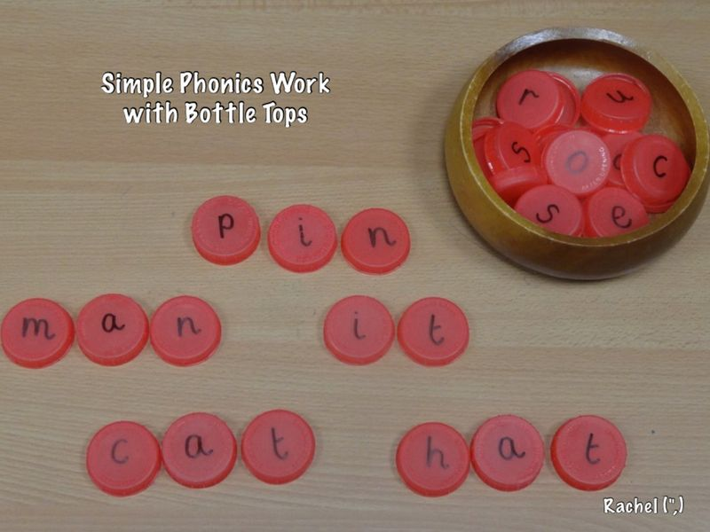
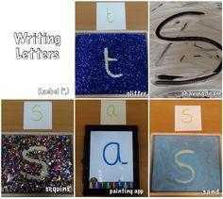
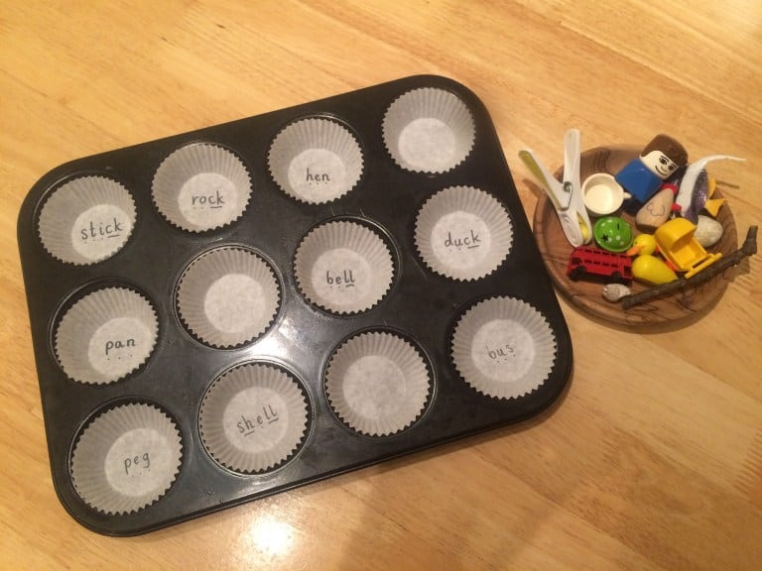
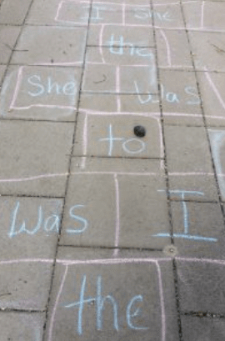
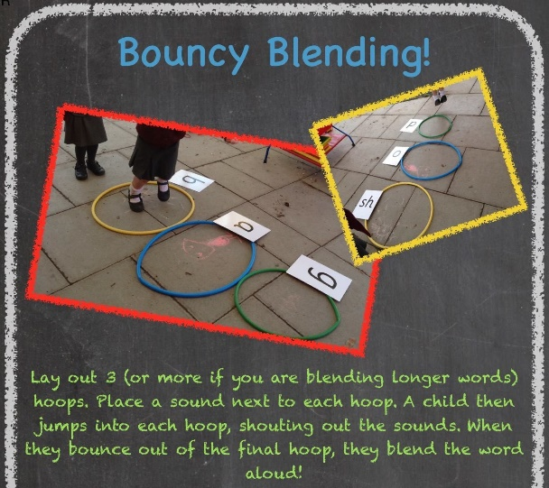
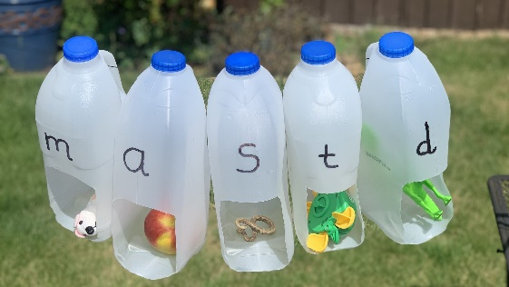
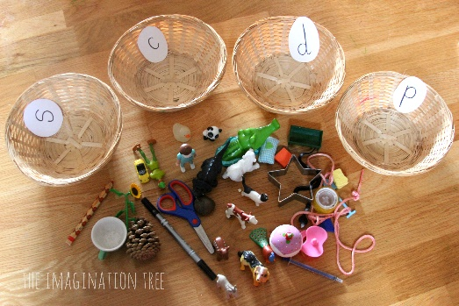
Practical activities

Slide 33
Play with sounds
I Spy
As you are walking down the road play I spy using sounds e.g. I spy with my little eye something beginning with b.
Find Them All
Find everything beginning with ....
Give your child a sound and find as many objects as they can.

Slide 34
Snap/Matching pairs
Write a few sounds/phonemes on cards. Play snap with your child as you put the card down, ask them to say the sound out loud. If they match then the first person to say ‘Snap’ gets all the cards. Who can collect all the cards?
Write a few of the sounds on cards at least twice. Turn over 2 at a time. Read both sounds and if they match, then you keep them and if not turn them over.

Slide 35
And...
By enriching conversations through description:
“Look at that rain. It looks like little diamonds sparkling on the window pane!”
By praising your child for using new words or interesting images
By having a look at the parents’ pages on the web for tips and resources for supporting your child at home:
www.ruthmiskinliteracy.com
Notes:
35

Slide 36
Speaking and Listening
At this stage, they need to listen, understand more and share their ideas within the classroom.
Opportunities for Speaking & Listening at home:
Have a chat during meal times.
Play a game together.
Talk about the things you see and do when you are out and about.
‘If they can’t say it, they can’t write it’.
We need to encourage the development of language and listening skills in order to develop children's writing ability.
It is not something they can do on their own.
Encourage your child to talk and interact with you at every possibility.

Slide 37

Any questions?

Slide 38

Thank you...
Happy reading!

