Slide 1
Year 3, 4, 5 & 6 Maths Workshop
Miss Oakes
Maths Lead

Slide 2
Maths at St. Michael & St. Martin
Here at school, we truly value how developing a good grounding and strength in numeracy will help support your children as they progress throughout their education and into their adult lives.
Every year group undertakes a minimum of 5 hours of numeracy learning each week, which covers a wide range of topics including: basic number & understanding, shapes, space & measure and more developed, applied mathematics.
We challenge and encourage our children to partake in mental math tasks and teach them various methods to make calculations in their heads.
We aim to help each child by breaking down any fears they may have around numeracy through encouragement and support, and a firm belief that all our children can learn to love maths like we do!
Parent Information on our website: https://www.stmichaelandstmartin.co.uk/maths-1/

Slide 3
Maths National Curriculum
The national curriculum for mathematics aims to ensure that all pupils:
•become fluent in the fundamentals of mathematics, including through varied and frequent practice with increasingly complex problems over time, so that pupils develop conceptual understanding and the ability to recall and apply knowledge rapidly and accurately.
•reason mathematically by following a line of enquiry, conjecturing relationships and generalisations, and developing an argument, justification or proof using mathematical language
•can solve problems by applying their mathematics to a variety of routine and non-routine problems with increasing sophistication, including breaking down problems into a series of simpler steps and persevering in seeking solutions.

Slide 4
OfSted and Maths
Her Majesty’s Chief Inspector, Amanda Spielman, said:
•Our education inspection framework is clear that schools should ensure the maths curriculum is designed to help pupils to gain increasing mathematical proficiency and build confidence in their ability.
It said high-quality maths education would ensure new content draws on and links to content that pupils have previously acquired.

Slide 5
White Rose Maths
•Concrete-pictorial-abstract (CPA) approach to support children to understand the maths they are learning and to be able to use it elsewhere.
•“Small step” approach means nothing is left to chance – all curriculum objectives are broken down into accessible parts that build on each other so the learning journey is complete.
•Schemes start with blocks on Place Value, followed by the essential calculation skills children need to succeed in maths. This firm grounding in number gives children confidence and helps them to access the rest of the maths curriculum.
•They have continuously reviewed their schemes in the light of previous events and released an updated version for September 2023.

Slide 6
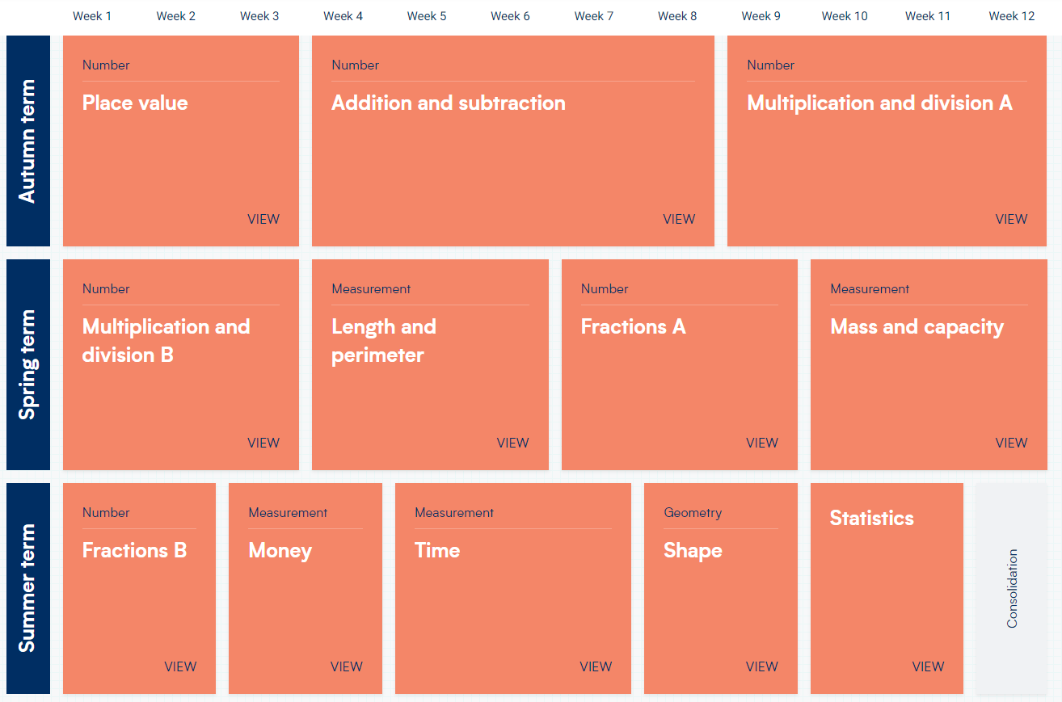
How does it show progression?
Year 3

Slide 7
How does it show progression?
Year 4

Slide 8
How does it show progression?
Year 5

Slide 9
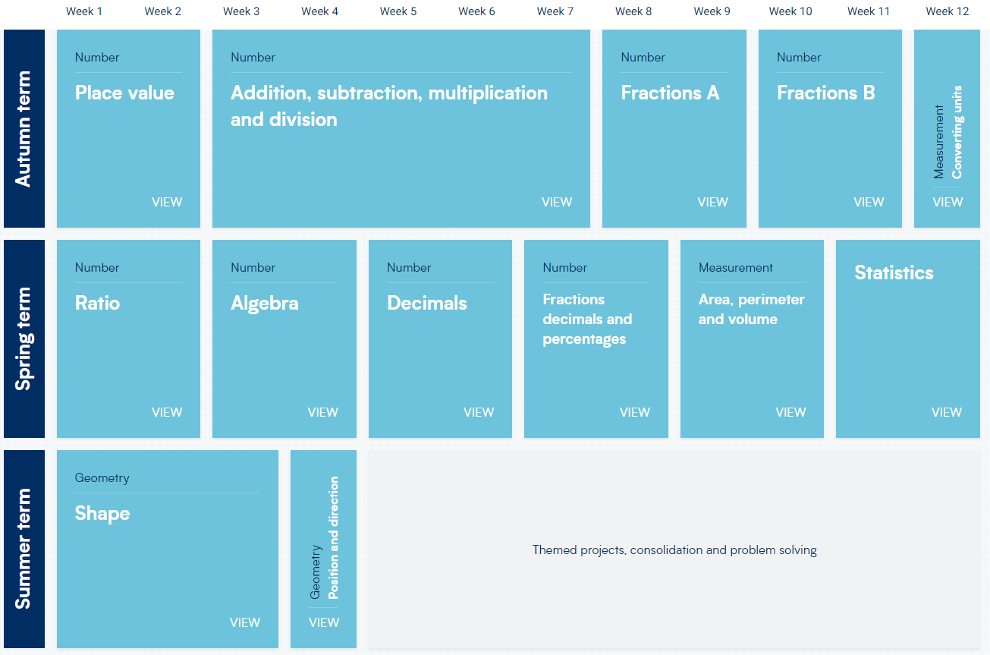
How does it show progression?
Year 6

Slide 10
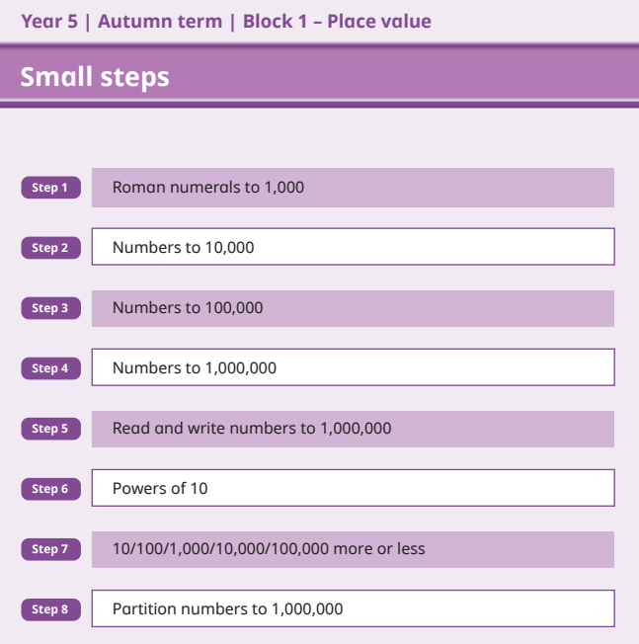
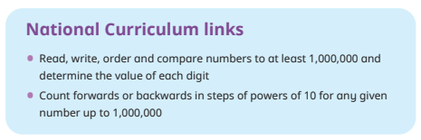
How does it show progression?
Small Steps

Slide 11
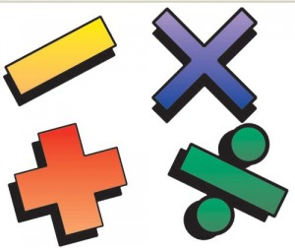
Why do we need a calculation policy?
To provide an understanding of when and how the four operations –addition, subtraction, multiplication and division, are taught.
To make teachers and parents aware of the continuity and progression in skill development across the year groups.
Equip our children with a bank of strategies to tackle different types of mathematical problems.
Calculation Policy: https://primarysite-prod-sorted.s3.amazonaws.com/st-michael-st-martin-catholic-primary-school/UploadedDocument/6332359c-396c-4f45-80b7-31abd155cea4/st-mm-calculation-policy.pdf

Slide 12
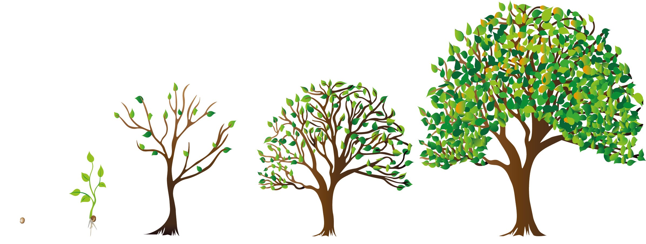
How does it show progression?
How does it show progression?
Children will progress through the stages and methods in each of the four areas.
All children will be given the opportunity to learn different methods for each operation.
Some children may need to recap or go back a stage to consolidate their understanding of concepts.

Slide 13
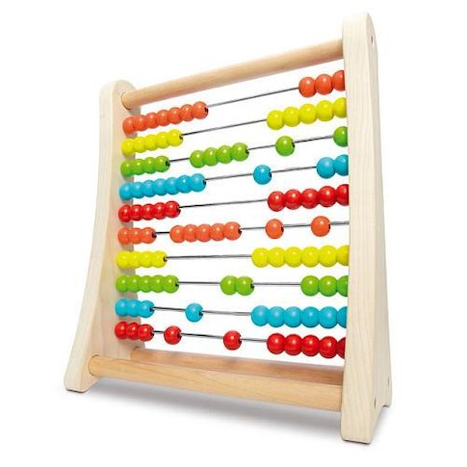
Addition [+]
Addition is the process of calculating the total of two or more numbers or amounts.
It is the inverse of subtraction.

Slide 14
Addition [+]
Nursery 1+1 = | Reception 6+ 4 = | Year 1 9 + 6 = | Year 2 23+ 35 =
Year 3 123 + 94 = | Year 4 1226 + 192 = | Year 5 2,999 + 497 = | Year 6 3,350 + 4,652 =

Slide 15
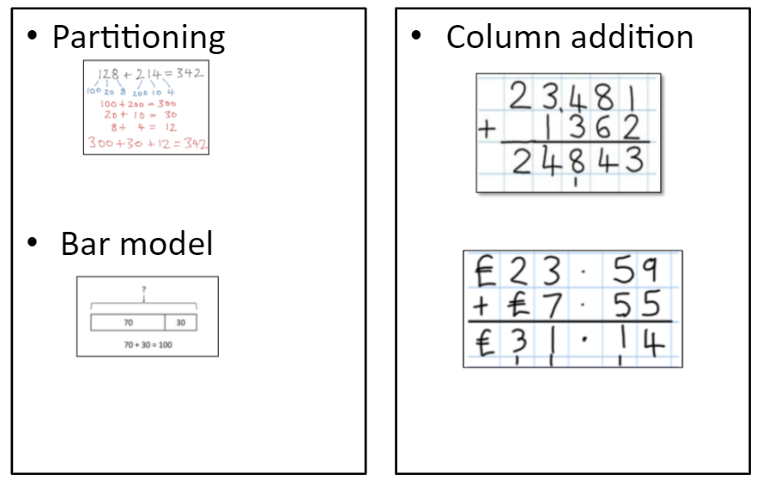
Methods for Addition [+]

Slide 16
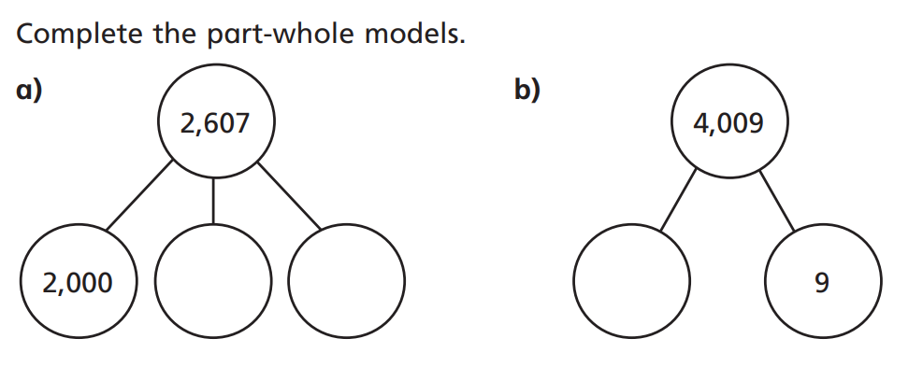
Partitioning
128 + 214 =
Bar Model

Slide 17
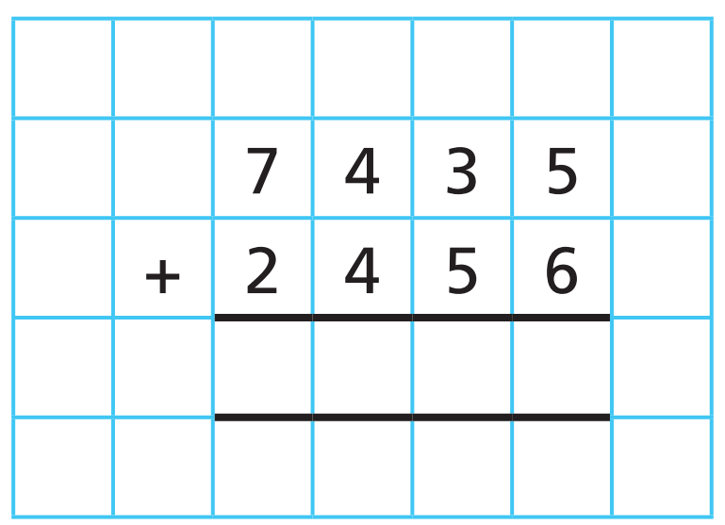

Slide 18
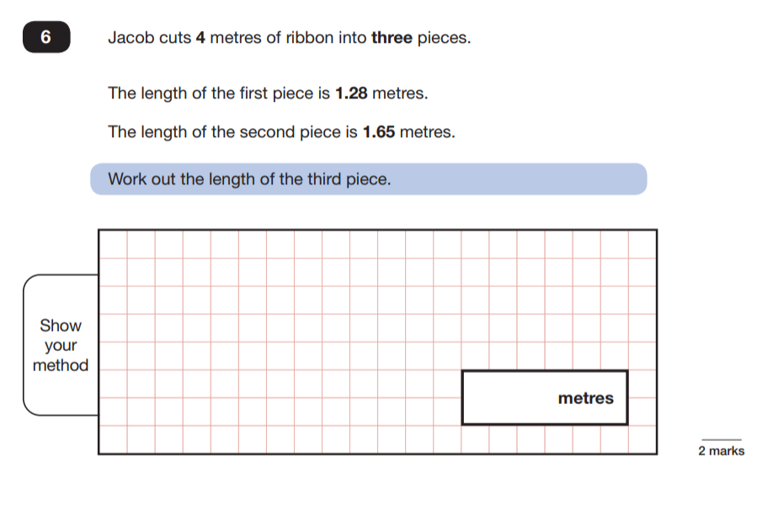
Reasoning & Problem Solving

Slide 19
Subtraction[-]
Subtraction is the process or skill of taking one number or amount away from another or finding the difference between two numbers.

Slide 20
Subtraction[-]
Nursery 2 - 1 = | Reception 6- 4 = | Year 1 11 - 6 = | Year 2 35 + 23 =
Year 3 123 - 94 = | Year 4 1226 - 192 = | Year 5 2,999 - 1497 = | Year 6 4,350 - 2,652 =

Slide 21
Methods for Subtraction [-]

Slide 22
Bar Model

Slide 23
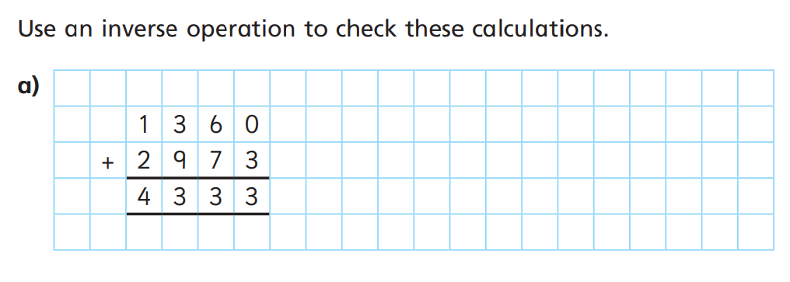
Column Subtraction

Slide 24
Multiplication[x]
Multiplication is the product of two numbers or repeatedly adding the same set of number as many times as the other number.
It is an inverse operation of division.

Slide 25
Multiplication[x]
Nursery (doubling) 1 + 1 = | Reception (doubling) 5+5 = | Year 1 4 x 2 = | Year 2 12 x 3 =
Year 3 36 x 4 = | Year 4 126 x 6= | Year 5 1234 x 13 = | Year 6 2345 x 24=

Slide 26
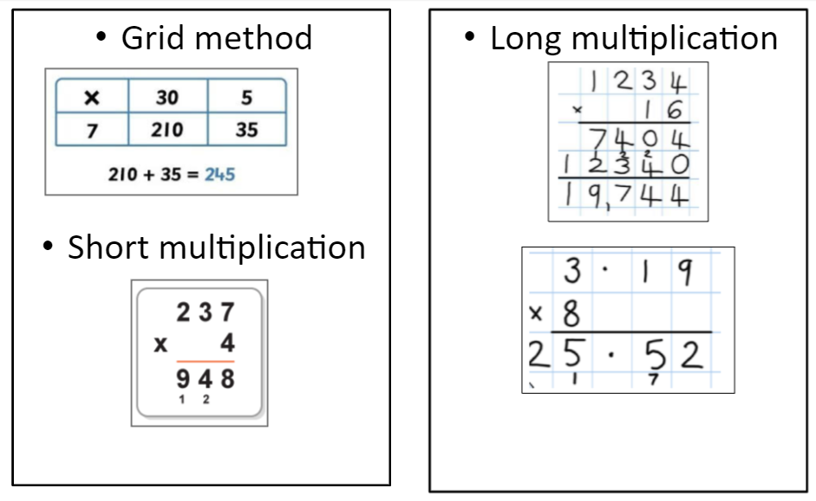
Methods for Multiplication[x]

Slide 27
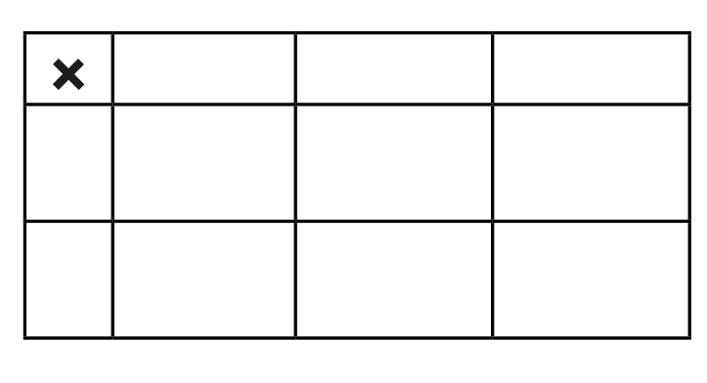
Grid Method: 234 x 25 =

Slide 28
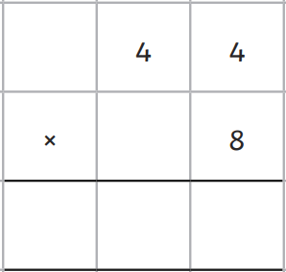
Short Multiplication
Long Multiplication

Slide 29
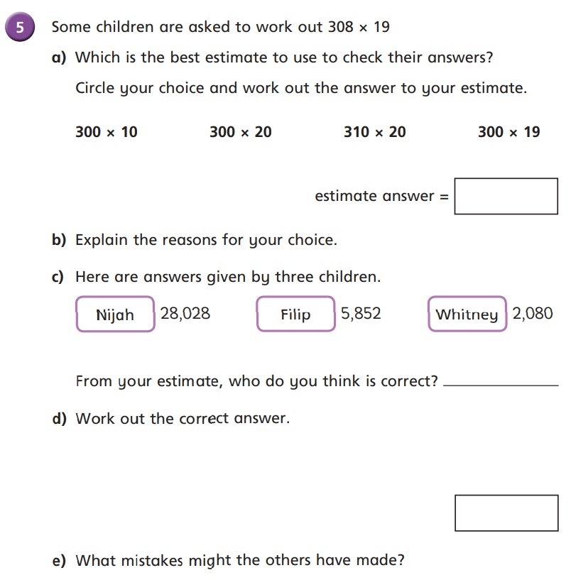
Problem Solving & Reasoning

Slide 30
Division
Dividing is a quick way of subtracting several lots of the same number or quantity, or splitting it up into equal groups.

Slide 31
Division
Nursery 2 ÷ 1 = | Reception 6 ÷ 3 = | Year 1 10 ÷ 2 = | Year 2 24 ÷ 4 =
Year 3 36 ÷ 9 = | Year 4 125 ÷ 5 = | Year 5 726 ÷ 7 = | Year 6 7548 ÷ 9 =

Slide 32
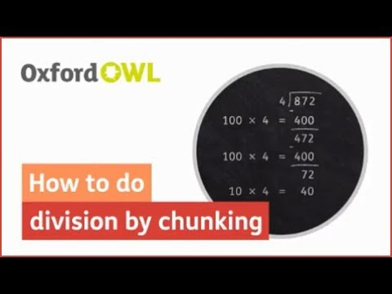
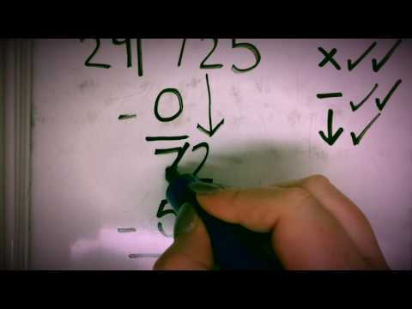
Methods for Division

Slide 33
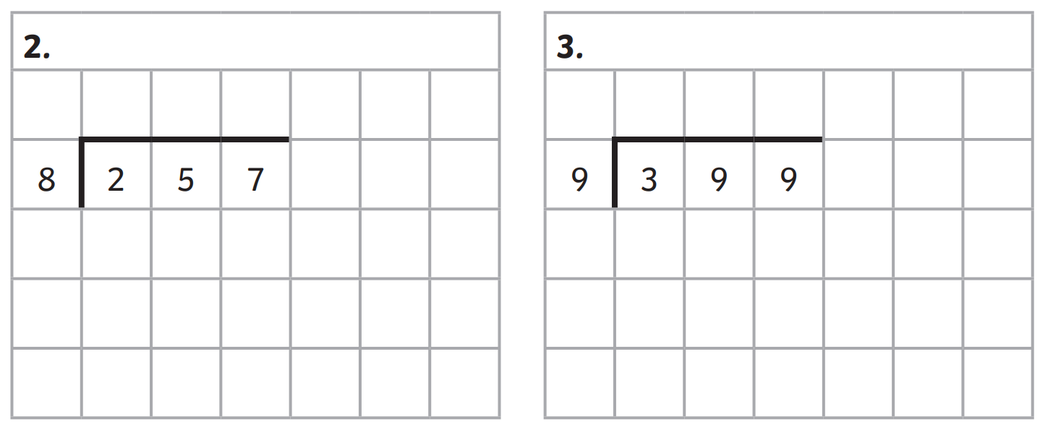

Slide 34
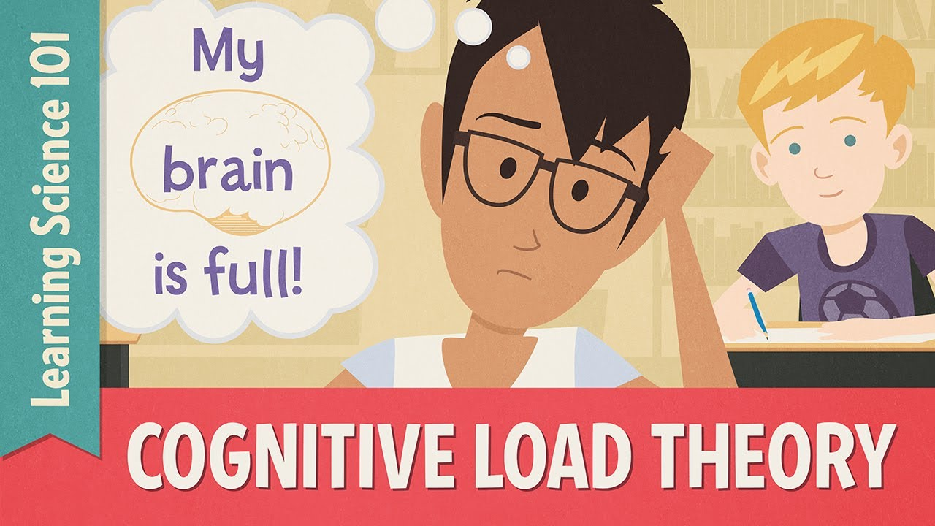
Cognitive Overload
Cognitive load is the term used in cognitive science to describe how much working memory capacity a topic takes up. Cognitive overload is what happens if too many demands are placed on working memory at once.

Slide 35
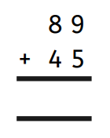
Cognitive Overload in Maths
Look at children learning to use the vertical addition algorithm with the following example:
A child who has their number bonds stored in their long-term memory and knows that 9 + 5 = 14 can import that fact into their working memory without conscious effort.
None of that precious, finite capacity of working memory has to be wasted working out 9+5.
Whereas, a child who does not know the answer automatically has to divert processing resources away from thinking about columns, value and regrouping, thinking instead about what 9+5 adds up to.
Their overloaded working memory can’t cope with this additional demand on top of everything else it is already thinking about, so it ‘forgets’ one of the important steps in the procedure. The child therefore gets the answer wrong.
Or even if the child doesn’t get the answer wrong, they do not learn how to use the vertical algorithm as a useful method they can generalise and transfer to other similar problems.
The value of children practising their number bonds and times tables every evening cannot be undermined - it is one of the main reasons children can end up struggling with mathematical concepts in UKS2.

Slide 36
Year 4 Times
table Test
The purpose of the MTC is quite simply to check whether pupils know their tables well before their Year 6 SATs performance.
The Multiplication Tables Check is to be taken towards the end of Year 4 to make sure children are meeting the benchmark of memorising their times tables up to 12 x 12 before moving up to Upper Key Stage 2 (Year 5 and Year 6).
Having a secure grasp of the basics of maths, including the fluent recall of times tables, is crucial for children’s success in moving on to more complex maths.
The multiplication tables check is an important part of the government’s plan to ensure that every child has the knowledge and skills they need to succeed at secondary school, supporting numeracy in primary schools in the same way that the phonics screening check supports literacy.

Slide 37
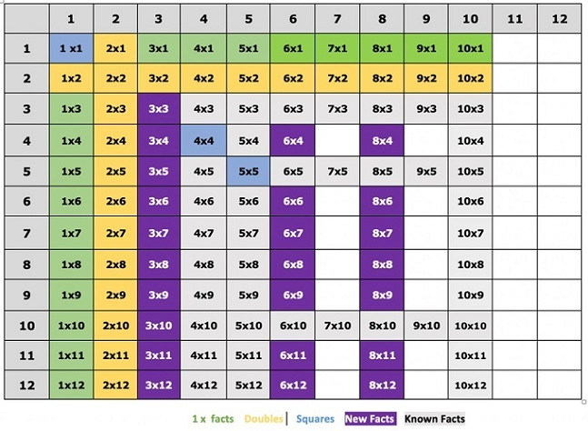
Year 3 Number Facts
Addition and subtraction of multiples of 10 where the answer is between 0 and 100 (e.g. 70 + 30 = 100, 20 + 40 = 60)
Double and halves of multiples of 10 to 100 (e.g. double 60 = 120)
Multiplying two-digit number by 10. (e.g. 24 x 10 = 240)

Slide 38
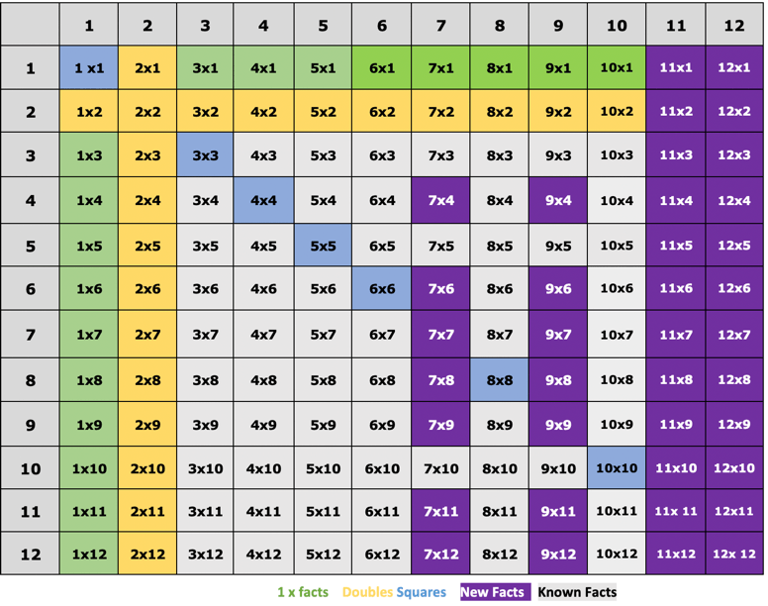
Year 4 Number Facts
Addition and subtraction of multiples of 10 (e.g. 70 + 30 = 100, 50 + 60 = 110, 20 + 40 = 60);
Addition and subtraction of multiples of 100 where the answer is 1,000 or less (e.g. 300 + 400 = 700, 400 + 600 = 1,000);
Double and halves of multiples of 10 to 100 (e.g. double 60 = 120, half 50 = 25);
Multiplying two-digit numbers by 10 (e.g. 24 x 10 = 240);
Halves of any even number to 100 (e.g. half of 22 = 11);
And multiplying any two and three-digit number by 10 and 100 (e.g. 24 x 100 = 2,400)

Slide 39
Year 5 Number Facts
Addition and subtraction of multiples of 10 (e.g. 70 + 30 = 100, 50 + 60 = 110, 20 + 40 = 60);
Addition and subtraction of multiples of 100 (e.g. 300 + 400 = 700, 400 + 600 = 1,000, 800 + 500 = 1,300);
Addition and subtraction of multiples of 1000 (e.g. 3000 + 4000 = 7000);
Double and halves of multiples of 10 to 100 (e.g. double 60 = 120, half 50 = 25);
Quadruples (x4) of all numbers to 10 (e.g. 6 x 4 = 24);
Multiplying two-digit number by 10. (e.g. 24 x 10 = 240);
Halves of any number to 100 (e.g. half of 22 = 11, half of 51 = 25.5);
Multiplying and dividing any number by 10 and 100 (e.g. 24 x 100 = 2,400, 45 ÷ 100 = 0.45, 3.4 x 10 = 34);
Squares of all number up to 12;
And cubes of 2,3,4 and 5.

Slide 40
Year 6 Number Facts
Addition and subtraction of multiples of 10 (e.g. 70 + 30= 100, 50 + 60 = 110, 20 + 40 = 60);
Addition and subtraction of multiples of 100 (e.g. 300 + 400 = 700, 400 + 600 = 1,000, 800 + 500 = 1,300);
Addition and subtraction of multiples of 1000 (e.g. 3000 + 4000 = 7000);
Double and halves of multiples of 10 to 100 (e.g. double 60 = 120, half 50 = 25);
Quadruples (x4) of all numbers to 10 (e.g. 6 x 4 = 24);
Multiplying two-digit number by 10 (e.g. 24 x 10 = 240);
Halves of any number up to 100 (e.g. half of 22 = 11, half of 51 = 25.5);
Multiplying and dividing any number by 10 and 100 (e.g. 24 x 100 = 2,400, 45 ÷ 100 = 0.45, 3.4 x 10 = 34);
Multiplication of multiples of 10 and 100 based on known facts (e.g. 40 x 40 = 1,600);
Squares of all number up to 12;
And cubes of 2,3,4 and 5.

Slide 41
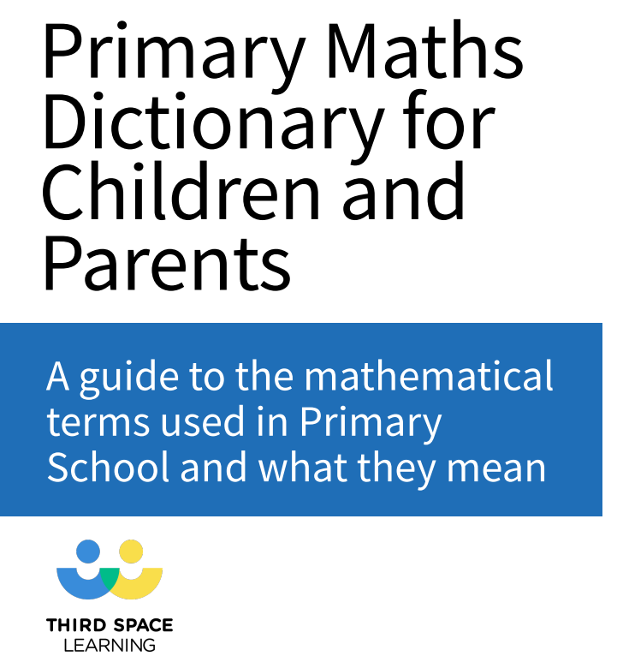
Vocabulary
https://drive.google.com/file/d/1Z7sYTK-UX7b0l2HzvCTn2_uBDrTJ5Acz/view?usp=sharing

Slide 42
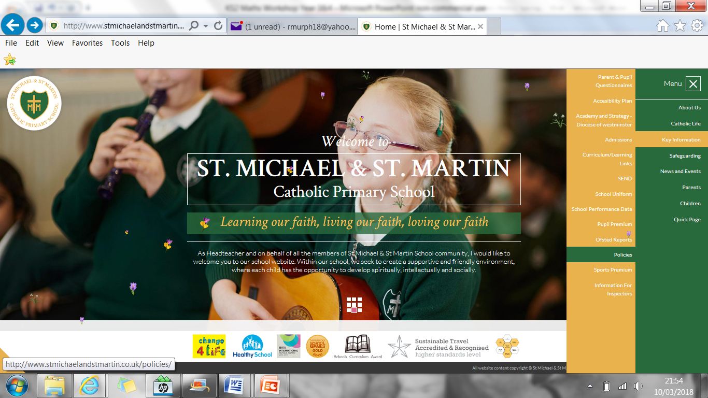
Reasoning Workshop

