Slide 1
The rationale behind Penpals for Handwriting

Slide 2
What is Penpals?
Penpals is a complete handwriting scheme for 3- to 11-year olds.
Using Penpals ensures a coherent whole-school approach to driving up handwriting standards.
The scheme is made up of Teacher’s Books, Pupil Practice Books, write-in Workbooks and Interactive resources.

Slide 3
Why we have chosen Penpals
A fluent, legible style
Progression from 3-11 yrs
5 clear developmental stages
Sensible links for application
Interactive and multisensory
Easy to use
Delivers results

Slide 4
Rationale
A flexible, fluent and legible handwriting style empowers children to write with confidence and creativity.
Handwriting should be skilfully taught with a careful progression.
Handwriting should be practised both discretely and in the context of other learning.
Associating handwriting movement with visual letter patterns and aural phonemes will help children learn to spell.
It is important that all staff follow the scheme for consistency.

Slide 5
Five developmental stages
Penpals leads children through five distinct stages:
Physical preparation for handwriting (Foundation / 3–5 years)
Securing correct letter formation (Key Stage 1/5–6 years)
Beginning to join (Key Stage 1/6–7 years)
Securing the joins (Lower Key Stage 2/7–9 years)
Speed, fluency and developing a personal style (Upper Key Stage 2, 9–11 years)

Slide 6
A practical approach
Time: A focus on whole-class teaching, with key teaching points clearly identified, allows effective teaching in the time available.
Planning: Help with long-, medium- and short-term planning.
Practice: Practice Books for independent writing.
Assessment: Self-assessment throughout, as well as specific assessment units.
Motivation: Written with the support of handwriting experts to stimulate and motivate children.
Penpals Interactive: Digital content enriches and extends children’s handwriting experiences.

Slide 7
Structure
The start of each Teacher’s Book includes a full scope and sequence so you can see how the children will progress throughout the scheme. Penpals is unashamedly handwriting focused but can be used alongside your phonics scheme.

Slide 8
The components
Foundation 1 (ages 3-5)
to
Year 6 (ages 10-11)

Slide 9
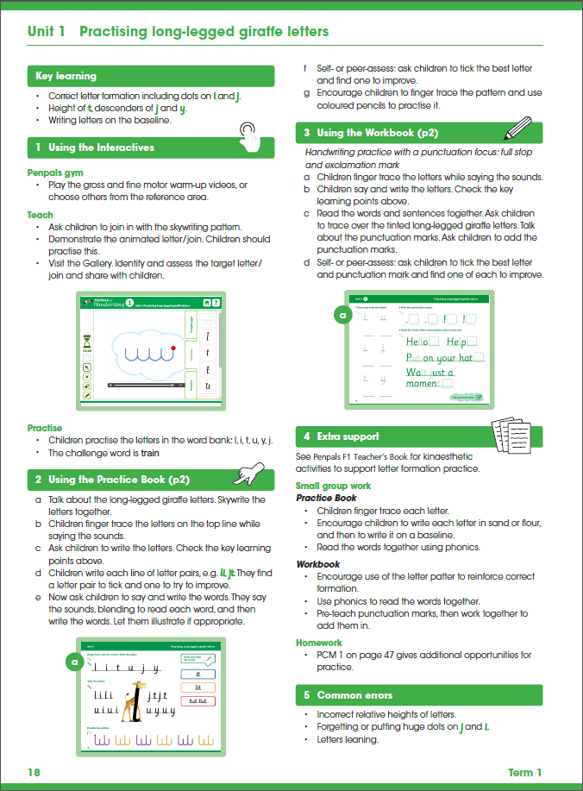
Teacher’s Books for F1 to Y6
Whole-class teaching support linked to Penpals Interactive.
Links to the use of the corresponding Practice Books and Workbooks.
Suggestions for independent and group work.
Activities and take-away suggestions for additional practice.

Slide 10
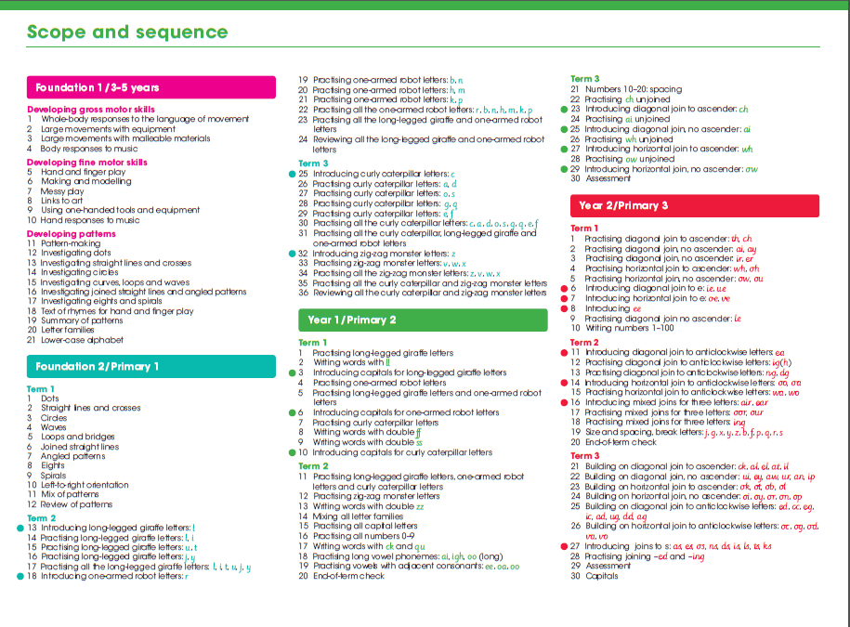
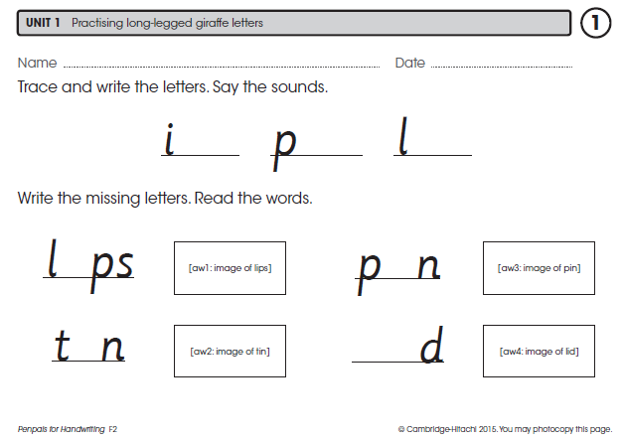
Teacher’s Books for F1 to Y6
A full scope and sequence for the whole scheme showing progression of skills.
A beginning-of-year assessment to help you track pupil progress.
Photocopy masters for extra handwriting practice.

Slide 11
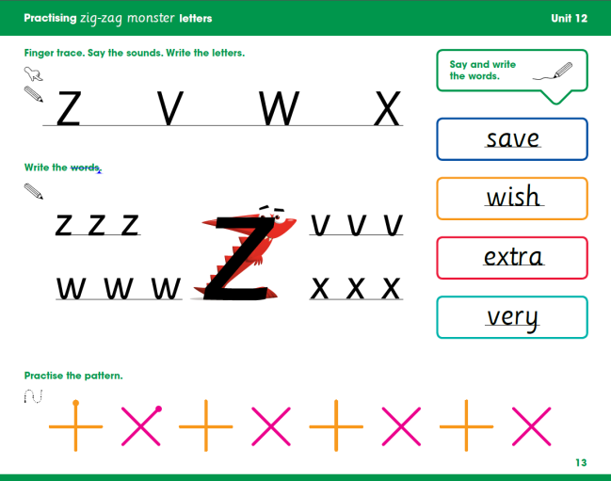
Practice Books for Y1 to Y6
Practice Books for independent writing following a whole-class teaching session.
Finger tracing, writing letters and phrases.
Pattern practice.

Slide 12
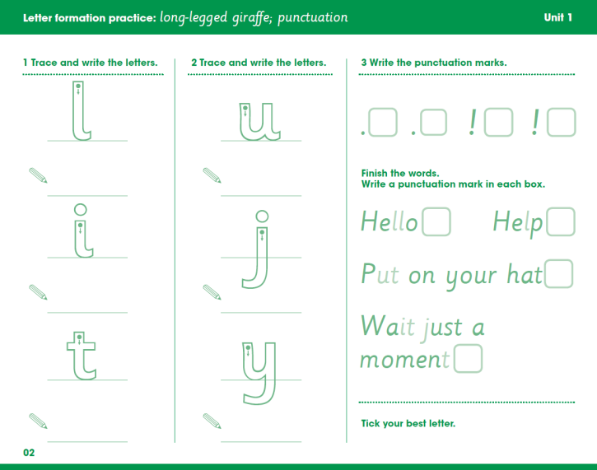
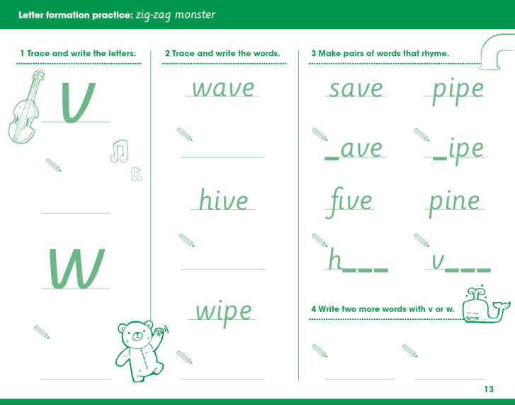
Workbooks for F2 to Y6
Additional handwriting practice in the context of GPS (Grammar, Punctuation and Spelling).
Opportunity for children to trace and write standalone letters and then letters in context.

Slide 13
Interactive DVD-ROMs
Interactive DVD-ROMs for whole-class teaching on the interactive whiteboard.

Slide 14
Penpals Gym
Penpals Gym provides age-appropriate film warm up exercises throughout the programme. This ensures pupil engagement – and makes it fun!

Slide 15
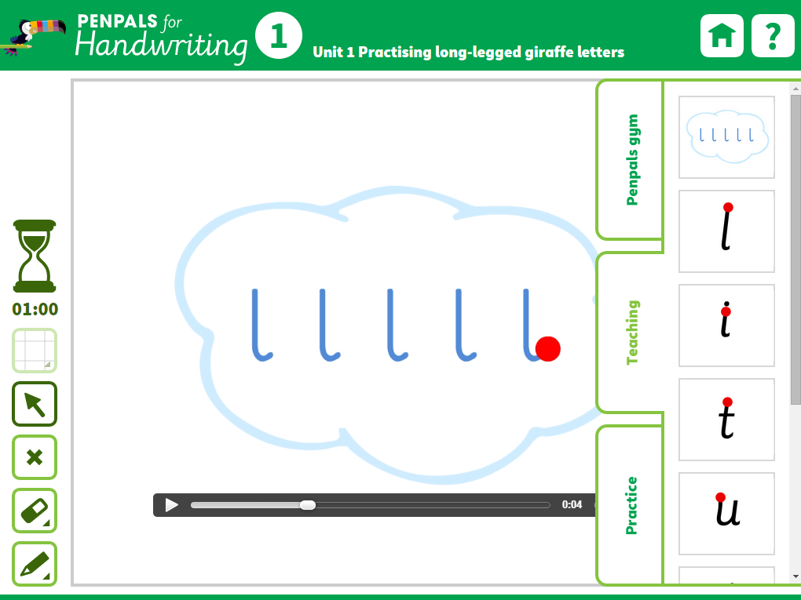
Teaching
Teaching tab gives you:
animated skywriting patterns to follow
letter formation and joins for perfect modelling
gallery of other children’s work to discuss

Slide 16
Teaching
Every letter and join is animated for clarity.

Slide 17
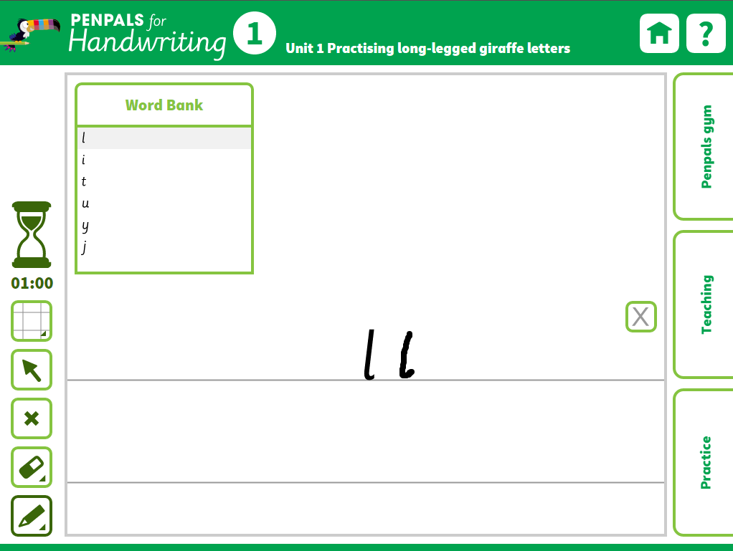
Practice
The Practice tab gives you:
Word Banks to trace and copy on screen.

Slide 18
A note on Foundation 1
Teacher’s Book and Interactive cover essential pre-skills to precede any handwriting scheme
Mark-making and Creativity
‘Talkabouts’ for Circle Time
Play-based learning
Supports children working within Phases 1 and 2 of Letters and Sounds
Penpals Foundation 1 should continue to be used throughout the Foundation Stage as children will continue to benefit from the activities even after they have begun working with the Penpals Foundation 2 resources.

Slide 19
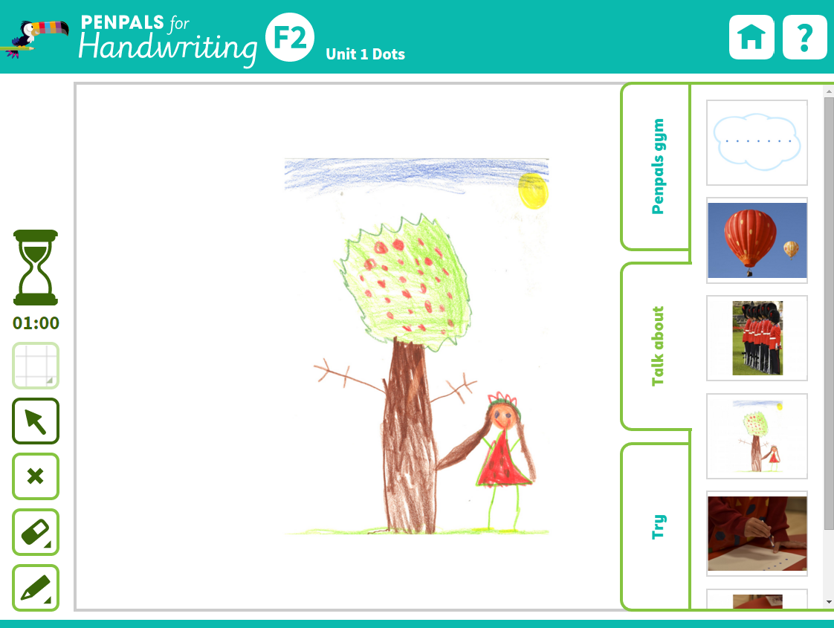
The Talk about tab gives you:
Images of shapes and patterns found in the environment.
Samples of children’s patterns and drawings to discuss.

Slide 20
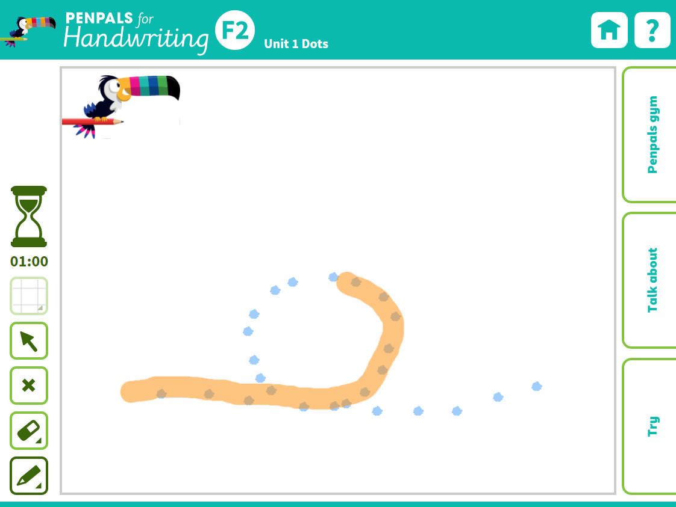
The Try tab gives you:
Fun, on-screen activities to encourage children to make marks on screen.
F1 fun ‘Try Its’ for the whiteboard

Slide 21
Classroom organisation and timing

Slide 22
Classroom organisation
Arrange tables so that all children can see the interactive whiteboard
Each child needs:
dry-wipe board (preferably with guidelines) and a marker pen, or
pencil and paper
Handwriting is usually done on a horizontal or slightly sloped surface

Slide 23
Timing
‘Little and often’ is the most effective approach
The whole-class session for each unit (including warm-up): 15 minutes
The independent session:15–20 minutes.
Extra daily ‘practice times’ of 5–10 minutes are ideal. Use these to:
practise the high-frequency words
extend their pattern practice
revisit the letter pattern shown in the Practice Book

Slide 24
Home-school links

Slide 25
Home-school links
A take-home information sheet is provided for parents on the Penpals web pages.
Penpals at Home series supports the main Penpals scheme at Foundation stage.
Write-in/wipe-clean pages for extra practice.
Free iOS/Android app demonstrates the letters.

Slide 26
Differentiation

Slide 27
Differentiation
Children working individually with a Teaching Assistant may benefit from additional practice on dry-wipe boards.
Some children may benefit from revisiting materials from the previous year to revise teaching of joins
Home practice activities provide additional opportunities for differentiation. Activities in materials from earlier years may provide extra, simpler practice
Higher-achieving children can be stretched through the challenge activities provided in the write-in Workbooks and more demanding targets for control and evenness of letters.

Slide 28
Assessment and record-keeping

Slide 29
Penpals offers many opportunities for assessment, including: self-assessment questions and challenges throughout the practice books and workbooks; two or three assessment units in each year group and assessment ideas in the Teacher’s Books. The Penpals for Handwriting Intervention Programme also provides further information, activities and checklists.

Slide 30
Formative assessment
On-going assessment gives you the chance to spot any errors or inconsistencies that are likely to impede a fast, fluent hand in the future.
Formative assessment opportunities are identified in every unit using key learning points.
Encourage your children to understand what is meant and assessed by these points.

Slide 31
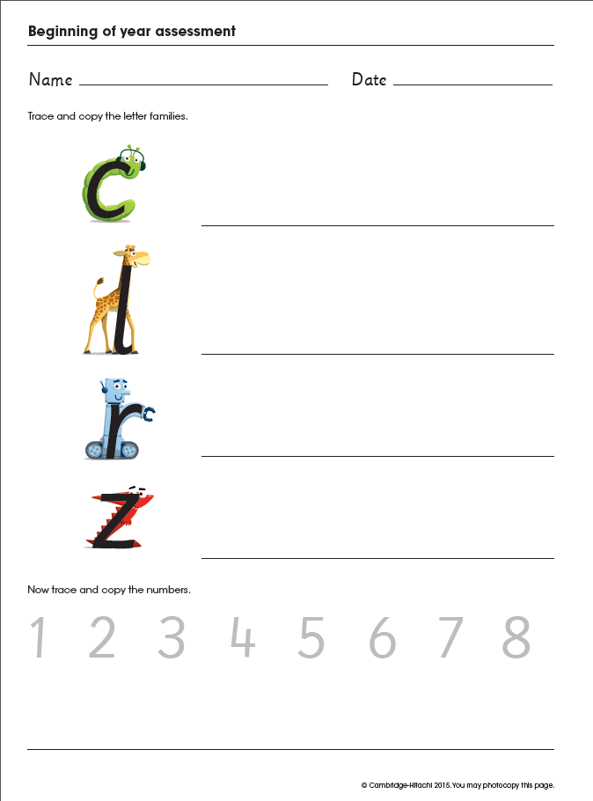
Summative assessment
Summative assessment opportunities are provided:
Beginning of year
End of term
End of year

Slide 32
Some common handwriting issues and the Penpals approach to them

Slide 33
Links to spelling
Learning to associate the kinaesthetic handwriting movement with the visual letter pattern and the aural phonemes will help children with learning to spell
A spelling/vocabulary link is identified at the start of each unit
Foundation 1 links to phases 1 and 2 of Letters and Sounds
Penpals units can be reorganised to support Jolly Phonics

Slide 34
Font
The main font used for Penpals is Sassoon Cambridge Joiner.
In Years 5 and 6, a more sloped style is introduced.
Intended as a model, but variety is natural!
The Show Alphabet section on the Interactive has animations of all letters
Also see the Teacher’s Book introduction for clarification on individual letters

Slide 35
The Show Alphabet screen

Slide 36
The two basic join types
Diagonal join (e.g. ): this is the most common join. It starts from the final flick on the baseline (or ‘curl’ in the case of the letter ).
Letters that come before a diagonal join are:
(and in which the flick begins below the baseline).

