Slide 1

Curriculum Talk
Secondary Transfer
Internet Safety
Year 6
2026-27
Miss Montenero
6M
Mrs Straczek
6S

Slide 2

Mission Statement
Learning our Faith
Living our Faith
Loving our Faith
Notes:
‹#›

Slide 3






STRIVE -School Visions and Values
Here at St Michael and St Martin, we want the children display these core values to help them be well-rounded individuals. They must strive to be:
Spiritual
Thinkers
Resilient
Independent
Valued
Empathetic

Slide 4
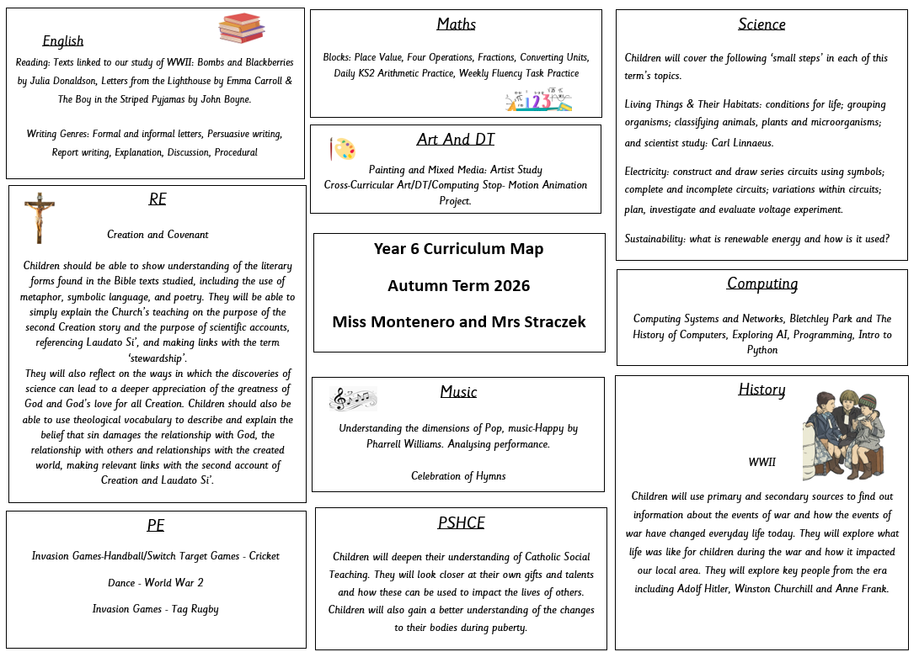
Curriculum Map

Slide 5
Expectations for Behaviour
We encourage all children to demonstrate a high standard of behaviour at all times in order to create a safe, respectful and happy learning environment.
Each class has participated in the process of making a set of ‘Golden Rules.’ The children have agreed to follow the rules as they understand that this will help their learning.
Respecting each other and all members of staff is expected and reflects the ethos of our school.
The children are required to listen carefully and to develop their self control and concentration in class and in the playground.
Working together with parents and guardians plays a big part in establishing good relationships and standards of behaviour.

Slide 6
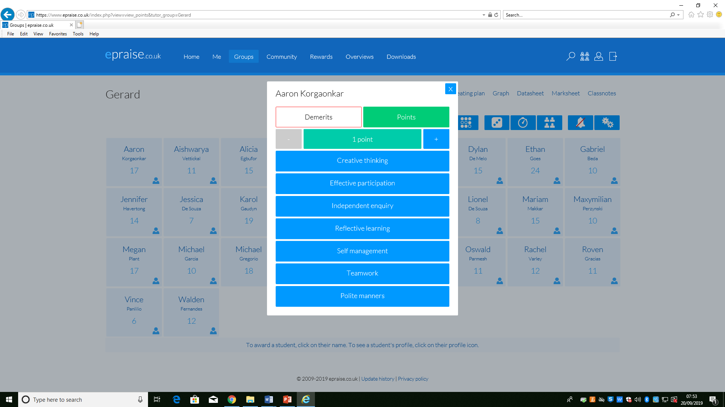
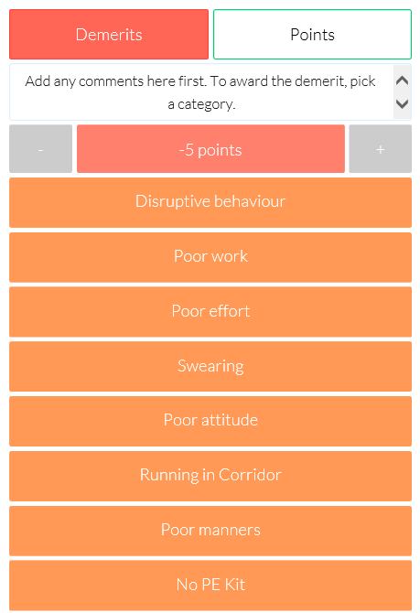
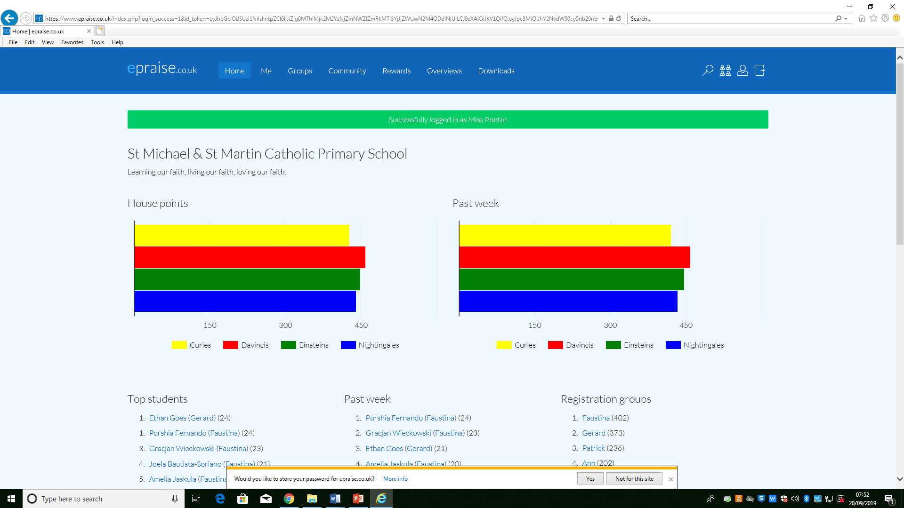
House Points- Epraise

Slide 7
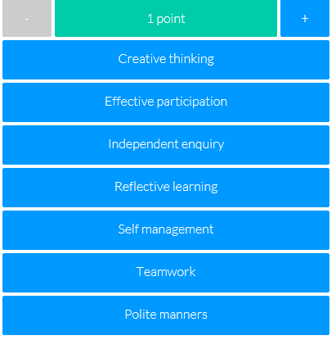
Expectations for Behaviour
Epraise
Our school is continuing to use our online school rewards system designed to motivate students to work harder, attend more and behave better.
Our house points, demerits and detentions will now be recorded electronically and when the children accumulate their house points, they can redeem them for rewards. In addition to earning house points as a team, this new system recognises the efforts of individuals – ‘silent achievers’.
House points are awarded to children
for the following contributions to their
learning and the school environment:

Slide 8
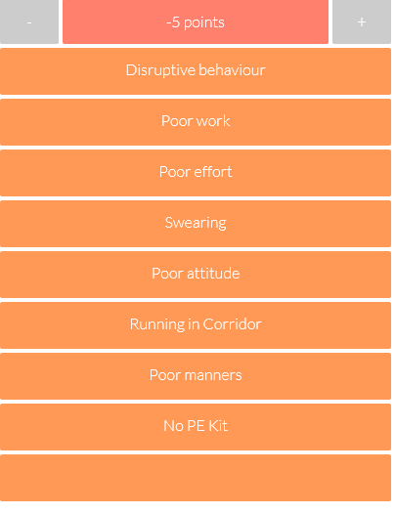
Expectations for Behaviour
Demerits are issued where a child fails to follow the school or class rules. They are also issued if a child doesn’t bring in homework when it’s due.
Three demerits equal a detention.
Detentions are recorded by the teacher & Mrs Duggan.

Slide 9
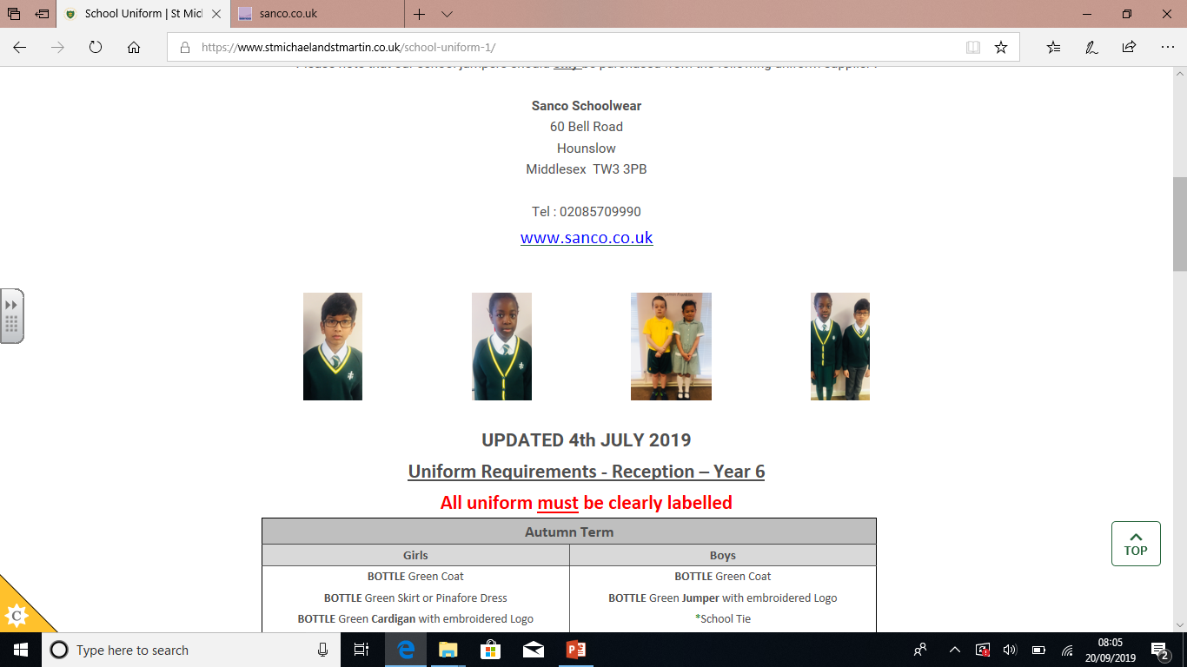
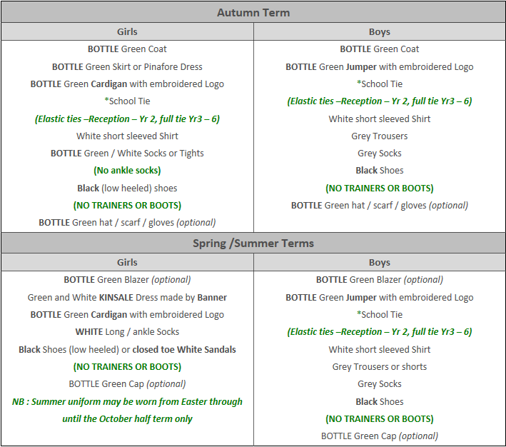
Uniforms

Slide 10
Personal Hygiene
Encouraging Healthy Hygiene Habits
Daily showers, using deodorant, and wearing clean clothes can help manage body odour.
Ensure your child understands the importance of regular washing, especially after physical activities.
Deodorants and Antiperspirants
Encourage your child to use deodorant or antiperspirant, but make sure to choose one that is age-appropriate and free of harsh chemicals.
Support and Patience
Be patient as your child adjusts to these changes. Some may feel self-conscious, so it’s important to create a positive, supportive environment around hygiene.
Open Communication
Gently remind your child of the importance of personal hygiene and let them know that everyone goes through these changes

Slide 11
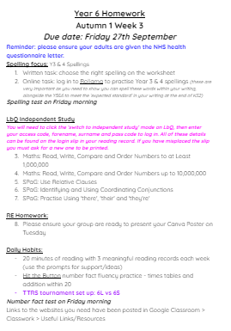
Homework
In Y6, one of our main goals is to ensure children are well-prepared for their transition to secondary school.
With that, children should start to take greater responsibility and autonomy over their own learning, and develop their time-management skills.
Each Friday (or Monday), children will be assigned a set number of tasks to complete for homework and this will be due in on the following Friday.
Homework tasks will be clearly outlined for children so they can keep track of what they have due.
The learning tasks assigned will feed directly into the work children are covering in class that week and many tasks will be revision from previous concepts covered in Y3, Y4 & Y5.

Slide 12
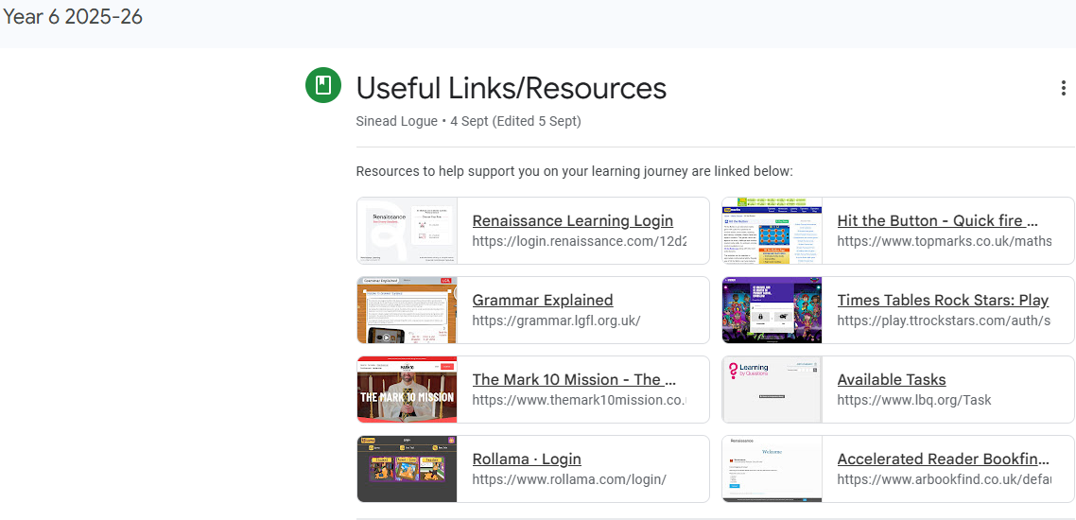
Online Learning Platforms

Slide 13
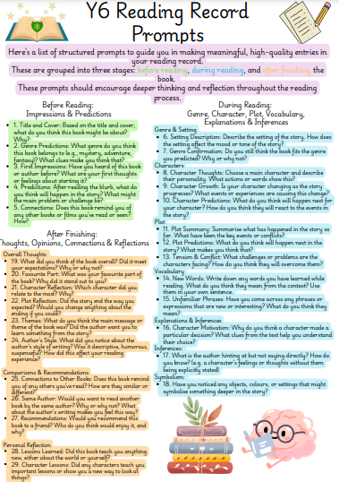
Reading Records
Children are expected to fill in 3 entries per week in their reading records having read for a minimum of 20 minutes per day.
They should use their prompts to help them to do this.
Reading records should be signed by a parent/guardian every week.

Slide 14

The Importance of Daily Reading

Slide 15
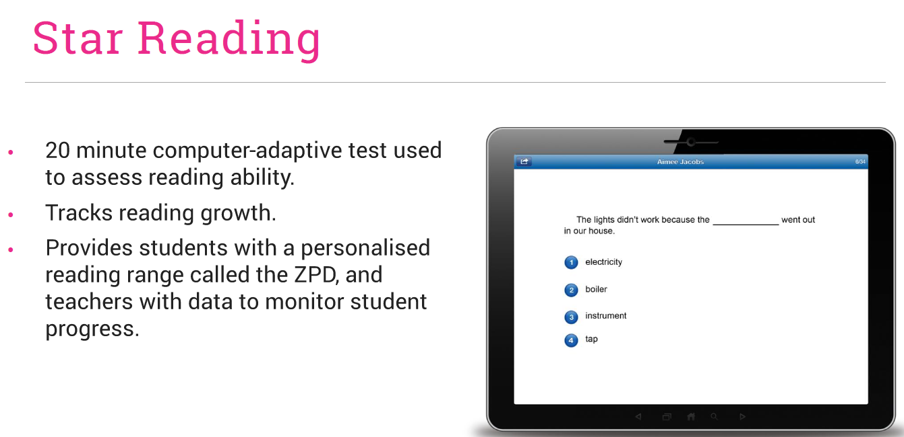
“ Our primary purpose is to accelerate learning for all children, ability levels and ethnic and social backgrounds.” Accelerated Reader

Slide 16
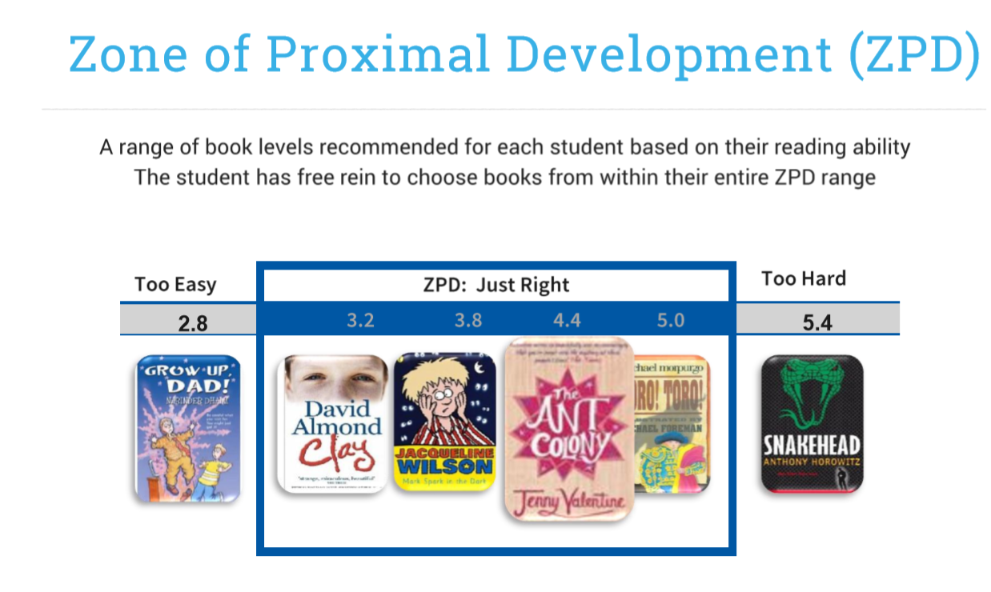

Slide 17
Routines
PE kits:
PE takes place every Thursday afternoon. All children must wear their labelled PE kit in school on these days.
There are also extra games for Year 6 children every Friday afternoon.
Please remember to supply your child with a water bottle everyday. Do not provide your child hot water in their bottles.
It is important to encourage your child to take responsibility for their organisation in preparation for secondary school next year.

Slide 18

Parents’ Evening
Dates :
03/11 - Parents’ Evening 1 (In School)
5pm - 7.30pm
04/11 - Parents’ Evening 2 (School Cloud) 5pm - 7.30pm

Slide 19

Dates for the Diary
09/10 - 6S Assembly 9.10am - Black History and World Mental Day
16/10 - 6M Assembly 9.10am - Rosary
09/11 - 6S - Imperial War Museum Tip
6M Imperial War Museum Trip TBC

Slide 20

Reminders:
Sex Education
Official Guidance on RSE/Sex Education:
Parents/carers can't withdraw their child from relationships or health education.
In primary schools, if you choose to teach sex education, you must allow parents/carers to withdraw their child from part or all of it.
Our mission is to nurture spiritual growth, personal development and social responsibility by sharing inspiring, creative content through a Catholic lens.
Further communication/information will be provided to parents regarding this.

Slide 21
Secondary School Transfer 2027
Making informed choices • Understanding the process • Meeting the deadlines
Notes:
‹#›

Slide 22


The Local Authority Process
Step 1:
Apply through your home Local Authority
All applications must be made through the Local Authority where you live. If you live outside Hounslow, apply through your own Local Authority.
Apply online
Hounslow admissions information and the eAdmissions portal should be used for the online application.
Closing date: midnight, 31 October 2026
This falls on a Saturday during half term. We strongly recommend submitting at least one week in advance.
Do not leave the application until the final day.
https://www.hounslow.gov.uk/secondary-school-admissions/apply-secondary-school-place
https://www.eadmissions.org.uk/

Slide 23


Preferences and key dates
Step 2:
How preferences work
• Make 6 preferences on the Hounslow form.
• Put schools in your genuine order of preference — #1 is your first choice.
• You will be offered the highest available preference.
• Schools are not told your preference order.
Key dates
1 September 2026 — applications open
31 October 2026 — closing date
1 March 2027 — National Offer Day
15 March 2027 — last date to respond online
If you want a Catholic place, include all Catholic schools you would genuinely accept on the Local Authority form.

Slide 24


The Schools’ Process
1.Local Authority form
Include the school on your Local Authority preference form.
2.Supplementary form
For Church schools, complete the school’s Supplementary Information Form (SIF) and return it directly to the school.
3 Catholic practice
Catholic schools require the relevant priest reference / Certificate of Catholic Practice. Please see the Parish Office about signing dates.
What happens next?
Schools apply their published admissions criteria and inform the Local Authority; the Local Authority then makes the offer based on your preference order.

Slide 25

Schools for families to consider:
St Mark’s Catholic School
St Paul’s Catholic College
St Richard Reynolds Catholic College
Gumley House Catholic School for Girls
Gunnersbury Catholic School for Boys
Cardinal Vaughan Catholic School
Sacred Heart Catholic School for Girls
The Oratory School for Boys

Slide 26
Questions to ask when choosing a school
Do I want a Catholic school?
What facilities does the school offer?
What is the pastoral system?
What is Religious Education like?
What extra-curricular activities are available?
Where does my child want to go — and why?
How far away is it — and how will my child travel?
What are the school’s results?
How is the school organised?
How does the school approach behaviour, bullying and prevention?
What are my child’s realistic admission chances?
Can I see my child being happy here for the next 5–7 years?

Slide 27
Four things to remember
Be wary of superficial impressions.
Think carefully about your genuine order of preference.
If you want a Catholic school place, include all Catholic schools you would genuinely accept.
Remember: the final decision is yours as a parent.

Slide 28

E-Safety

Slide 29
Key Stage 2 SATs
A School Presentation to Parents

Slide 30
The Tests
Key stage 2
The key stage 2 tests are timetabled from Monday 11th May to Thursday 14th May 2027.
Statutory tests will be administered in the following subjects:
Reading (60 minutes)
Spelling (approximately 15 minutes)
Punctuation, Vocabulary and Grammar (45 minutes)
Mathematics
- Paper 1: Arithmetic (30 minutes)
- Paper 2: Reasoning (40 minutes)
- Paper 3: Reasoning (40 minutes)
All tests are externally marked.
Writing will be ‘Teacher Assessed’ internally, as in recent years.

Slide 31
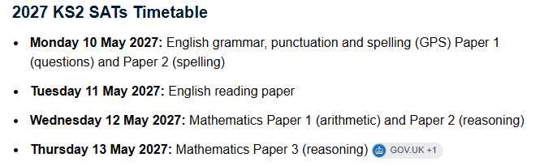

Slide 32
Scaled Scores
What is meant by ‘scaled scores’?
100 will always represent the ‘national standard’.
Each pupil’s raw test score will therefore be converted into a score on the scale, either at, above or below 100.
The scale has a lower end point of 80 and an upper end point of 120.
80 – 99 = Below National Expectation
100 – 109 = National Expectation
110 – 120 = Greater Depth
A child who achieves the ‘national standard’ (a score of 100) will be judged to have demonstrated sufficient knowledge in the areas assessed by the tests.
At the end of the academic year, your child’s results will be shared in their end of year report.

Slide 33
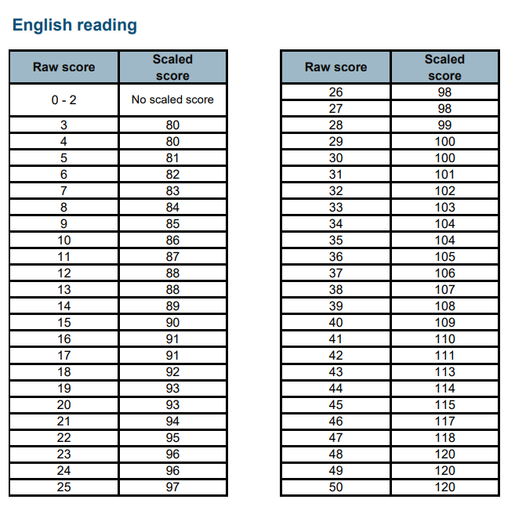

Slide 34
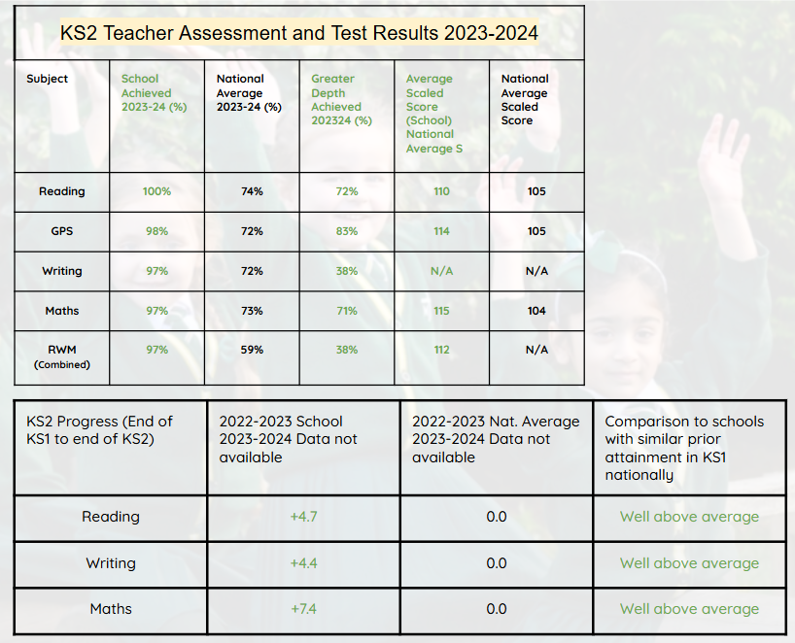
KS2 School Results 2023/24 (official data)

Slide 35
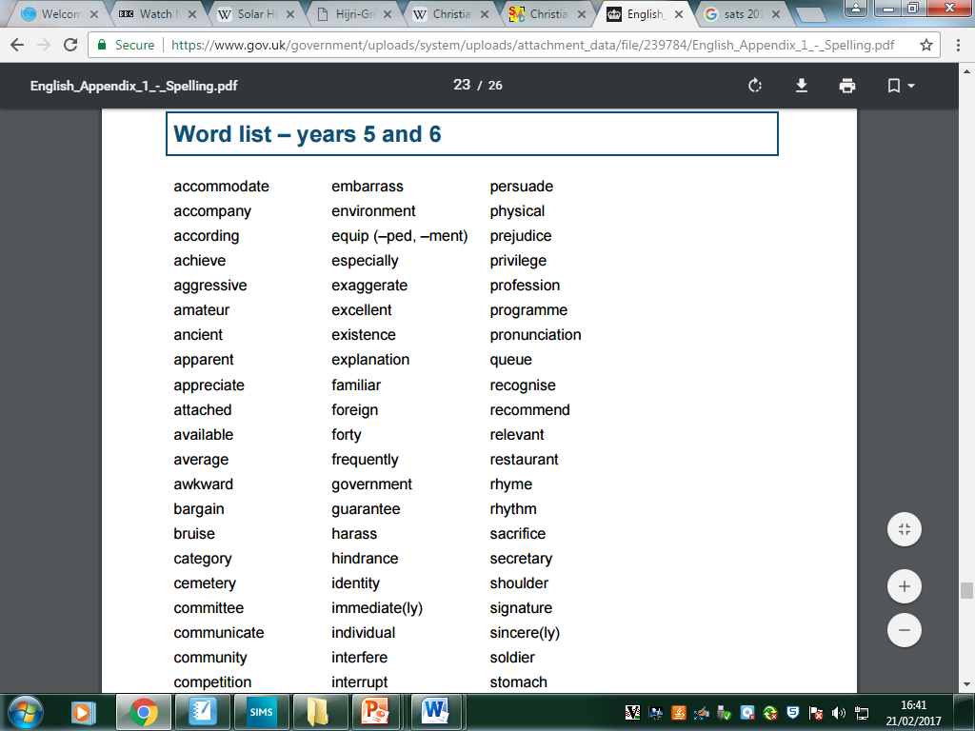
This is the Word List for Years 5 and 6 children.
Children should be able to spell and define each word.
Notes:
‹#›

Slide 36
Mathematics
Children will sit three tests: Paper 1, Paper 2 and Paper 3.
Paper 1 is for ‘Arithmetic’ lasting for 30 minutes, covering calculation methods for all operations, including use of fractions, percentages and decimals.
Questions gradually increase in difficulty. Not all children will be expected to access some of the more difficult questions later in the paper but we encourage all children to do so.
Papers 2 and 3 cover ‘Problem Solving and Reasoning’, each lasting for 40 minutes.
Pupils will still require calculation skills but will need to answer questions in context and decide what is required to find a solution.
Notes:
‹#›

Slide 37
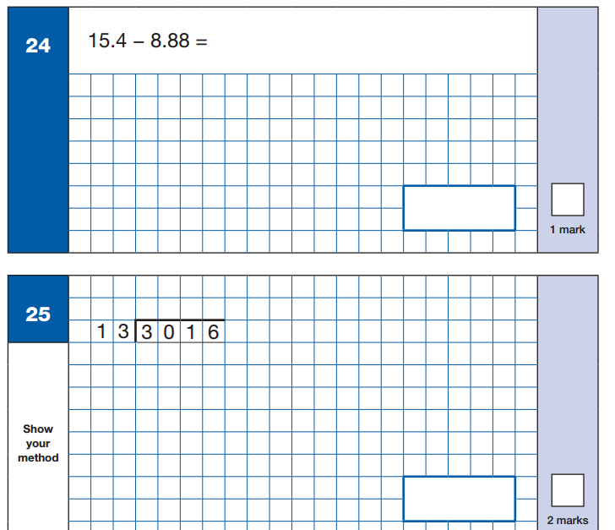
Sample Questions
Maths Paper 1: Arithmetic
Notes:
‹#›

Slide 38
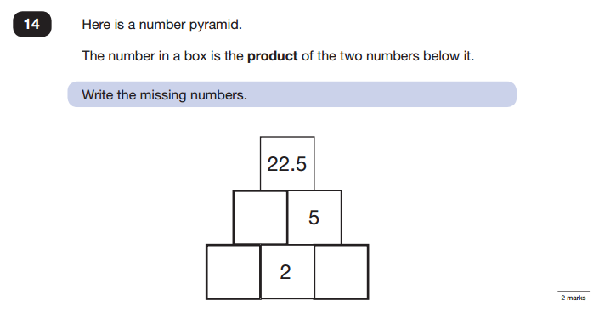
Sample Questions
Maths Paper 2 / Paper 3 : Reasoning
Notes:
‹#›

Slide 39
How to support your child with Maths
Knowing their times tables – if timetables are known children can use them accurately and quickly for multiplication, division. To help your child learn their times tables (up to X12) we recommend: Times Table Rock Stars & Hit the Button
Formal method for the four operations practice: it is important child can complete methods accurately. (Methods for year 6 child: column addition, column subtraction, short multiplication, long multiplication, short division, long division including expressing remainders as fractions, decimals and remainder form).
Arithmetic speed practice.

Slide 40
Reading
The Reading Test consists of a single test paper with three unrelated reading texts.
Children are given 60 minutes in total, which includes reading the texts and answering the questions.
A total of 50 marks are available.
Questions are designed to assess the comprehension and understanding of a child’s reading.
Some questions are multiple choice or selected response, others require short answers and some require an extended response or explanation.
Notes:
‹#›

Slide 41
Current Issues with Reading
Reading stamina – children are expected to read 3 texts and answer a range of comprehension questions, all within 60 minutes.
Limited exposure to different genres – children often immerse themselves in fictional texts and find it difficult to relate to non-fiction texts.
Practise reading and answering questions under timed conditions on a regular basis.
Ensure your child is reading a range of text genres and are answering comprehension questions.
Notes:
‹#›

Slide 42
Vocabulary – children do not understand the meaning of certain words, which is hindering their ability to answer the questions.
Inference – children find it difficult to ‘read between the lines’ and pick up clues from the text.
Exposure to new, unfamiliar words. Children can use dictionaries to check the meaning, thesauruses to check for synonyms etc.
Encourage your child to answer the questions by giving their opinion and justifying their answers by referring to the text (A.P.E).
Notes:
‹#›

Slide 43

Sample KS2 Reading texts
Notes:
‹#›

Slide 44
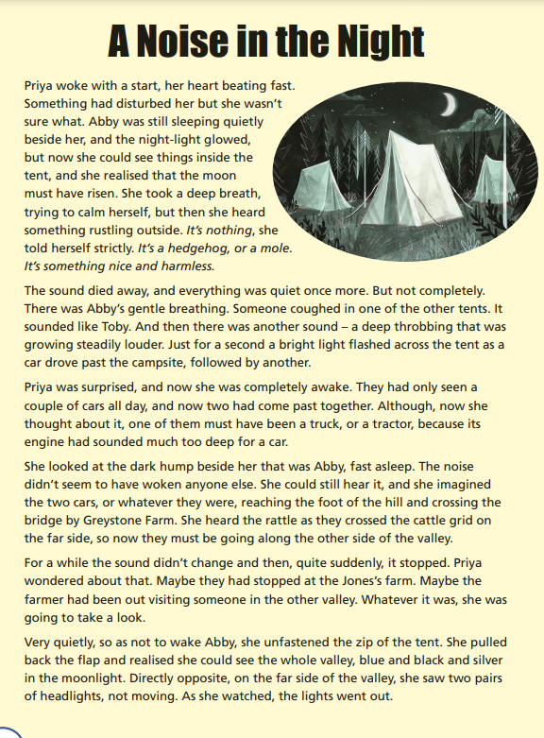
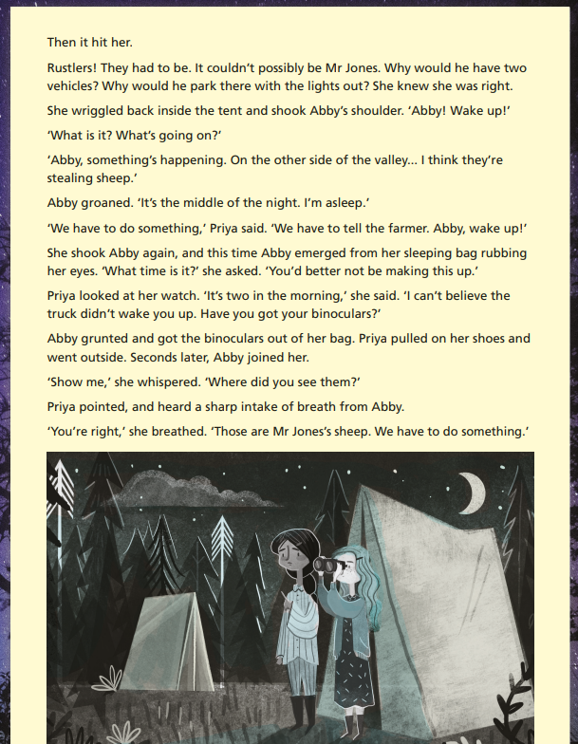
Sample KS2 Reading texts
SAMPLE

Slide 45
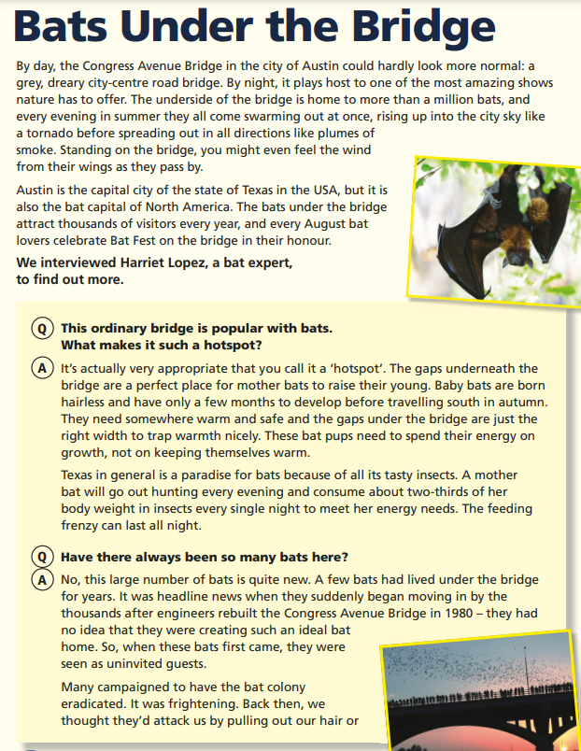
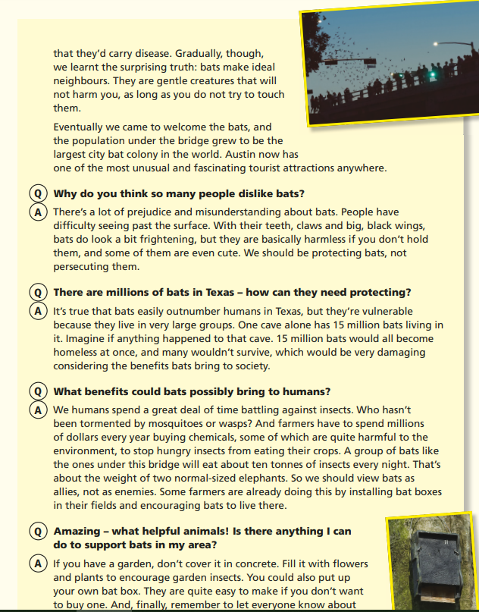
Sample KS2 Reading texts
SAMPLE
Notes:
‹#›

Slide 46

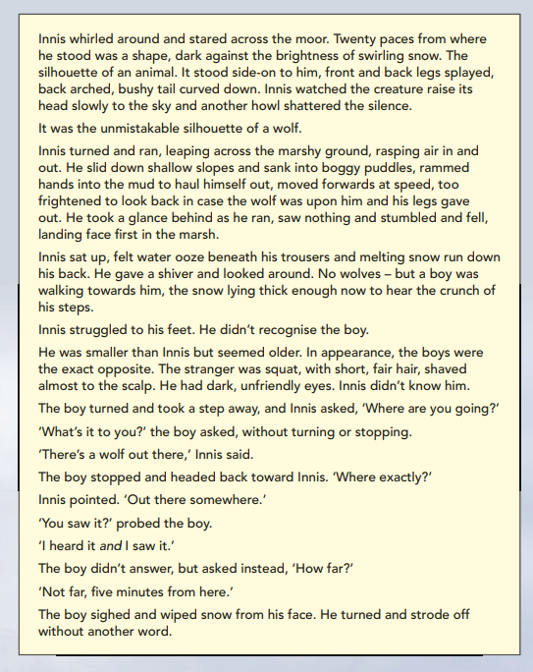
SAMPLE

Slide 47
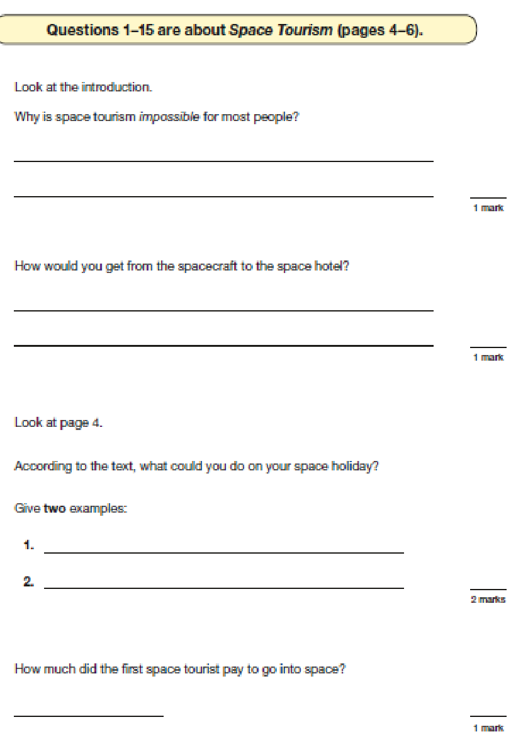
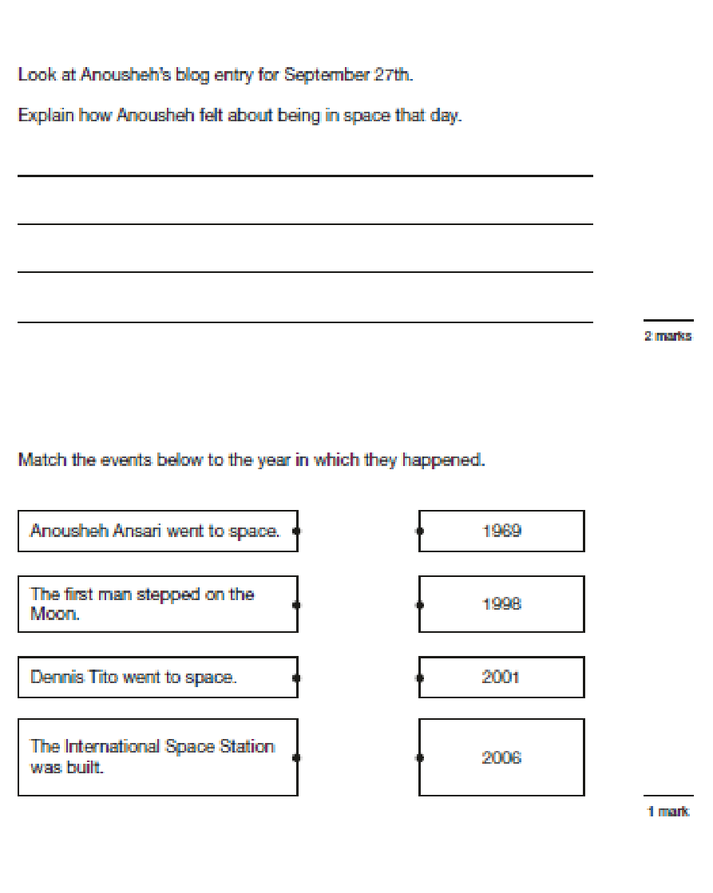
Sample KS2 Reading questions
Notes:
‹#›

Slide 48
Our Top Tips
•Tip 1: Remember your child’s education is a partnership. Attend parents’ evenings to discuss your child's progress including strengths and areas for development.
•Tip 2: Support your child with homework tasks and daily reading. Try drawing or acting out answers of difficult concepts.
•Tip 3: Encourage your child to work to speed. Try timed recall of timetables in the car/journey to school. Set challenges for example – ‘can you find the word on the page that means ‘dangerous’ you have 1 minute - go!’ ‘What is 10% of 150? You have 10 seconds - go!’
•Tip 4: Make sure your child is aware that getting stuck is not a problem. Move on and give them another challenge and come back to the hard ones at the end and/or go through it together.
Notes:
‹#›

Slide 49
Our Top Tips
•Tip 5: Encourage your child to believe in themselves, ‘you can do it!’ Growth Mindset.
•Tip 6: Remind your child that the tests are important, but that they are not the only way they are to be measured. We don’t want child panicking or worried, we want them to be prepared.
•Tip 7: Approach a subject from lots of different angles. Software, games, activities, books, flash cards and practical applications all help. Make the revision time at home as fun and interactive as possible.
•Tip 8: It is easier said than done, BUT do not put your child under too much pressure. Have fun – they will find things easier to remember if they recall the good times they had learning.
Notes:
‹#›

Slide 50




Recommended Revision Guides
All of these resources (and more) are available online from Amazon, prices range from £4 to £8 and in local stores.
The following are the names of the publishers that you need to look out for if purchasing these resources:
CGP Revision Guide
Pearson
Please avoid purchasing CGP test papers or using past SATs papers as we use these materials to assess your child's progress in school.
Notes:
‹#›

Slide 51
SATs Boosters
Every year, usually beginning in the spring term, children are put into small groups and will be invited to stay for after-school sessions twice weekly.
The sessions will be divided into maths and English sessions.
The children are grouped carefully to ensure small group, targeted provision. This is to help close any gaps in learning which they may have and to revise previously-taught concepts.

Slide 52



May 2027
Monday 24th - Wednesday 26th
https://schoolsandgroups.pgl.co.uk/centres/grosvenor-hall/

Slide 53
Y6 Residential Trip
£320 total cost
Letter will be sent in the coming weeks with further details
Payment request was loaded on ParentPay in July: £45 to secure your child’s place
Payment breakdown:
5 installments of £55 (or more, if you wish to finalise payment sooner) to be paid, in full, by 27th March 2026.
Please speak to the office if financing the trip will be an obstacle. If you don’t ask for help, then we can’t provide the support! :)

