Slide 1
Secondary Transfer
2026

Slide 2
Questions to consider:
Is St Mark’s your first choice of school?
Is a Catholic education a priority for you and your child?
If you’ve answered YES to either/both of these questions, then the following information is very important.

Slide 3


https://education.rcdow.org.uk/wp-content/uploads/2025/08/Choosing-a-Catholic-Secondary-School-2026.pdf

Slide 4
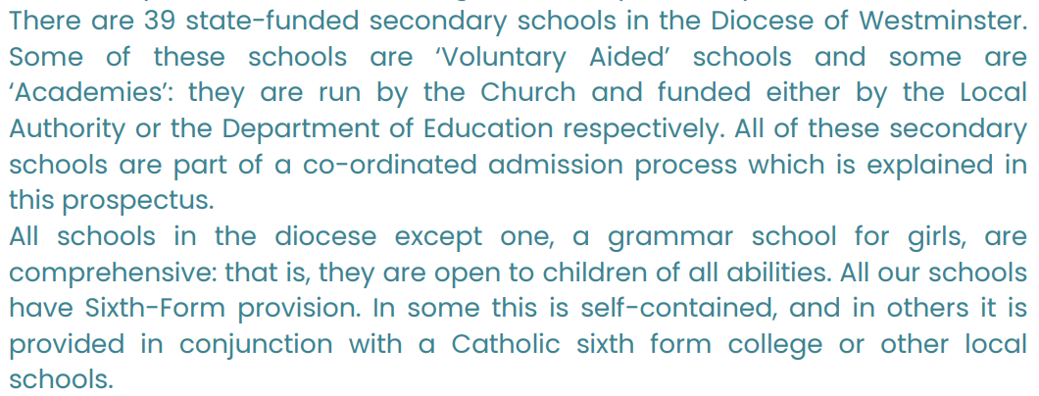

Slide 5
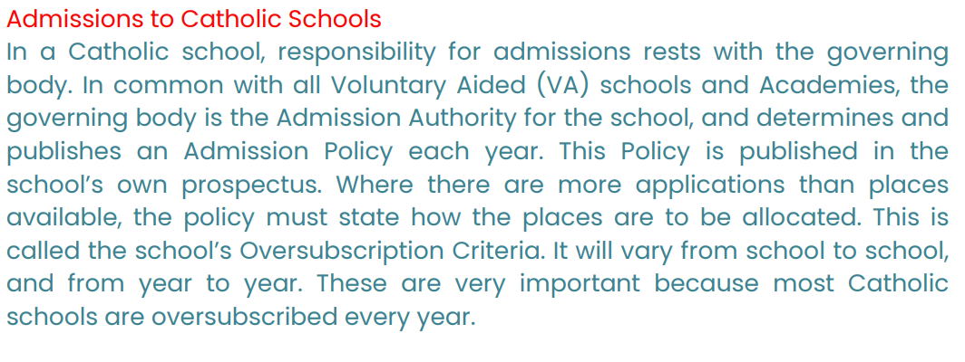

Slide 6
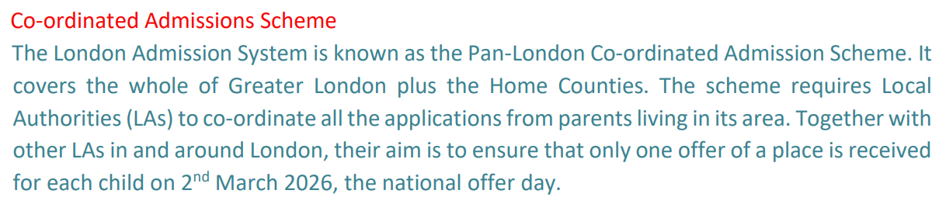

Slide 7
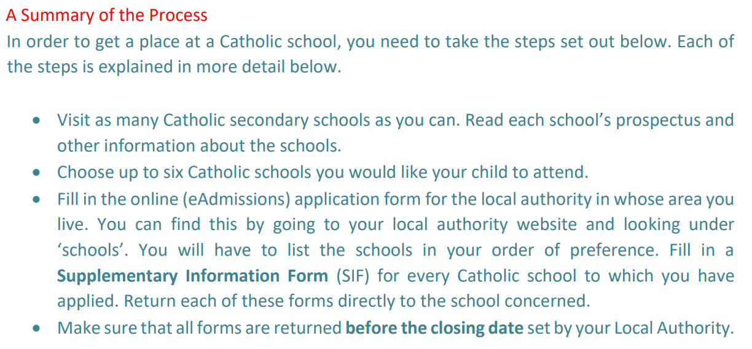

Slide 8
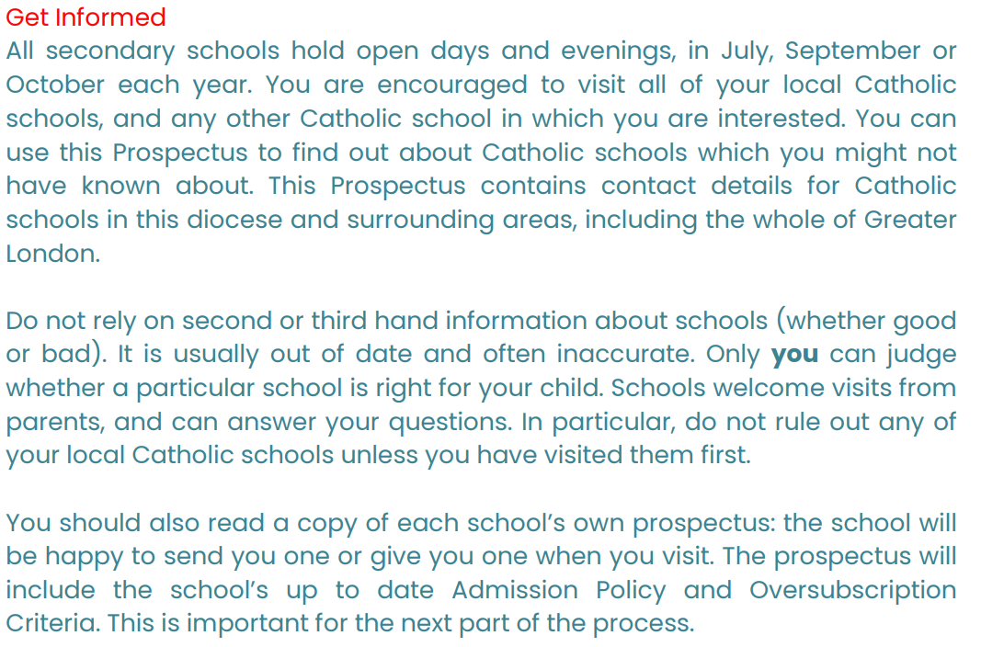

Slide 9
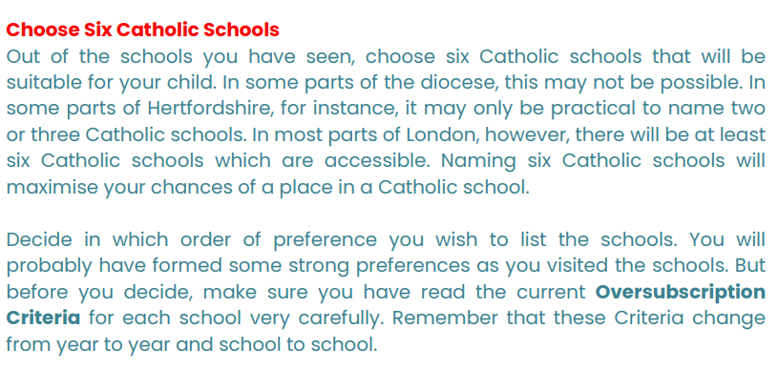

Slide 10
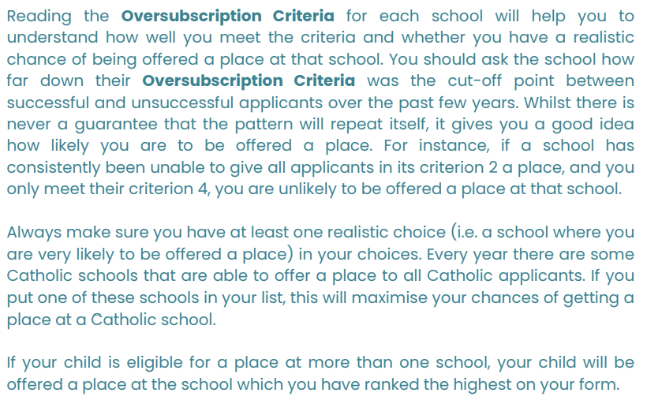

Slide 11

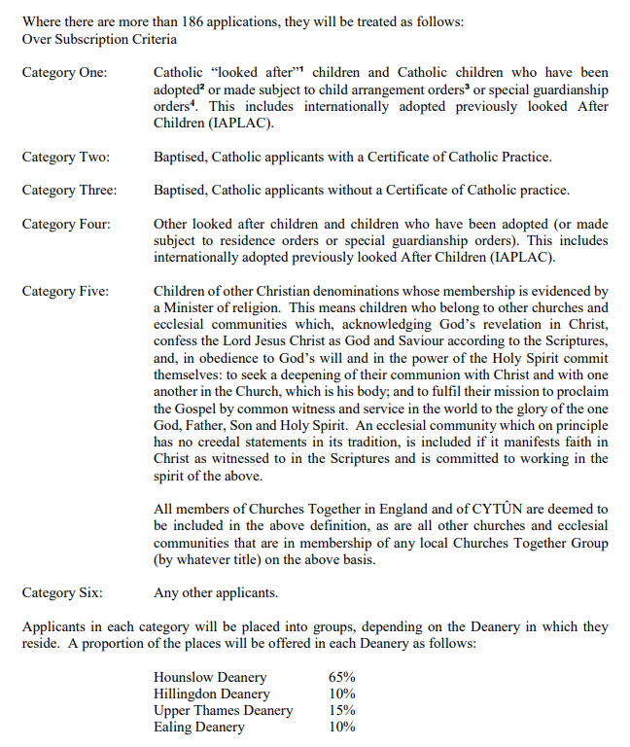
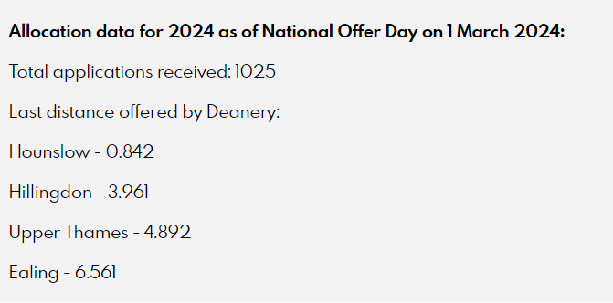
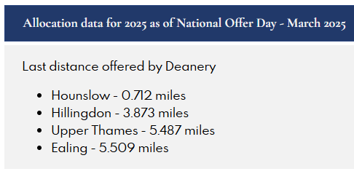
186 places

Slide 12
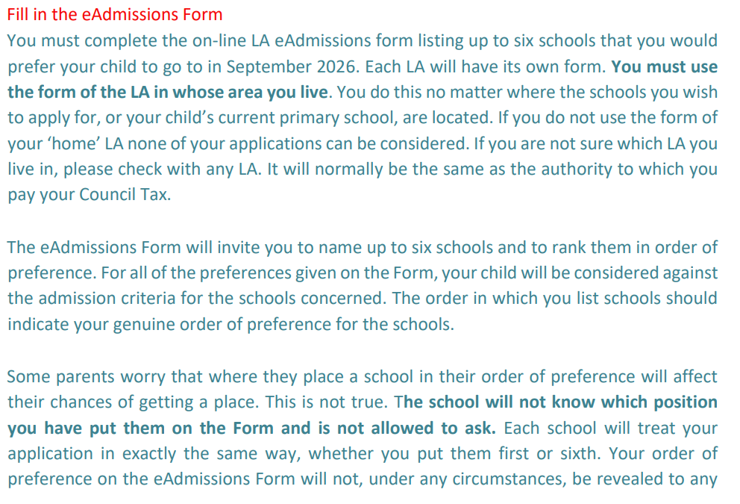

Slide 13
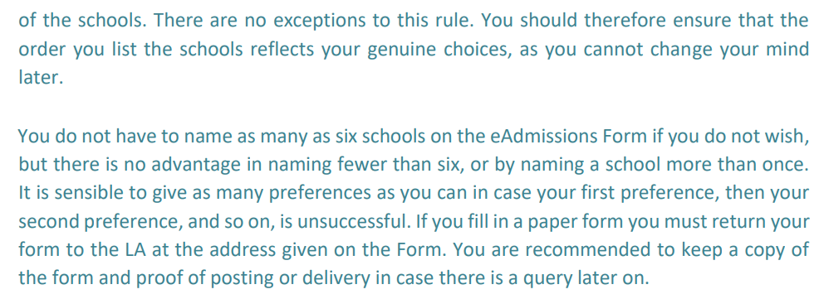

Slide 14
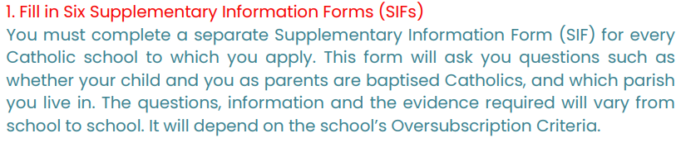
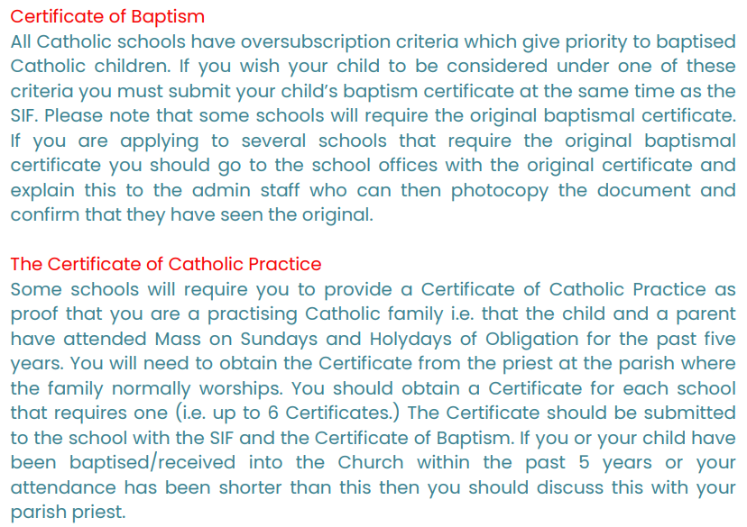

Slide 15

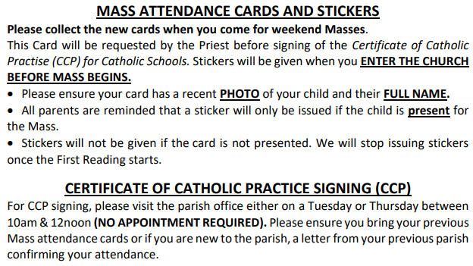

Slide 16
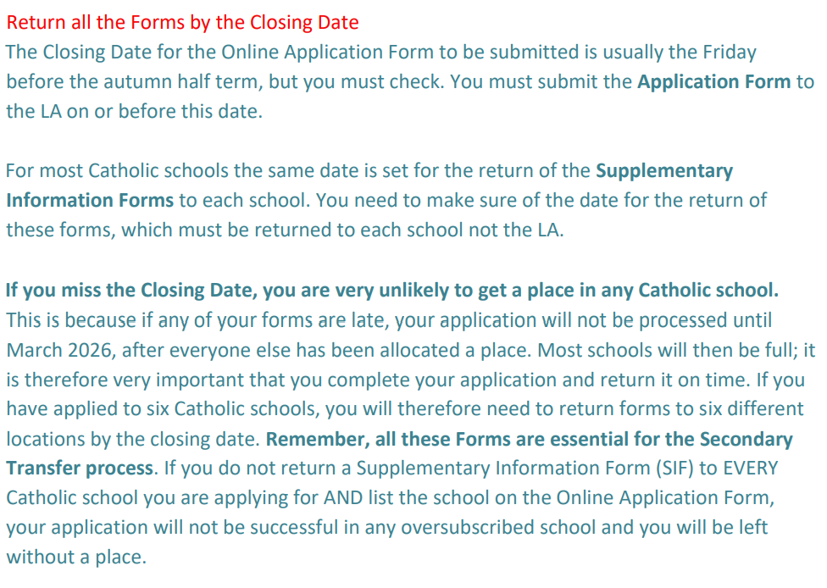

Slide 17
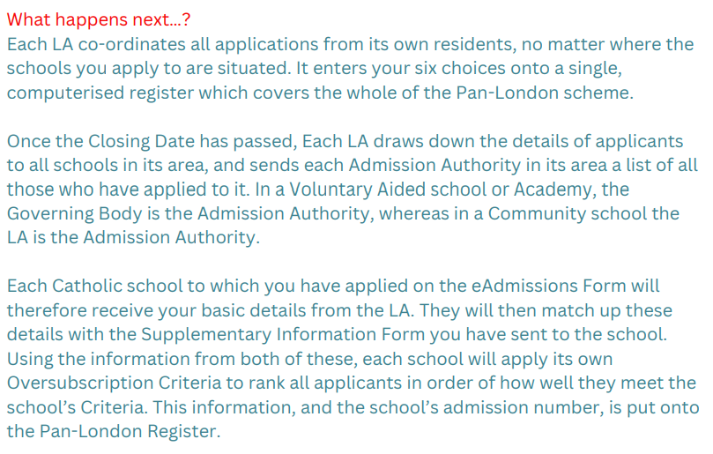

Slide 18
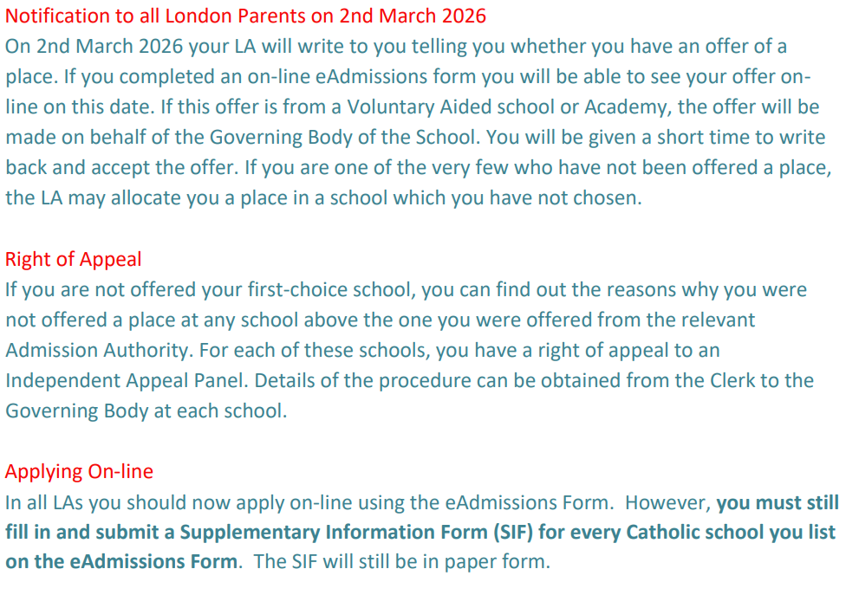

Slide 19
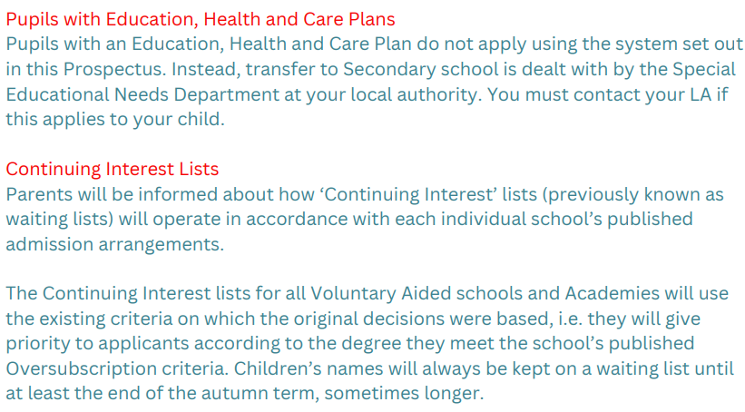

Slide 20
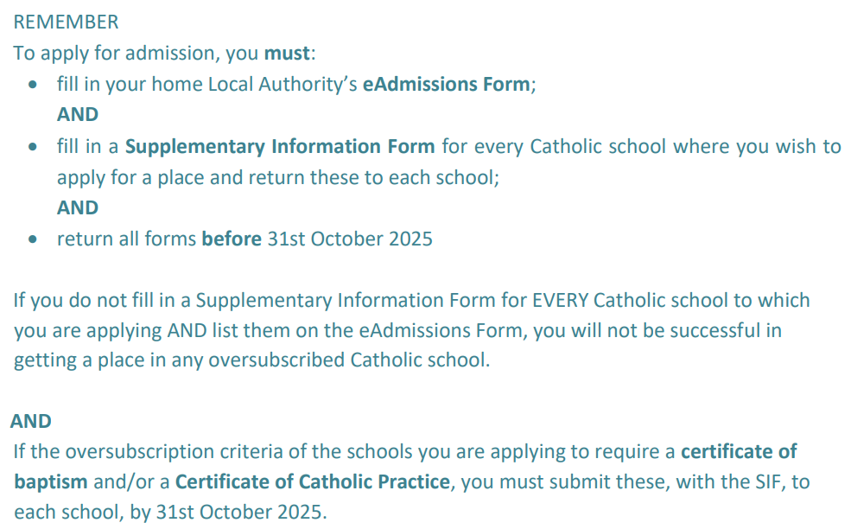

Slide 21

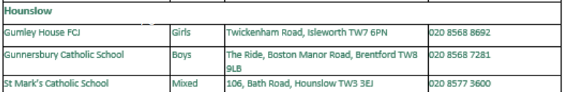
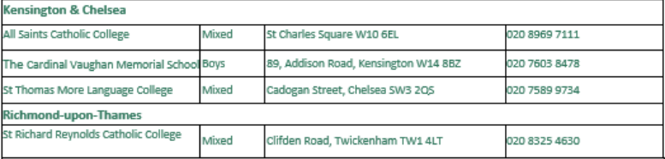

Slide 22
The Local Authority Process
You must apply to your Local Authority –no applications will be considered if not on the local authority form!
You must apply online using the eadmissions websites. For Hounslow Borough residents use the following link: http://www.hounslow.gov.uk/secondaryadmissions
The ‘Secondary School Transfer brochure’ is available at:https://www.hounslow.gov.uk/downloads/file/4373/secondary_transfer_2025
If you live outside of the London Borough of Hounslow e.g. Surrey or Richmond, you must apply through your own local authority - NOT the authority of the primary school or desired secondary school.
The closing date is 31st October 2025.

Slide 23



Slide 24
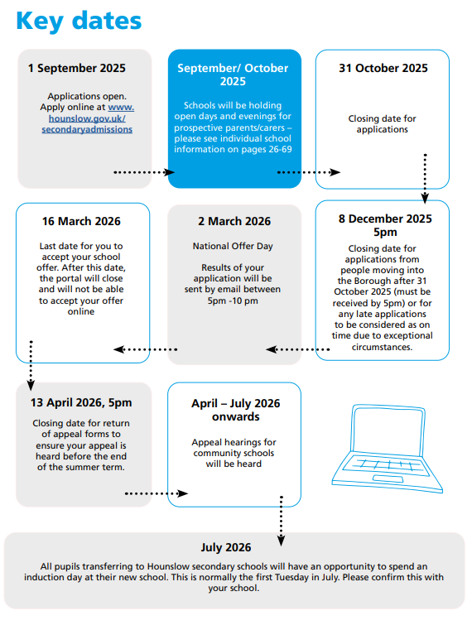

https://www.hounslow.gov.uk/downloads/file/11498/secondary-school-transfer-2025

Slide 25
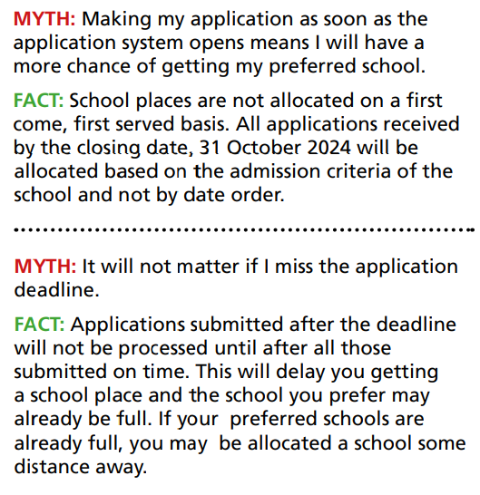
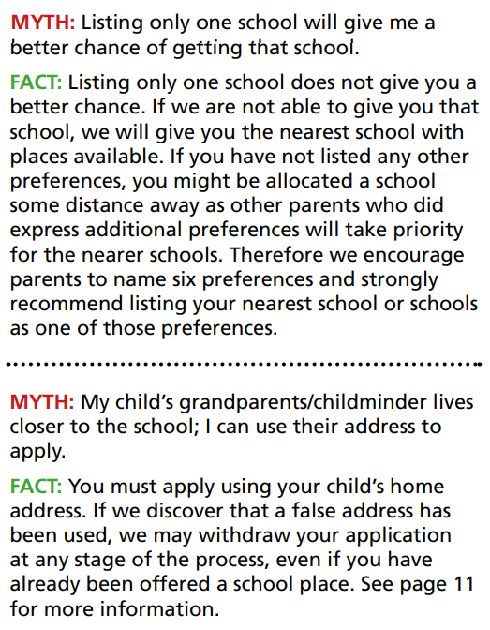
Myth Busters

Slide 26
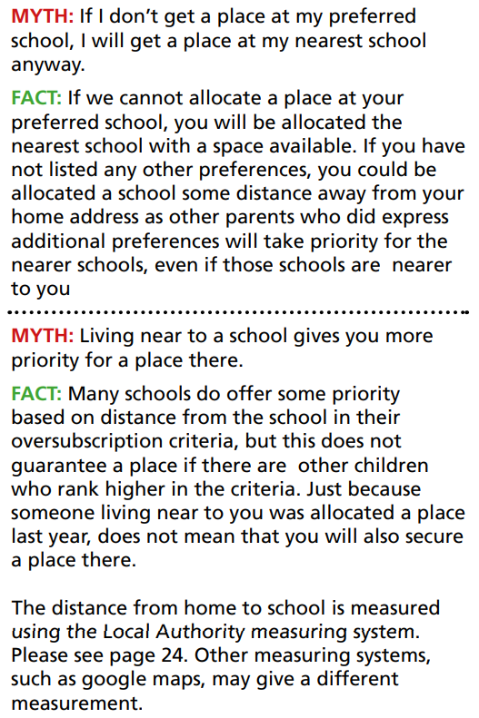
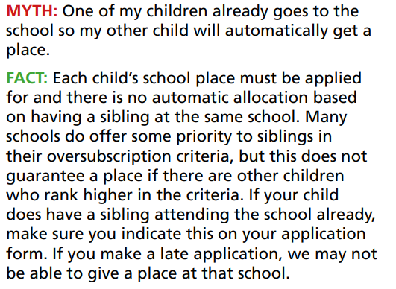

Slide 27
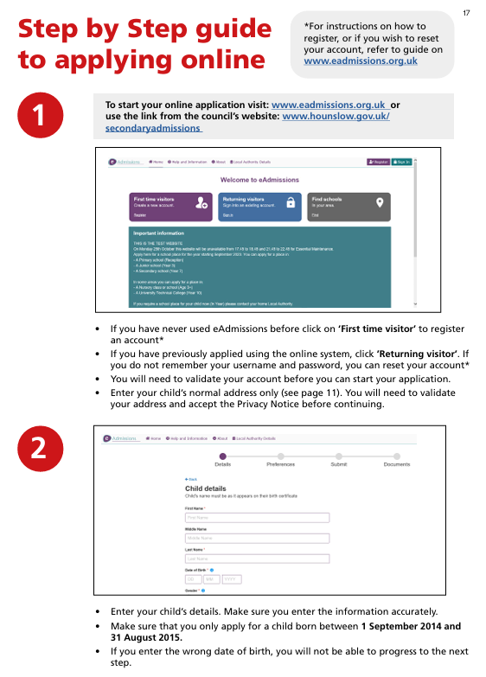
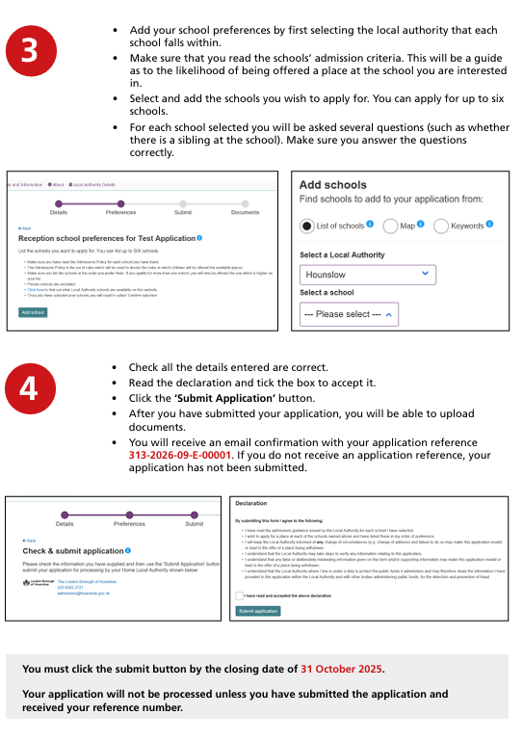

Slide 28
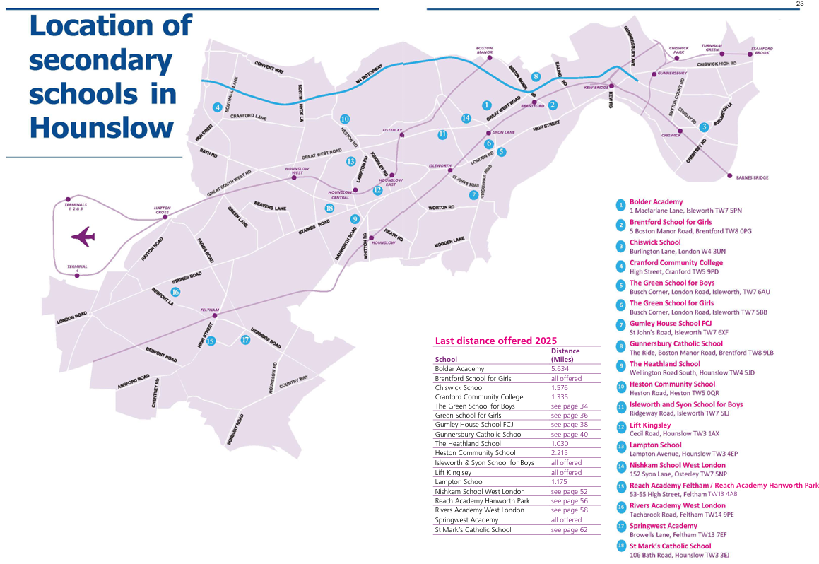

Slide 29
Catholic Schools Most-Often Considered (nearest distance):
St Mark’s Catholic School (Mixed) Hounslow www.st-marks.hounslow.sch.uk
St Paul’s Catholic College (Mixed) Sunbury www.st-pauls.surrey.sch.uk
Gumley House School (Girls Only) Isleworth www.gumleyhouse.com
Gunnersbury Catholic School (Boys Only) Brentford www.gunnersbury.com
St Richard Reynolds Catholic College (Mixed) Twickenham www.strichardreynolds.org.uk

Slide 30
Other Schools to Consider:
The Cardinal Vaughan Memorial School (boys) (Catholic)
Sacred Heart Girls School, Hammersmith (Catholic)
The London Oratory (boys) - Catholic
Bishop Wand
Reach Academy
The Green School for Girls/Boys
Private Schools - St Catherine's, Hampton, Lady Eleanor Holles Involves a selection test
Grammar Schools - Tiffin & St Bernard's. Entrance involves a test

Slide 31
Points to Consider:
Do I want a Catholic School?
How far away is it and how will my child get there?
What facilities does the school offer?
What are the school’s results?
What is the pastoral system?
How is the school organised?
Religious Education?
Discipline – systems, prevention, bullying
Extra – curricular activities - what are they?
Admission – what are my chances?
Where does my child want to go and why?
Does the school feel right – can I see my child here for the next 5/7 years?
Visit the schools’ open days and make the choices that best-suit the needs of your child.

