Slide 1

Curriculum Talk
Secondary Transfer
Internet Safety
Year 6
2025-26
Miss Logue
6L
Mrs Straczek
6S

Slide 2

Mission Statement
Learning our Faith
Living our Faith
Loving our Faith
Notes:
‹#›

Slide 3





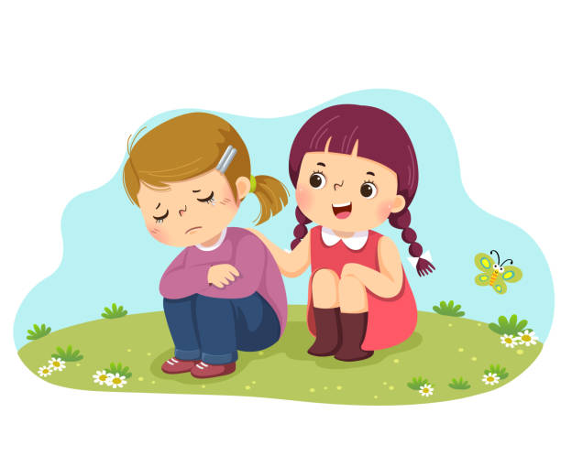
STRIVE -School Visions and Values
Here at St Michael and St Martin, we want the children display these core values to help them be well-rounded individuals. They must strive to be:
Spiritual
Thinkers
Resilient
Independent
Valued
Empathetic

Slide 4
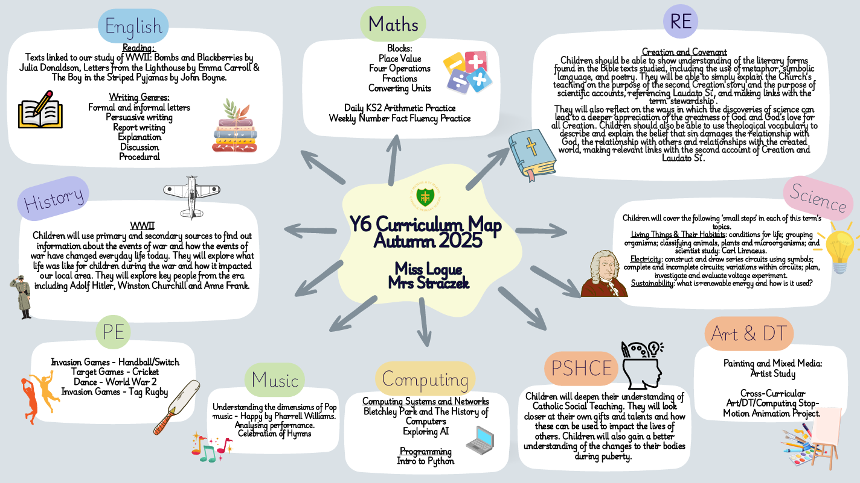
Curriculum Map

Slide 5
Expectations for Behaviour
We encourage all children to demonstrate a high standard of behaviour at all times in order to create a safe, respectful and happy learning environment.
Each class has participated in the process of making a set of ‘Golden Rules.’ The children have agreed to follow the rules as they understand that this will help their learning.
Respecting each other and all members of staff is expected and reflects the ethos of our school.
The children are required to listen carefully and to develop their self control and concentration in class and in the playground.
Working together with parents and guardians plays a big part in establishing good relationships and standards of behaviour.

Slide 6
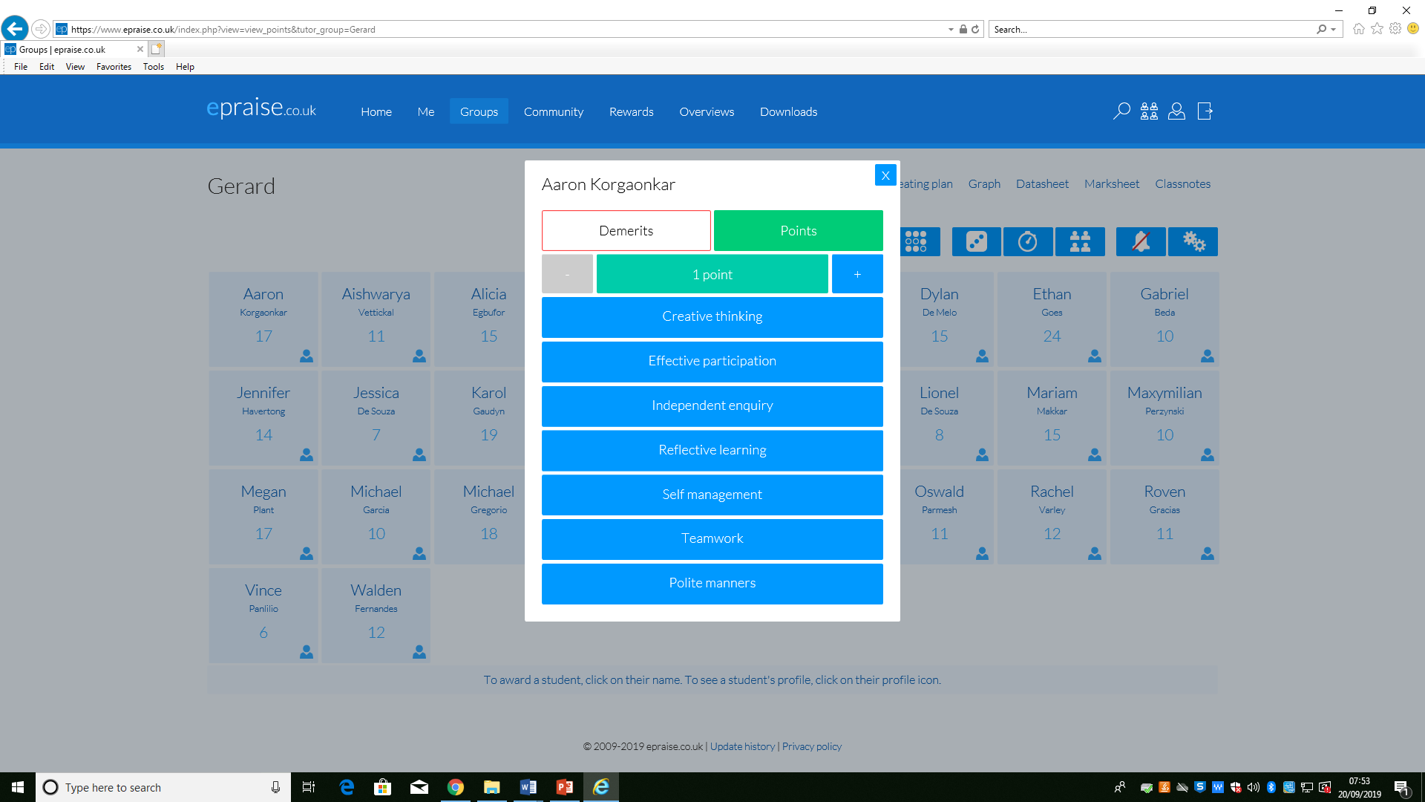
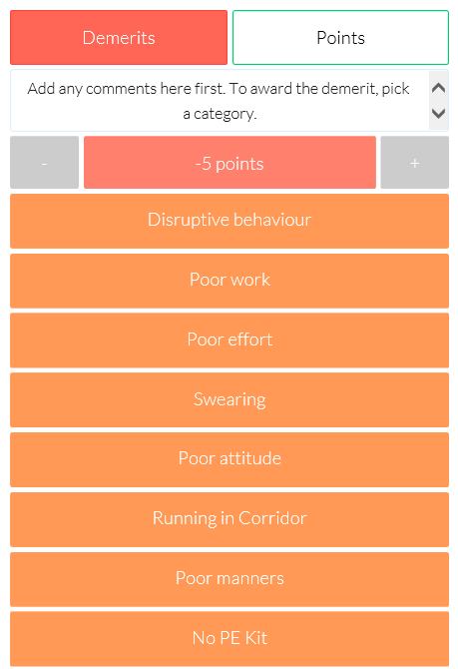
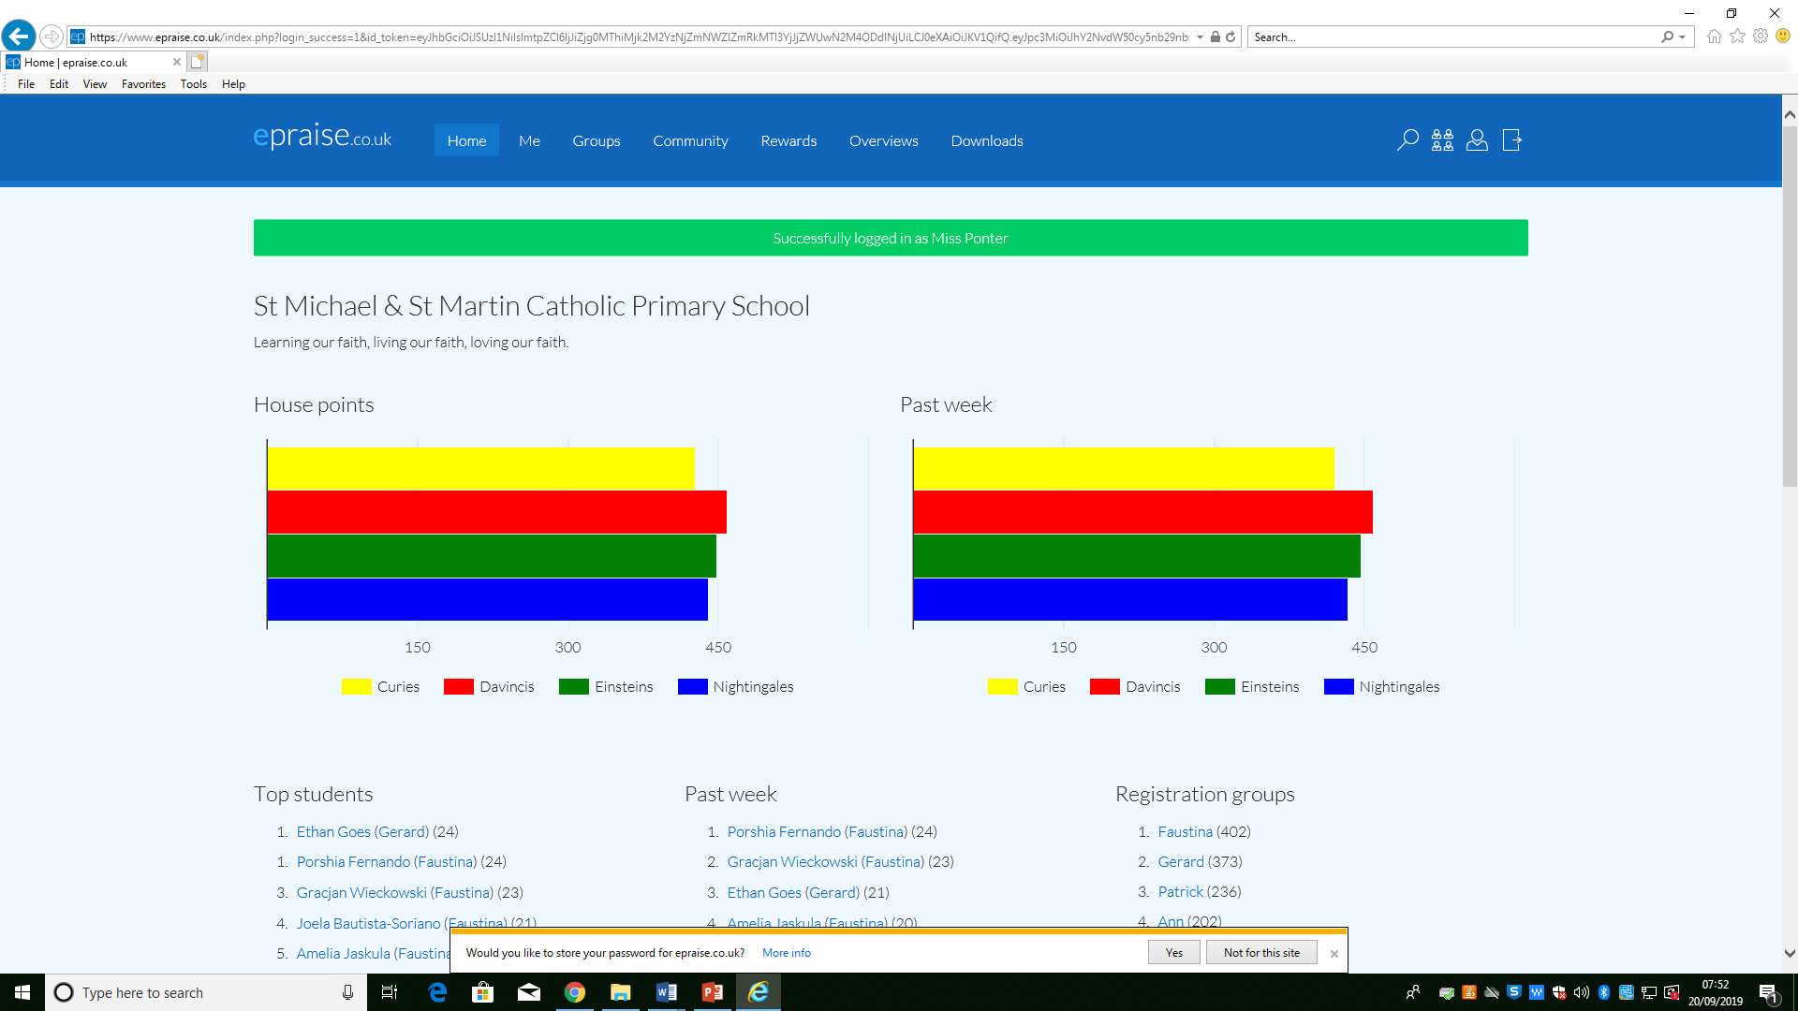
House Points- Epraise

Slide 7
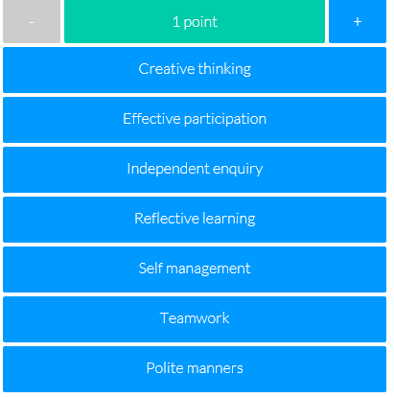
Expectations for Behaviour
Epraise
Our school is continuing to use our online school rewards system designed to motivate students to work harder, attend more and behave better.
Our house points, demerits and detentions will now be recorded electronically and when the children accumulate their house points, they can redeem them for rewards. In addition to earning house points as a team, this new system recognises the efforts of individuals – ‘silent achievers’.
House points are awarded to children
for the following contributions to their
learning and the school environment:

Slide 8
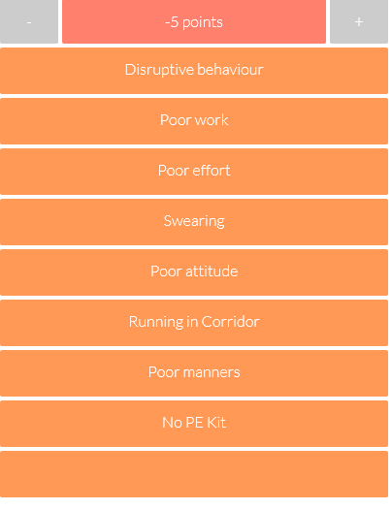
Expectations for Behaviour
Demerits are issued where a child fails to follow the school or class rules. They are also issued if a child doesn’t bring in homework when it’s due.
Three demerits equal a detention.
Detentions are recorded by the teacher & Mrs Duggan.

Slide 9
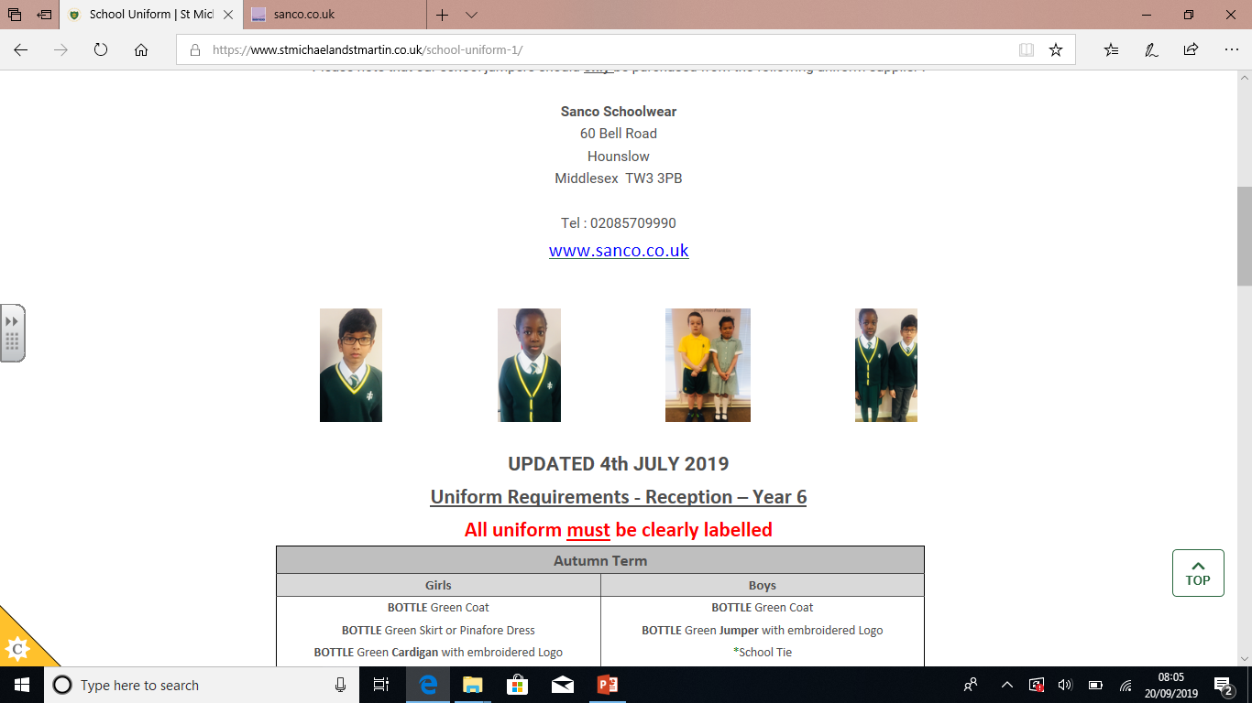
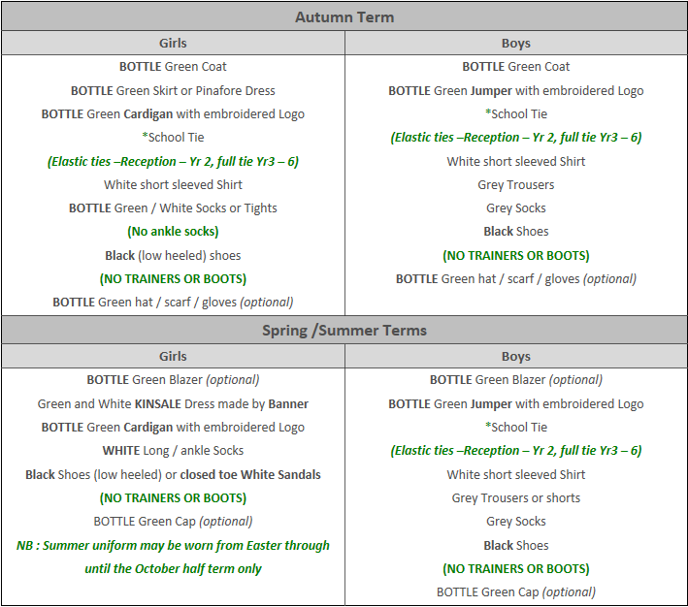
Uniforms

Slide 10
Personal Hygiene
Encouraging Healthy Hygiene Habits
Daily showers, using deodorant, and wearing clean clothes can help manage body odour.
Ensure your child understands the importance of regular washing, especially after physical activities.
Deodorants and Antiperspirants
Encourage your child to use deodorant or antiperspirant, but make sure to choose one that is age-appropriate and free of harsh chemicals.
Support and Patience
Be patient as your child adjusts to these changes. Some may feel self-conscious, so it’s important to create a positive, supportive environment around hygiene.
Open Communication
Gently remind your child of the importance of personal hygiene and let them know that everyone goes through these changes

Slide 11
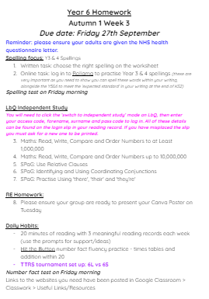
Homework
In Y6, one of our main goals is to ensure children are well-prepared for their transition to secondary school.
With that, children should start to take greater responsibility and autonomy over their own learning, and develop their time-management skills.
Each Friday (or Monday), children will be assigned a set number of tasks to complete for homework and this will be due in on the following Friday.
Homework tasks will be clearly outlined for children so they can keep track of what they have due.
The learning tasks assigned will feed directly into the work children are covering in class that week and many tasks will be revision from previous concepts covered in Y3, Y4 & Y5.

Slide 12
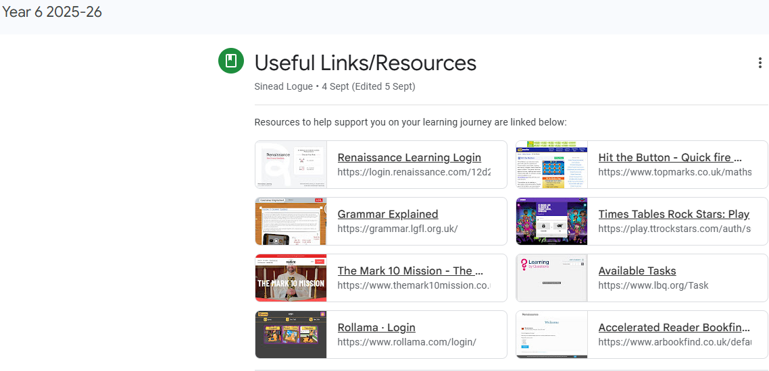
Online Learning Platforms

Slide 13
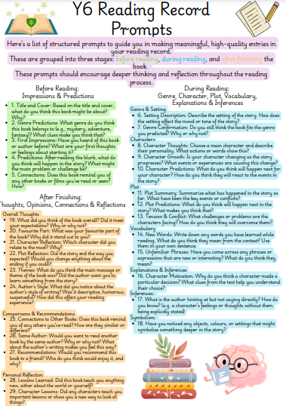
Reading Records
Children are expected to fill in 3 entries per week in their reading records having read for a minimum of 20 minutes per day.
They should use their prompts to help them to do this.
Reading records should be signed by a parent/guardian every week.

Slide 14
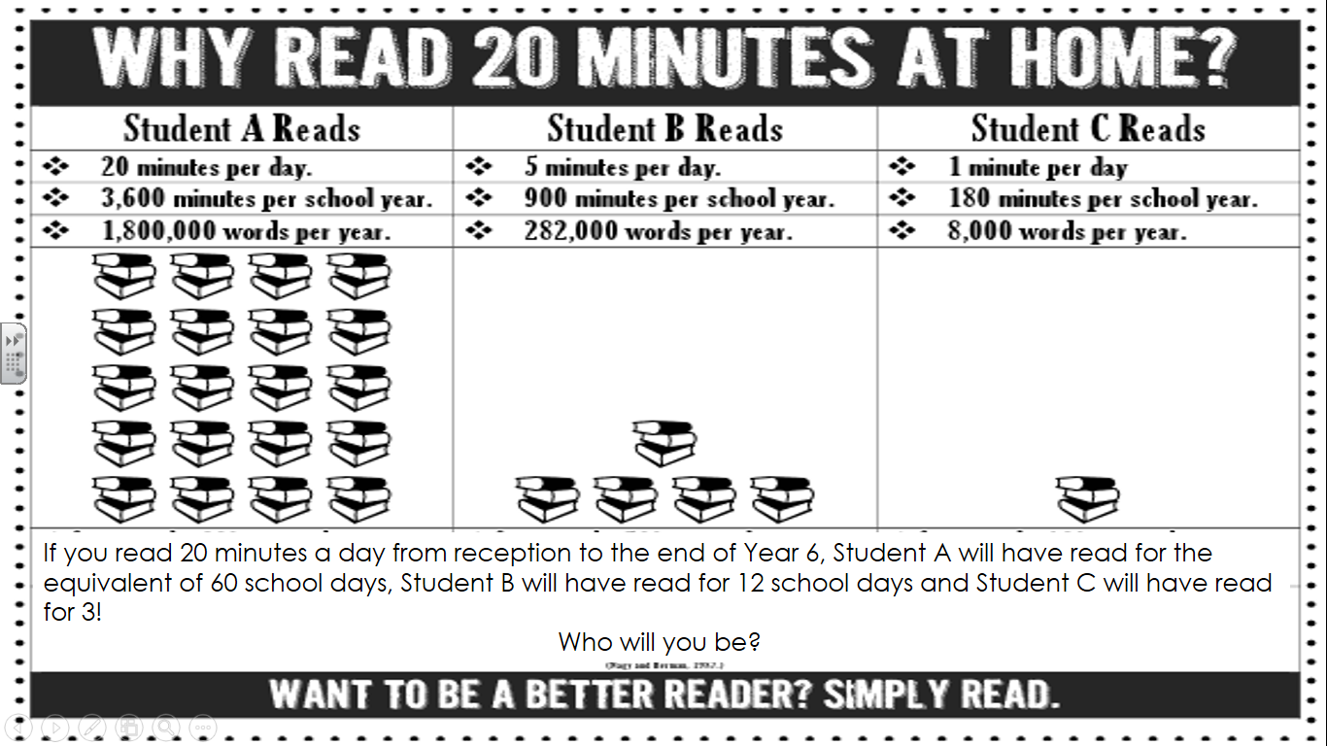
The Importance of Daily Reading

Slide 15
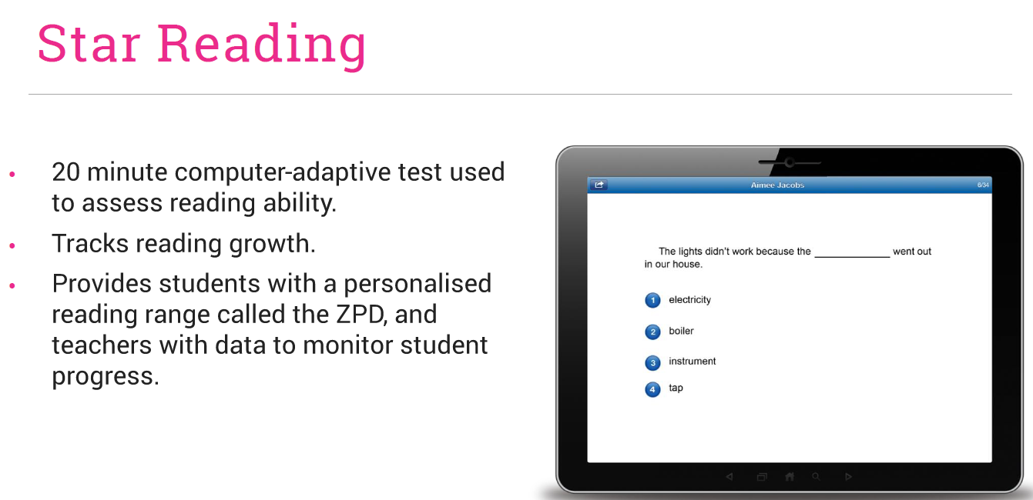
“ Our primary purpose is to accelerate learning for all children, ability levels and ethnic and social backgrounds.” Accelerated Reader

Slide 16
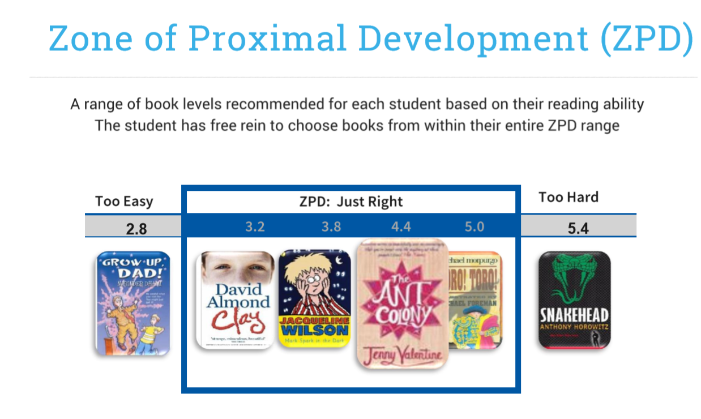

Slide 17
Routines
PE kits:
PE takes place every Friday afternoon. All children must wear their labelled PE kit in school on these days.
Please remember to supply your child with a water bottle everyday. Do not provide your child hot water in their bottles.
It is important to encourage your child to take responsibility for their organisation in preparation for secondary school next year.

Slide 18

Parents’ Evening
Dates :
04/11 - Parents’ Evening 1 (In School)
5pm - 7.30pm
05/11 - Parents’ Evening 2 (School Cloud) 5pm - 7.30pm

Slide 19

Dates for the Diary
10/10 - 6S Assembly 9.30am - Black History and World Mental Day
17/10 - 6L Assembly 9.30am - Rosary
18/11 - 6S - Imperial War Museum Tip
January TBC - 6L Imperial War Museum Trip

Slide 20

Reminders:
Sex Education
Official Guidance on RSE/Sex Education:
Parents/carers can't withdraw their child from relationships or health education.
In primary schools, if you choose to teach sex education, you must allow parents/carers to withdraw their child from part or all of it.
Our mission is to nurture spiritual growth, personal development and social responsibility by sharing inspiring, creative content through a Catholic lens.
Further communication/information will be provided to parents regarding this.

Slide 21
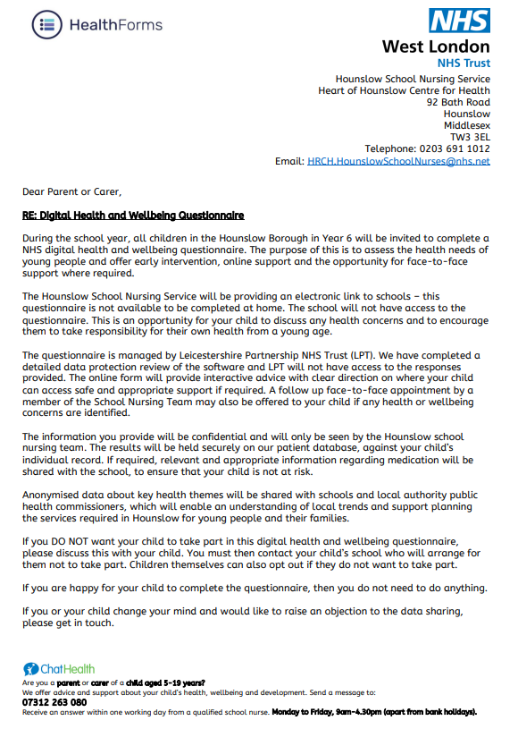
Reminders:
2. NHS Health Questionnaire
Your children will have the letter from the NHS in their homework folders this afternoon. Please read the information carefully and, if you wish to opt out of your child taking part, you will need to fill in the Google Form that will be sent out next week.
Further communication/information will be provided to parents regarding this.

Slide 22

E-Safety

Slide 23
Key Stage 2 SATs
A School Presentation to Parents

Slide 24
The Tests
Key stage 2
The key stage 2 tests are timetabled from Monday 11th May to Thursday 14th May 2026.
Statutory tests will be administered in the following subjects:
Reading (60 minutes)
Spelling (approximately 15 minutes)
Punctuation, Vocabulary and Grammar (45 minutes)
Mathematics
- Paper 1: Arithmetic (30 minutes)
- Paper 2: Reasoning (40 minutes)
- Paper 3: Reasoning (40 minutes)
All tests are externally marked.
Writing will be ‘Teacher Assessed’ internally, as in recent years.

Slide 25
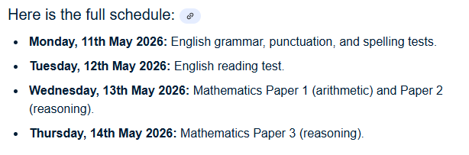

Slide 26
Scaled Scores
What is meant by ‘scaled scores’?
100 will always represent the ‘national standard’.
Each pupil’s raw test score will therefore be converted into a score on the scale, either at, above or below 100.
The scale has a lower end point of 80 and an upper end point of 120.
80 – 99 = Below National Expectation
100 – 109 = National Expectation
110 – 120 = Greater Depth
A child who achieves the ‘national standard’ (a score of 100) will be judged to have demonstrated sufficient knowledge in the areas assessed by the tests.
At the end of the academic year, your child’s results will be shared in their end of year report.

Slide 27
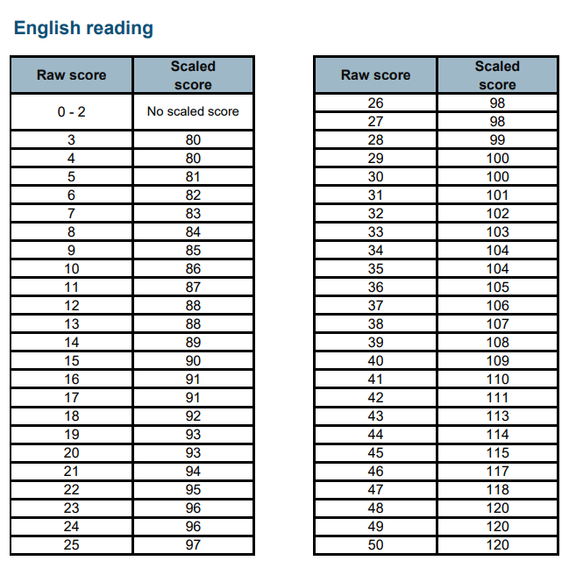

Slide 28
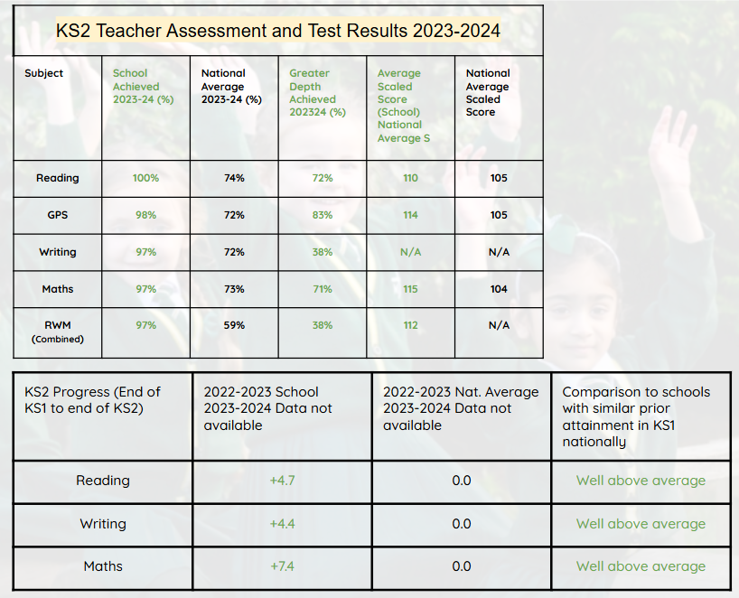
KS2 School Results 2023/24 (official data)

Slide 29
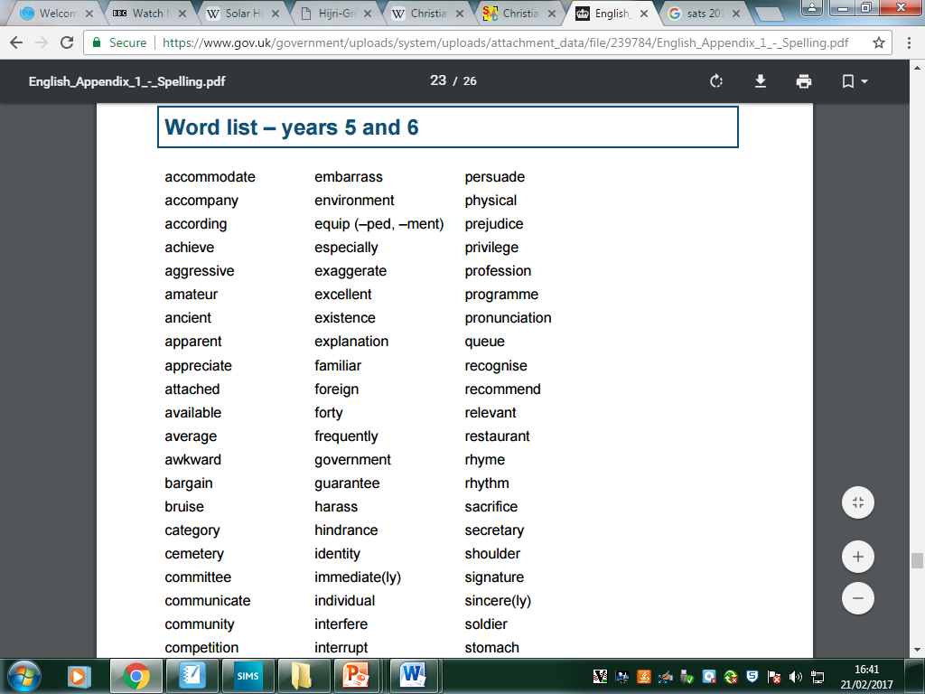
This is the Word List for Years 5 and 6 children.
Children should be able to spell and define each word.
Notes:
‹#›

Slide 30
Mathematics
Children will sit three tests: Paper 1, Paper 2 and Paper 3.
Paper 1 is for ‘Arithmetic’ lasting for 30 minutes, covering calculation methods for all operations, including use of fractions, percentages and decimals.
Questions gradually increase in difficulty. Not all children will be expected to access some of the more difficult questions later in the paper but we encourage all children to do so.
Papers 2 and 3 cover ‘Problem Solving and Reasoning’, each lasting for 40 minutes.
Pupils will still require calculation skills but will need to answer questions in context and decide what is required to find a solution.
Notes:
‹#›

Slide 31
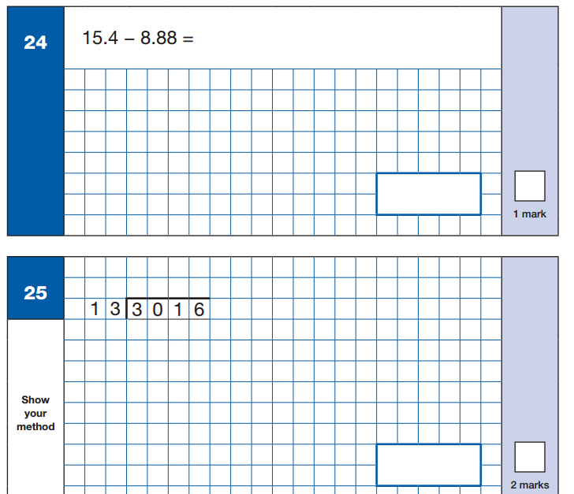
Sample Questions
Maths Paper 1: Arithmetic
Notes:
‹#›

Slide 32
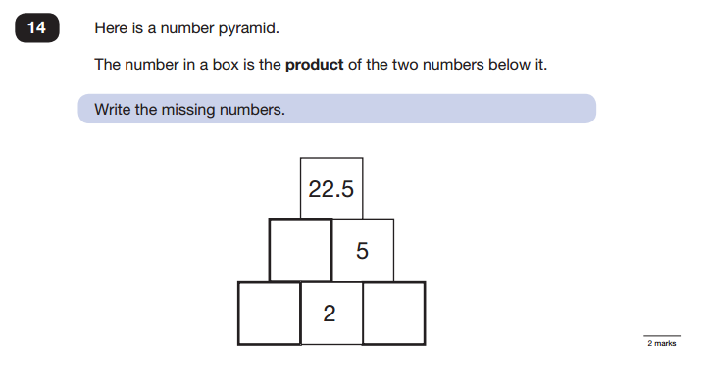
Sample Questions
Maths Paper 2 / Paper 3 : Reasoning
Notes:
‹#›

Slide 33
How to support your child with Maths
Knowing their times tables – if timetables are known children can use them accurately and quickly for multiplication, division. To help your child learn their times tables (up to X12) we recommend: Times Table Rock Stars & Hit the Button
Formal method for the four operations practice: it is important child can complete methods accurately. (Methods for year 6 child: column addition, column subtraction, short multiplication, long multiplication, short division, long division including expressing remainders as fractions, decimals and remainder form).
Arithmetic speed practice.

Slide 34
Reading
The Reading Test consists of a single test paper with three unrelated reading texts.
Children are given 60 minutes in total, which includes reading the texts and answering the questions.
A total of 50 marks are available.
Questions are designed to assess the comprehension and understanding of a child’s reading.
Some questions are multiple choice or selected response, others require short answers and some require an extended response or explanation.
Notes:
‹#›

Slide 35
Current Issues with Reading
Reading stamina – children are expected to read 3 texts and answer a range of comprehension questions, all within 60 minutes.
Limited exposure to different genres – children often immerse themselves in fictional texts and find it difficult to relate to non-fiction texts.
Practise reading and answering questions under timed conditions on a regular basis.
Ensure your child is reading a range of text genres and are answering comprehension questions.
Notes:
‹#›

Slide 36
Vocabulary – children do not understand the meaning of certain words, which is hindering their ability to answer the questions.
Inference – children find it difficult to ‘read between the lines’ and pick up clues from the text.
Exposure to new, unfamiliar words. Children can use dictionaries to check the meaning, thesauruses to check for synonyms etc.
Encourage your child to answer the questions by giving their opinion and justifying their answers by referring to the text (A.P.E).
Notes:
‹#›

Slide 37

Sample KS2 Reading texts
Notes:
‹#›

Slide 38
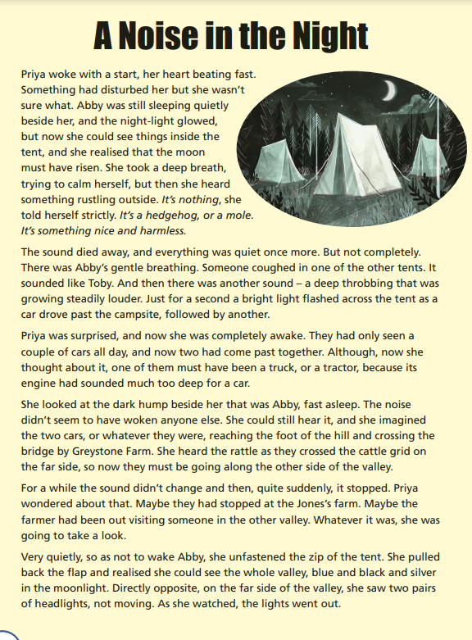
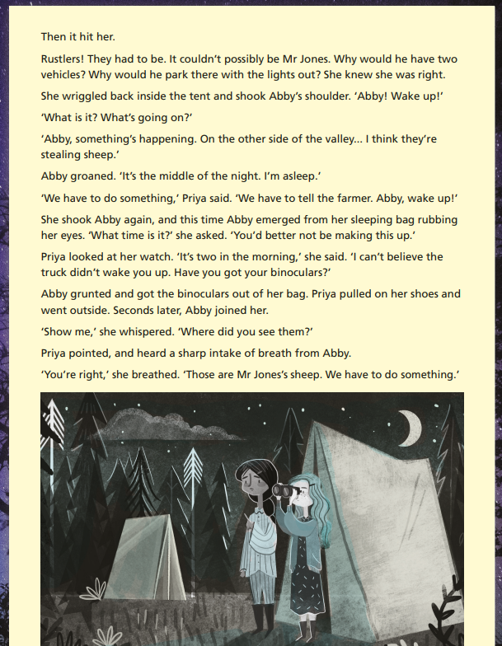
Sample KS2 Reading texts
SAMPLE

Slide 39
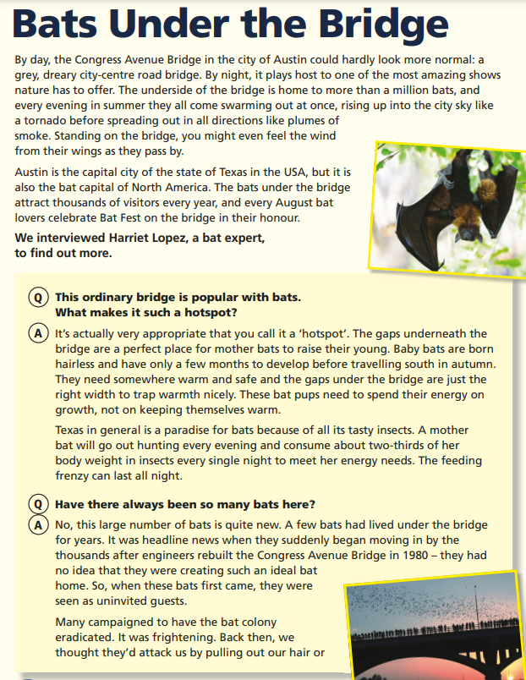
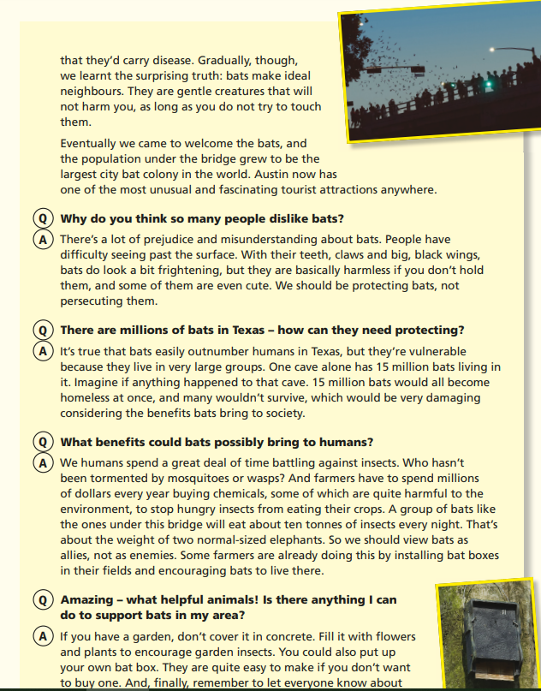
Sample KS2 Reading texts
SAMPLE
Notes:
‹#›

Slide 40

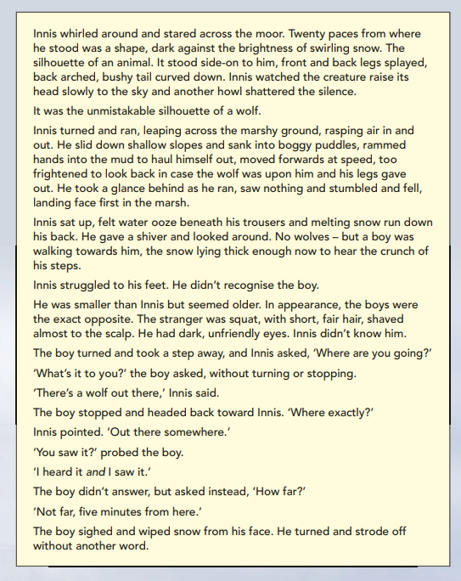
SAMPLE

Slide 41
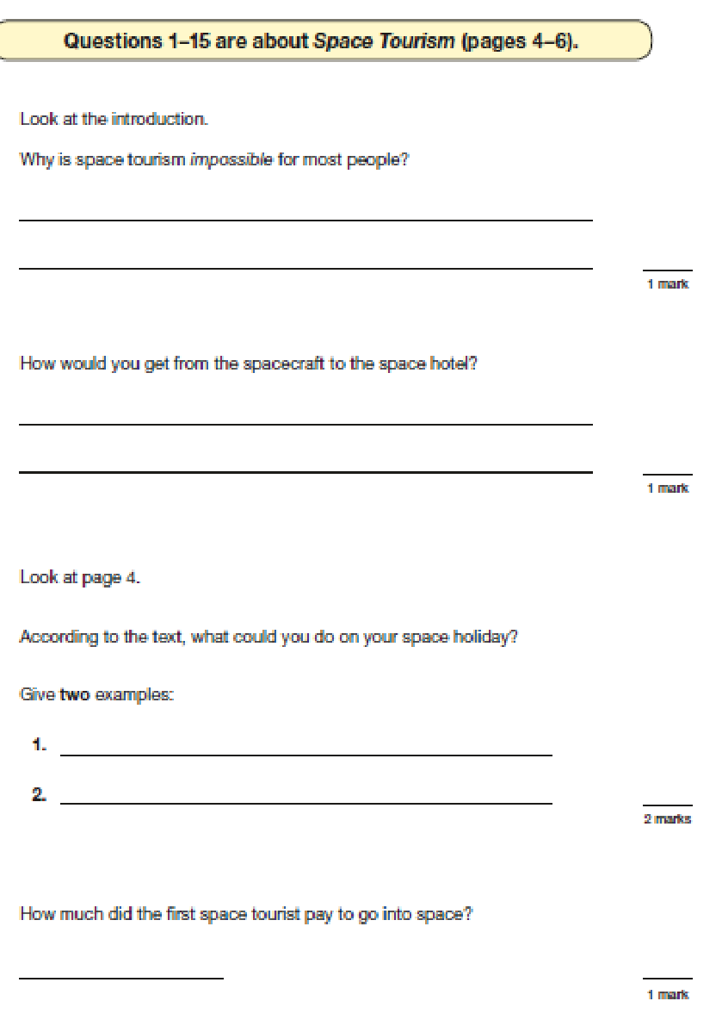
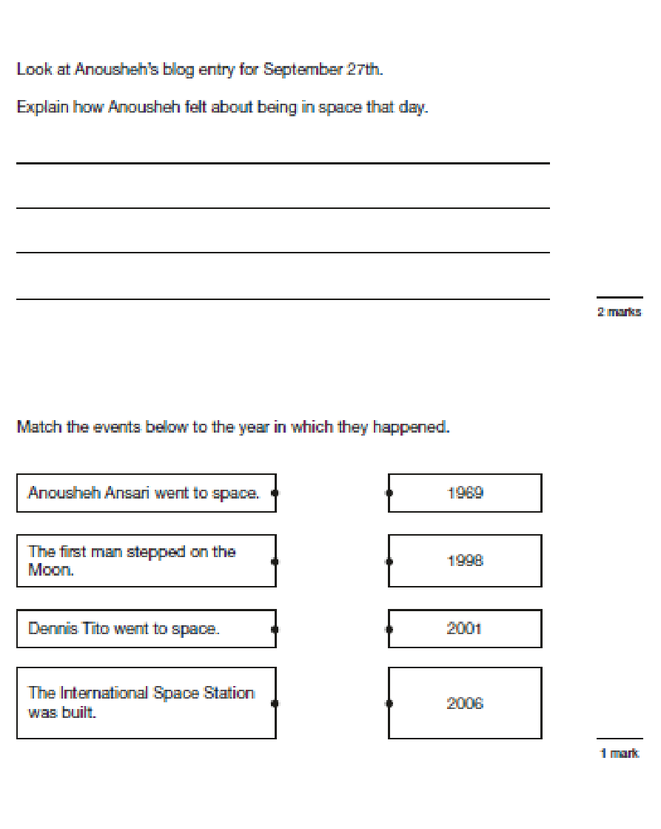
Sample KS2 Reading questions
Notes:
‹#›

Slide 42
Our Top Tips
•Tip 1: Remember your child’s education is a partnership. Attend parents’ evenings to discuss your child's progress including strengths and areas for development.
•Tip 2: Support your child with homework tasks and daily reading. Try drawing or acting out answers of difficult concepts.
•Tip 3: Encourage your child to work to speed. Try timed recall of timetables in the car/journey to school. Set challenges for example – ‘can you find the word on the page that means ‘dangerous’ you have 1 minute - go!’ ‘What is 10% of 150? You have 10 seconds - go!’
•Tip 4: Make sure your child is aware that getting stuck is not a problem. Move on and give them another challenge and come back to the hard ones at the end and/or go through it together.
Notes:
‹#›

Slide 43
Our Top Tips
•Tip 5: Encourage your child to believe in themselves, ‘you can do it!’ Growth Mindset.
•Tip 6: Remind your child that the tests are important, but that they are not the only way they are to be measured. We don’t want child panicking or worried, we want them to be prepared.
•Tip 7: Approach a subject from lots of different angles. Software, games, activities, books, flash cards and practical applications all help. Make the revision time at home as fun and interactive as possible.
•Tip 8: It is easier said than done, BUT do not put your child under too much pressure. Have fun – they will find things easier to remember if they recall the good times they had learning.
Notes:
‹#›

Slide 44




Recommended Revision Guides
All of these resources (and more) are available online from Amazon, prices range from £4 to £8 and in local stores.
The following are the names of the publishers that you need to look out for if purchasing these resources:
CGP Revision Guide
Pearson
Please avoid purchasing CGP test papers or using past SATs papers as we use these materials to assess your child's progress in school.
Notes:
‹#›

Slide 45


Copies provided by school.
You should not feel under pressure to buy resources.

Slide 46
SATs Boosters
Every year, usually beginning in the spring term, children are put into small groups and will be invited to stay for after-school sessions twice weekly.
The sessions will be divided into maths and English sessions.
The children are grouped carefully to ensure small group, targeted provision. This is to help close any gaps in learning which they may have and to revise previously-taught concepts.

Slide 47



June 2026
Friday 5th - Monday 8th
https://schoolsandgroups.pgl.co.uk/centres/grosvenor-hall/

Slide 48
Y6 Residential Trip
£300 total cost
Letter will be sent in the coming weeks with further details
Payment request was loaded on ParentPay in July: £30 to secure your child’s place
Payment breakdown:
6 installments of £45 (or more, if you wish to finalise payment sooner) to be paid, in full, by 28th March 2026.
Please speak to the office if financing the trip will be an obstacle. If you don’t ask for help, then we can’t provide the support! :)

