Slide 1

Welcome to the Curriculum Talk for Year 5 2025 - 2026
Miss Oakes, Mr Marston, Mrs Feddersen-Doyle and Mrs Fernandes

Slide 2
Mission Statement
Learning our faith
Living our faith
Loving our faith

Slide 3
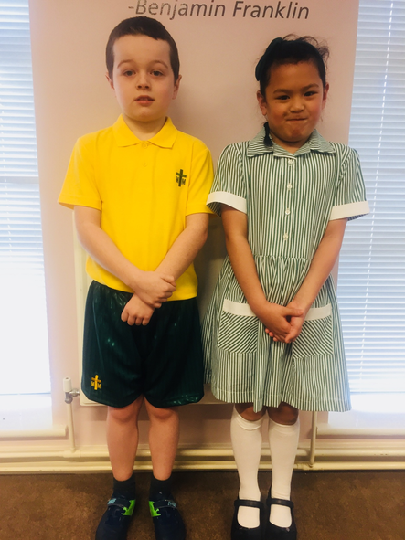
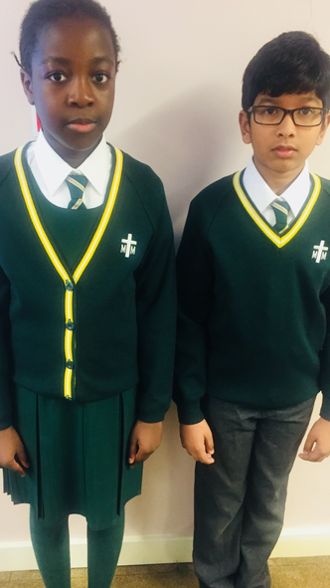
Uniform
Please ensure your child is wearing the correct school uniform and please refer to the guidance on the school website for both summer and winter.
Boys should wear grey ankle socks only.
Girls may wear either long or ankle white socks with the summer dress, however ankle socks are not permitted with the winter uniform.
Girls should wear long white socks or green/white tights with the winter uniform. Tights should not be worn with summer dresses.
Please ensure that your child’s school uniform is clearly labelled.

Slide 4
Expectations for Behaviour
We encourage all children to demonstrate a high standard of behaviour at all times in order to create a safe, respectful and happy learning environment.
Each class has participated in the process of making a set of ‘Golden Rules.’ The children have agreed to follow the rules as they understand that this will help their learning.
Respecting each other and all members of staff is expected and reflects the ethos of our school.
The children are required to listen carefully and to develop their self control and concentration in class and on the playground.
Working together with parents and guardians plays a big part in establishing good relationships and standards of behaviour.

Slide 5
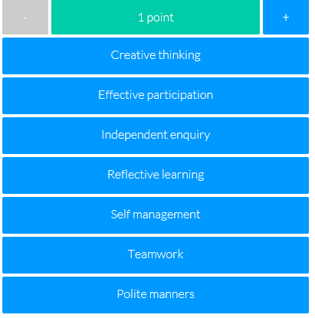
Expectations for Behaviour
Epraise
We use an online school rewards system designed to motivate students to work harder, attend more and behave better.
Our house points, demerits and detentions are recorded electronically and when the children accumulate their house points, they can redeem them for rewards. In addition to earning house points as a team, this new system recognises the efforts of individuals – the so-called ‘silent achievers’.
House points are awarded to children
for the following contributions to their
learning and the school environment:

Slide 6
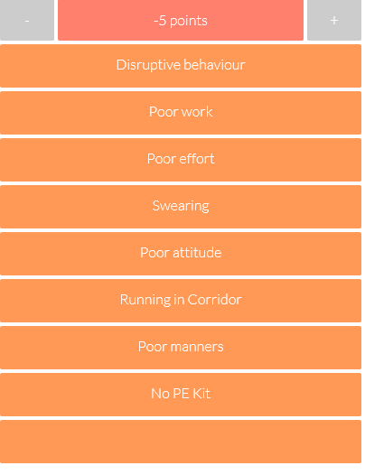
Expectations for Behaviour
Demerits are issued when a child fails to follow the school or class rules. They are also issued if a child doesn’t bring in a piece of homework when it’s due.
Three demerits equal a formal detention.
Formal detentions are recorded by the class teacher & Mrs Duggan and a note will go home with the child that requires a signature from the parent/carer.

Slide 7
Timetable
English and Maths - Daily
RE - once/twice a week
PE - Wednesdays (PE must be worn to school)
Swimming - Fridays
Art/D&T are rotated half-termly.

Slide 8
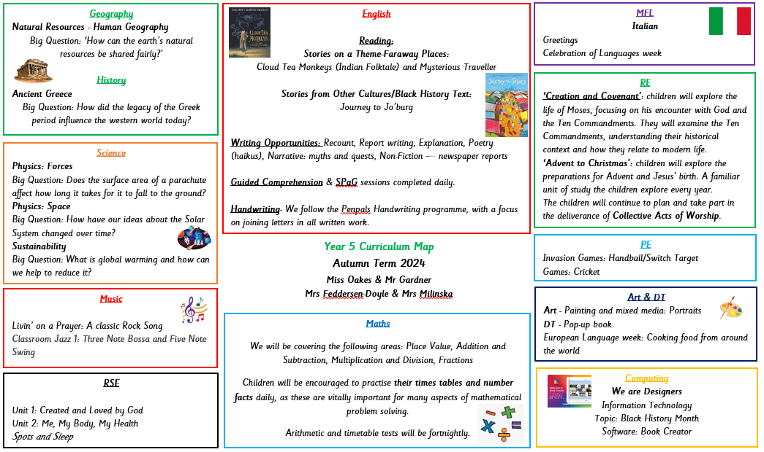
Curriculum Map
The Curriculum Map is available on our website and is updated termly.

Slide 9



English
Our English lessons are comprehensive, and we have adapted our curriculum to ensure we are reaching the needs of the children and consolidating strands from the previous year, whilst introducing the Year 5 curriculum.
Some of the texts we will be covering this year include:
Cloud Tea Monkeys
Journey to Jo’burg
The Adventures of Odysseus
Tom’s Midnight Garden
Street Child
We are passionate about all of the texts and it is important for us to engage and excite the children as this year is integral for them before moving into Year 6.

Slide 10

Reading
Reading at home is essential for helping children to make progress in English and across the curriculum areas.
As part of our home school agreement, as parents, you have agreed to support your child in reading for 20 minutes per night.
Reading Records allow us, as a school, to keep track of your child’s reading for enjoyment and the frequency of their reading.
Please support us by writing a brief comment when you listen to your child read.
Your child must write at least 3 comments every week and they must be signed by you.

Slide 11


Handwriting
Handwriting is a big focus currently for our school. Pupils should be demonstrating evidence of handwriting in-line with the corresponding stage statements on the writing Framework for letter formation/joining. It is expected across the school that pupils display handwriting that is joined/neat/correctly formed.
Only erasable ink pens are allowed.

Slide 12
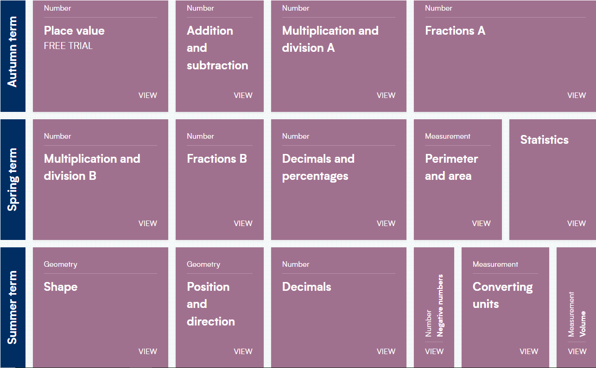
Maths
Maths forms an important part of our broad and balanced curriculum, where we endeavour to ensure that children develop an enjoyment and enthusiasm for maths. Children participate in daily maths lessons where learning is sequenced into small steps to break down key areas of learning.
We want the children to be confident, resilient mathematicians with a deep conceptual understanding of the skills and knowledge required to approach any mathematical problem.

Slide 13
Number facts
Number facts are early stage addition, subtraction, multiplication and division calculations that children should be able to recall easily and off by heart.
‘Fluency in calculations such as their multiplication facts has led to pupils tackling more complex problems with greater confidence and resilience.
Because they are no longer having to tackle remembering how to do the calculations needed or the most appropriate strategy to choose each time, they are able to put all their energy into how to solve their mathematical problem.’

Slide 14
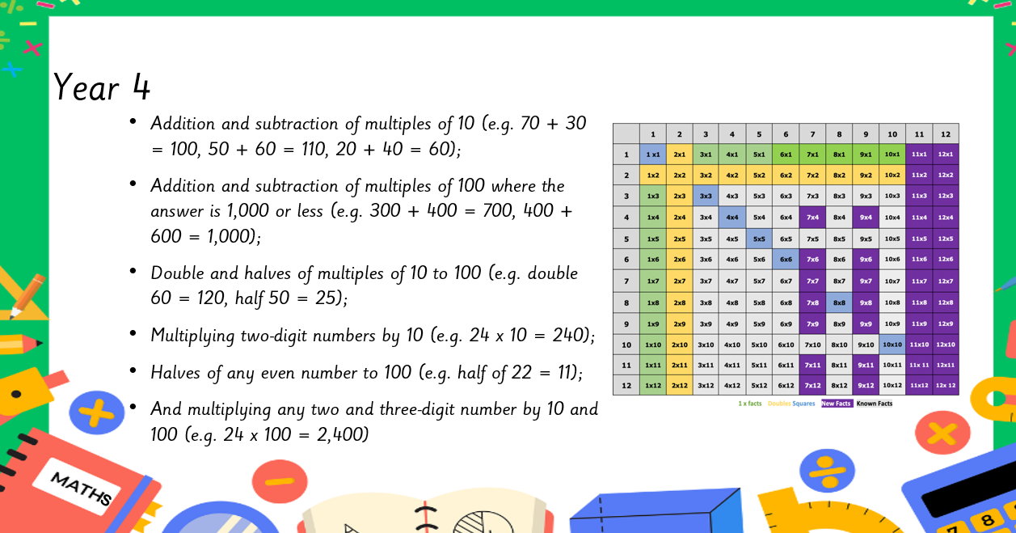
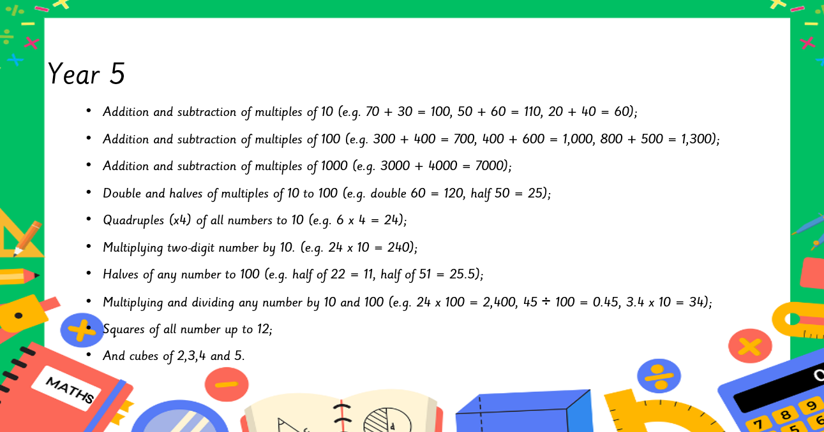

Slide 15

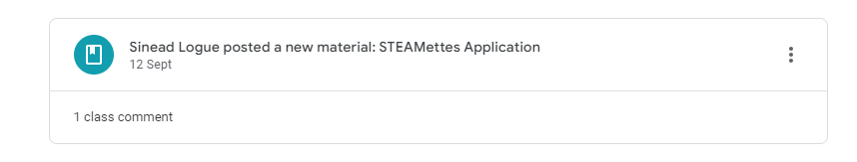

Google Classroom
Each year group has access to their own Google Classroom page which the children are proficient with.
Teachers across the school use the page for any announcements, homework or resources posted.
The children are encouraged to check Google Classroom every evening.

Slide 16
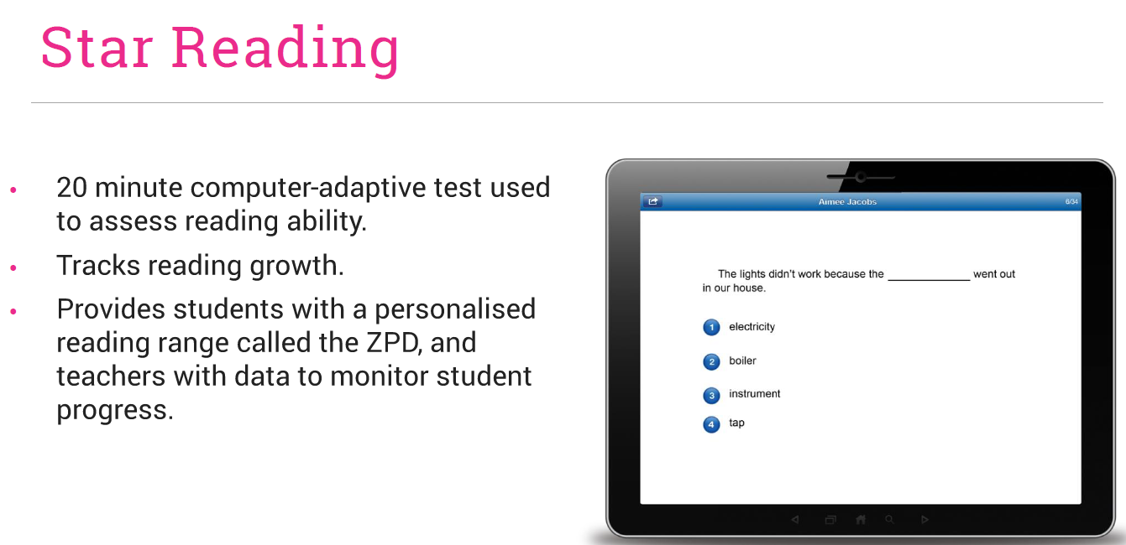
“Our primary purpose is to accelerate learning for all children of all ability levels and ethnic and social backgrounds”
- Accelerated Reader
Accelerated Reader

Slide 17
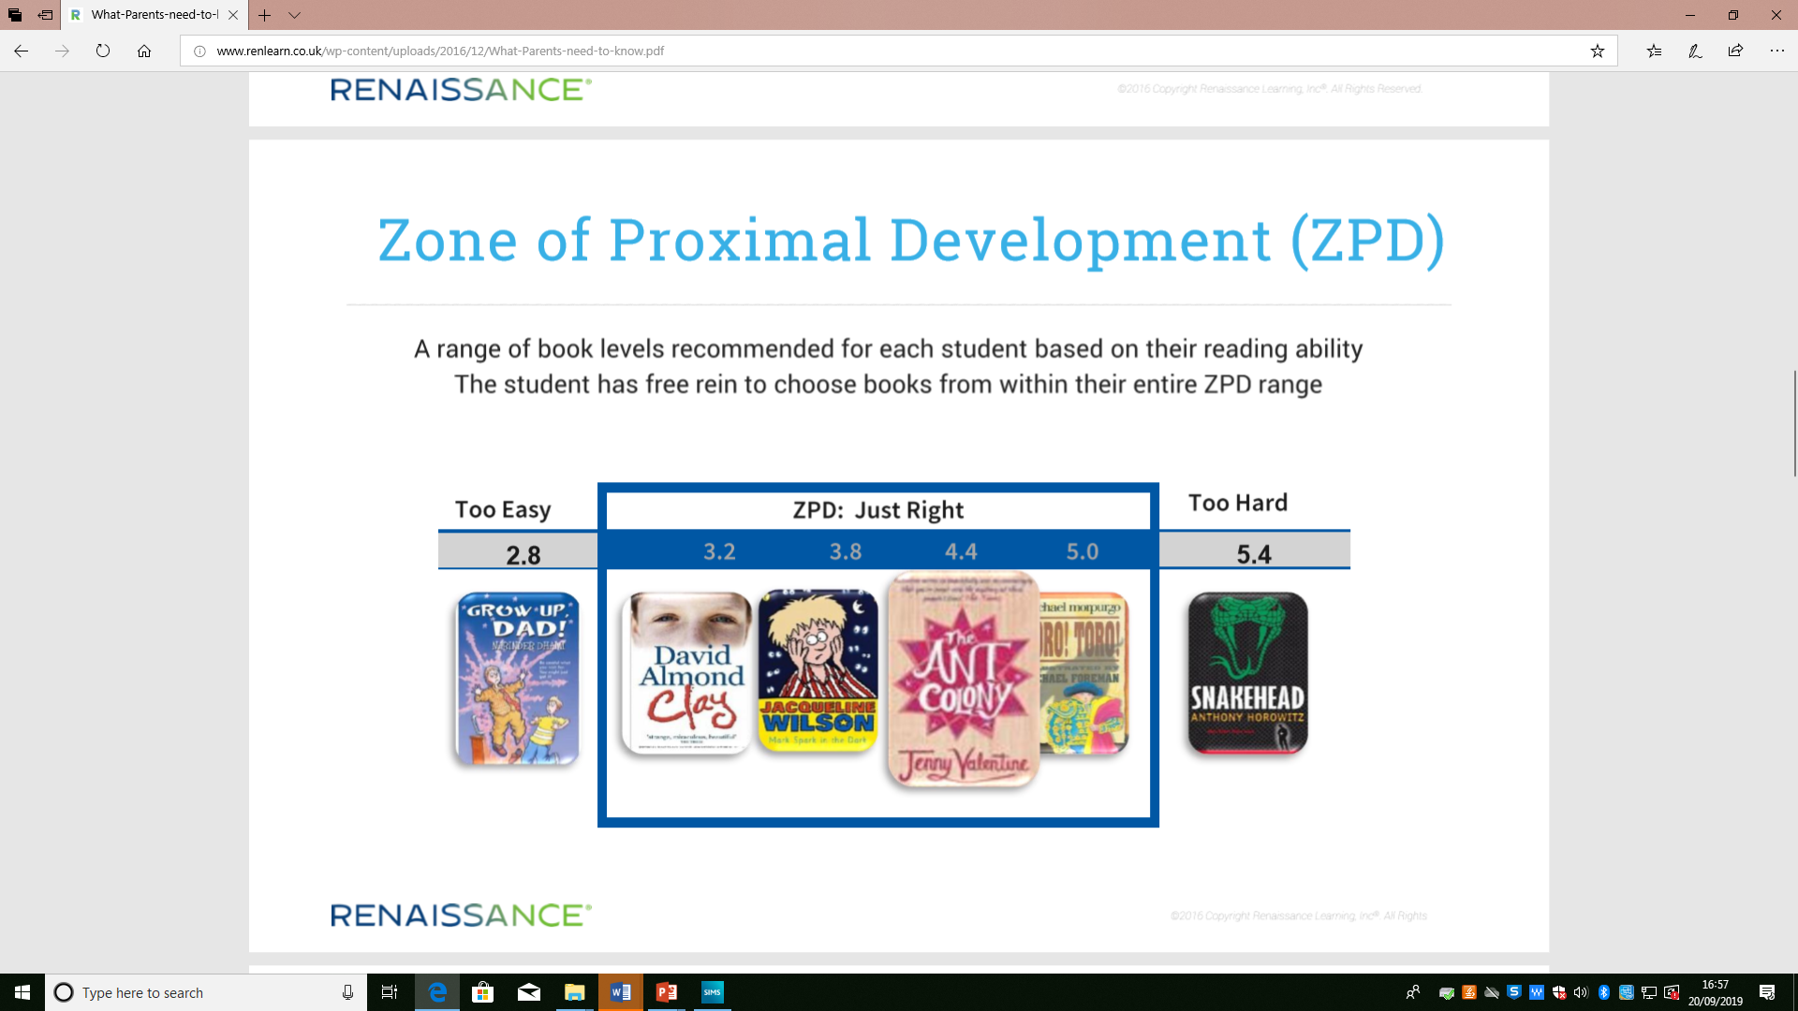

Slide 18


Trips
Educational workshops will take place throughout the year both in-school and off-site to provide exciting learning opportunities and experiences for the children. Next week, the children are taking part in cooking a delicious snack, as well as learning a traditional Australian song for ‘Languages Week’. There will also be a range of workshops and activities for the children to take part in during ‘Black History Month’ in October as well as Maths week in November.
In order for workshops and extra-curricular activities to take place, it is vital that timely contributions/payments are made. This enables the school to fund these activities and prepare well in advance.

Slide 19
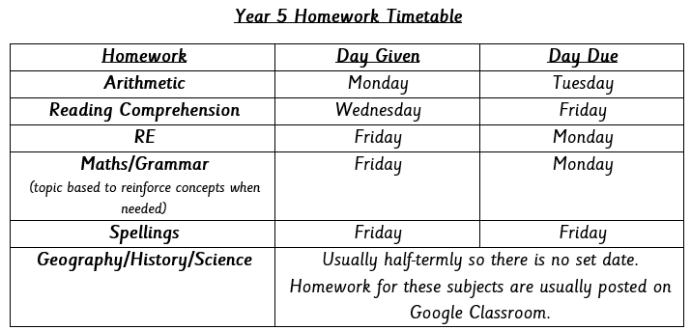
Homework Expectations
We have already provided the children with a homework timetable (stuck in the front/back of their Reading Record). We believe in setting homework accordingly to the children’s needs.
They are fully informed daily about their homework, both in school and on Google Classroom.
We would like the children to begin taking ownership of their own learning and ensuring that they are completing their homework without your prompting.
Pupils must revise the year 5 / 6 common exception words and times tables.
Useful Websites for home learning:
BBC Bitesize
Oxford Reading Owls
ICT Games
Top Marks Games
TTRockstars (times tables)

Slide 20

Marking and Feedback
Research has shown that the most effective form of feedback is immediate and given during the point of learning.
As a school, we have moved towards using verbal feedback as our main form of feedback.
Feedback includes verbal, paired, whole-class and written feedback given in NOW comments.

Slide 21

Parents Evening
There will be the option of one evening for face-to-face appointments and the other will be on School Cloud subject to availability.
Tuesday 4th/Wednesday 5th November

Slide 22

How can you help your child at School?

Slide 23

Reading – Children must read every day for 20 minutes. Please listen to your child read and comment/sign the record book at least once a week.
Attendance – every lesson counts
It is important that pupils attend school daily as this has an impact on their learning and progression. Classes are rewarded weekly for 100% attendance.
Punctuality
It is paramount that the children attend school on time. We organise our learning from 8:35am and the children will benefit greatly by starting their day by being as punctual as possible.
CGP revision books. These are a wonderful means of preparing for the demands of year 5 as well as next years SATs exams.
Notes:
Sabina – discuss this slide

Slide 24
Healthy snack and water bottle (daily) - No packed lunch boxes for break time snack
Pencil case – Pupils need a simple pencil case (no Smiggle stationery). Ensure your child has a pencil, eraser, sharpener, ruler, glue stick and a green pen.
English dictionary & Thesaurus (pocket size)
PE kits - PE takes place every Wednesday.
Screen time – Please try to limit the amount of time children spend using electronic devices. Excessive use can negatively impact their behaviour and their ability to apply themselves to lessons.
Prayers –The Confiteor (I Confess…) and The Memorare (Remember Oh Most Gracious Virgin Mary…)

Slide 25
Talk with your child. Talking and listening play major roles in children's school success. It's through hearing parents and family members talk and through responding to that talk that young children begin to pick up the language skills.
In addition, children who haven't learned to listen carefully often have trouble following directions and paying attention in class.
It's also important for you to show your child that you're interested in what he has to say. Talking With Your Child offers some great ideas for using conversation to stimulate language development.

Slide 26
Reminders
It is wonderful that the children are enthused and join many after school clubs, however, children must be collected as the club finishes. Unfortunately, children not picked up on time will be withdrawn from the club.
Discussions with a teacher at the school gates should be kept brief – please arrange a phone appointment through the office if you wish to discuss matters in more detail.
Home-school agreement must be adhered to as this will ensure that we are working collaboratively towards a common goal.

Slide 27

Wellbeing and Pastoral Support
The children have had many opportunities through discussions and lessons to speak about their feelings and express their opinions. We pride ourselves in supporting the children in building their resilience and making healthy new beginnings.
The additional ways in which we support the children are:
Choosing texts that provoke discussion and reflection
Collective Acts of Worship
Mindful moments and activities designed to calm our busy minds and focus on the present.
Gospel assembly
A class ‘Worry Box’
Gratitude journaling

Slide 28


Growth Mindset
It is extremely important you encourage your child to persevere when times are tough. Adopting a resilient attitude to challenges will greatly benefit your child’s well-being and overall success socially, emotionally and academically.

Slide 29

You can keep up to date with the school’s events and newsletters by looking at our school website and checking out our instagram page.
www.stmichaelandstmartin.co.uk

Slide 30

Thank you for your continued support.
We look forward to building positive relationships with you and we hope that your children have a happy and successful year ☺

Slide 31


