Slide 1

Welcome to the Year 4 curriculum talk!
Mr McElearney, Mrs Montenero, Mrs Pinto, Mrs Fernando

Slide 2

Learning our faith
Living our faith
Loving our faith

Slide 3
School Expectations
We encourage all children to demonstrate a high standard of behaviour at all times in order to create a safe, respectful and happy learning environment.
Each class has participated in the process of making a set of ‘Golden Rules.’ The children have agreed to follow the rules as they understand that this will help their learning.
Respecting each other and all members of staff is expected and reflects the ethos of our school. The children are required to listen carefully to their teachers and peers.
We are proud of how smart the children look in our new uniforms and have been very impressed by how the children take pride in their appearance.
Working together with parents and guardians plays a big part in establishing good relationships and standards of behaviour.
Every lesson counts! Attendance and punctuality is more important than ever in these uncertain times. Please ensure your child attends school every day if they are able.

Slide 4
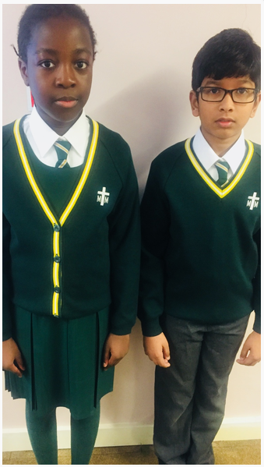
Uniform
Please ensure your child comes to school dressed in the correct school uniform.
Girls can only wear green or white tights with winter uniform and long or short white socks with summer uniform.
Long hair must always be tied back. No large or non-green hair accessories.
Trainers (black or otherwise) are not appropriate school shoes.
If you are unsure about haircuts, please refer to the school uniform policy.

Slide 5
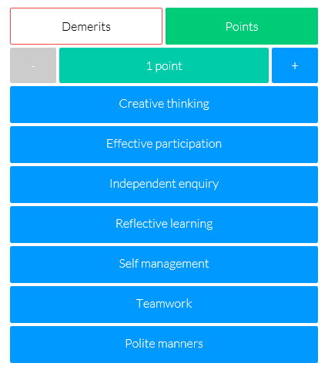
House points and Epraise
Epraise
We use an online school rewards system designed to motivate students to work harder, attend more and behave better.
Our house points, demerits and detentions are recorded electronically and when the children accumulate their house points, they can redeem them for rewards.
Members of staff can give out 1-5 house points for a range of different good behaviours that children are showing.

Slide 6
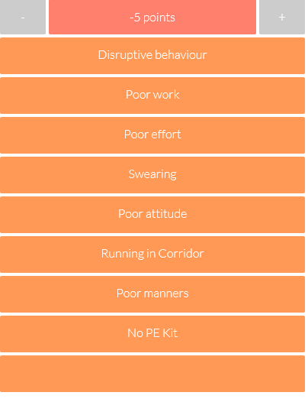
Demerits/Detentions
Demerits will be issued if your child:
Is not following the class rules
Late homework
No PE kit
If your child receives 3 demerits in one week, your child will be issued with a detention. They will be issued with a detention slip which will need to be signed and returned to school.

Slide 7

School Attendance
It is vital that children attend school everyday. Every lesson counts! If your child is ill, on return to school a letter explaining absence must be given to their class teacher.
If your child is absent on a Friday, please ensure that they get a copy of the homework from a friend.

Slide 8
Our Top Tips
•Tip 1: Remember your child’s education is a partnership. Attend parents evenings to discuss your child's progress including strengths and areas for development.
•Tip 2: Support your child with homework tasks and daily reading. Try drawing or acting out answers of difficult concepts.
•Tip 3: Make sure your child is aware that getting stuck is not a problem. Move on and give them another challenge and come back to the hard ones at the end and/or go through it together.

Slide 9
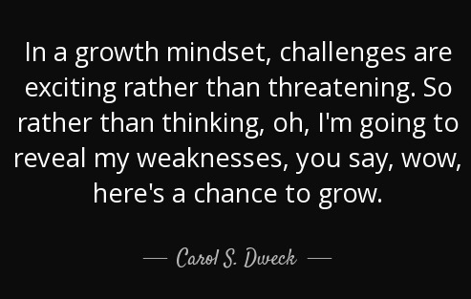

Growth Mindset
It is extremely important you encourage your child to persevere when times are tough. Adopting a resilient attitude to challenges will greatly benefit your child.
First
Attempt
In
Learning

Slide 10
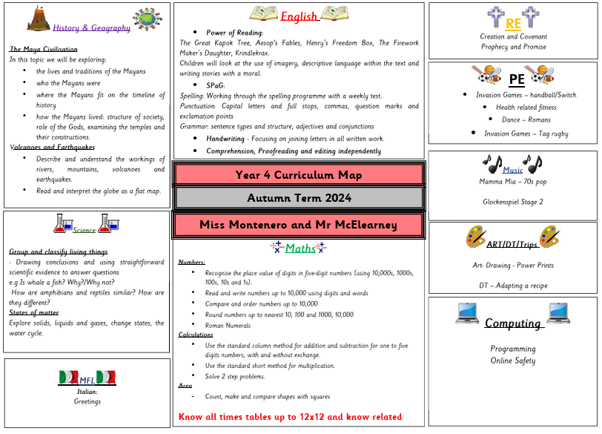
Curriculum Maps
Autumn 2025

Slide 11
Routines - homework
It is essential that the children complete their homework in a timely manner. Each week, the homework that has been set, consolidates the learning that has been happening in your child’s class.
A timetable has been sent home with your children. Please keep an eye on google classroom for any changes.

Slide 12
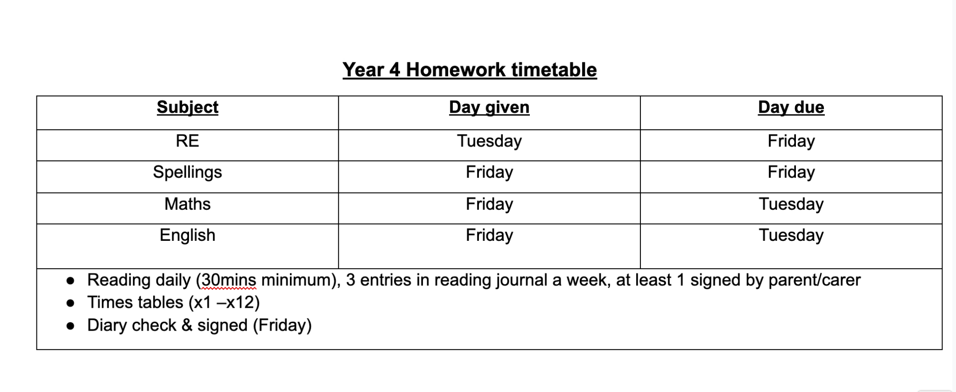
Homework timetable
A piece of science/topic homework may also be sent home to further your child’s understanding.

Slide 13
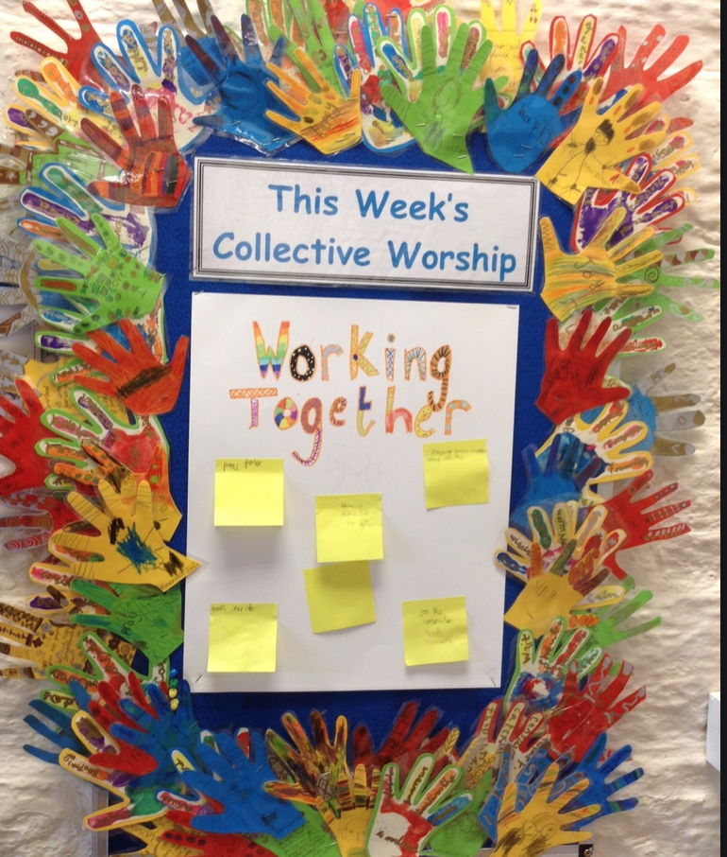

Collective Worship
To help with the children’s well-being and spiritual life, Collective Worship and Reflection will take place daily. The Collective Worship will be both teacher and child-led and overseen by our Chaplaincy Team.

Slide 14

Collective Worship and reflection opportunities
Every Monday there will be a Gospel Assembly or Mark 10 mission.
Collective acts of worship which are lead by the children will take place at least once a week. There is also a teacher led moment of reflection once a week.
Daily prayer time allocated within the classroom.
Well being and mindfulness activities carried out regularly.
Each classroom has a worry box.
Notes:
‹#›

Slide 15
Curriculum: English
Reading skills
Identify words which have been chosen to interest the reader
Make predictions about what might happen next in the text
Read a wide range of fiction/ non – fiction / poetry
Draw inferences about events from a story, retrieving information accurately
Writing skills
Write with joined handwriting
A greater emphasis on the development of vocabulary, spelling, punctuation and grammar
Curriculum: Maths
Solve 2 step problems
Know all times tables up to 12x12 and know related division facts
Solving arithmetic questions within time constraints
Problem solving and reasoning – mastery questions
Read, write and convert times between analogue and digital (including 24 hour)

Slide 16
Year 4 Times Tables check
Schools should administer the multiplication tables check within the 3-week period from Monday 8 June 2026.
25/25 is needed for a pass!

Slide 17
Reading Records
Reading at home is essential for helping children to make progress across the curriculum.
As part of our home-school agreement, you have agreed to support your child in reading for 20 minutes each day.
Reading Records allow us as a school to keep track of your child’s reading.
Please support us by writing a brief comment when you listen to your child read.
Child to record date, title and rating daily. They only need to write a more detailed comment 3 times each week.

Slide 18


Slide 19

Encourage your child to read. Helping your child become a reader is the single most important thing that you can do to help the child to succeed in school-and in life. The importance of reading simply can't be overstated. Reading helps children in all school subjects.

Slide 20
Sport
PE kits:
PE takes place every Thursday. All children should come to school on this day wearing their named PE kit.
Additional PE every other Monday - children to wear normal uniform and trainers.
Please remember to supply your child with a named water bottle everyday.

Slide 21
Pick up and drop off
Please be aware that the teacher on duty at the front gate in the mornings is there to ensure that all children are welcomed into school safely. They will be unable to have lengthy discussions in the morning. If you do wish to speak to your child’s teacher, you are more than welcome to book an appointment via the school office.
Children must be collected promptly from school at 3:30pm. Remember to inform your child’s class teacher or the school office if there is a change in who is collecting them as this can pose significant safeguarding risks.
If your child attends an after school club, they must be collected on time otherwise the pupil will no longer be allowed to attend that club. This will be strictly monitored on a three strike basis.

Slide 22

School trips

Slide 23

Google classroom
Make sure your child has access to our year 4 google classroom, as this is where we will post any notices if needed.

Slide 24
Talk with your child. Talking and listening play major roles in children's school success. It's through hearing parents and family members talk and through responding to that talk that young children begin to pick up the language skills.
In addition, children who haven't learned to listen carefully often have trouble following directions and paying attention in class.
It's also important for you to show your child that you're interested in what they have to say. Talking With Your Child offers some great ideas for using conversation to stimulate language development.

Slide 25

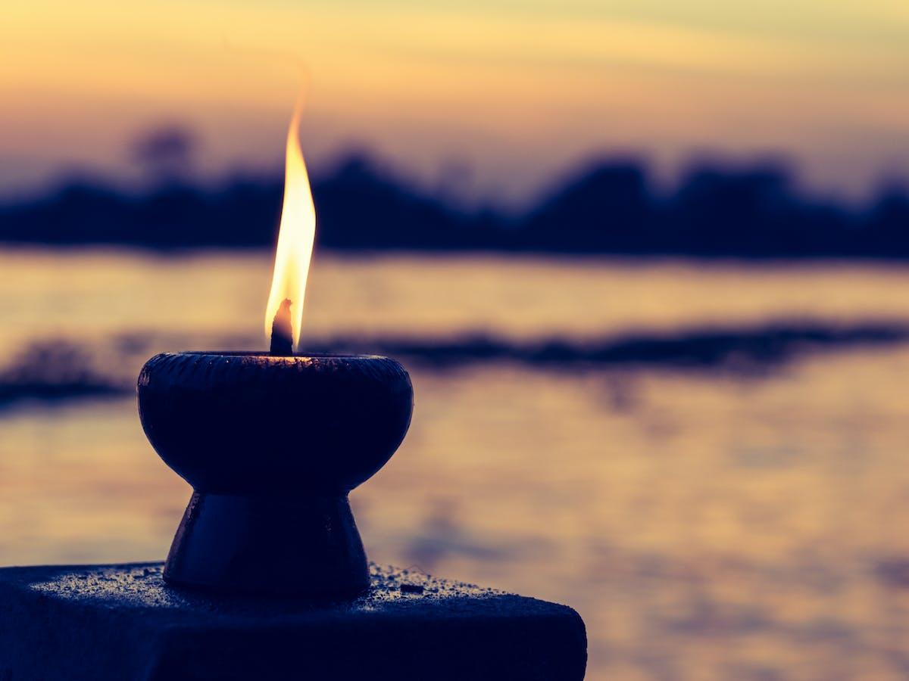
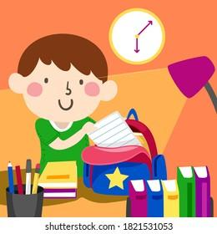


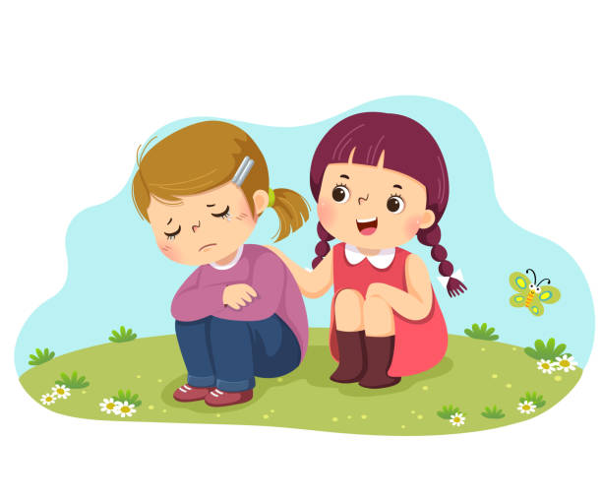
STRIVE -School Visions and Values
Here at St Michael and St Martin, we want the children display these core values to help them be well-rounded individuals. They must strive to be:
Spiritual
Thinkers
Resilient
Independent
Valued
Empathetic

Slide 26


Please keep up-to-date with the curriculum and weekly newsletters by looking at our school website, checking your emails often, as well as checking our Twitter page for school events.
www.stmichaelandstmartin.co.uk
@STMM20

Slide 27

Thank you for your continued support. We look forward to building positive relationships with you, and we hope that your child will have a happy and successful year.

