Slide 1

Welcome to the Year 3 curriculum talk!
Miss Moran
and Mrs Enyenihi

Slide 2
Mission statement
Learning our faith
Living our faith
Loving our faith

Slide 3
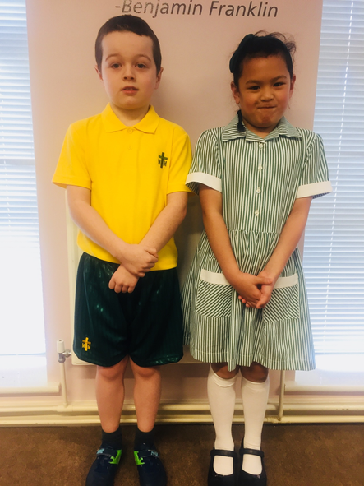
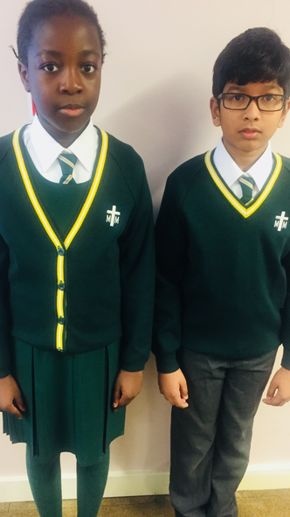
Uniform
Please ensure your child is wearing the correct school uniform and please refer to the guidance on the school website for both summer and winter.
Boys should wear grey ankle socks only.
Girls may wear either long or ankle white socks with the summer dress, however ankle socks are not permitted with the winter uniform.
Girls should wear long white socks or green/white tights with the winter uniform. Tights should not be worn with summer dresses.
Please ensure that your child’s school uniform is clearly labelled.

Slide 4
Expectations for Behaviour
We encourage all children to demonstrate a high standard of behaviour at all times in order to create a safe, respectful and happy learning environment.
Each class has participated in the process of making a set of ‘Golden Rules.’
The children have agreed to follow the rules as they understand that this will help them learn.
Treating each other and all members of staff with respect and courtesy is expected of both children and parents and this reflects the ethos of our school.
The children are required to listen carefully to develop their self control and concentration in class and in the playground.
Working together with parents and guardians plays a big part in establishing good relationships and standards of behaviour.

Slide 5
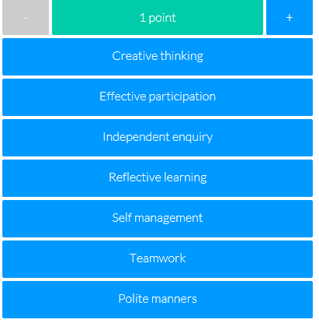
Expectations for Behaviour
Epraise
We use an online school rewards system designed to motivate students to work harder, attend more and behave better.
Our house points, demerits and detentions are recorded electronically and when the children accumulate their house points, they can redeem them for rewards. In addition to earning house points as a team, this new system recognises the efforts of individuals – the so-called ‘silent achievers’.
House points are awarded to children
for the following contributions to their
learning and the school environment:

Slide 6
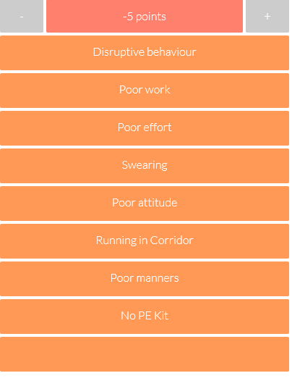
Expectations for Behaviour
Demerits are issued when a child fails to follow the school or class rules. They are also issued if a child doesn’t bring in a piece of homework when it’s due.
Three demerits equal a formal detention.
Formal detentions are recorded by the class teacher & Mrs Duggan and a note will go home with the child that requires a signature from the parent/carer.

Slide 7





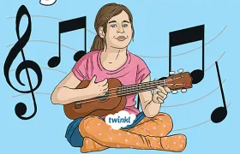

KS2 Transition
Reading Record – Please listen to your child read and comment/sign the Reading Record
Pencil case – include sharp pencils, coloured pencils, highlighter, a glue stick and a rubber.
Healthy Snack
Ukulele Music
First Holy Communion
Unauthorised absences

Slide 8
Timetable
English and Maths - Daily
RE - once/twice a week
PE - Tuesday (PE must be worn to school)
Music - Ukulele on Tuesday
Art/D&T are rotated half-termly.
History/Geography are rotated half-termly.
Computing - weekly

Slide 9
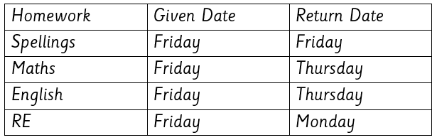
Homework Timetable
Useful Websites for home learning:
BBC Bitesize
Oxford Reading Owls
ICT Games
Top Marks Games
TTRockstars (times tables)
There will be projects given for history, geography, design and technology throughout the year. The information for these will be put onto Google Classroom and will be in addition to the homework schedule.

Slide 10
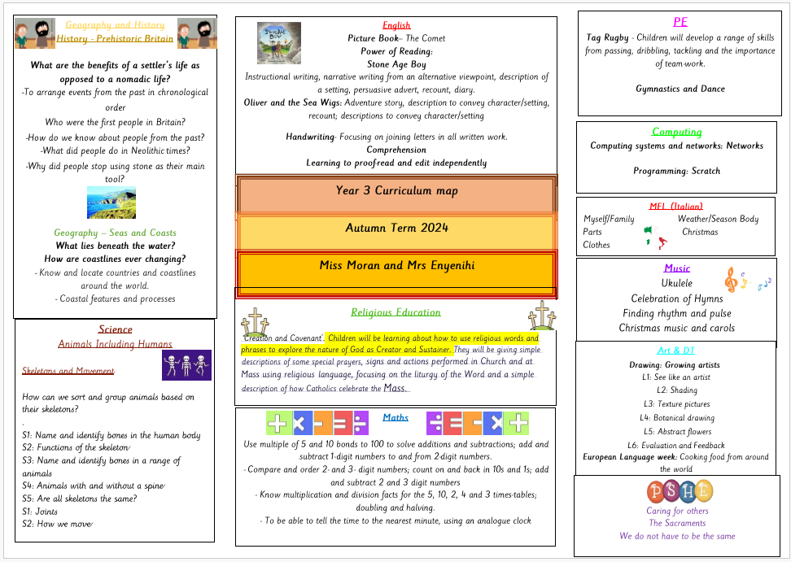

Slide 11
Reading and Writing
Reading skills
Identify words which have been chosen to interest the reader
Make predictions about what might happen next in the text
Summarise ideas from several paragraphs of reading
Recognise some different forms of poetry
Writing skills
Write with joined handwriting
A greater emphasis on the development of vocabulary, spelling, punctuation and grammar e.g. possessive apostrophes, prefixes and suffixes and using conjunctions, prepositions and adverbs

Slide 12



Slide 13

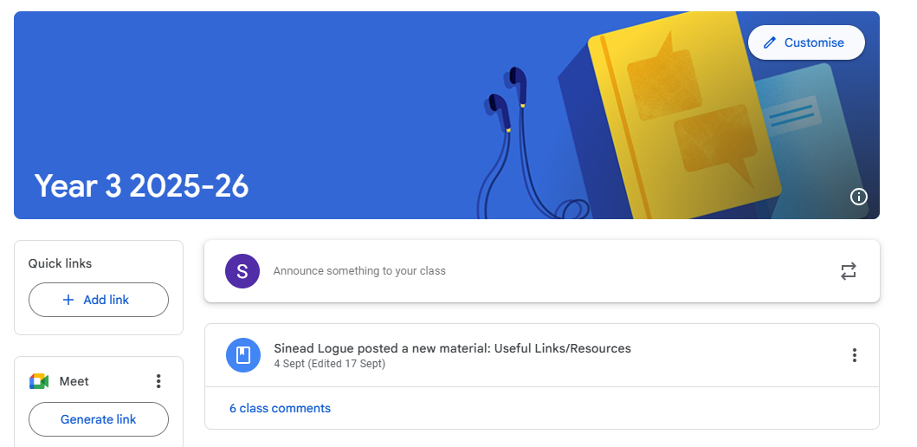
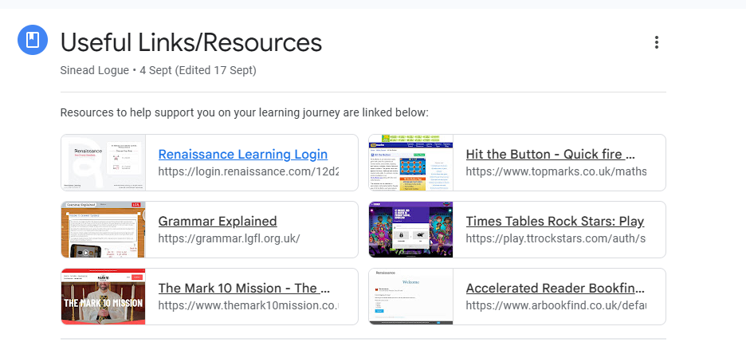


Slide 14
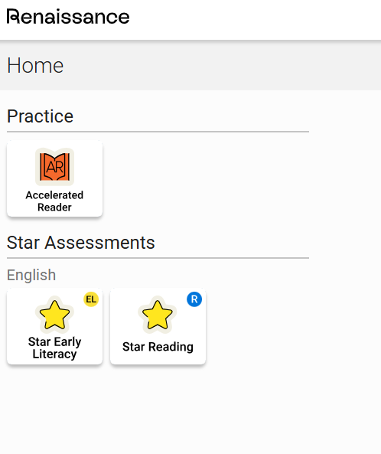
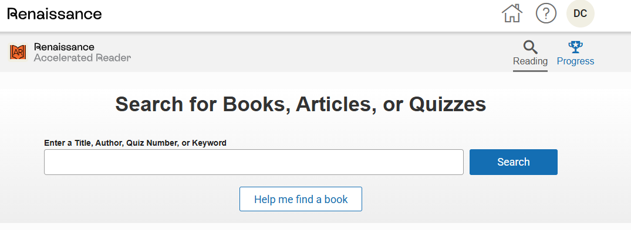
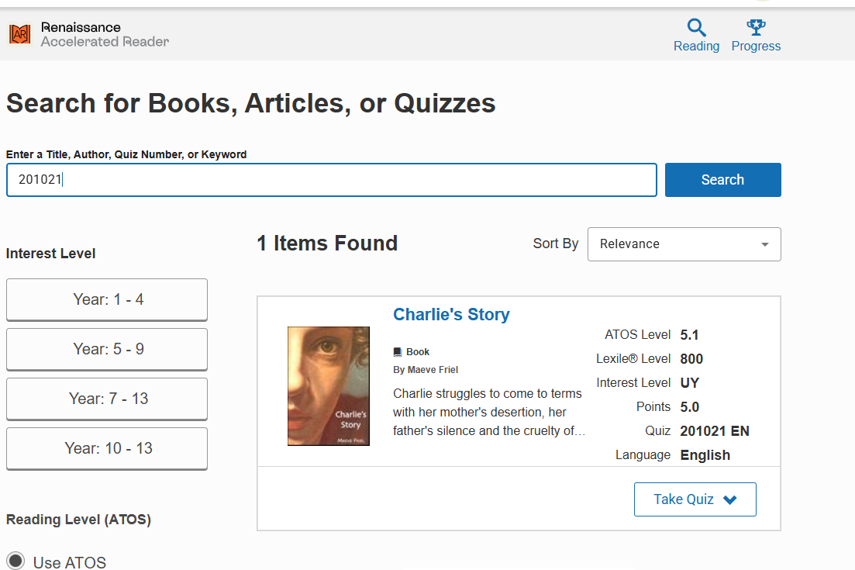

Slide 15
Reading Records
Reading at home is essential for helping children to make progress across the curriculum.
As part of our home-school agreement, you have agreed to support your child in reading for 20 minutes each day.
Reading Records allow us as a school to keep track of your child’s reading.
Please support us by signing it with your initial when you listen to your child read.
Child to record date and title daily. They only need to write a more detailed comment 3 times each week and these will be checked. Parents need to sign their child’s comment.

Slide 16
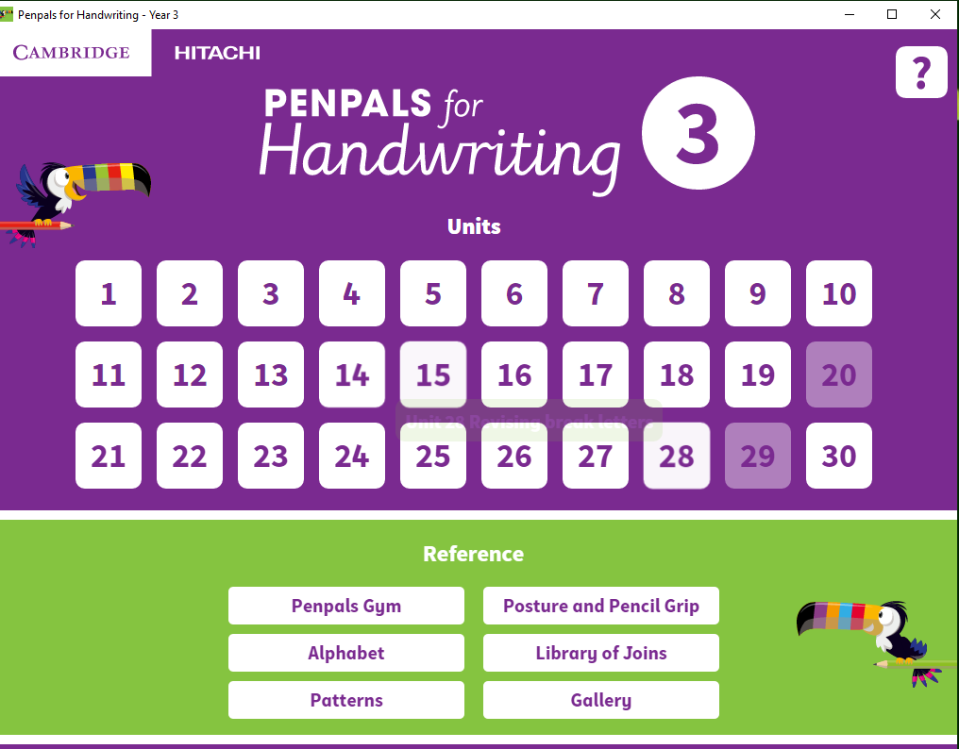
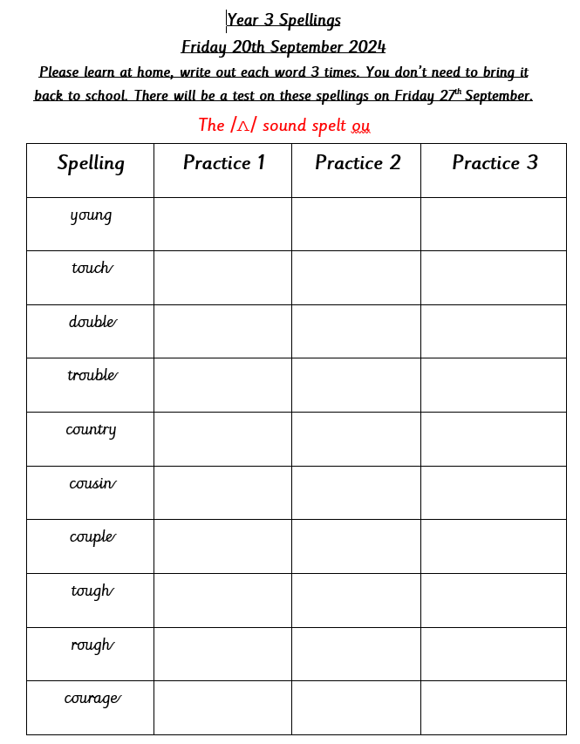

Slide 17
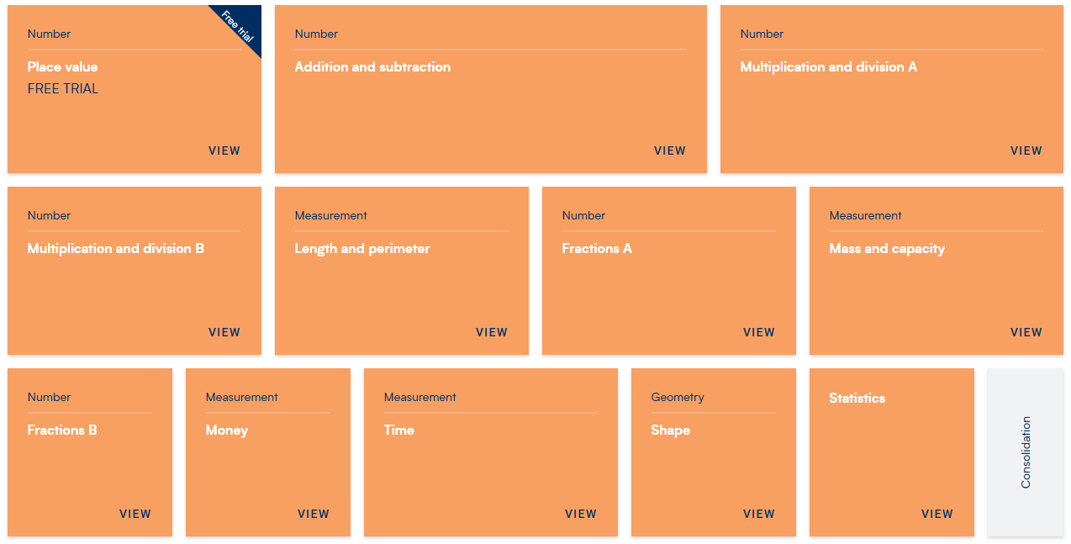
Maths
Maths forms an important part of our broad and balanced curriculum, where we endeavour to ensure that children develop an enjoyment and enthusiasm for maths. Children participate in daily maths lessons where learning is sequenced into small steps to break down key areas of learning.
We want the children to be confident, resilient mathematicians with a deep conceptual understanding of the skills and knowledge required to approach any mathematical problem.

Slide 18



Slide 19
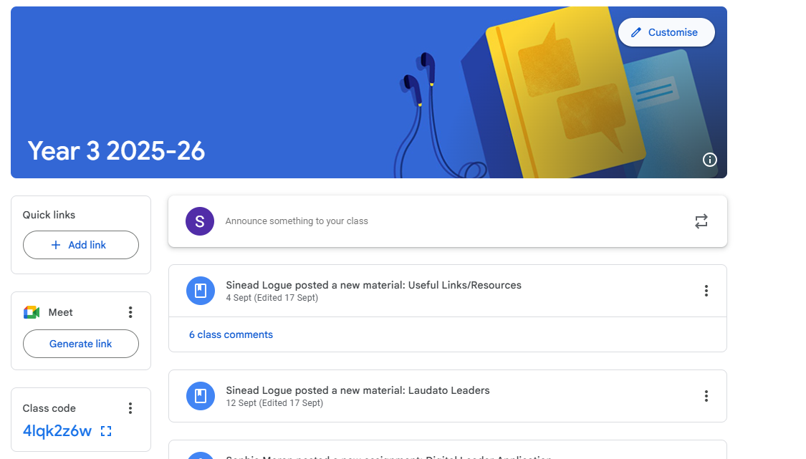
Google Classroom
Each year group has access to their own Google Classroom page which the children are proficient with.
Teachers across the school use the page for any announcements, homework or resources posted.
The children are encouraged to check Google Classroom every evening.

Slide 20
Our Top Tips
•Tip 1: Remember your child’s education is a partnership. Attend parents evenings to discuss your child's progress including strengths and areas for development.
•Tip 2: Support your child with homework tasks and daily reading. Try drawing or acting out answers of difficult concepts.
•Tip 3: Make sure your child is aware that getting stuck is not a problem. Move on and give them another challenge and come back to the hard ones at the end and/or go through it together.

Slide 21
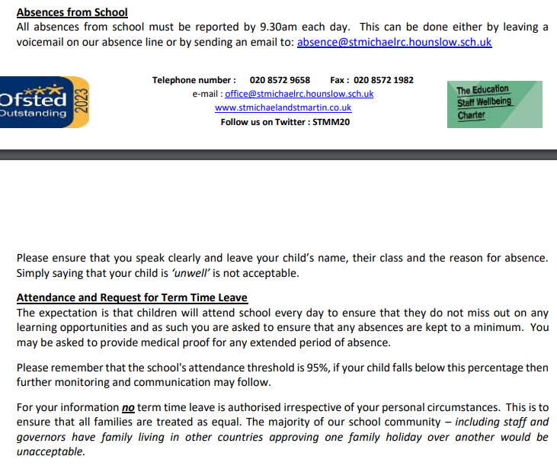

School Attendance
It is vital that children attend school everyday. Every lesson counts!
If your child was absent, on return to school a brief note explaining absence must be given to their class teacher. Follow the school procedure for reporting absences explained in the welcoming letter by Mrs Duggun.
Any holiday during term time will be unauthorised.

Slide 22

School trips
Date: 12 Nov 2025

Slide 23

Parents Evening
There will be the option of one evening for face-to-face appointments and the other will be on School Cloud subject to availability.
Tuesday 4th November and Wednesday 5th November

Slide 24

Pick up and drop off
Children must be collected promptly from school at the allocated time.
Remember to inform your child’s class teacher or the school office if there is a change in who is collecting them as this can pose significant safeguarding risks.

Slide 25





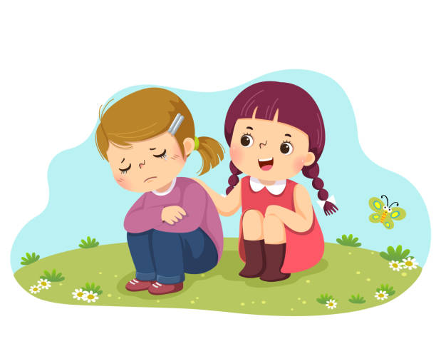
STRIVE -School Visions and Values
Here at St Michael and St Martin, we want the children to develop these core values to help them be well-rounded individuals. They must strive to be:
Spiritual
Thinkers
Resilient
Independent
Valued
Empathetic
A STRIVE assembly is held on a Tuesday to recognise and celebrate children who are displaying these attributes in class and school.

Slide 26

Please keep up-to-date with the curriculum and weekly newsletters by looking at our school website, checking your emails regularly, as well as checking Class Pages, Google Classroom and our Twitter feed for school events.
www.stmichaelandstmartin.co.uk

Slide 27
Internet Safety
Advice for Parents & Carers
September 2025
Miss Moran

Slide 28


IT COULD HAPPEN HERE!

Slide 29
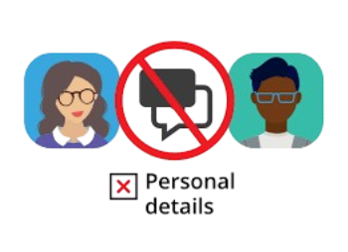


10 Key Internet Safety Tips for Children
Be careful who you talk to – strangers can pretend to be children. Never share personal details (name, school, address, photos). If asked for pictures, say no and tell a trusted adult.
Social media age limits – most apps require you to be 13+. Keep accounts private, think before posting, and remember images can be shared anywhere once uploaded.
AI tools – not everything they generate is true. Never give them personal info or photos, as these could be misused.

Slide 30



10 Key Internet Safety Tips for Children
4. Your digital footprint matters – what you post now could affect things like job opportunities later.
5. If something upsets you online – tell a trusted adult straight away and report it using the app’s tools (usually via the 3 dots).
6. Check your sources – news and stories online may be fake or misleading.

Slide 31




10 Key Internet Safety Tips for Children
7. Beware of scams – don’t forward chain messages or give out passwords or payment details.
8. Avoid money transfer schemes – offers of “easy cash” are usually linked to crime.
9. Think before spending in games – loot boxes and in-game purchases can add up quickly.
10. Don’t believe everything you see – people edit photos, exaggerate lifestyles, or use AI. Gang life online, for example, is rarely what it seems.

Slide 32
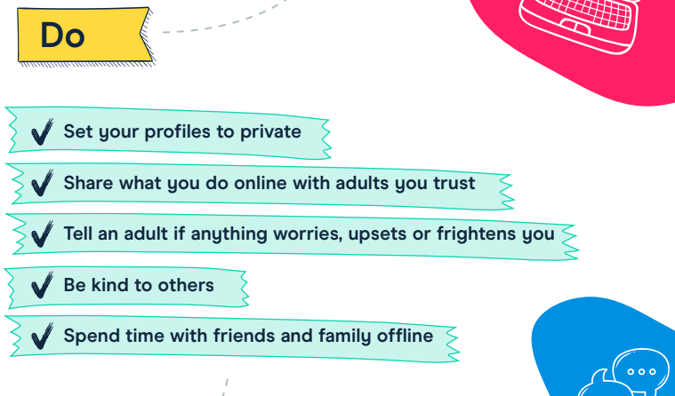

Slide 33
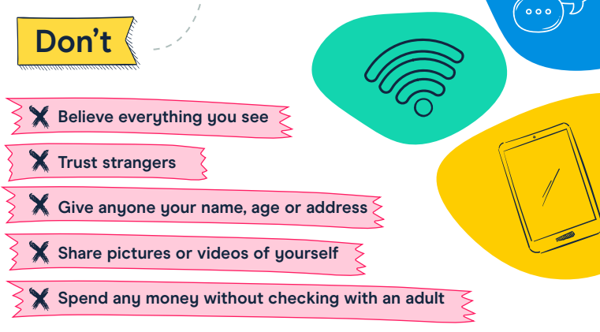

Slide 34
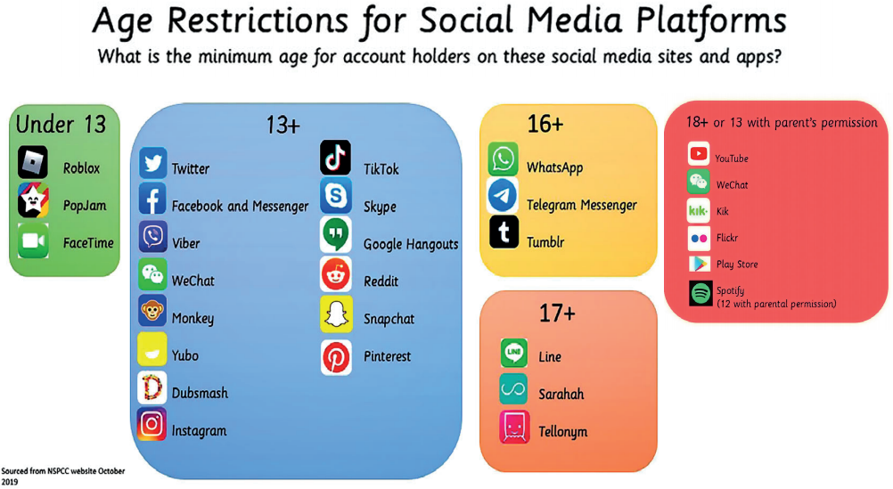

Slide 35
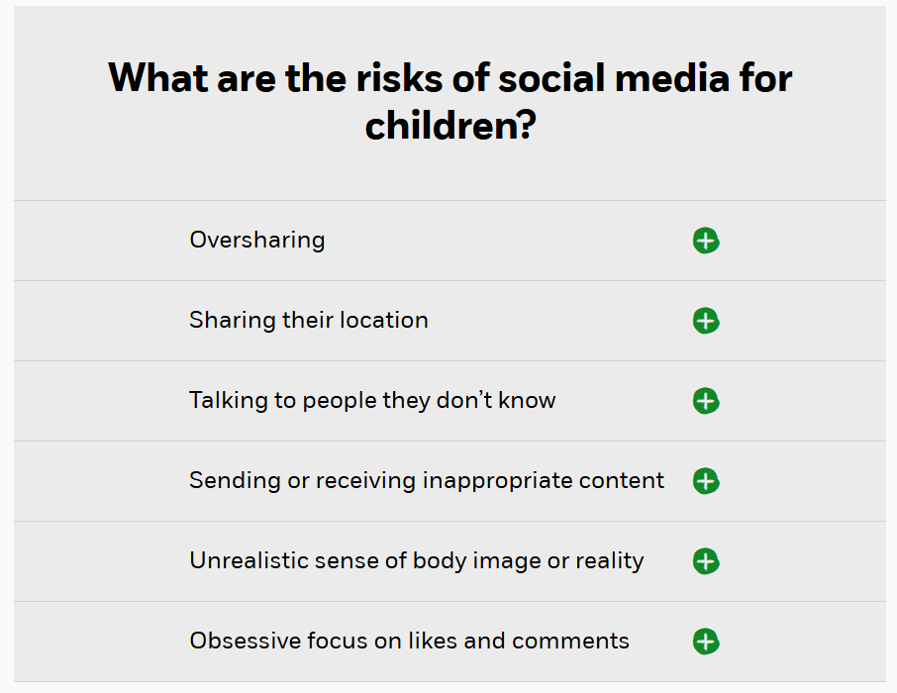







Slide 36
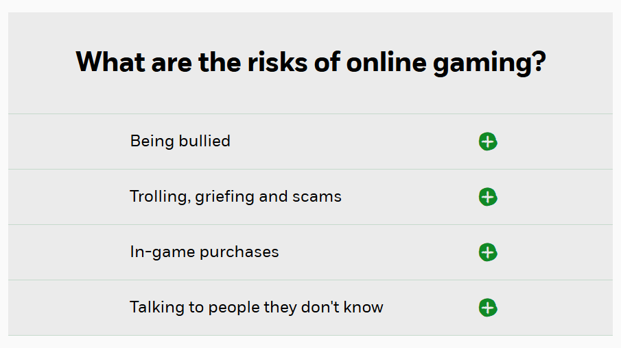




Slide 37

“I thought he safe…he was just in his room.”

Slide 38
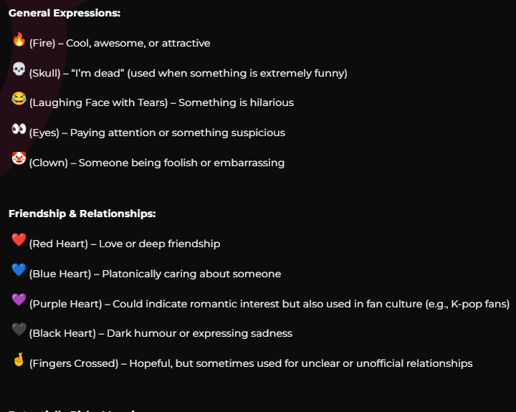
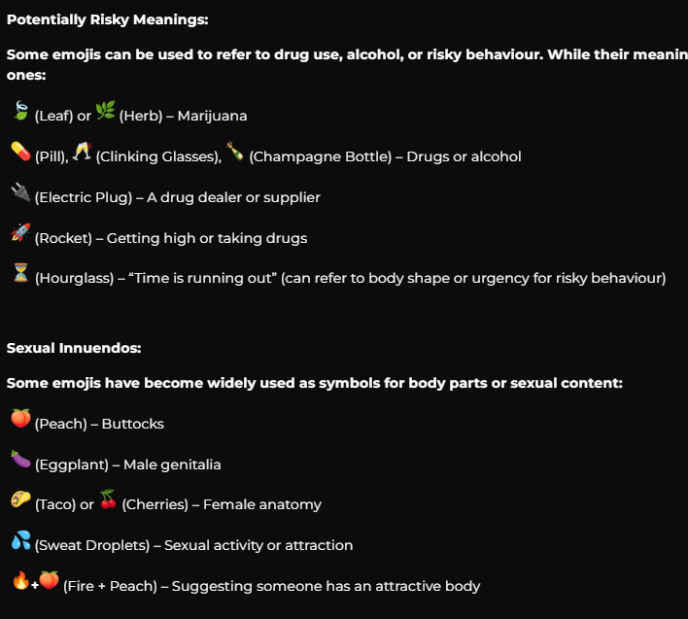
https://www.schoolsforeverychild.org.uk/blog-posts/understanding-teen-emoji-language-a-guide-for-parents-to-keep-children-safe-online
In today’s digital world, teenagers are using emojis as a form of coded language on social media, texting apps, and online forums. While most emoji use is harmless, some symbols carry hidden meanings that parents should be aware of, especially when they relate to risky behaviours such as substance use or inappropriate online interactions.

Slide 39


Children and Parents: Media Use and Attitudes Report (May, 2025)
https://www.ofcom.org.uk/siteassets/resources/documents/research-and-data/media-literacy-research/children/childrens-media-use-and-attitudes-report-2025/childrens-media-literacy-report-2025.pdf?v=396621

Slide 40
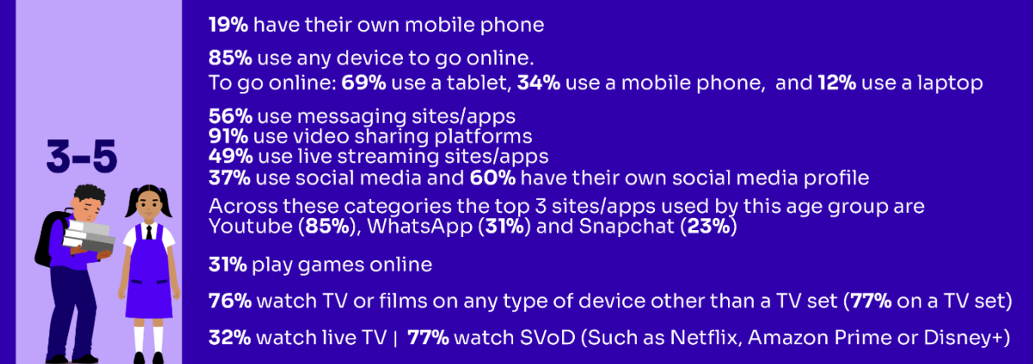
Media use, by age:

Slide 41
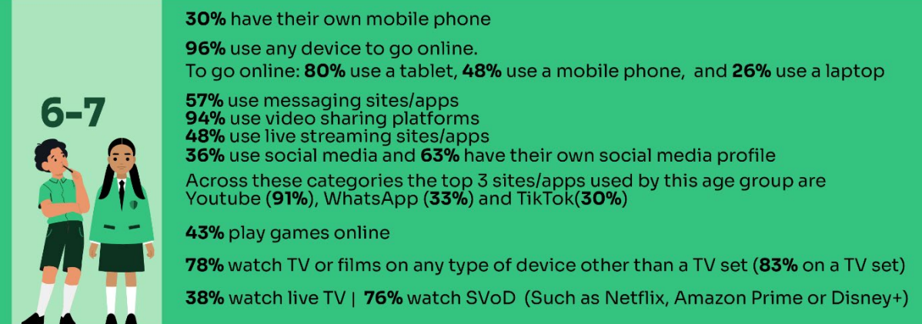
Media use, by age:

Slide 42
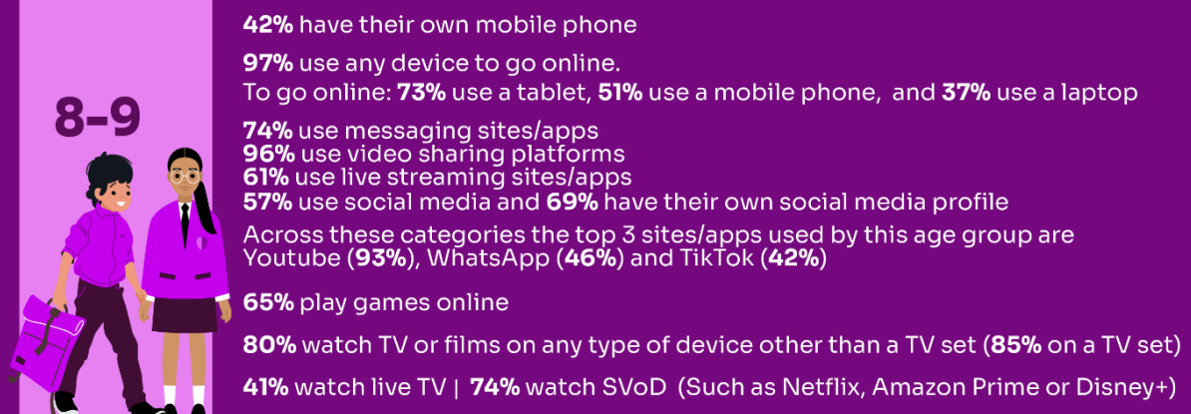
Media use, by age:

Slide 43
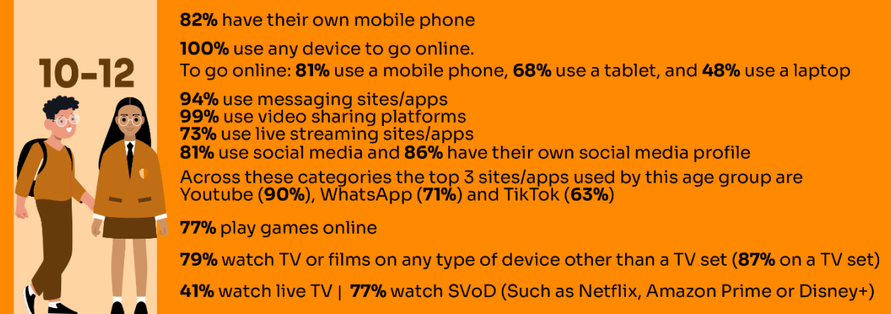
Media use, by age:

Slide 44
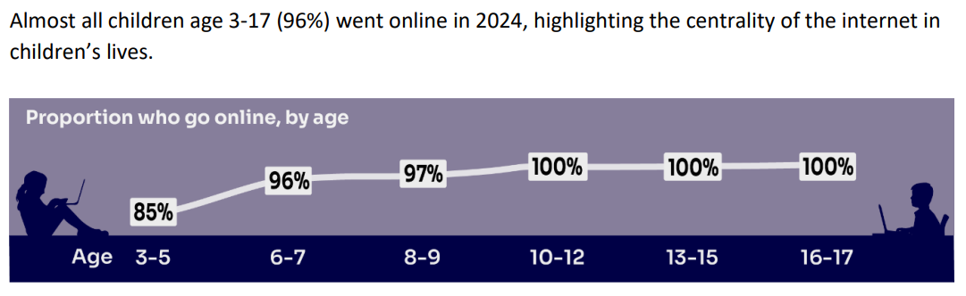

Slide 45
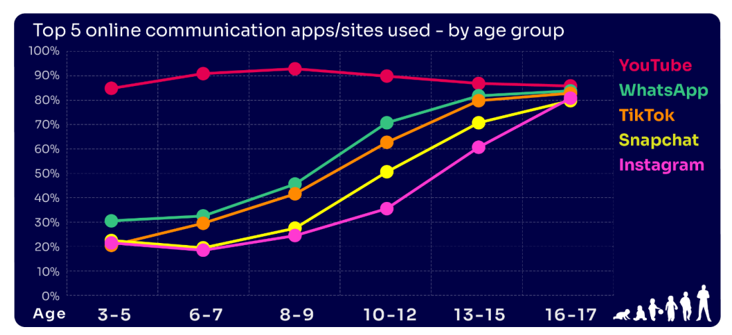

Slide 46
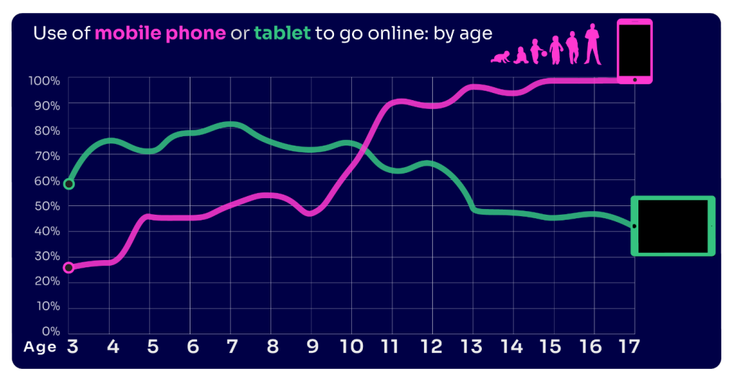

Slide 47
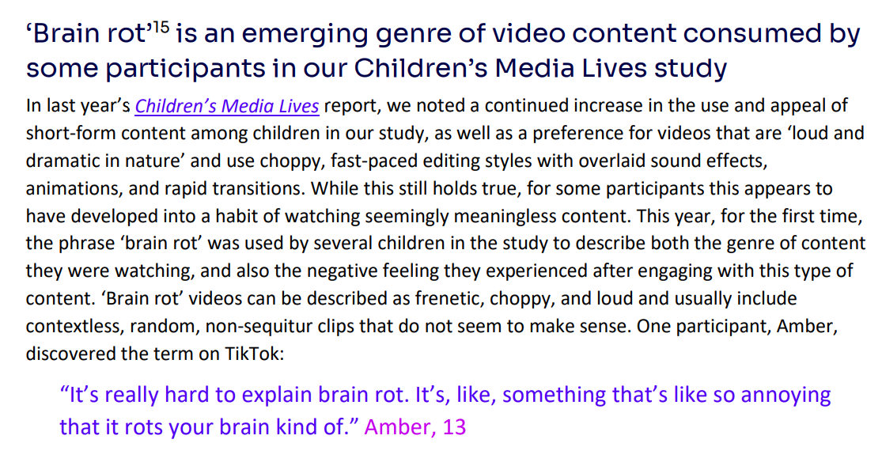

Slide 48
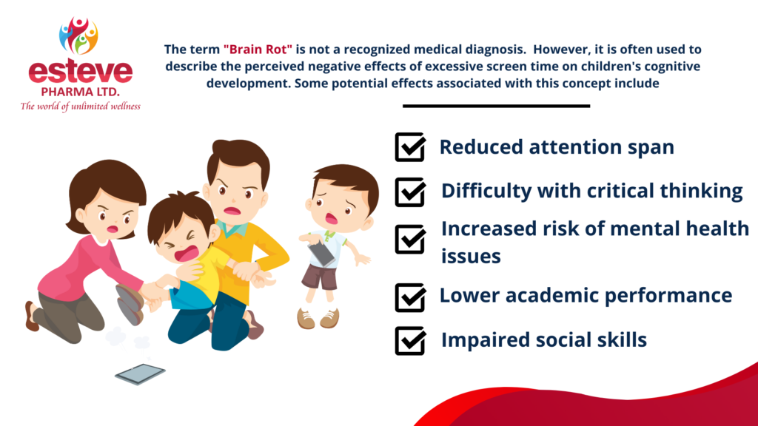

Slide 49
Key Findings:
Nearly four in ten 8-17s believe that people are mean or unkind to each other online all or most of the time
Girls continue to be more likely than boys to experience nasty or hurtful interactions online
Certain demographics (8-13) are more likely to see worrying or nasty content online
Nearly four in ten parents would let their child create a profile before reaching the minimum age
Parents continue to set rules for their children about being online, although there have been some decreases among parents of 10-12s
A high proportion of parents are aware of online protection tools or controls, but many do not use them
Many parents who are aware of content filters prefer to rely on their child’s ability to navigate online content

Slide 50

https://www.securus-software.com/dangerous-apps-for-children/

Slide 51


How can we help to protect children?

Slide 52
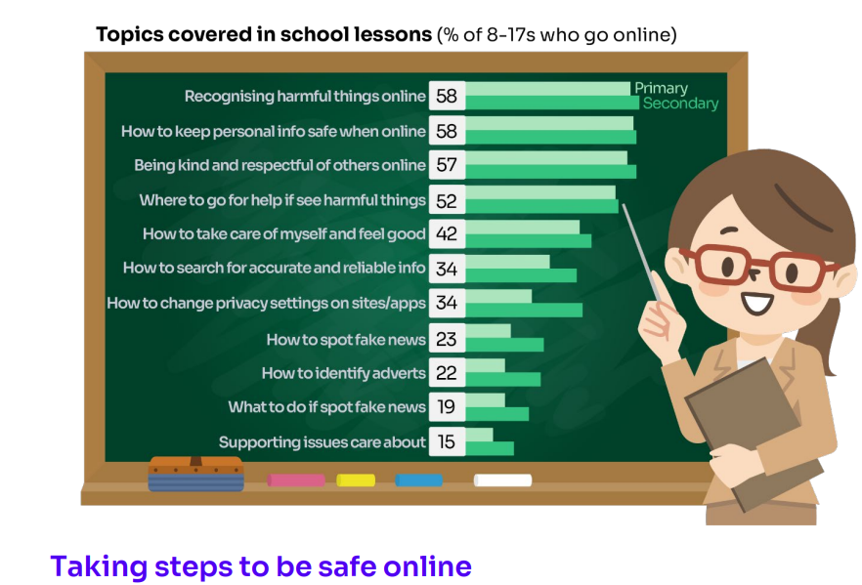

Slide 53
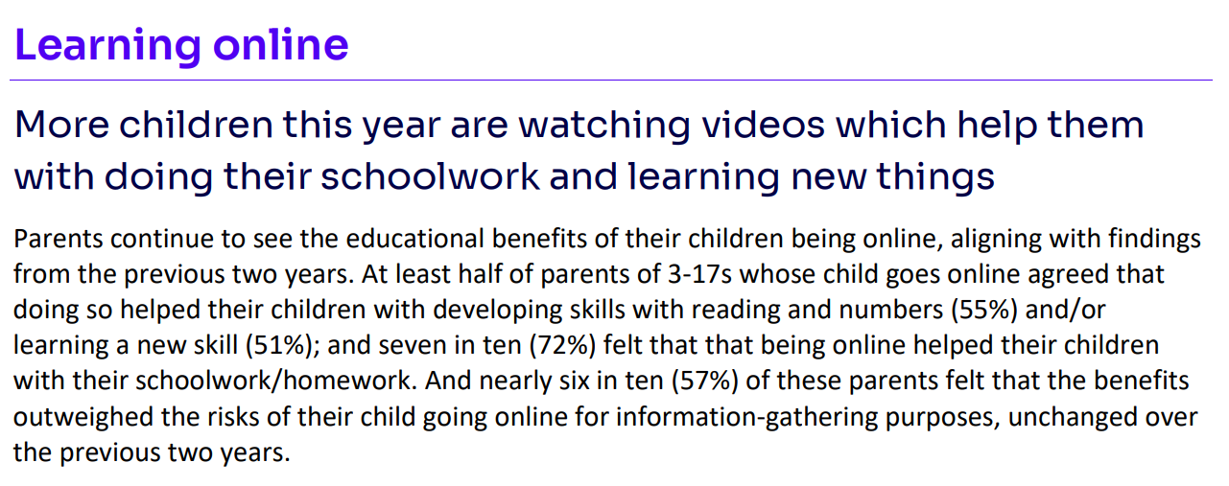

Slide 54
✅ Actionable Advice for Online Safety
Set Clear Screen Time Limits
Agree on daily/weekly screen time and stick to it.
Use tools like “downtime” or “bedtime” features on devices to automatically limit usage.
Encourage balance: outdoor play, reading, and family time alongside screen time.

Slide 55
✅ Actionable Advice for Online Safety
2. Stay Informed and Educated
Keep up to date with the apps, games, and websites your child is using.
Explore resources like NSPCC Net Aware, UK Safer Internet Centre, or Childnet.
Talk to your child regularly about their online interests so you understand what they enjoy and where risks might lie.

Slide 56
✅ Actionable Advice for Online Safety
3. Remember: It Could Happen Here
Don’t assume “my child would never…”—online risks (cyberbullying, strangers, inappropriate content) can affect any child.
Keep conversations open so children feel safe telling you if something goes wrong.

Slide 57
✅ Actionable Advice for Online Safety
4. Use Filtering and Parental Controls
Activate filters on your home Wi-Fi and on individual devices.
Set up child accounts with age-appropriate restrictions.
Regularly review privacy and security settings on apps and websites.

Slide 58
✅ Actionable Advice for Online Safety
5. Limit Internet Access Times
No devices in bedrooms overnight—charge them in a shared space.
Set “offline times” such as during meals, family activities, or before school.

Slide 59
✅ Actionable Advice for Online Safety
6. Monitor Devices Proactively
Keep devices in shared areas where you can see what’s happening.
Check browsing history, app use, and friend lists on social apps/games.
Consider agreeing a “digital contract” with your child, setting expectations about how devices are used.

Slide 60
✅ Actionable Advice for Online Safety
7. Talk Openly and Regularly
Encourage your child to tell you if they see something that worries or confuses them.
Role-play scenarios (“What would you do if someone you don’t know messages you?”).
Praise honesty—children are less likely to hide mistakes if they feel supported.

Slide 61
✅ Actionable Advice for Online Safety
8. Model Good Online Habits
Show your child that you also put your phone away at dinner or bedtime.
Be mindful of your own screen time, social media use, and sharing of photos/information.

Slide 62




Useful links and resources:
https://www.nspcc.org.uk/keeping-children-safe/online-safety/
https://saferinternet.org.uk/guide-and-resource/parents-and-carers
https://www.gov.uk/government/publications/coronavirus-covid-19-keeping-children-safe-online/coronavirus-covid-19-support-for-parents-and-carers-to-keep-children-safe-online
https://www.barnardos.org.uk/get-support/support-for-parents-and-carers/child-abuse-and-harm/keeping-children-safe-online

Slide 63
Thank you for your continued support.
We look forward to building positive relationships with you, and we hope that your child will have a happy and successful year.

