Slide 1

Mission Statement
Learning our faith
Living our faith
Loving our faith

Slide 2
Internet Safety
Advice for Parents & Carers
September 2025
Miss Moran

Slide 3


IT COULD HAPPEN HERE!

Slide 4



10 Key Internet Safety Tips for Children
Be careful who you talk to – strangers can pretend to be children. Never share personal details (name, school, address, photos). If asked for pictures, say no and tell a trusted adult.
Social media age limits – most apps require you to be 13+. Keep accounts private, think before posting, and remember images can be shared anywhere once uploaded.
AI tools – not everything they generate is true. Never give them personal info or photos, as these could be misused.

Slide 5



10 Key Internet Safety Tips for Children
4. Your digital footprint matters – what you post now could affect things like job opportunities later.
5. If something upsets you online – tell a trusted adult straight away and report it using the app’s tools (usually via the 3 dots).
6. Check your sources – news and stories online may be fake or misleading.

Slide 6




10 Key Internet Safety Tips for Children
7. Beware of scams – don’t forward chain messages or give out passwords or payment details.
8. Avoid money transfer schemes – offers of “easy cash” are usually linked to crime.
9. Think before spending in games – loot boxes and in-game purchases can add up quickly.
10. Don’t believe everything you see – people edit photos, exaggerate lifestyles, or use AI. Gang life online, for example, is rarely what it seems.

Slide 7
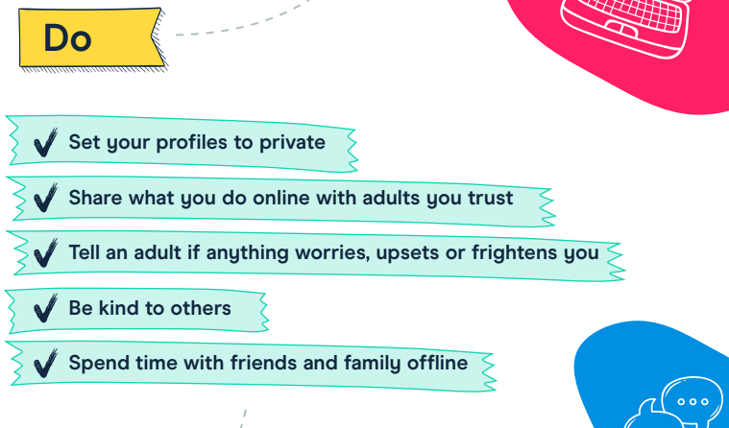

Slide 8
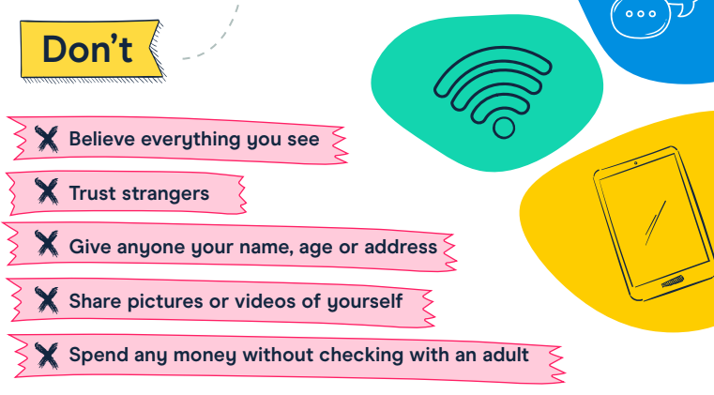

Slide 9
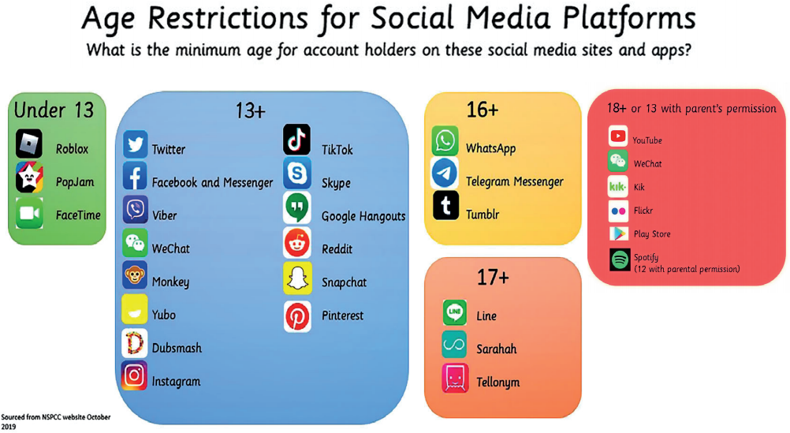

Slide 10
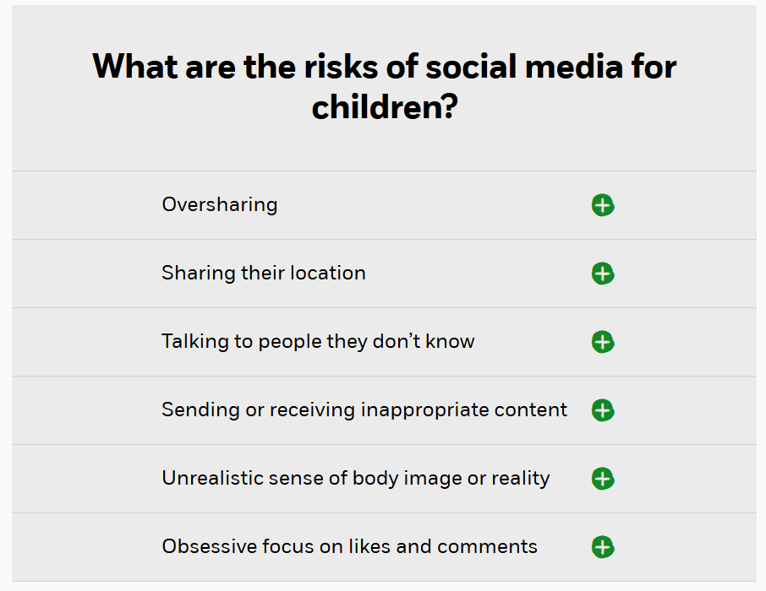







Slide 11
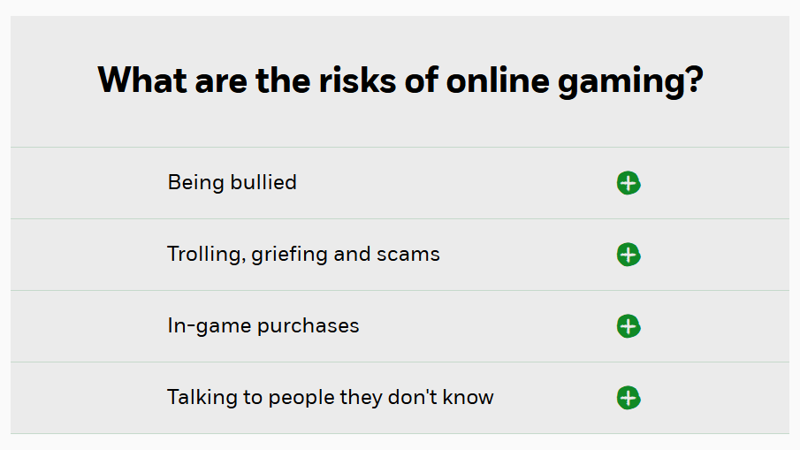




Slide 12



Roblox
Sign up with the correct age
Make sure your child creates an account using the correct age. On Roblox, certain safety settings and parental controls are enabled by default for children under 13. However, you should still review the settings to ensure they’ve been set up correctly.
Build a list of age-appropriate games
Not all games on Roblox will be appropriate for your child. The platform has a setting that lets parents and carers limit what their child can play by allowing them to build lists of age-appropriate games. You can also switch off in-app spending or set them monthly limits.
Explore communication settings
You can manage who your child can speak to by disabling chat completely or limiting it to friends only. You can also switch off their inbox to stop them receiving direct messages.

Slide 13

“I thought he safe…he was just in his room.”

Slide 14
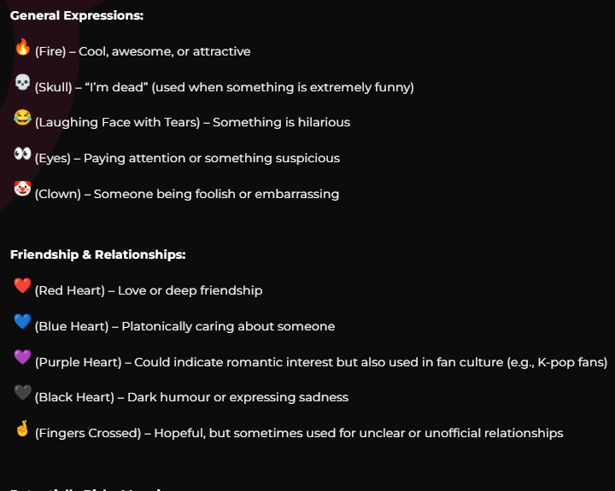
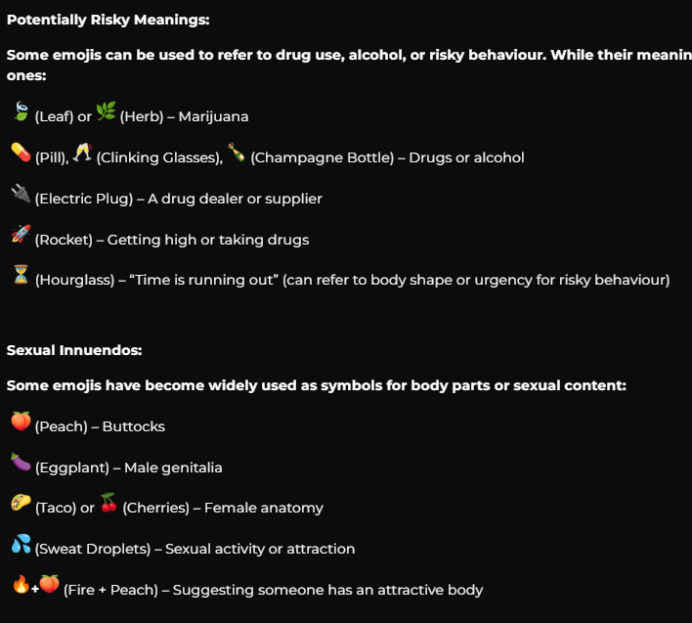
https://www.schoolsforeverychild.org.uk/blog-posts/understanding-teen-emoji-language-a-guide-for-parents-to-keep-children-safe-online
In today’s digital world, teenagers are using emojis as a form of coded language on social media, texting apps, and online forums. While most emoji use is harmless, some symbols carry hidden meanings that parents should be aware of, especially when they relate to risky behaviours such as substance use or inappropriate online interactions.

Slide 15


Children and Parents: Media Use and Attitudes Report (May, 2025)
https://www.ofcom.org.uk/siteassets/resources/documents/research-and-data/media-literacy-research/children/childrens-media-use-and-attitudes-report-2025/childrens-media-literacy-report-2025.pdf?v=396621

Slide 16
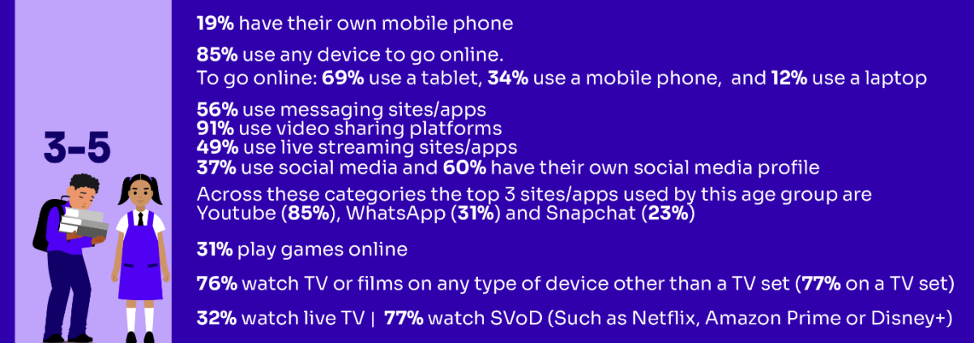
Media use, by age:

Slide 17
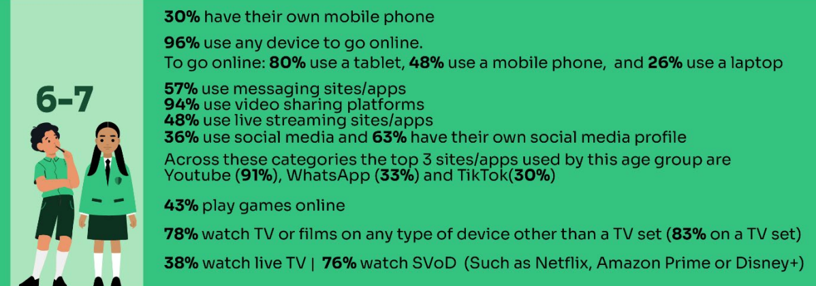
Media use, by age:

Slide 18
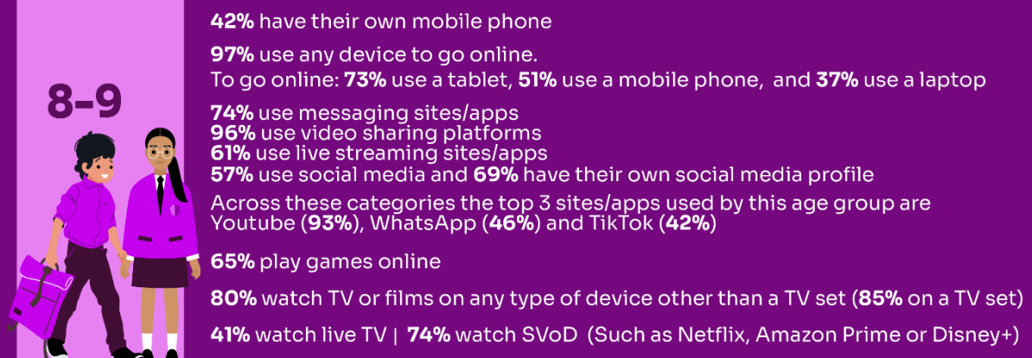
Media use, by age:

Slide 19
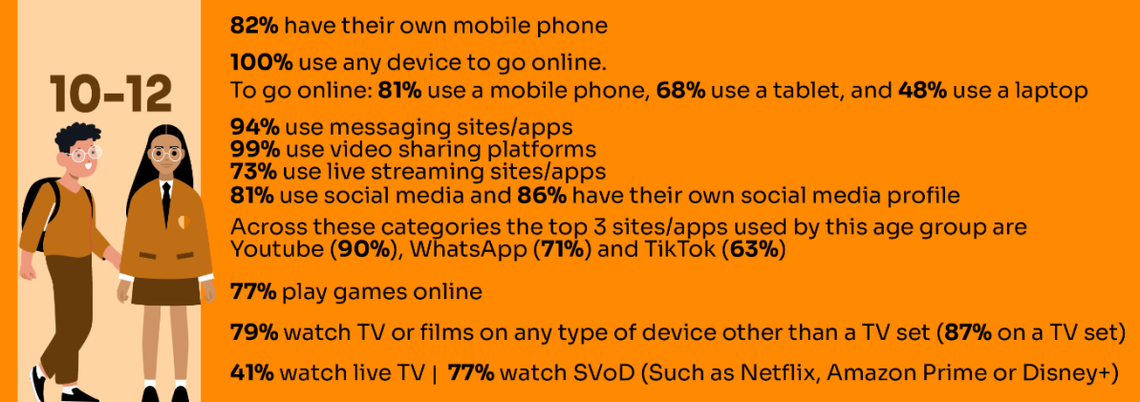
Media use, by age:

Slide 20
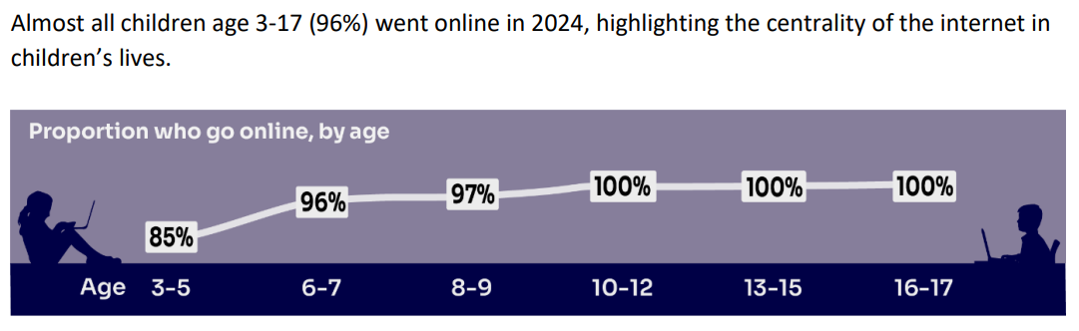

Slide 21
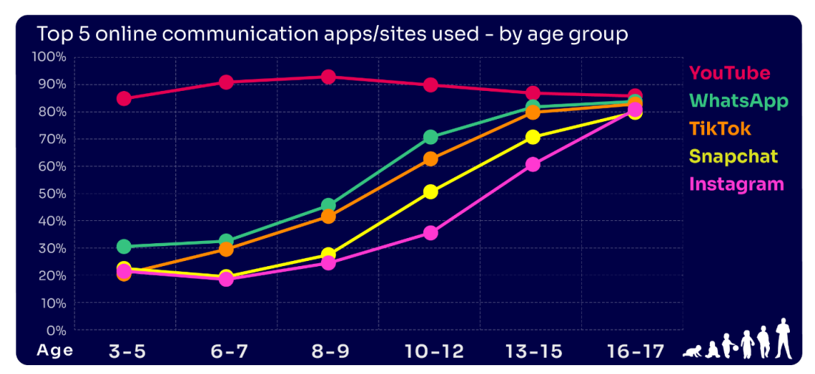

Slide 22
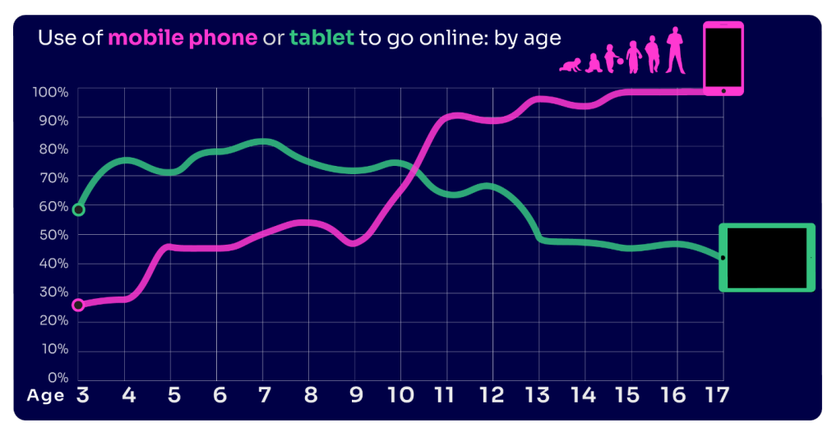

Slide 23
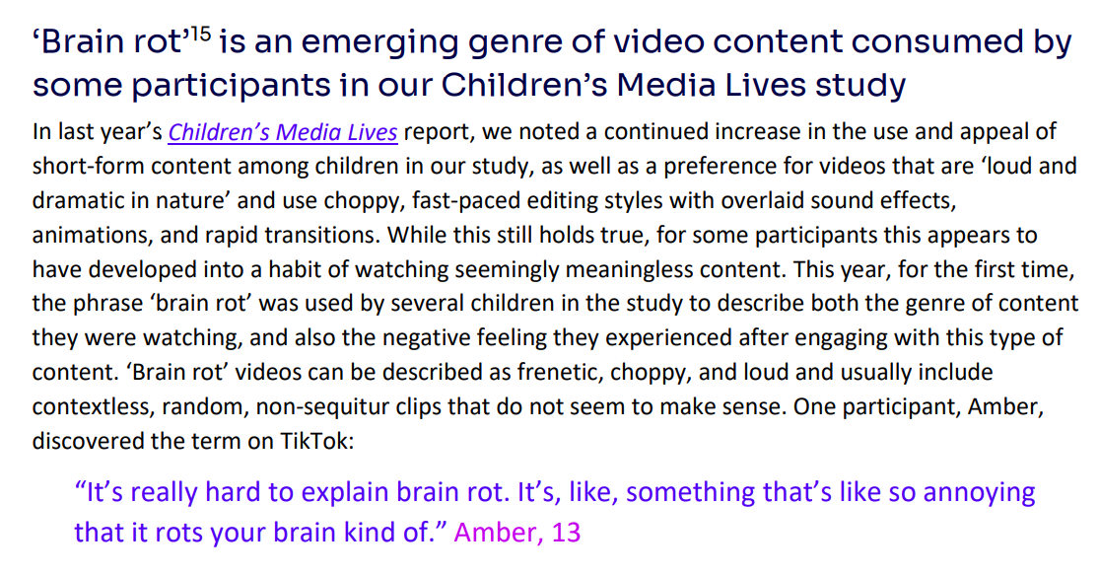

Slide 24
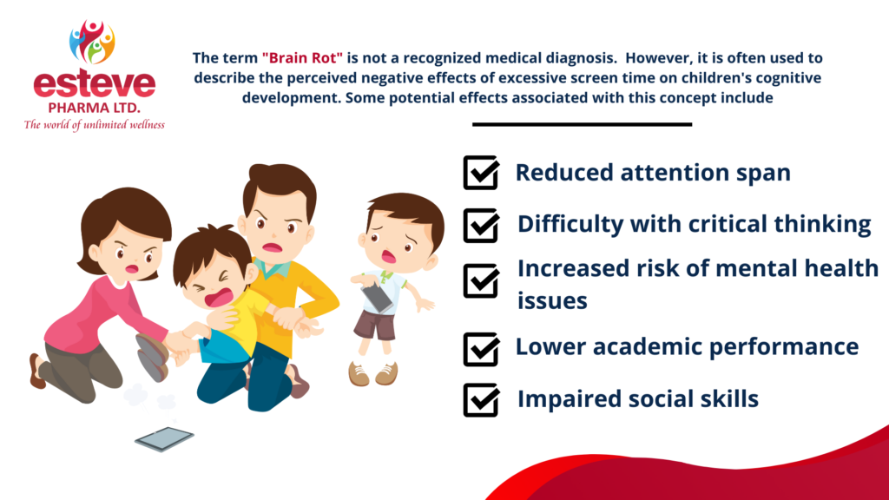

Slide 25
Key Findings:
Nearly four in ten 8-17s believe that people are mean or unkind to each other online all or most of the time
Girls continue to be more likely than boys to experience nasty or hurtful interactions online
Certain demographics (8-13) are more likely to see worrying or nasty content online
Nearly four in ten parents would let their child create a profile before reaching the minimum age
Parents continue to set rules for their children about being online, although there have been some decreases among parents of 10-12s
A high proportion of parents are aware of online protection tools or controls, but many do not use them
Many parents who are aware of content filters prefer to rely on their child’s ability to navigate online content

Slide 26

https://www.securus-software.com/dangerous-apps-for-children/

Slide 27


How can we help to protect children?

Slide 28
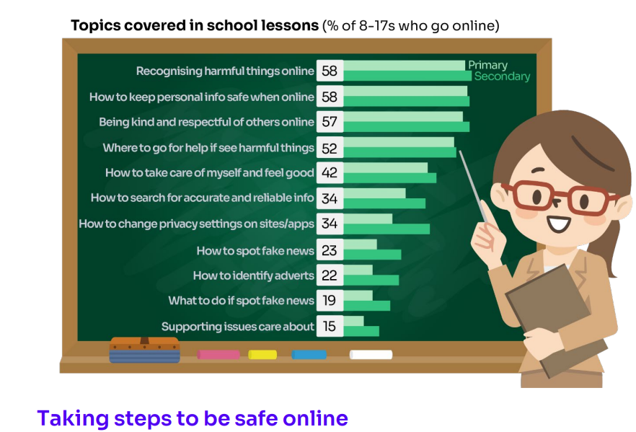

Slide 29
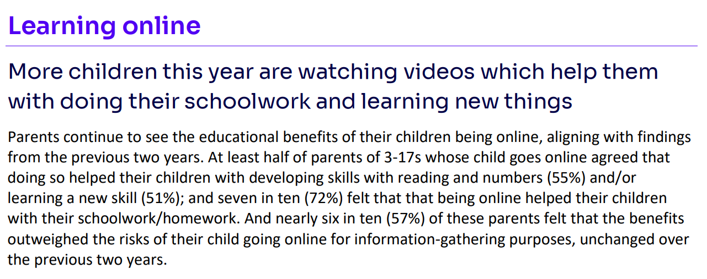

Slide 30
✅ Actionable Advice for Online Safety
Set Clear Screen Time Limits
Agree on daily/weekly screen time and stick to it.
Use tools like “downtime” or “bedtime” features on devices to automatically limit usage.
Encourage balance: outdoor play, reading, and family time alongside screen time.

Slide 31
✅ Actionable Advice for Online Safety
2. Stay Informed and Educated
Keep up to date with the apps, games, and websites your child is using.
Explore resources like NSPCC Net Aware, UK Safer Internet Centre, or Childnet.
Talk to your child regularly about their online interests so you understand what they enjoy and where risks might lie.

Slide 32
✅ Actionable Advice for Online Safety
3. Remember: It Could Happen Here
Don’t assume “my child would never…”—online risks (cyberbullying, strangers, inappropriate content) can affect any child.
Keep conversations open so children feel safe telling you if something goes wrong.

Slide 33
✅ Actionable Advice for Online Safety
4. Use Filtering and Parental Controls
Activate filters on your home Wi-Fi and on individual devices.
Set up child accounts with age-appropriate restrictions.
Regularly review privacy and security settings on apps and websites.

Slide 34
✅ Actionable Advice for Online Safety
5. Limit Internet Access Times
No devices in bedrooms overnight—charge them in a shared space.
Set “offline times” such as during meals, family activities, or before school.

Slide 35
✅ Actionable Advice for Online Safety
6. Monitor Devices Proactively
Keep devices in shared areas where you can see what’s happening.
Check browsing history, app use, and friend lists on social apps/games.
Consider agreeing a “digital contract” with your child, setting expectations about how devices are used.

Slide 36
✅ Actionable Advice for Online Safety
7. Talk Openly and Regularly
Encourage your child to tell you if they see something that worries or confuses them.
Role-play scenarios (“What would you do if someone you don’t know messages you?”).
Praise honesty—children are less likely to hide mistakes if they feel supported.

Slide 37
✅ Actionable Advice for Online Safety
8. Model Good Online Habits
Show your child that you also put your phone away at dinner or bedtime.
Be mindful of your own screen time, social media use, and sharing of photos/information.

Slide 38




Useful links and resources:
https://www.nspcc.org.uk/keeping-children-safe/online-safety/
https://saferinternet.org.uk/guide-and-resource/parents-and-carers
https://www.gov.uk/government/publications/coronavirus-covid-19-keeping-children-safe-online/coronavirus-covid-19-support-for-parents-and-carers-to-keep-children-safe-online
https://www.barnardos.org.uk/get-support/support-for-parents-and-carers/child-abuse-and-harm/keeping-children-safe-online

Slide 39
Welcome to the curriculum talk for Year 1
Miss Green and Mrs Preston

Slide 40
Our School Values
We are…
Spiritual
Independent
STRIVE
Valued
Thinkers
Empathetic
Resilient

Slide 41

Expectations for Behaviour
We encourage all children to demonstrate a high standard of behaviour at all times in order to create a safe, respectful and happy learning environment.
Respecting each other and all members of staff is expected and reflects the ethos of our school.
The children are required to listen carefully to their teachers and peers.
Children should always try their best and aim to present consistently high quality work.
Each class has participated in the process of making a set of ‘Golden Rules.’ The children have agreed to follow the rules as they understand that this will help their learning.

Slide 42
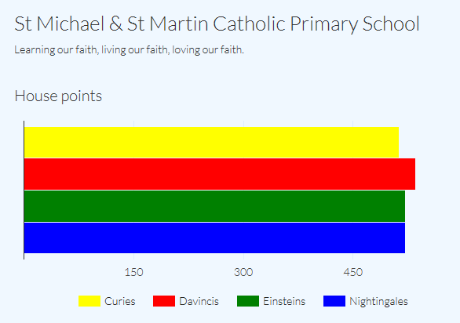
Behaviour Systems
We are in the process of introducing epraise to the children, an online house point system which is already in place in KS2. Children will be rewarded for following the school’s expectations of behaviour.
The winning house will receive extra play on a Friday.
Working together with parents and guardians plays a big part in establishing good relationships and standards of behaviour.
We also use sticker charts to help reinforce good behaviour and praise examples of this.

Slide 43



Routines
Book bags:
Please bring book bags in to school every day. Scheme Books will be changed on Tuesday and Friday, the children will choose a free choice book on the other days.
Homework: Will be given out on Fridays to be returned on the following Friday.
Spelling book: Children will get a spelling list on Fridays, these spelling will then be tested the following Friday. (Red spelling Books)
PE kits:
PE takes place every Thursday. All children should have a named PE kit. Please ensure that your child has the school polo shirt and green shorts with the school’s logo. For the winter they should wear bottle green tracksuit bottoms. As you know the children come in dressed in their PE uniform and remain in it for the whole day.
Please remember to supply your child with a named water bottle everyday.

Slide 44


Reading
Tuesday and Friday- reading scheme book for your child to read aloud to you.
All other days - free choice book to be shared together (not a school scheme book)
Please remember:
to ask your child a range of questions to check their comprehension.
the children have been taught at school to use phonics as the prime approach when attempting to read most unfamiliar words.
to sign their reading record with a short comment and regularly ask your child to also review their book. If your child does not return the school scheme book or have their reading record book signed, they will not receive a new book.
sharing books with your child is an extremely important process and we would encourage you to read books together daily. This will help your child to acquire and develop their language skills, vocabulary, expression and love of reading.

Slide 45
Phonics Screening Check
In June 2026 the Year 1 children will take part in the Phonics Screening Check. This year’s Phonics Screening Check will take place w/b Monday 8th June 2026.
They will read 40 words to their class teacher (20 real words and 20 non-words)
The children usually enjoy the 1:1 time with their class teacher
They will have lots of opportunities to complete practise assessments
Phonics homework and phonics based spellings help to reinforce the class teaching so that the children will be confident in their ability by June
We do not want the children to feel worried about the test
There will be RWI (phonics) training videos posted on your Google classroom to help you at home to support your child in phonics, please watch these in your own time.
There will be a RWI phonics screening workshop next term for parents (dates to be confirmed)

Slide 46
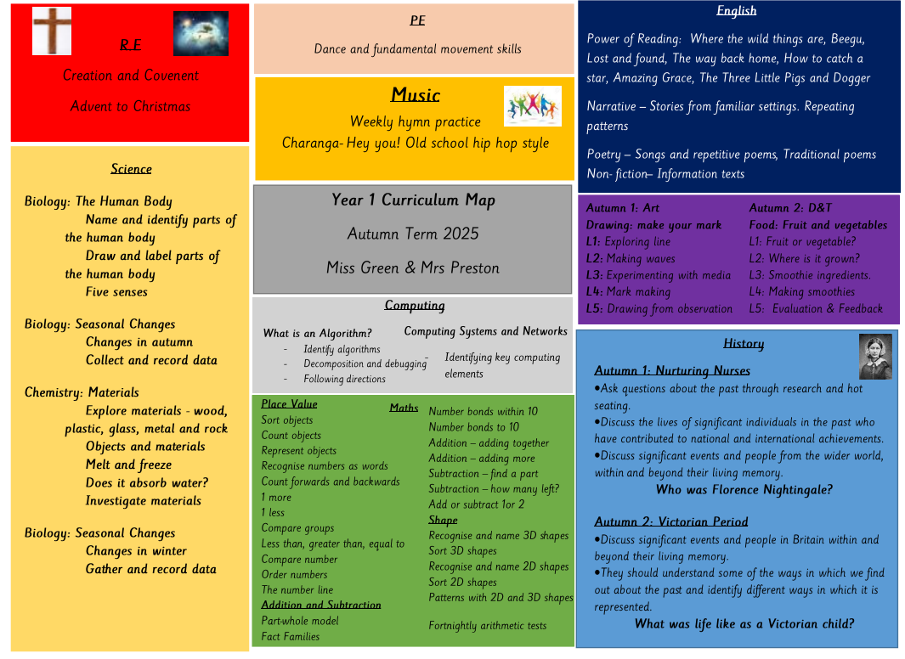
Curriculum Maps
The Curriculum Map is available on our website and will be updated termly.
Please check this regularly as you will be able to find out what your child is doing in school.

Slide 47




Year 1 Curriculum
In English, children will be taught to:
develop pleasure in reading, motivation to read, vocabulary and understanding by listening to and discussing a wide range of poems, stories and non-fiction at a level beyond that at which they can read independently recognising and joining in with predictable phrases
appreciate rhymes and poems, and to recite some by heart
discuss word meanings, linking new meanings to those already known
make inferences on the basis of what is being said and done
When writing sentences they must:
▪ say out loud what they are going to write about
▪ compose a sentence orally before writing it
▪ sequence sentences to form short narratives
▪ re-read what they have written to check that it makes sense
The children must:
▪ sit correctly at a table, holding a pencil comfortably and correctly
▪ begin to form lower-case letters in the correct direction, starting and finishing in the
right place
▪ form capital letters
▪ form digits 0-9
▪ understand which letters belong to which handwriting ‘families’ (i.e. letters that are formed in similar ways) and to practise these.

Slide 48
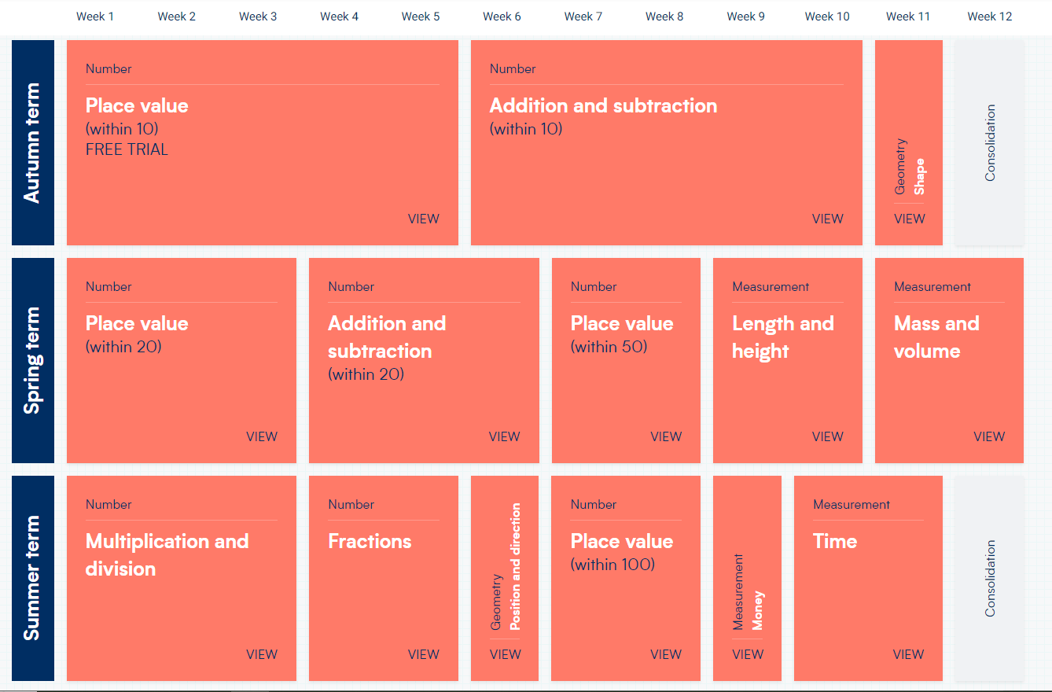
Year 1 Curriculum
Maths
read and write numbers up to 100 as digits.
count forwards and backwards from any number to 100 and beyond
write numbers as words up to 20
number bonds to 20 (addition and subtraction)
times tables (2, 5 and 10)

Slide 49
Year 1 Transition
Transition is a very important stage for the children in Year 1. They are leaving a play-based curriculum and entering a more structured curriculum.
We are very aware that for many of the children this can be a difficult time for them emotionally when adapting to a setting where they are not doing most of their learning through play.
Many of the lessons that the children take part in involve practical activities as well as role play, which the children have been used to in Reception. We will gradually move this towards a more formal whole class teaching approach.

Slide 50
Theme days/Trips
The educational trips that we will plan for the children this year are related to the curriculum topic that is being studied in school and are a very positive way of embedding their learning within context.
Educational workshops may also take place to provide exciting learning opportunities and experiences for the children.
We are planning to have a Victorian Day in Autumn 2, whereby the children can dress up and will be involved in Victorian activities.
Timely contribution payments for trips/£30 contribution per year to cover themed days.

Slide 51


Parents Evening
Parents Evening will be held on :
04/11 - Parents Evening
(In School) 5pm - 7.30pm
05/11 - Parents Evening
(School Cloud) 5pm - 7.30pm

Slide 52


Growth Mindset
As a whole school approach we are encouraging children to develop
a growth mindset, this will involve children:
Taking risks
Building their resilience and a positive attitude to learning
Embracing failure
First
Attempt
In
Learning

Slide 53

Reminders
Please ensure your child is wearing the correct uniform at all times - check the school website if you are unclear. In the autumn term girls are allowed to wear the school’s summer dress but this must be worn with socks and not tights!
School socks do appear to be a large issue at present. Please note below clear guidance for these:
Boys should wear grey socks only.
Girls may wear either long or ankle white socks with the summer dress however ankle socks are not permitted with the winter uniform.
Girls should wear long white socks or green/white tights with the winter uniform. Tights should not be worn with summer dresses.
Please note that no trainer socks should be worn by either girls or boys at any time.
Please ensure all uniform is clearly labelled.
Children must be picked up from clubs promptly if they are attending them. School policy says that your child may not be able to continue with this club if there are any late pick ups.
Please try to limit the amount of screen time your child is having. Try to use iPads and tablets for educational purposes.
Finally every lesson counts. Maintaining your child’s attendance is crucial for your child’s learning. There will be no authorisation of holidays in term time.

Slide 54


Ways to help and support your child
Encourage your child to complete their homework on time.
Spend regular time reading and listening to your child read.
Discuss what they are learning at school.
Make sure your child gets enough sleep – regular bedtime routines are crucial.
Give your child a named bottle of water to bring to school every day.
Check the book bags and Google Classroom regularly for letters.
Ensure funds and payments are provided to support your child's learning through trips and resources. This allows staff to provide learning experiences that brings topics and subjects alive.
Supporting your children at home is imperative to your child’s progression throughout the year.
Notes:
Reading every day. Read to your child as well as letting them read to you. Please check book bags for homework. It will always be set on a Friday.

Slide 55


You can keep up to date with the school’s events and newsletters by looking at our school website.
www.stmichaelandstmartin.co.uk
Likewise, keep updated through our school’s Instagram account and your individual Google Classrooms.

Slide 56

Thank you for your continued support.
We look forward to building positive relationships with you and we hope that your children have a happy and successful year. ☺

