Slide 1

Welcome to the Reception Curriculum Talk
Mrs Brown, Ms Polad, Mrs O, Ms Giammatteo

Slide 2

Learning our faith
Living our faith
Loving our faith

Slide 3
School Expectations
We encourage all children to demonstrate a high standard of behaviour at all times in order to create a safe, respectful and happy learning environment.
Each class has participated in the process of making a set of ‘Golden Rules.’ The children have agreed to follow the rules as they understand that this will help their learning.
Respecting each other and all members of staff is expected and reflects the ethos of our school. The children are required to listen carefully to their teachers and peers.
We are proud of how smart the children look in our uniforms and have been very impressed by how the children take pride in their appearance.
Working together with parents and guardians plays a big part in establishing good relationships and standards of behaviour.
Every lesson counts! Attendance and punctuality is more important than ever in these uncertain times. Please ensure your child attends school every day if they are able.

Slide 4
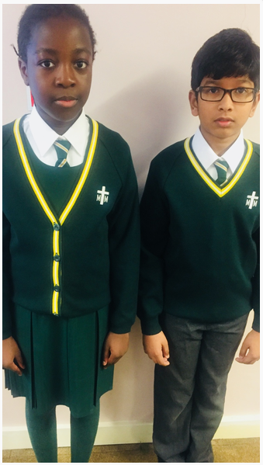
Uniform
Please ensure your child comes to school dressed in the correct school uniform.
Girls can only wear green or white tights with winter uniform and long or short white socks with summer uniform. No tights with summer dresses.
Long hair must always be tied back. No large or non-green hair accessories.
Trainers (black or otherwise) are not appropriate school shoes.
If you are unsure about haircuts, please refer to the school uniform policy.

Slide 5
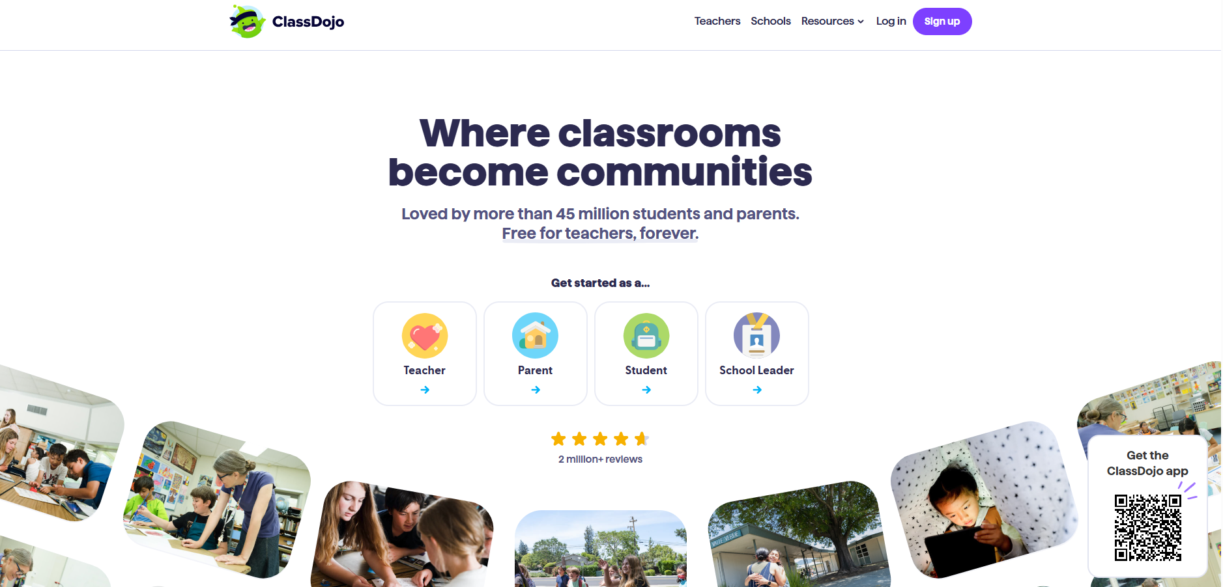
Class Dojo Points
As a reward system, we use Dojo Points. Each child can get a point for excellent behaviour, kindness, saying their prayers beautifully, tidying up and participation in lessons.

Slide 6

School Attendance
It is vital that children attend school everyday. Every lesson counts! If your child is ill, on return to school a letter explaining absence must be given to their class teacher.
If your child is absent on a Friday, please ensure that they get a copy of the homework from a friend.

Slide 7
Absences
If your child is sick, please call the office in the morning each day they are off.
Provide a letter of absence on their return.
Please try to make appointments outside school hours to avoid disruption to your child’s day- (please provide evidence of appointment letters).
Term time holidays are not permitted and will not be authorised.

Slide 8
Our Top Tips
•Tip 1: Remember your child’s education is a partnership. Attend parents evenings to discuss your child's progress including strengths and areas for development.
•Tip 2: Support your child with homework tasks and daily reading.
•Tip 3: Make sure your child is aware that getting stuck is not a problem. Move on and give them another challenge and come back to the hard ones at the end and/or go through it together.

Slide 9
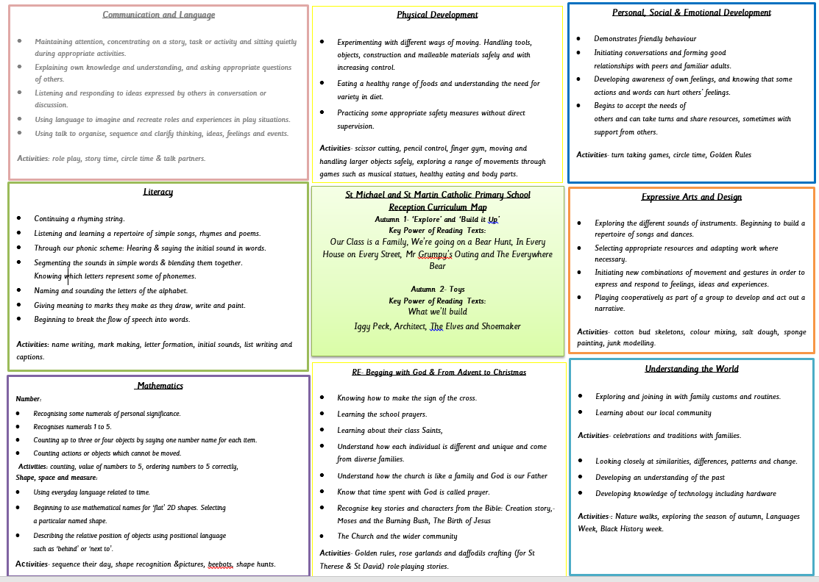
Curriculum Maps
Autumn 2025

Slide 10
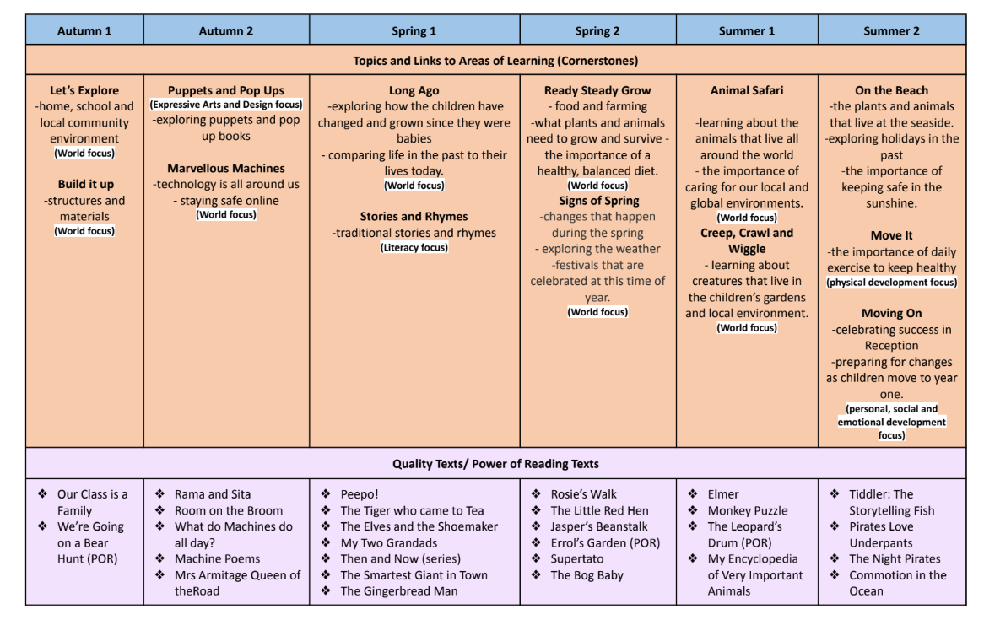
Our Curriculum

Slide 11
Progress and Achievement
All children are assessed on entry (Baseline Assessment) and will be assessed continually throughout the year.
You will be invited to attend 2 parents meetings, so you will know how well your child is doing compared to the expectations for children of their age range.
Early Years experiences are crucial in getting children ready to learn and full of enthusiasm and ideas.

Slide 12

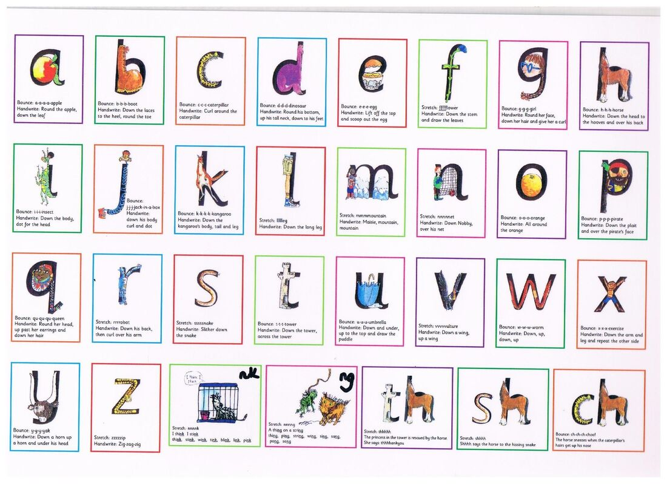
Phonics is the sounds that the letters make, for example, A is a.
Children are taught to use their phonic knowledge to decode and read words when reading and to sound out and blend the sounds when writing.
We use the Read Write Inc scheme, you can look at videos of initial sounds on the Ruth Miskin website: https://www.ruthmiskin.com/en/find-out-more/parents/
We run phonics workshops for parents.

Slide 13
Reading in Reception
• Your child will be given one phonics book/ flash cards and one book which is to be read for pleasure. The reading for pleasure book should be read to the your child and enjoyed together.
• Please ensure your child reads with you for 10 mins every day and discusses the content of their reading with you. This should be recorded in your child’s home school diary.
• Reading books and home/school diaries should be kept in your child’s bag and brought into school every day.

Slide 14
Reading Records
Reading at home is essential for helping children to make progress across the curriculum.
As part of our home-school agreement, you have agreed to support your child in reading for 10 minutes each day.
Reading Records allow us as a school to keep track of your child’s reading.
Please support us by writing a brief comment when you listen to your child read.

Slide 15

Encourage your child to read. Helping your child become a reader is the single most important thing that you can do to help the child to succeed in school-and in life. The importance of reading simply can't be overstated. Reading helps children in all school subjects.

Slide 16
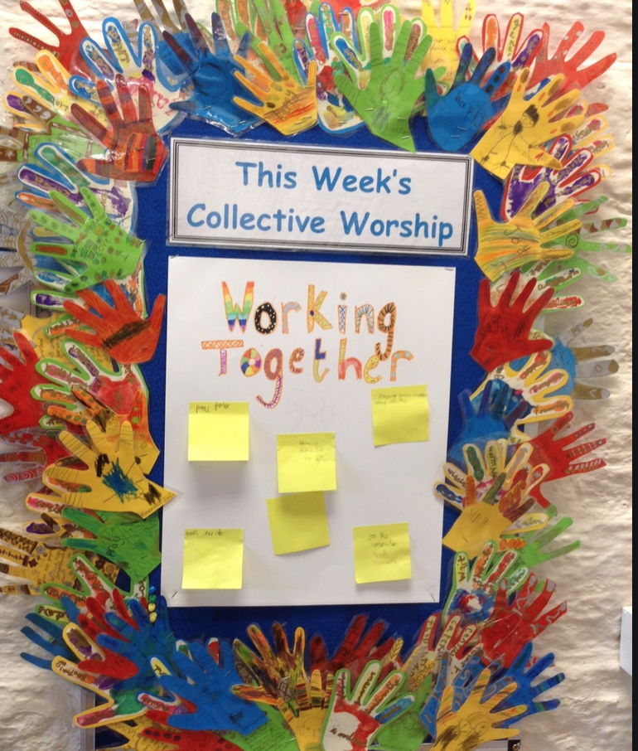

Collective Worship
To help with the children’s well-being and spiritual life, Collective Worship and Reflection will take place daily. The Collective Worship will be both teacher and child-led and overseen by our Chaplaincy Team.

Slide 17
Sport
PE kits:
PE takes place every Friday. All children should come to school on this day wearing their named PE kit.
Please remember to supply your child with a named water bottle everyday.

Slide 18
Pick up and drop off
Please be aware that the teacher on duty at the front gate in the mornings is there to ensure that all children are welcomed into school safely. They will be unable to have lengthy discussions in the morning. If you do wish to speak to your child’s teacher, you are more than welcome to book an appointment via the school office.
Children must be collected promptly from school at 3:30pm. Remember to inform your child’s class teacher or the school office if there is a change in who is collecting them as this can pose significant safeguarding risks.

Slide 19

Google Classroom
Make sure your child has access to our Reception Google Classroom, as this is where we will post any notices if needed.

Slide 20
Talk with your child. Talking and listening play major roles in children's school success. It's through hearing parents and family members talk and through responding to that talk that young children begin to pick up the language skills.
In addition, children who haven't learned to listen carefully often have trouble following directions and paying attention in class. Please limit time using an ipad!
It's also important for you to show your child that you're interested in what they have to say. Talking With Your Child offers some great ideas for using conversation to stimulate language development.

Slide 21


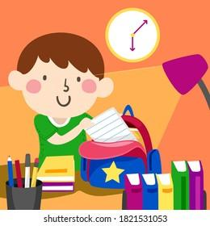


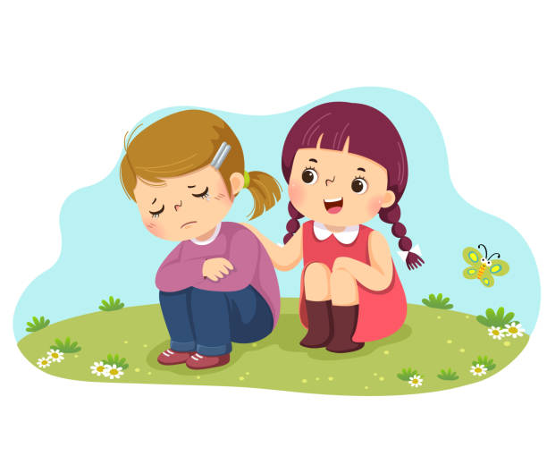
STRIVE -School Visions and Values
Here at St Michael and St Martin, we want the children display these core values to help them be well-rounded individuals. They must strive to be:
Spiritual
Thinkers
Resilient
Independent
Valued
Empathetic

Slide 22


Please keep up-to-date with the curriculum and weekly newsletters by looking at our school website, checking your emails often, as well as checking our Twitter page for school events.
www.stmichaelandstmartin.co.uk
@STMM20

Slide 23

Thank you for your continued support. We look forward to building positive relationships with you, and we hope that your child will have a happy and successful year.

